Slide 1

PREDICTION OF POTENTIAL FRAUD IN INCOME TAX
RANDOM FOREST
Presented by: Tarun Mondal

Slide 2
OVERVIEW
01
02
03
Objective
Solution
Business Impact

Slide 3


Objectives
The aim of this project is to develop a Random Forest Classification model to identify individuals with ‘Risky’ taxable income.

Slide 4
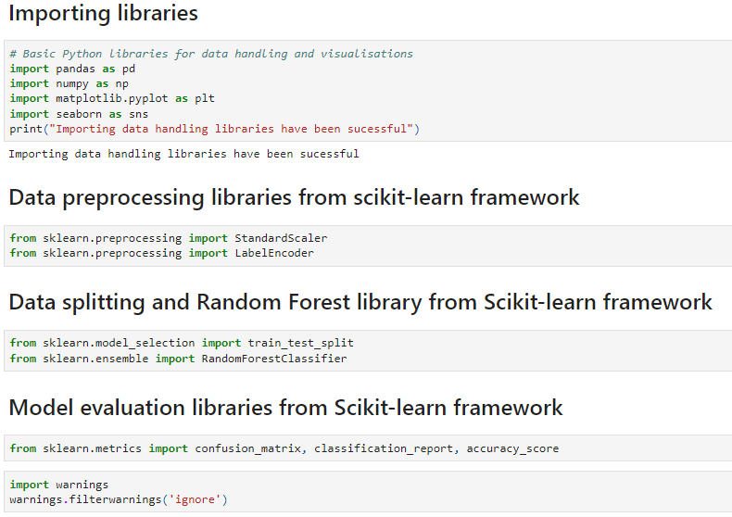

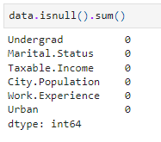
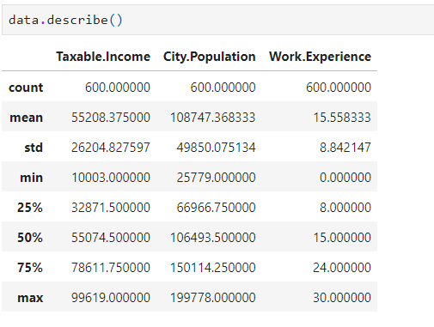
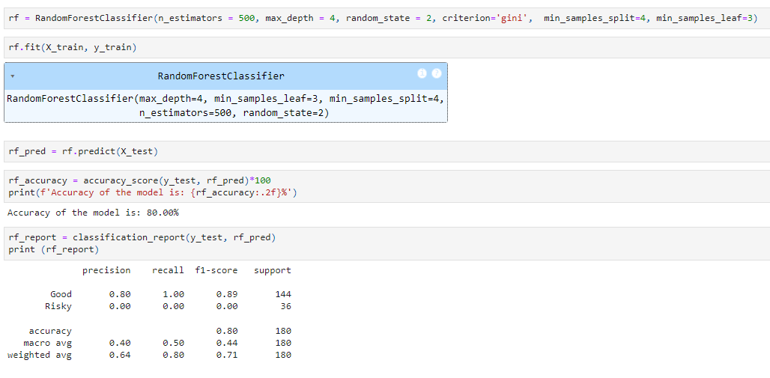
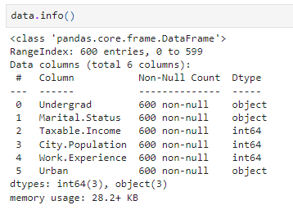

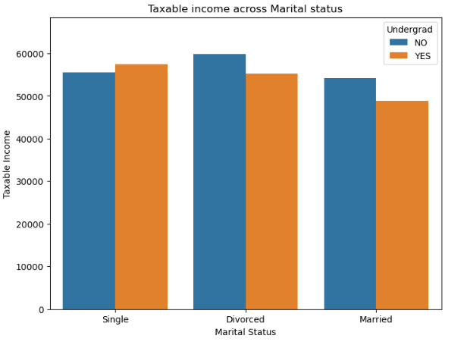
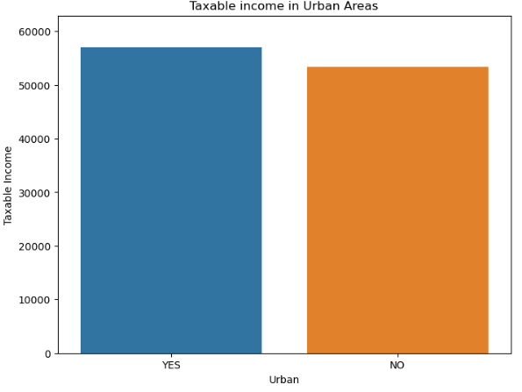
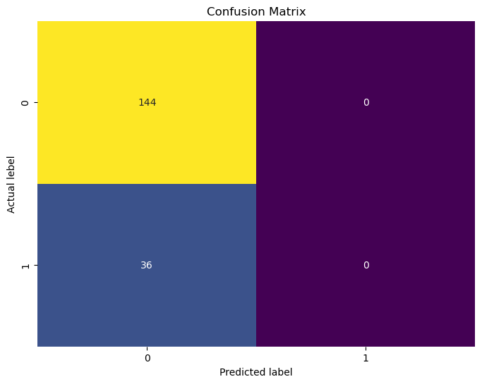
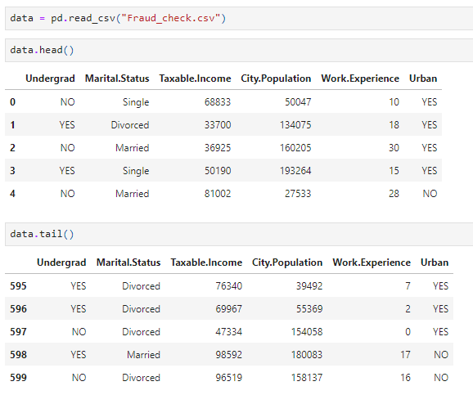
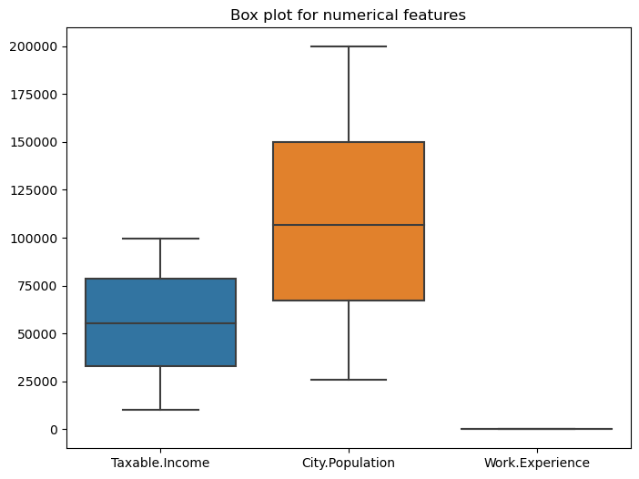
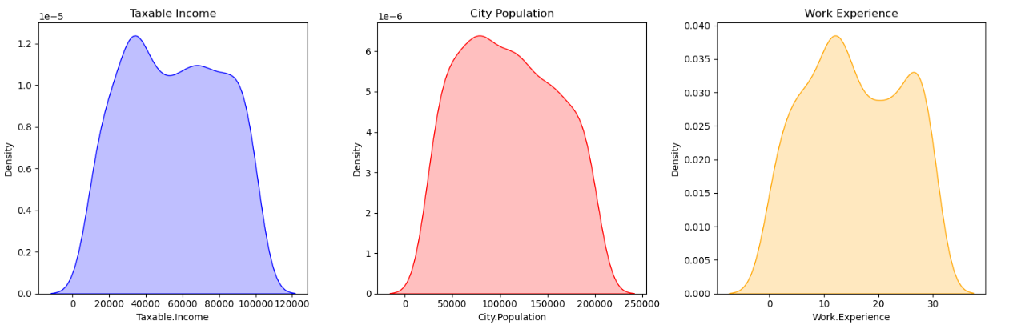
Solution
Libraries importing
Data Loading
Data Exploration
Data Preprocessing
EDA
Model development

Slide 5




Prediction of Fraud in Income tax
Estimation of Risk in Income Taxation across Population
Business Impact
Evaluation of Tax paying ability across population

Slide 6

Thank's For Watching

