Slide 1




PREDICTION MODEL FOR PREDICTING PRICE OF THE TOYOTA COROLLA
Prepared by: Tarun Mondal

Slide 2
Objective
The objective of this study is to predict the price of Toyota cars based on different attributes such as age, power, doors, gears, quarterly_Tax and weight.

Slide 3
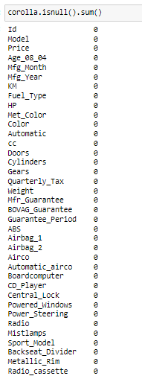


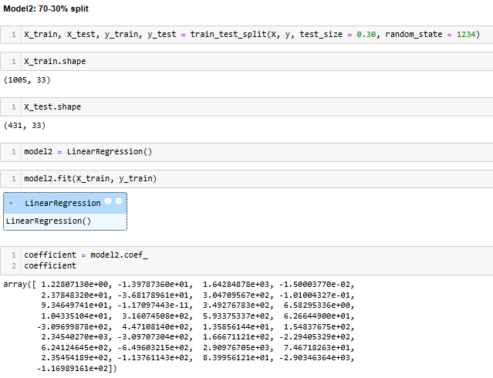
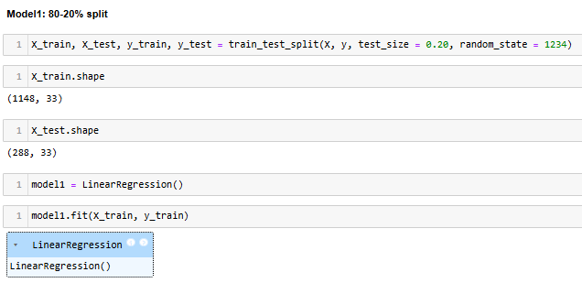

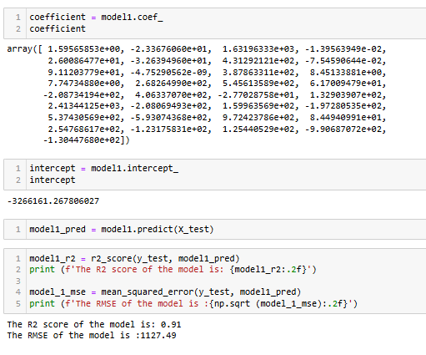
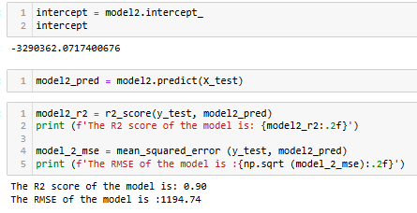

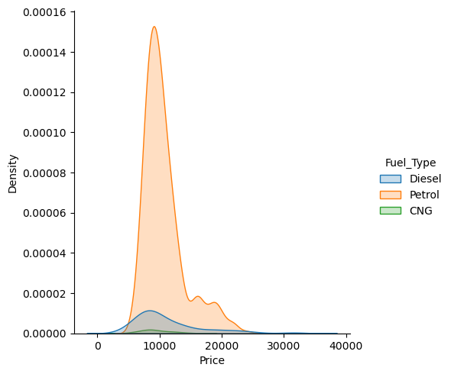
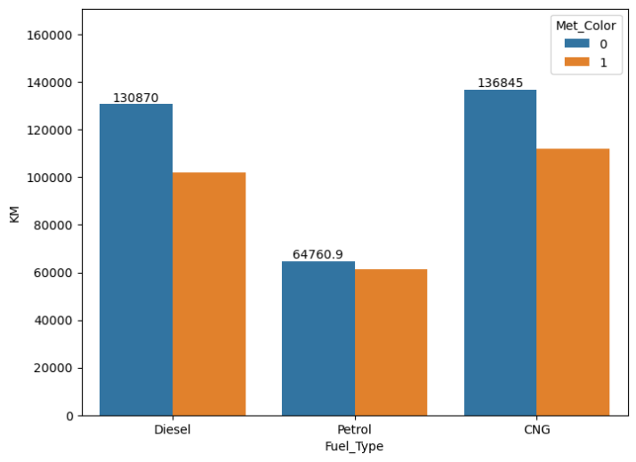
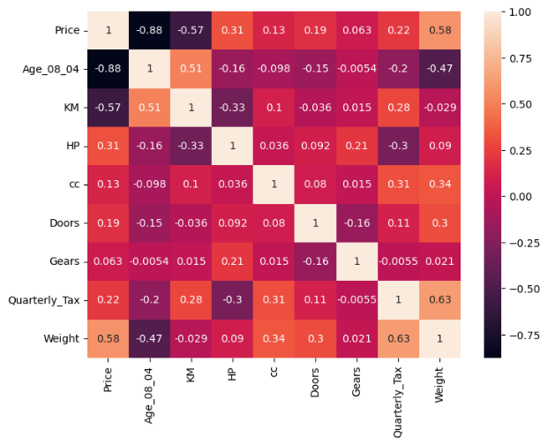
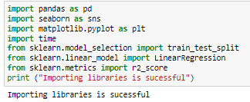
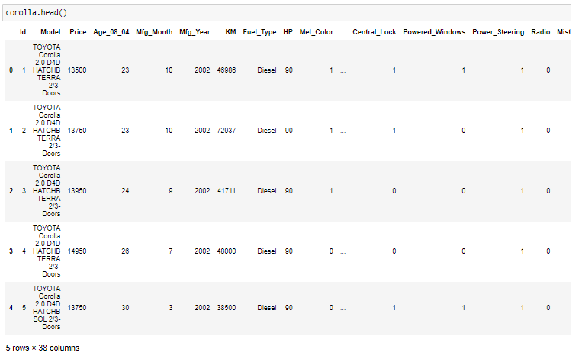
Solution
Data Preprocessing
Data Loading
Model development
Step 2
Step 4
Step 6
Step 1
Step 3
Step 5
Libraries importing
Data Exploration
Exploratory data analysis (EDA)

Slide 4
Business Impact
01 – Prediction ofPrice of cars of Toyota
02 –Evaluating features influencing car prices
03 –Optimal costing of the cars

Slide 5
THANK YOU

