Slide 1




PREDICTION MODEL FOR PREDICTING PRICE OF THE TOYOTA COROLLA
Prepared by: Tarun Mondal

Slide 2
Objective
The objective of this study is to predict the price of Toyota cars based on different attributes such as age, power, doors, gears, quarterly_Tax and weight.

Slide 3
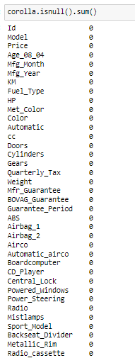


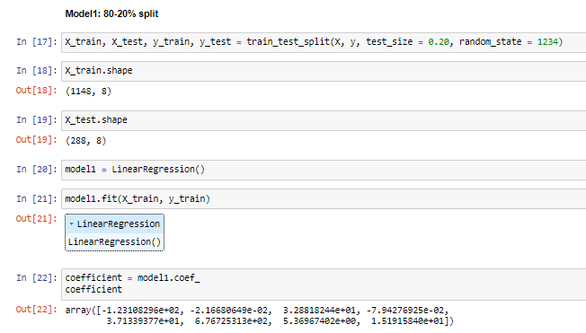
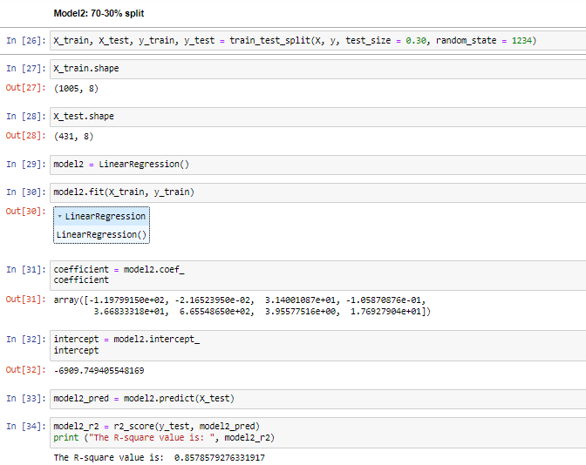


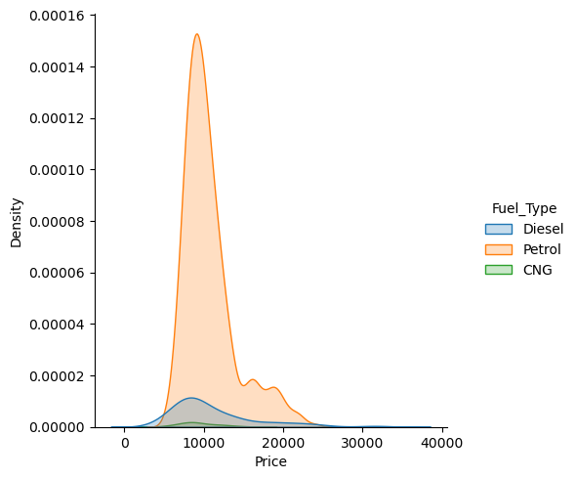
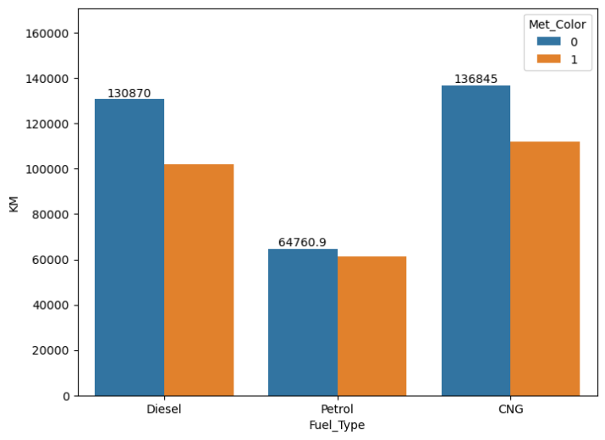
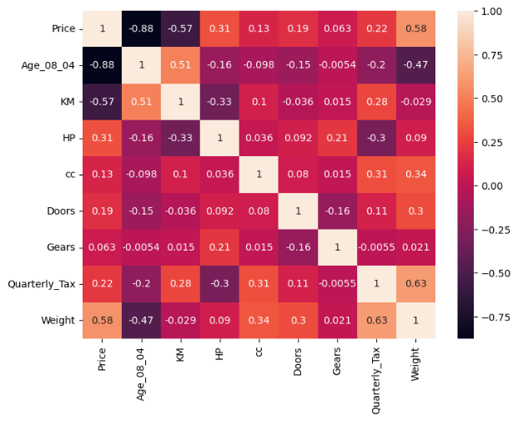
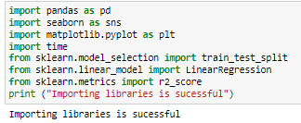
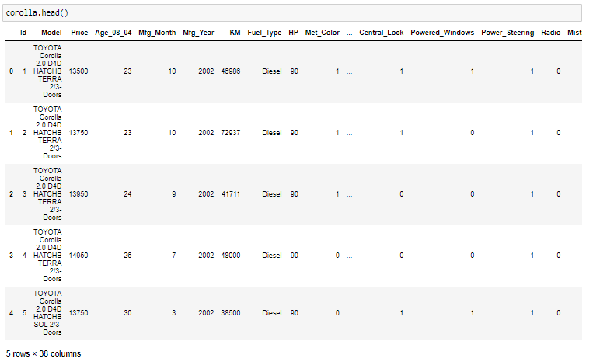
Solution
Data Preprocessing
Data Loading
Model development
Step 2
Step 4
Step 6
Step 1
Step 3
Step 5
Libraries importing
Data Exploration
Exploratory data analysis (EDA)

Slide 4
Business Impact
80-20% split
01 – Prediction ofPrice of cars of Toyota
Price = -4423.47 + Age_08_04 * (-123.10) + KM * (-0.021) + HP * (32.88) + cc * (-0.079) + Doors * (37.13) + Gears * (676.72) + Quarterly_Tax * (5.36) + Weight * (15.19) …. (Equation 1)
02 –Evaluating features influencing car prices
70-30% split
Price = -6909.749 + Age_08_04 * (-119.19)+ KM * (-0.021) + HP * (31.40) + cc * (-0.010) + Doors * (36.68) + Gears * (665.54) + Quarterly_Tax * (3.95) + Weight * (17.692) …. (Equation 2)
03 –Optimal costing of the cars

Slide 5
THANK YOU

