Slide 1




DELIVERY TIME PREDICTION: LINEAR REGRESSION MODEL
Prepared by: Tarun Mondal

Slide 2
Objective
The objective of this project is to predict the Delivery Time based on Sorting Time using Machine Learning (Regression) approach

Slide 3

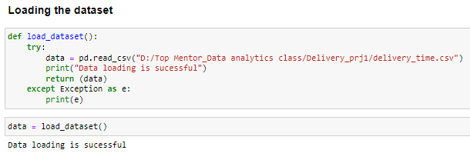
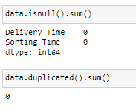
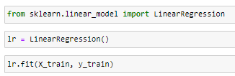
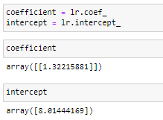

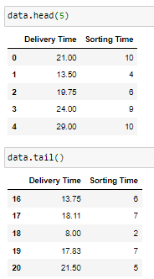
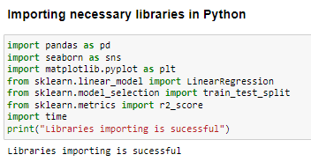
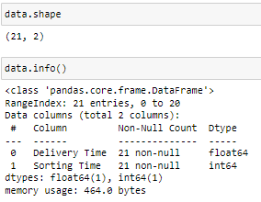
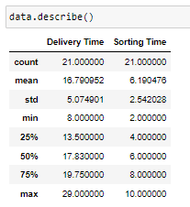
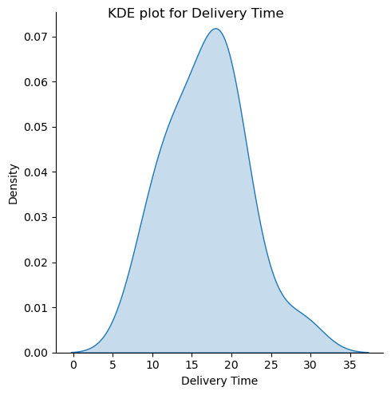
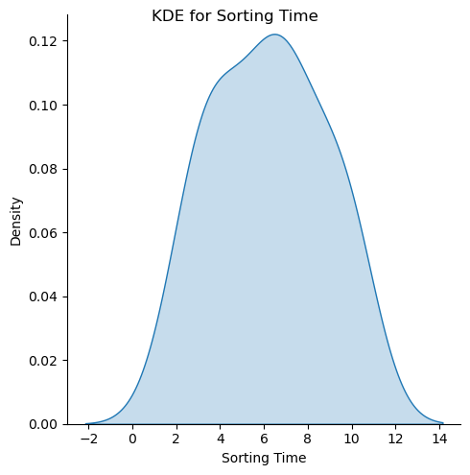
Solution
Data Preprocessing
Data Loading
Model development
Step 2
Step 4
Step 6
Step 1
Step 3
Step 5
Libraries importing
Data Exploration
Exploratory data analysis (EDA)
Notes:
70-30% splitting has been performed by using the train_test_split function from ‘scikit-learn’ framework, through which 70% of data has been used to train the model and remaining 30% of data has been used to test the model performance. A random state of 1234 has been considered to maintain the same output across multiple runs.
The coefficient and intercept obtained from the simple linear regression model are 1.32215 and 8.01444. Thus, the equation of the regression line is: Delivery Time = 8.01444 + (1.32215 * Sorting Time).

Slide 4

Business Impact
For a sorting time of 23.12, the predicted delivery time is 38.58. Using this model, users can estimate the delivery time based on a given sorting time, allowing them to make informed decisions regarding delivery schedules.
01 – Prediction of Delivery Time
02 –Advance Scheduling of Delivery
03 –Minimization of Logistic delays

Slide 5
THANK YOU

