Slide 1

Multi-Question Guided Fact Checker
CS 678 ADVANCED NLP FINAL PROJECT
Samanvitha Matta, G01252738--George Mason University
Tarun Sai Naga Chadaram, G01445928--George Mason University
Sai Prakash Jallu, G01442762--George Mason University

Slide 2
OUTLINE
Introduction
Approach
Fact-Checker Architecture
Fact-Checker Problem Approach
Experiments: Dataset
Experiments: CHKP 1: Base Model
Results: F1 Metrics
Experiments: CHKP 2: Robustness
Results: Perturbation Data
Future Work
Sources

Slide 3
INTRODUCTION
Fact-checking is crucial in combating the rapid spread of misinformation.
It ensures the credibility and reliability of information.
The motivation behind fact-checking is to prevent harm from false information.
Our system is designed to provide a guided reasoning process through a series of relevant questions for verifying a claim
We utilize GPT 3.5 turbo API to enhance the efficiency of the fact-checking system.

Slide 4
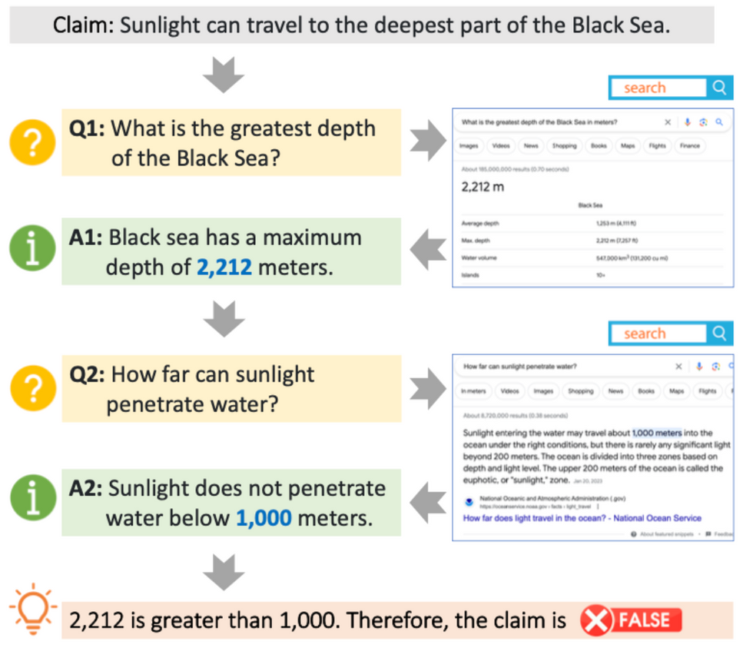
APPROACH
Our approach uses multi-hop reasoning guided by automatically generated questions.
This enables transparent and explainable verification of claims using fact_checker.py file by breaking down the reasoning into interpretable steps.
For each claim, the system provides:
A final verdict of true or false.
A detailed rationale explaining the reasoning process step-by-step.
Includes the relevant questions and evidence used at each step.
Figure 1: An example of question-guided reasoning for fact-checking on real-world claims.

Slide 5
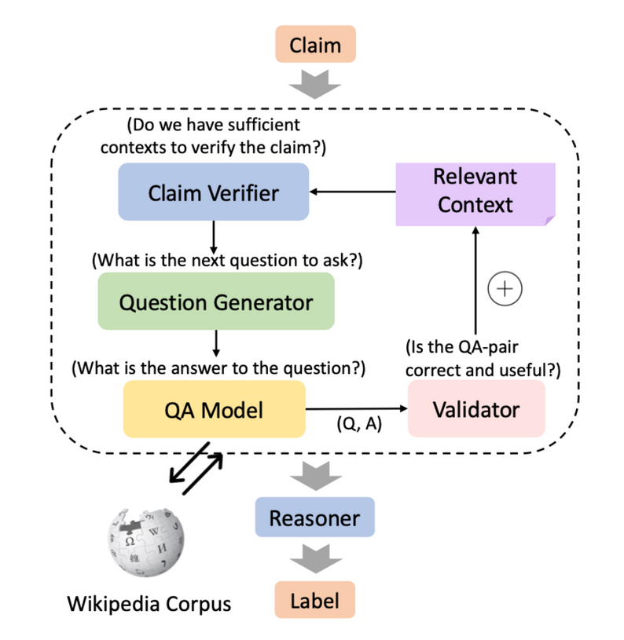
FACT-CHECKER ARCHITECTURE
Our system utilizes a five-module architecture to guide the reasoning process through a series of relevant questions critical for verifying a claim.
CLAIM VERIFIER
Assessing the sufficiency of gathered information for claim verification.
QUESTION GENERATOR
Generating relevant questions to guide the reasoning process.
QUESTION ANSWERING
Providing answers to raised questions, and facilitating continuous verification.
QA VALIDATOR
Evaluating the usefulness of generated question-answer pairs.
REASONER
Producing the final verdict based on all collected contexts.
Figure 2: Fact-Checker System Architecture

Slide 6
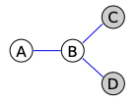

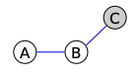

EXPERIMENT: DATASETS
Hover
Hover
Hover
Feverous
2-HOP
3-HOP
4-HOP
MULTI-HOP
We utilized 202 records from HOVER two-hop data to evaluate our model’s performance as well as compare our metrics with the original paper.
We utilized 202 records from HOVER three-hop data to evaluate our model’s performance as well as compare our metrics with the original paper.
We utilized 202 records from HOVER four-hop data to evaluate our model’s performance as well as compare our metrics with the original paper.
We utilized 202 records from the FEVEROUS multi-hop data to evaluate our model’s performance as well as compare our metrics with the original paper.

Slide 7
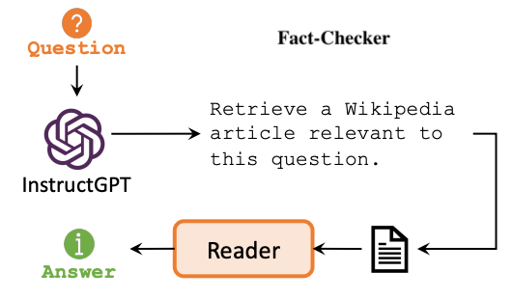
EXPERIMENTS: CHKP 1: BASE MODEL
Baseline Method: Fact-Checker:
Verifies the truthfulness of a claim using the GPT 3.5 fact-checking system.
Iteratively generates questions, retrieves answers, and assesses evidence until a conclusion is reached or a stopping criterion is met.
It comprises three key modules: question generator, question answerer, and fact reasoner.
Question Generator: Based on GPT-3 which creates relevant questions based on the claim.
Question Answerer: Based on GPT-3 and provides answers to these questions.
Fact Reasoner: Analyzes the collected evidence to determine the claim's veracity.
Evaluation Metric: F1 Score
The F1 score offers a balanced assessment of our system's precision and recalls
It is crucial for fact-checking tasks where minimizing false positives and false negatives is paramount.

Slide 8
RESULTS
MODEL | HOVER 2-HOP | HOVER 3-HOP | HOVER 4-HOP | FEVEROUS MULTI-HOP
GIVEN RESULTS | 55.67 | 54.67 | 52.35 | 59.47
OUR RESULTS | 59.27 | 55.33 | 54.95 | 56.43
The F1 metric table summarizes our model’s performance in predicting labels. We ran our model on the Hover (2-Hop, 3-Hop, 4-Hop) datasets and the Feverous multi-hop dataset with about 200 records in each.

Slide 9

EXPERIMENTS: CHKP 2: ROBUSTNESS
Dataset Dimensions:
MFT: Adopted the techniques of the Minimum Functionality Test in shortlisting the data from HOVER and FEVEROUS.
INV: Adopted the techniques of the Invariance Test by creating one dataset with synonym perturbation, another with typos & no punctuation perturbation, and one that combined perturbation datasets.
Evaluation Metrics:
We used the same F1 score to evaluate metrics to check the model’s performance on each dataset for every perturbation.

Slide 10
RESULTS PERTURBATION DATA
DATASET | No Perturbations | All Perturbations (Synonyms, Typos, No Punctuation) | Only Synonyms Perturbation | Only Typos & No Punctuation Perturbations
Hover 2-HOP | 59.27 | 49.97 | 51.75 | 52.45
Hover 3-HOP | 55.33 | 59.82 | 51.83 | 44.92
Hover 4-HOP | 54.95 | 47.50 | 49.44 | 54.16
Feverous | 56.43 | 50.00 | 51.00 | TBD
The table summarizes our model’s prediction performance using the F1 scores evaluation metric for all three types of perturbed datasets in comparison with the original non perturbed dataset.

Slide 11
FUTURE WORK
Implementing pre-processing techniques using NLTK functions to improve the performance of question answering and question generation on noisy data.
Adjusting model parameters to optimize performance for fact-checking tasks after modifying question answering and question generation modules.
Testing accuracy and efficiency in fact-checking for new improved modules.
Implementing task-specific modifications to optimize performance in fact-checking and claim verification.
Beyond class work we want to Explore the integration of LLM agents like BERT and RoBERTa for enhanced natural language understanding and processing capabilities.

Slide 12
SOURCES
https://aclanthology.org/2020.acl-main.442.pdf
https://aclanthology.org/2023.emnlp-demo.23.pdf
https://github.com/marcotcr/checklist
https://github.com/XinyuanLu00/QACheck
https://arxiv.org/pdf/2011.03088
https://arxiv.org/pdf/2106.05707
https://fever.ai/dataset/feverous.html
https://huggingface.co/datasets/hover
https://github.com/hover-nlp/hover/tree/main?tab=readme-ov-file

Slide 13
Thank you!
FOR LISTENING TO US
Samanvitha Matta
Tarun Sai Naga Chadaram
Sai Prakash Jallu
29 April, 2024

