Slide 2
Add Intelligence to your applications ft. Azure Cognitive Services
Subtitle or speaker name
Tarun Nanduri

Slide 3
Azure Cognitive Services
Azure Cognitive Services are cloud-based services with REST API’s and client SDK’s which help developers integrate intelligent solutions into their applications.

Slide 4
Cognitive abilities of Azure AI
Vision
Speech
Language
Web Search
Decision

Slide 5
Vision
Computer Vision
Custom Vision
Face
Ink Recognizer
Video Indexer

Slide 6
Custom Vision
Azure Custom Vision is an image recognition service that lets you build, deploy, and improve your own image identifiers.
Types
Image Classification.
Object Detection.

Slide 7

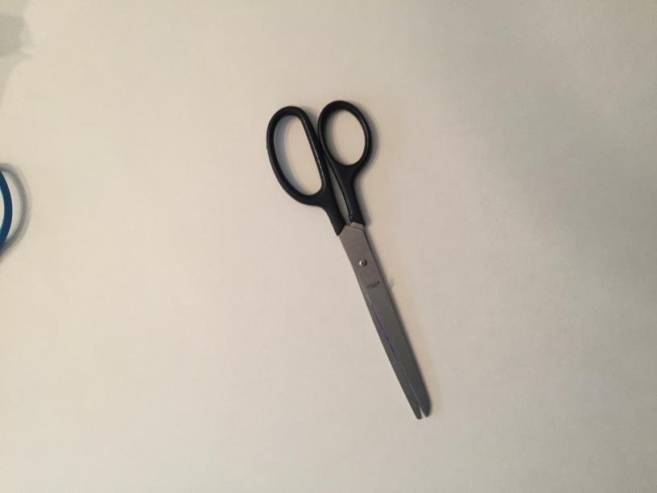
Object Detection using Python SDK for Custom Vision
Task: Detect Fork(s) and Scissors in a given image

Slide 8

Python SDK for Custom Vision
Let’s experience on VS Code.

Slide 9
Thank you
LinkedIn Tarun Nanduri
Twitter @TarunNanduri7
Email tarunnanduri7@gmail.com

