Slide 1
CS 4476/6476 PS 5
Tarun Pasumarthi
tpasumarthi3@gatech.edu
903085537

Slide 2
Part 1: Tiny Image Representation and Nearest-Neighbor Classification

Slide 3
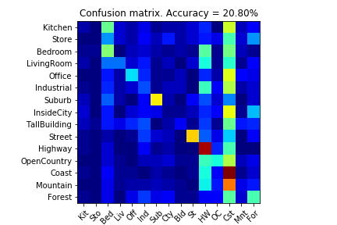
Part 1.3.a: Your confusion matrix, together with the accuracy for Part 1 with the standard parameter set (image_size = 16, k = 3)
<Plot here>

Slide 4
Part 1.3.b: Experiments: change image size and k individually using the following values, and report the accuracy (when tuning one parameter, keep the other as the standard (16 x 16, 3)):
ie. when you’re tuning image size, keep k at 3, when changing k, keep image size as 16x16
image size:
8 x 8: 18.53%
16 x 16: 20.80%
32 x 32: 19.87%
k:
1: 21.00%
3: 20.80%
5: 20.60%
10:20.80%
15: 21.47%

Slide 5
Part 1.3.c: When tuning the parameters (image size and k), what did you observe about the processing time and accuracy? What do you think led to this observation?
The accuracies remained about the same as I changed both the image size and k. The best image size was 16x16 and the best k value was 15. I think this lack in change was due to the fact that increasing these parameters did not change the neighboring value’s mode class.

Slide 6
Part 2: Bag-of-words with SIFT Features

Slide 7
Part 2.3: Reflection on Tiny Image Representation vs. Bag of Words with SIFT features:
Why do you think that the tiny image representation gives a much worse accuracy than bag of words? Additionally why do you think Bag of Words is better in this case?
I think the tiny image representation gives a much worse accuracy because it discards all of the high frequency image content and is not especially invariant to spatial or brightness shifts. Especially in this case where the classes are grayscale, and from various orientations, I would predict bag of words with sift, which is invariant of these features, to perform better

Slide 8
Part 2.4.a: Your confusion matrix, together with the accuracy for Part 2 with the standard parameter set (vocab_size = 50, k = 3, max_iter = 10, stride(build_vocab) = 20, stride(get_bags_of_sift) = 5

Slide 9
Part 2.4.a: Experiments: change vocab_size and k individually using the following values, and report the accuracy (when tuning one parameter, keep the other as the standard (50, 3)):
ie. when you’re tuning vocab_size, keep k at 3, when changing k, keep vocab_size as 50. (Other params max_iter = 10, stride(build_vocab) = 20, stride(get_bags_of_sift) = 5)
vocab size:
50:
100:
200:
k:
1:
3:
5:
10:
15:

Slide 10
Part 2.4.a: Paste the confusion matrix for your best result with the previous experimentation in this slide.
<Plot here>
vocab_size:
k:
max_iter: 10
stride(build_vocab): 20
stride(get_bags_of_sift): 5

Slide 11
Part 2.4.b: Reflection: when experimenting with the value k in kNN, what did you observe? Compare the performance difference with the k value experiment in Part 1.3, what can you tell from this?
<Text solution here>

Slide 12
Part 3: Extra Credit

Slide 13
EXTRA CREDIT
Part 3.1: Post best confusion matrix, together with the accuracy out of all the parameters you tested. Report the parameter settings used to obtain this result.
<Plot here>
Parameter settings:
max_iter:
stride(build_vocab):
stride(get_bags_of_sift):
vocab_size:
k (kNN):

Slide 14
EXTRA CREDIT
Part 3.2: Post confusion matrix along with the distance metric that you used for achieving a better accuracy on standard parameters. Why do you think it performs better?
<Plot here>
Distance metric and why it works better:

Slide 15
EXTRA CREDIT
Part 3.3: Post confusion matrix along with your explanation of your SVM model and detail any other changes your made to reach an accuracy of 65% or greater.
<Plot here>
Description of your model:

