Slide 1
Array

Slide 2
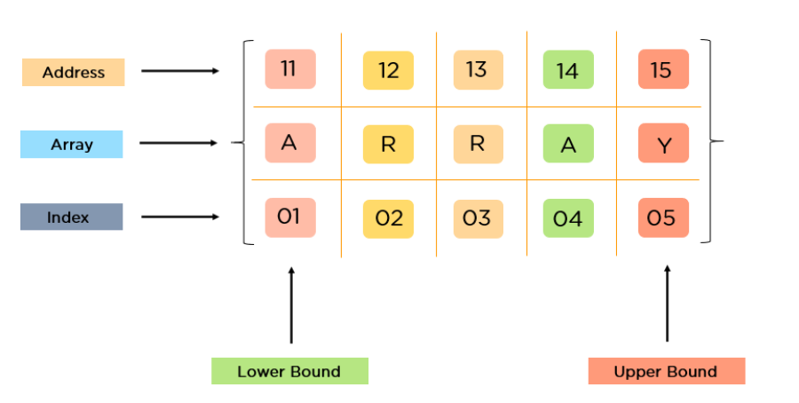
Description of various Data Structures : Arrays
An array is defined as a set of finite number of homogeneous elements or same data items.
It means an array can contain one type of data only, either all integer, all float-point number or all character.

Slide 3
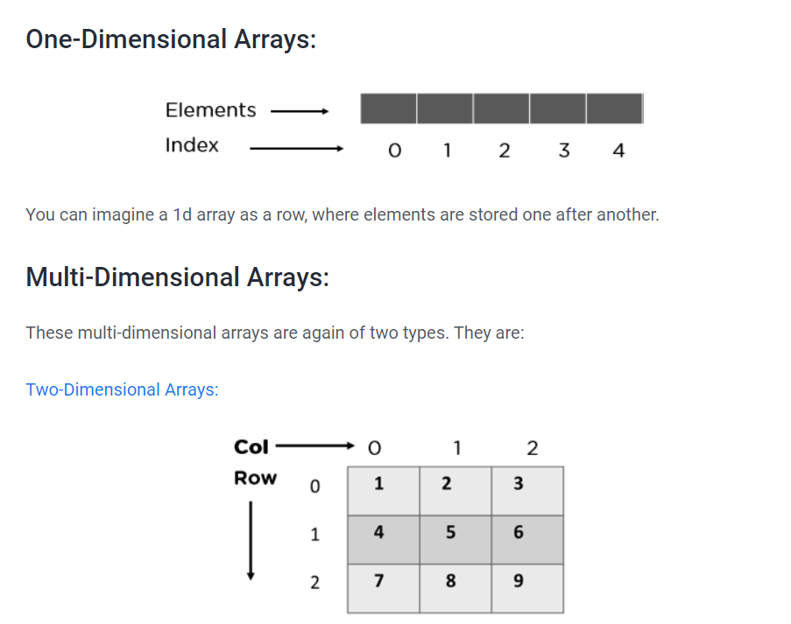

Slide 4
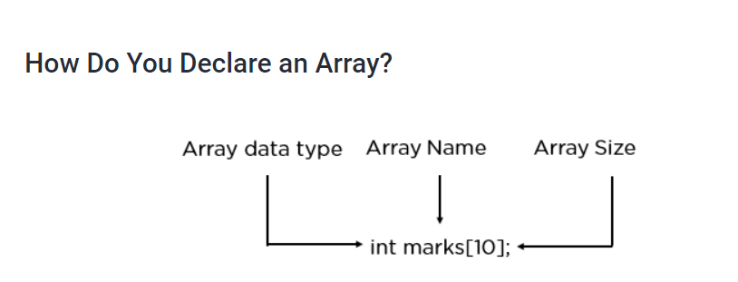
Where int specifies the data type or type of elements arrays stores.
“marks” is the name of array & the number specified inside the square brackets is the number of elements an array can store, this is also called sized or length of array.

Slide 5
Arrays
Following are some of the concepts to be remembered about arrays:
The individual element of an array can be accessed by specifying name of the array, following by index or subscript inside square brackets.
The first element of the array has index zero[0]. It means the first element and last element will be specified as:arr[0] & arr[9]
Respectively.

Slide 6
Arrays
The elements of array will always be stored in the consecutive (continues) memory location.
The number of elements that can be stored in an array, that is the size of array or its length is given by the following equation:
(Upperbound-lowerbound)+1

Slide 7
Arrays
For the above array it would be
(9-0)+1=10,where 0 is the lower bound of array and 9 is the upper bound of array.
Array can always be read or written through loop. If we read a one-dimensional array it require one loop for reading and other for writing the array.

Slide 8
Arrays
Some common operation performed on array are:
Creation of an array
Traversing an array
Insertion of new element
Deletion of required element
Modification of an element
Merging of arrays

Slide 9
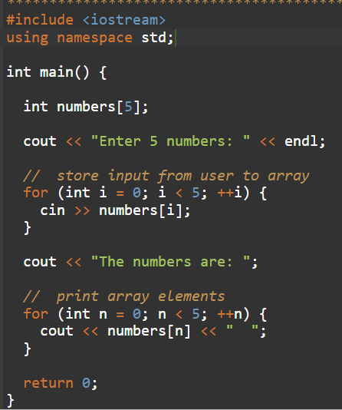
WAP to store and print elements in an Array

Slide 10
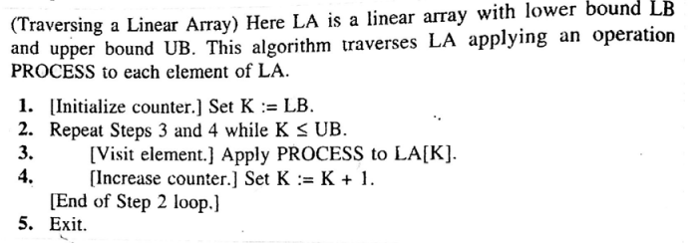
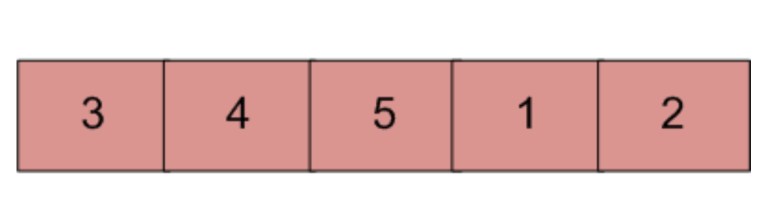
Traversing of an Array

Slide 11
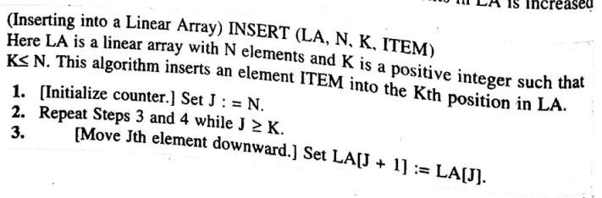
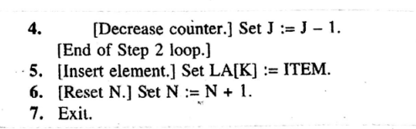
Inserting an Element in an Array

Slide 12
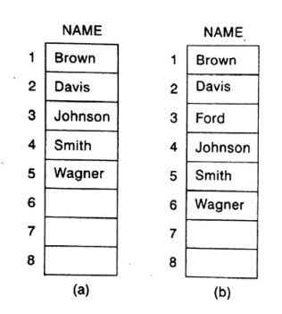
Inserting an Element in an Array

Slide 13
Inserting an Element in an Array
Step 1: J=N
J= 5
Step 2 : J>=K
5>=3
Step 3 : Set LA[J] to LA[J+1]
LA[5] to LA[6]
J=j-1
So now J= 4
Check 4 >= 3 [True]
LA[4] to LA[5]
J=J-1
So now J=3
Check 3>=3 [True]
LA[3] to LA[4}
J= J-1
Now J=2
2>=3 [False]
Step 4 :Set LA[3] = Ford [New element added]
Add the element Ford at position 3 (k=3)

Slide 14
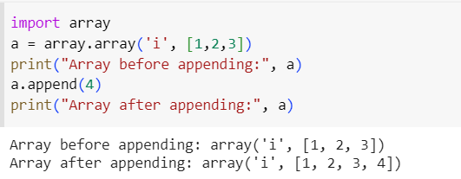
WAP to insert an element in an array
A) Add a single element to an array with the append() method. The method appends a new value to the end, which must match the array element type.

Slide 15
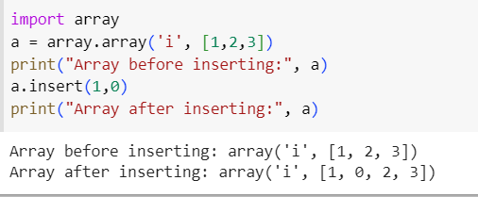
WAP to insert an element in an array
B) Add an element to a specific place in an array with the insert() method. Set the element index and provide the element value to insert the value.

Slide 16
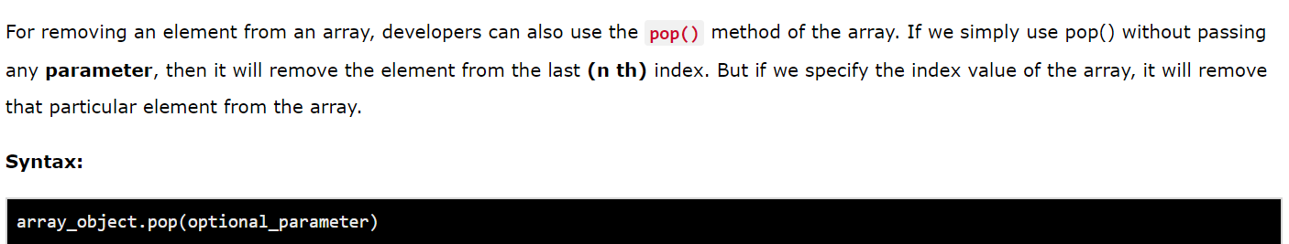
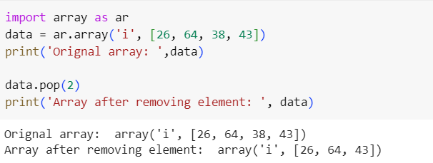
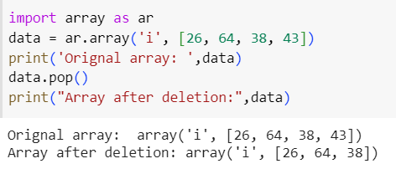
WAP to delete an element from the array

Slide 17
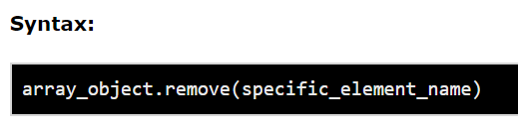
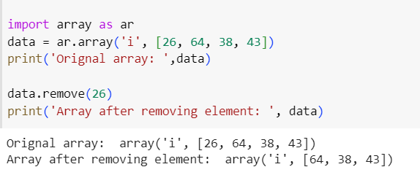
WAP to delete an element from the array

Slide 18
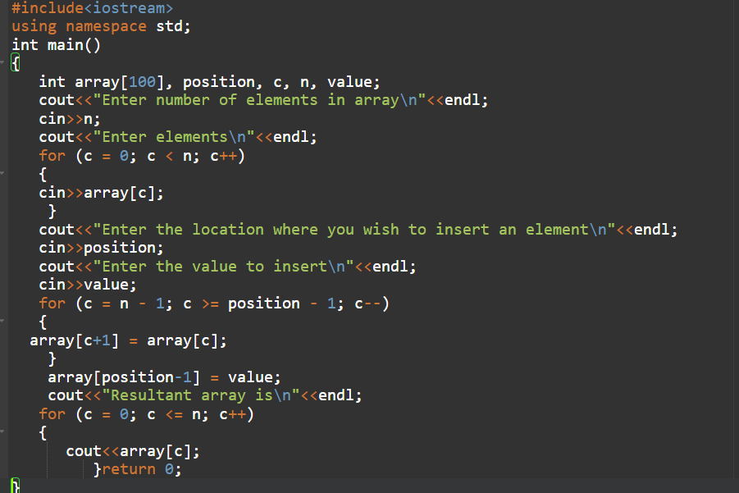
WAP to insert an element in an Array at specific position

Slide 19

Exercise Question
Traverse the given array show all the steps

Slide 20
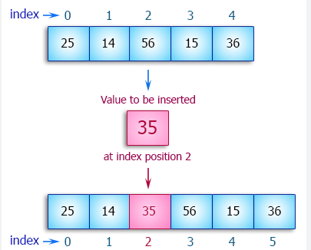
Exercise Question

