Slide 1
JAVA

Slide 2
Overview
Java is a class-based object-oriented simple programming language.
It is a general-purpose, high-level programming language that helps programmers and developers to write a code once and run it anywhere.
Java is considered both a compiled and interpreted language
It is because Java source code is first compiled to bytecode which is then interpreted by Java Virtual Machine.
Java Virtual Machine interprets the bytecode and converts it to platform specific machine code.
Hence, Java is also called a platform-independent programming language.

Slide 3
Why Use Java?
1) Object-Oriented
2) Portable
3) Simple
4) Secure
5) Robust
6) Platform Independent
7) Architecture neutral

Slide 4
Example program in java.
/* Here, we import classes from the packages. */
import java.io.*;
Import java.util.*;
Import java.applet.*
import java.lang.Math.sqrt();
// This is the main class.
public class Main {
// This is the main driver method.
public static void main(String[] args) {
// This is the standard print statement
System.out.println("Welcome to JAVA");
}
}

Slide 5
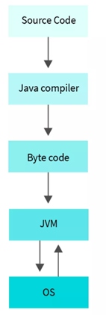
JAVA Terminology

Slide 6
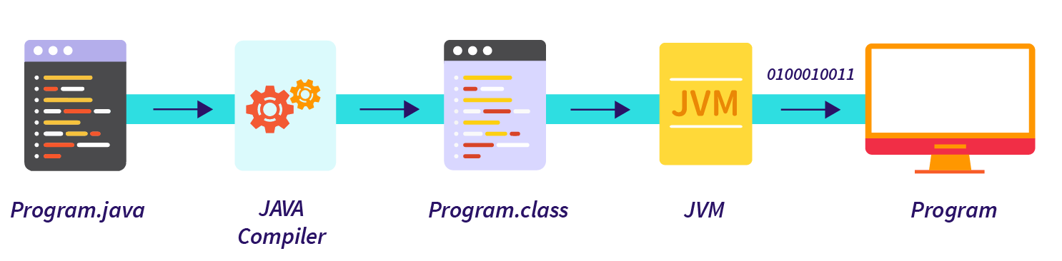
How Does Java Programming Language Work?
The working of the Java programming language can be summed up in three steps.

Slide 7
Java Tokens
A token is the smallest element of a program that is meaningful to the compiler.
Tokens can be classified as follows:
Keywords
Identifiers
Constants
Special Symbols
Operators
Literals
Punctuators

Slide 8
For example, consider the following code
public class Demo
{
public static void main(String args[])
{
System.out.println("javatpoint");
}
}
In the above code snippet, public, class, Demo, {, static, void, main, (, String, args, [, ], ), System, ., out, println, javatpoint, etc. are the Java tokens.
The Java compiler translates these tokens into Java bytecode.
Further, these bytecodes are executed inside the interpreted Java environment.

Slide 9
Keywords in Java
In Java, a keyword is a reserved word that conveys a specific meaning to the Java compiler.
Keywords are special words that have a predefined meaning to the Java compiler.
They are reserved words and cannot be used as an identifier, function names, class names, etc in a programming language.
However, if try to use them as an identifier, variable name, etc then we will be getting a compile-time error.

Slide 10
Java Keywords List
abstract | assert | boolean | break | byte
case | catch | char | class | const
continue | default | do | double | else
enum | extends | final | finally | float
for | goto | if | implements | import
instanceof | int | interface | long | native
new | package | private | protected | public
return | short | static | strictfp | super
switch | synchronized | this | throw | throws
transient | try | void | volatile | while

Slide 11
Identifiers in Java
Identifiers in Java are symbolic names used for identification. They can be a class name, variable name, method name, package name, constant name, and more.
However, In Java, There are some reserved words that can not be used as an identifier.
For every identifier there are some conventions that should be used before declaring them.

Slide 12
Rules for Identifiers in Java
There are some rules and conventions for declaring the identifiers in Java. If the identifiers are not properly declared, we may get a compile-time error.
Following are some rules and conventions for declaring identifiers:
A valid identifier must have characters [A-Z] or [a-z] or numbers [0-9], and underscore(_) or a dollar sign ($). for example, @javatpoint is not a valid identifier because it contains a special character which is @.
There should not be any space in an identifier. For example, java tpoint is an invalid identifier.
An identifier should not contain a number at the starting. For example, 123javatpoint is an invalid identifier.
An identifier should be of length 4-15 letters only. However, there is no limit on its length. But, it is good to follow the standard conventions.
We can't use the Java reserved keywords as an identifier such as int, float, double, char, etc. For example, int double is an invalid identifier in Java.
An identifier should not be any query language keywords such as SELECT, FROM, COUNT, DELETE, etc.
Abc t

Slide 13
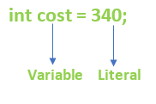
Literals in Java
Any constant value which can be assigned to the variable is called literal/constant.
It can be assigned directly to a variable.
Java has various types of literals. The following figure represents a literal.

Slide 14
Types of Literals in Java
There are the majorly four types of literals in Java:
Integer Literal
Character Literal
Boolean Literal
String Literal

Slide 15
Integer Literals
Integer literals are sequences of digits. There are three types of integer literals:
Decimal Integer: These are the set of numbers that consist of digits from 0 to 9. It may have a positive (+) or negative (-) Note that between numbers commas and non-digit characters are not permitted. For example, 5678, +657, -89, etc.
int decVal = 26;
Octal Integer: It is a combination of number have digits from 0 to 7 with a leading 0. For example, 045, 026,
int octVal = 067;

Slide 16
Hexa-Decimal: The sequence of digits preceded by 0x or 0X is considered as hexadecimal integers. It may also include a character from a to f or A to F that represents numbers from 10 to 15, respectively. For example, 0xd, 0xf,
int hexVal = 0x1a;
Binary Integer: Base 2, whose digits consists of the numbers 0 and 1 Prefix 0b represents the Binary system. For example, 0b11010.
int binVal = 0b11010;
Real Literals
The numbers that contain fractional parts are known as real literals. We can also represent real literals in exponent form.
For example, 879.90, 99E-3, etc.

Slide 17
Char literals
For char data types, we can specify literals in 4 ways:
Single quote: We can specify literal to a char data type as a single character within the single quote.
char ch = 'a';
Char literal as Integral literal: we can specify char literal as integral literal, which represents the Unicode value of the character, and that integral literal can be specified either in Decimal, Octal, and Hexadecimal forms. But the allowed range is 0 to 65535.
char ch = 062;

Slide 18
Unicode Representation: We can specify char literals in Unicode representation ‘\uxxxx’.
Here xxxx represents 4 hexadecimal numbers.
char ch = '\u0061';// Here /u0061 represent a.
Escape Sequence: Every escape character can be specified as char literals.
char ch = '\n';

Slide 19
String literals
Any sequence of characters within double quotes is treated as String literals.
String s = "Hello";
Boolean literals
Only two values are allowed for Boolean literals, i.e., true and false.
boolean b = true;

Slide 20
Null Literals
Null literal is often used in programs as a marker to indicate that reference type object is unavailable.
The value null may be assigned to any variable, except variables of primitive types.
String stuName = null;
Student age = null;

Slide 21
A Java Literal Example
System.out.println(count);
System.out.println(floatVal);
System.out.println(cost);
System.out.println(hexaVal);
System.out.println(binary);
System.out.println(alpha);
System.out.println(str);
System.out.println(boolVal);
System.out.println(octalVal);
System.out.println(stuName);
System.out.println(ch1);
System.out.println("\t" +"backslash literal");
System.out.println(ch2);
}
}
public class LiteralsExample
{
public static void main(String args[])
{
int count = 987;
float floatVal = 4534.99f;
double cost = 19765.567;
int hexaVal = 0x7e4;
int binary = 0b11010;
char alpha = 'p';
String str = "Java";
boolean boolVal = true;
int octalVal = 067;
String stuName = null;
char ch1 = '\u0021';
char ch2 = 1456;

Slide 22
What are Data Types in Java?
Data Types mean to identify the type of data and associate operations that can be done on the data values. Data types define the value that a variable can take.
Data types also tell us information about:
The size of the memory location.
The maximum and minimum value of the range that can store in the memory location.
Different types of operations can be done on the memory location.

Slide 23
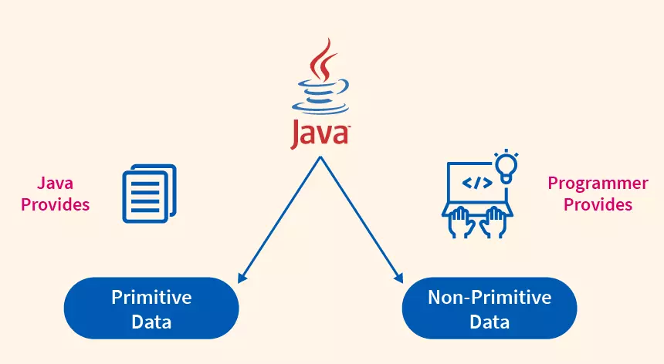
Types of Data Types in Java

Slide 24
Primitive Data Types
Primitive data types are those data types that are predefined in the Java programming language.
There are a total of eight primitive data types that are predefined in the Java programming language.
The size of the primitive data types does not change with changing the operating system because the Java programming language is independent of all the operating systems.
For example: byte, short, int, long, double, float, boolean, char

Slide 25
Non-Primitive Data Types
These are the data types that are not predefined but defined by the programmer according to the need for a particular task.
For example: String, Arrays, class, etc.

Slide 26
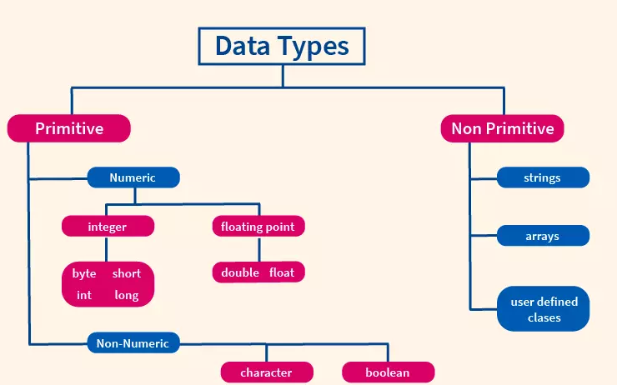
Classification chart of the Data types in Java

Slide 27
Data Type | Size | Description
byte | 1 byte | Stores whole numbers from -128 to 127 [ 2^7 to (2^7)-1]
short | 2 bytes | Stores whole numbers from -32,768 to 32,767 [ -2^15 to (2^15)-1]
int | 4 bytes | Stores whole numbers from -2,147,483,648 to 2,147,483,647 [ -2^31 to (2^31)-1]
long | 8 bytes | Stores whole numbers from -9,223,372,036,854,775,808 to 9,223,372,036,854,775,807 [ -2^63 to (2^63)-1]
float | 4 bytes | Stores fractional numbers. Sufficient for storing 6 to 7 decimal digits
double | 8 bytes | Stores fractional numbers. Sufficient for storing 15 decimal digits
boolean | 1 bit | Stores true or false values
char | 2 bytes | Stores a single character/letter or ASCII values

Slide 28
Integer Datatype in Java
int is used for storing integer values.
Its size is 4 bytes and has a default value of 0.
The maximum values of integer is 2^31 and the minimum value is -2^31.
It can be used to store integer values unless there is a need for storing numbers larger or smaller than the limits
Example- int a=56;

Slide 29
Float Datatype in Java
float is used for storing decimal values.
Its default value is 0.0f and has a size of 4 bytes.
It has an infinite value range.
However its always advised to use float in place of double if there is a memory constraint.
Only 6 bits of precision is allowed in the case of Float data type,
Example- float a=98.7f;

Slide 30
Character Datatype in Java
char as the name suggests is useful for storing single value characters.
Its default value is ‘\u0000’ with the max value being ‘\uffff’ and has a size of 2 bytes.
Example- char a=’D’;
It must be confusing for you to see this new kind of data ‘/u000’. This is the unicode format which java uses inplace of ASCII.

Slide 31
Boolean Datatype
boolean is a special datatype which can have only two values ‘true’ and ‘false’.
It has a default value of ‘false’ and a size of 1 byte.
It comes in use for storing flag values.
Example- boolean flag=true;

Slide 32
Byte Datatype in Java
It’s an 8 bit signed two’s complement .
The range of values are -128 to 127.
It is space efficient because it is smaller than integer datatype.
It can be a replacement for int datatype usage but it doesn’t have the size range as the integer datatype.
Example: byte a = 10;

Slide 33
Short Datatype in Java
This datatype is also similar to the integer datatype.
However it’s 2 times smaller than the integer datatype.
Its minimum range is -32,768 and maximum range is 32,767. It has a size of
Example- short a= 54;

Slide 34
Long Datatype in Java
This datatype primarily stores huge sized numeric data.
It is a 64 bit integer and ranges from -2^63 to +(2^63)-1.
It has a size of 8 bytes and is useful when you need to store data which is longer than int datatype.
Example- long a= 1273762;

Slide 35
Double Datatype in Java
This is similar to the float datatype.
Double data type can handle up to 15 bits of precision
It has a range of -2^31 to (2^31)-1.
Example- double DataFlair=99.987d;

Slide 36
Output of the program
class Test {
public static void main(String args[])
{
char ch='F';
int m=ch;
m=m+5;
System.out.println(m + " " + ch);
}
}

Slide 37
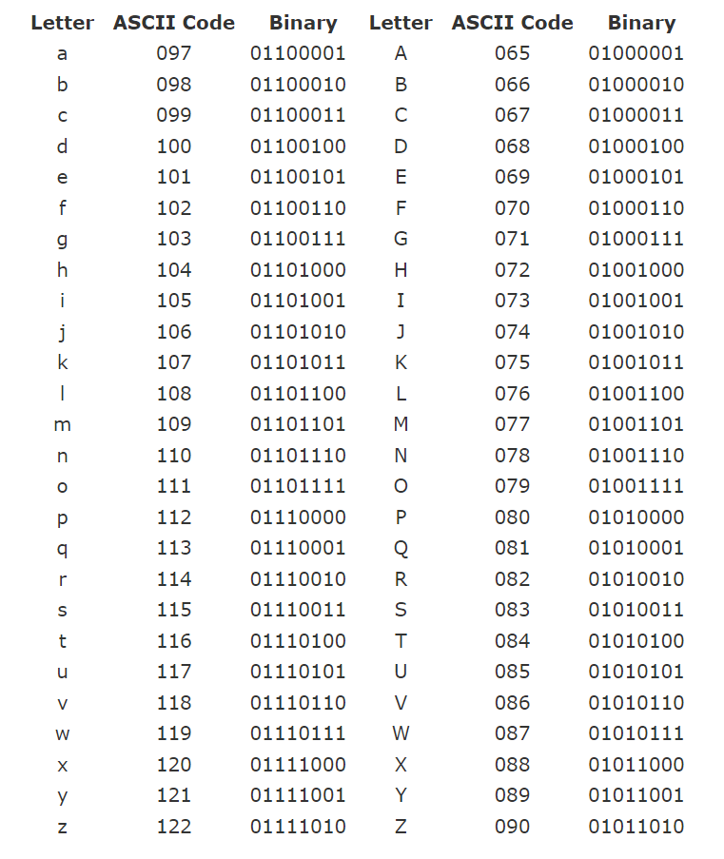

Slide 38
Java Operators
Operators in Java can be classified into 5 types:
Arithmetic Operators
Assignment Operators
Relational Operators
Logical Operators
Unary Operators
Bitwise Operators

Slide 39
1. Java Arithmetic Operators
Operator | Operation
+ | Addition
- | Subtraction
* | Multiplication
/ | Division
% | Modulo Operation (Remainder after division)

Slide 40
2. Java Assignment Operators
Operator | Example | Equivalent to
= | a = b; | a = b;
+= | a += b; | a = a + b;
-= | a -= b; | a = a - b;
*= | a *= b; | a = a * b;
/= | a /= b; | a = a / b;
%= | a %= b; | a = a % b;

Slide 41
3. Java Relational Operators
Relational operators are used to check the relationship between two operands. For example,
Operator | Description | Example
== | Is Equal To | 3 == 5 returns false
!= | Not Equal To | 3 != 5 returns true
> | Greater Than | 3 > 5 returns false
< | Less Than | 3 < 5 returns true
>= | Greater Than or Equal To | 3 >= 5 returns false
<= | Less Than or Equal To | 3 <= 5 returns true

Slide 42
4. Java Logical Operators
Logical operators are used to check whether an expression is true or false.
They are used in decision making.
Operator | Example | Meaning
&& (Logical AND) | expression1 && expression2 | true only if both expression1 and expression2 are true
|| (Logical OR) | expression1 || expression2 | true if either expression1 or expression2 is true
! (Logical NOT) | !expression | true if expression is false and vice versa

Slide 43
5. Java Unary Operators
Unary operators are used with only one operand. For example, ++ is a unary operator that increases the value of a variable by 1. That is, ++5 will return 6.
Operator | Meaning
+ | Unary plus: not necessary to use since numbers are positive without using it
- | Unary minus: inverts the sign of an expression
++ | Increment operator: increments value by 1
-- | Decrement operator: decrements value by 1
! | Logical complement operator: inverts the value of a boolean

Slide 44
// Demonstrate ++.
class IncDec {
public static void main(String args[]) {
int a = 1;
int b = 2;
int c;
int d;
c = ++b;
d = a++;
c++;
System.out.println("a = " + a);
System.out.println("b = " + b);
System.out.println("c = " + c);
System.out.println("d = " + d);
}
}

Slide 45
The output of this program follows:
a = 2
b = 3
c = 4
d = 1

Slide 46
Java Bitwise Operators
Bitwise operators in Java are used to perform operations on individual bits. For example,
Operator | Description
~ | Bitwise Complement
<< | Left Shift
>> | Right Shift
>>> | Unsigned Right Shift
& | Bitwise AND
^ | Bitwise exclusive OR

Slide 47
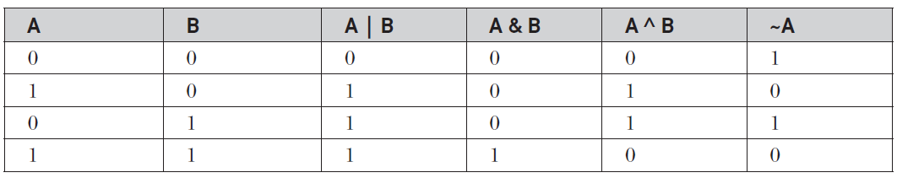
The Bitwise Logical Operators

Slide 48
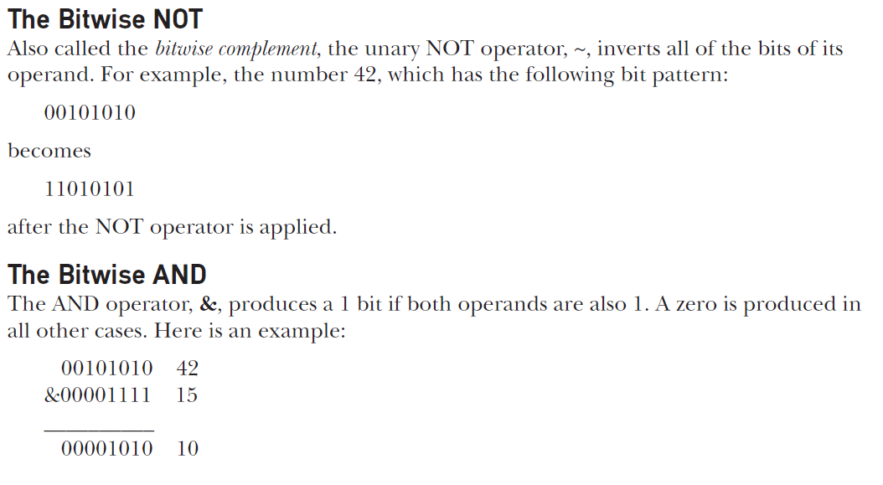

Slide 49
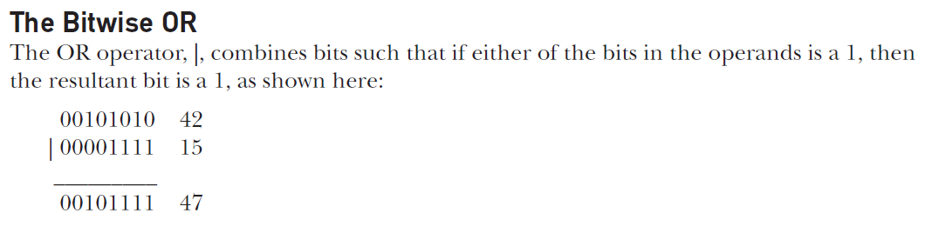

Slide 50
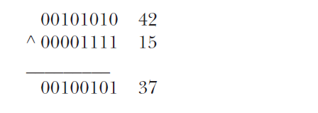
The Bitwise XOR
The XOR operator, ^, combines bits such that if exactly one operand is 1, then the result
is 1. Otherwise, the result is zero.
The following example shows the effect of the ^.

Slide 51
Java Ternary Operator
For example,
variable = Expression ? expression1 : expression2
If the Expression is true, expression1 is assigned to the variable.
If the Expression is false, expression2 is assigned to the variable.

Slide 52
Example
class Java {
public static void main(String[] args) {
int februaryDays = 29;
String result;
// ternary operator
result = (februaryDays == 28) ? "Not a leap year" : "Leap year";
System.out.println(result);
}
}

Slide 53
public class Test {
public static void main ( String[] args ) {
int a = 10;
boolean b = True;
System.out.println ( a++ );
System.out.println ( ++a );
System.out.println ( a-- );
System.out.println ( --a );
System.out.println ( !b );
}
}

Slide 54
Output:
10
12
12
10
False

Slide 55
int x = 0, y = 0 , z = 0 ; x = (++x + y-- ) * z++; What will be the value of "x" after execution ?
A. 0
B. 1
C. 2
D. -1

Slide 56
Ans :- A

Slide 57
public class Test1 {
public static void main(String[] args) {
// TODO Auto-generated method stub
int y=10;
int z= (++y * (y++ + 5));
System.out.println(z );
}
}

Slide 58
ANS 176

Slide 59
((0>1) || (0==1)) is

Slide 60
public class Test1 {
public static void main(String[] args) {
// TODO Auto-generated method stub
System.out.println((0>1) || (0==1));
}
}

Slide 61
False

Slide 62
If (a>b)
C=a;
Else
C=b;
Result of expression
9/9.0

Slide 63
Java Operator Precedence
Operator | Description | Associativity
() [] . | parentheses array access member access | left-to-right
++ -- | unary post-increment unary post-decrement | left-to-right
+ - ! ~ ++ -- | unary plus unary minus unary logical NOT unary bitwise NOT unary pre-increment unary pre-decrement | right-to-left
() new | cast object creation | right-to-left
* / % | multiplicative | left-to-right
+ - + | additive string concatenation | left-to-right

Slide 64
<< >> >>> | shift | left-to-right
< <= > >= instanceof | relational | left-to-right
== != | equality | left-to-right
& | bitwise AND | left-to-right
^ | bitwise XOR | left-to-right
| | bitwise OR | left-to-right
&& | logical AND | left-to-right
|| | logical OR | left-to-right

Slide 65
public class Test1 {
public static void main(String[] args) {
// TODO Auto-generated method stub
System.out.println("1 + 2 = " + 1 + 2);
System.out.println("1 + 2 = " + (1 + 2));
}
}
Answer: 1 + 2 = 12 and 1 + 2 = 3, respectively. If either (or both) of the operands of the + operator is a string, the other is automatically cast to a string.
String concatenation and addition have the same precedence and are left-to-right associative.
The parentheses in the second statement ensures that the second + operator performs addition instead of string concatenation.
1 + 2 = 12
1 + 2 = 3

Slide 66
What is the value of x after executing the following code fragment? Explain
int x = 10;
int y = x+++x;
System.out.println(y)
Ans: 21

Slide 67
What is the value of x after executing the following code fragment? Explain.
int x = 10;
++++x;
Answer: It leads to a compile-time error. Java parses it as ++(++x). The ++x term increments the variable x and evaulates to the integer 11. This leads to a compile-time error because you the pre-increment operator must be applied to a variable (not an integer). So, while the pre-increment operator has right-to-left associativity, this property is not useful.

Slide 68
List of Java Mathematical Functions
Syntax of abs() function
int abs(int num); // Returns the absolute value of an integer data type number
long abs(long num); // Returns the absolute value of a long data type number
float abs(float num); // Returns the absolute value of a float data type number
double abs(double num); // Returns the absolute value of a double data type number

Slide 69
Syntax of min() function
int min(int a, int b); // Returns the smallest among two integer data type numbers
long min(long a, long b); // Returns the smallest among two long data type numbers
float min(float a, float b); // Returns the smallest among two float data type numbers
double min(double a, double b); // Returns the smallest among two double data type numbers

Slide 70
Syntax of max() function
int max(int a, int b); // Returns the greater among two integer data type numbers
long max(long a, long b); // Returns the greater among two long data type numbers
float max(float a, float b); // Returns the greater among two float data type numbers
double max(double a, double b); // Returns the greater among two double data type numbers

Slide 71
Syntax of sqrt() function
double sqrt(double num);
x=Math.sqrt(n);
Syntax of pow() function
double pow(double x, double y);
floor() Function
The floor() function returns the nearest integer number less than the number passed as argument.
Syntax of floor() function
double floor(double num);
x=Math.floor(n);

Slide 72
ceil() Function
The ceil() function returns the nearest integer number greater than the number passed as argument.
Syntax of ceil() function
double ceil(double num);
x=Math.ceil(n);

Slide 73
exp | double exp(double x) | The exp() function returns e (2.7182818) raised to the xth power.
log | double log(double x) | The function log() returns the natural (base e) logarithm of x.
log10 | double log10(double x) | The log10() function returns the base 10 (or common) logarithm for x.

Slide 74
What is Type conversion in Java?
The process of converting a value from one data type to another is known as type conversion in Java.
Type conversion is also known as type casting in java or simply ‘casting’.
If two data types are compatible with each other, Java will perform such conversion automatically or implicitly for you.
We can easily convert a primitive data type into another primitive data type by using type casting.
Similarly, it is also possible to convert a non-primitive data type (referenced data type) into another non-primitive data type by using type casting.
But we cannot convert a primitive data type into an advanced (referenced) data type by using type casting.

Slide 75
Types of Casting in Java
Two types of casting are possible in Java are as follows:
Implicit type casting (also known as automatic type conversion)
Explicit type casting

Slide 76
Implicit Type Casting in Java
Automatic conversion (casting) done by Java compiler internally is called implicit conversion or implicit type casting in java.
Implicit casting is performed to convert a lower data type into a higher data type. It is also known as automatic type promotion in Java.
For example, if we assign an int value to a long variable, it is compatible with each other but an int value cannot be assigned to a byte variable.
int x = 20;
long y = x; // Automatic conversion
byte z = x; // Type mismatch: cannot convert from int to byte.

Slide 77
Automatic Type Promotion Rules in Expression
1. If byte, short, and int are used in a mathematical expression, Java always converts the result into an int.
2. If a single long is used in the expression, the whole expression is converted to long.
3. If a float operand is used in an expression, the whole expression is converted to float.
4. If any operand is double, the result is promoted to double.
5. Boolean values cannot be converted to another type.
6. Conversion from float to int causes truncation of the fractional part which represents the loss of precision. Java does not allow this.
7. Conversion from double to float causes rounding of digits that may cause some of the value’s precision to be lost.
8. Conversion from long to int is also not possible. It causes the dropping of the excess higher order bits.
For example, when you will perform the addition of an int and a double, it gives the result in a double, and

Slide 78
Explicit Type casting (Narrowing conversion) in Java
If you will assign a double value to an int variable, this conversion cannot be performed automatically because an int is smaller than a double.
In this case, we must use explicit type casting to create a conversion between two incompatible types. This kind of conversion is also known as narrowing conversion in java.
The conversion of a higher data type into a lower data type is called narrowing conversion.
Since this type of conversion is performed by the programmer, not by the compiler automatically, therefore, it is also called explicit type casting in java. It is done to convert from a higher data type to a lower data type.

Slide 79
The general form of a cast is given below:
Syntax:
(type_name) expression;
where type_name specify a standard data type. The expression may be a variable, constant, or an expression.

Slide 80
int x;
double y = 9.99;
x = (int)y; // It will compile in Java and the resulting value will simply be 9.
double d = 100.9;
long l = (long)d; // Explicit type casting.
The output will be 100 because the fractional part is lost.
3. int x;
float y = 27.6f;
x = (int)(y + 0.5);
On explicit type casting, the output becomes 28.
4. int a = 66;
char ch = (char)a; // ch stores 'B’
In this example, we are converting int type a value into char type. When the value of n is converted into char type, ch will store a character ‘B’ because value 66 of n is the ASCII value of ‘B’.

Slide 81
class IntegerConversion { public static void main(String args[]) { int i = 50000; short s = i; } }
Options:
s will be 50000
s will be between -32787 and 32786
s will be between -128 to 127
Program does not compile.

