Slide 1
Skill project presentation on Sports Image Classification

Slide 2
INDEX
Dataset Overview:
Simple Web Application using Pycharm and Flask for Simple Neural Network
Data Loading and Preprocessing
Binary Sequential model
Optimization Techinques ADAM,SGD,RMSPROP
Random –mini –batch evalution
CNN

Slide 3
About Dataset
Dataset Overview:
Contains images of 100 different sports.
Images are in 224x224x3 JPG format.
Dataset is clean, with no duplicate or low-quality images.
Dataset Split:
Train: 13,493 images
Test: 500 images
Validation: 500 images
Total: 14,493 images
Data Processing:
Images were collected from internet searches.
Scanned for duplicates to prevent bias in model performance.
CSV file provided with image paths, labels, and dataset splits.

Slide 4
Simple Web Application using Pycharm and Flask for Simple Neural Network
Objective:
Develop a simple web application using Flask and PyTorch to implement a basic neural network for binary classification. The application will take user inputs, process them through a trained neural network model, and return predictions via a web interface.
Tasks:
1. Build the Neural Network Model
Define a simple feedforward neural network using PyTorch.
Use ReLU activation and Sigmoid for binary classification.
Train the model on the XOR dataset.
2. Develop a Flask Web Application
Create a Flask server to handle HTTP requests.
Implement an API endpoint (/predict) to process user inputs and return predictions.
Load and use the trained model for inference.

Slide 5
Code
class SimpleNeuralNetwork(nn.Module): def __init__(self): super(SimpleNeuralNetwork, self).__init__() self.fc1 = nn.Linear(2, 4) self.relu = nn.ReLU() self.fc2 = nn.Linear(4, 1) self.sigmoid = nn.Sigmoid() def forward(self, x): x = self.fc1(x) x = self.relu(x) x = self.fc2(x) x = self.sigmoid(x) return x def train_neural_network(): # Input and output data X = torch.tensor([[0, 0], [0, 1], [1, 0], [1, 1]], dtype=torch.float32) y = torch.tensor([[0], [1], [1], [0]], dtype=torch.float32) # Model, loss function, and optimizer model = SimpleNeuralNetwork() criterion = nn.BCELoss() optimizer = optim.Adam(model.parameters(), lr=0.001) # Training loop for epoch in range(1000): optimizer.zero_grad() outputs = model(X) loss = criterion(outputs, y) loss.backward() optimizer.step() return model def predict(inputs): model = train_neural_network() with torch.no_grad(): input_tensor = torch.tensor(inputs, dtype=torch.float32) predictions = model(input_tensor).numpy() return predictions

Slide 6
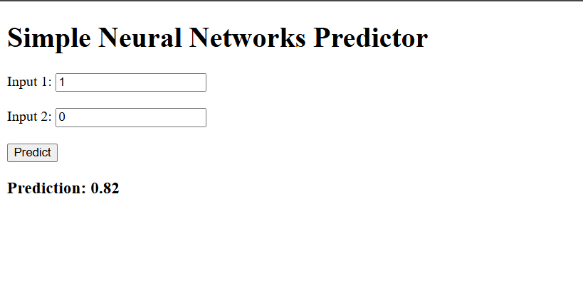
Output

Slide 7
Data Loading and Preprocessing
Objective:
Load and preprocess an image for deep learning applications, including data augmentation techniques to improve model generalization.
Tasks:
Load Image:
Read an image using the PIL library.
Display the original image with matplotlib.
Print image dimensions (width, height).
Apply Data Augmentation:
Resize image to 150×150.
Apply random rotation up to 30 degrees.
Perform horizontal and vertical flipping.
Adjust brightness and contrast randomly.
Visualize Augmented Images:
Generate 9 augmented images.
Display images in a 3×3 grid using matplotlib.

Slide 8
Code
from torchvision import transforms from PIL import Image import matplotlib.pyplot as plt import torch img_path = r"C:\Users\rampu\OneDrive\Desktop\3.2\Deep learning\Skill project\archive\test\baseball\1.jpg" image = Image.open(img_path) plt.imshow(image) plt.axis('off') plt.title("Original image") plt.show() print(image.size) transform = transforms.ToTensor() image_tensor = transform(image) channels, height, width = image_tensor.shape print(f"Image Size: {width}*{height}") print(f"Number of Channels: {channels}") print(image_tensor.shape) transform = transforms.Compose([ transforms.Resize((150,150)), transforms.RandomRotation(30), transforms.RandomHorizontalFlip(), transforms.RandomVerticalFlip(), transforms.ColorJitter(brightness=0.2, contrast=0.2), transforms.RandomAffine(degrees=0, translate=(0.1,0.1)), transforms.ToTensor() ]) def show_arg(image, transform, num_images=9): plt.figure(figsize=(10,10)) for i in range(num_images): aug_img = transform(image) aug_img_np = aug_img.permute(1,2,0).numpy() plt.subplot(3,3,i+1) plt.imshow(aug_img_np) plt.axis('off') plt.tight_layout() plt.show() show_arg(image,transform)

Slide 9
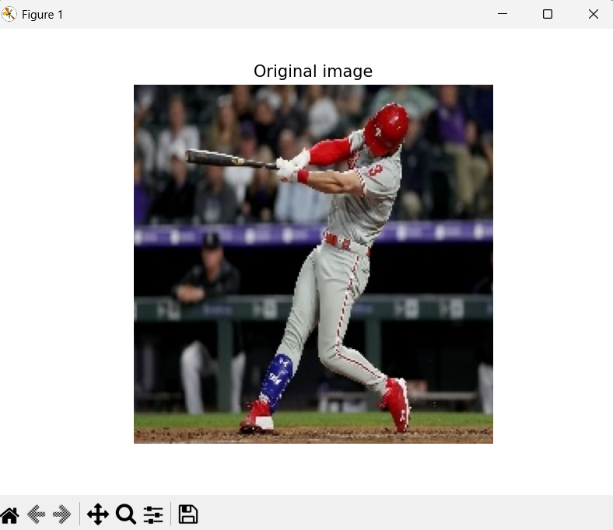
output
(224, 224)
Image Size: 224*224
Number of Channels: 3
torch.Size([3, 224, 224])

Slide 10
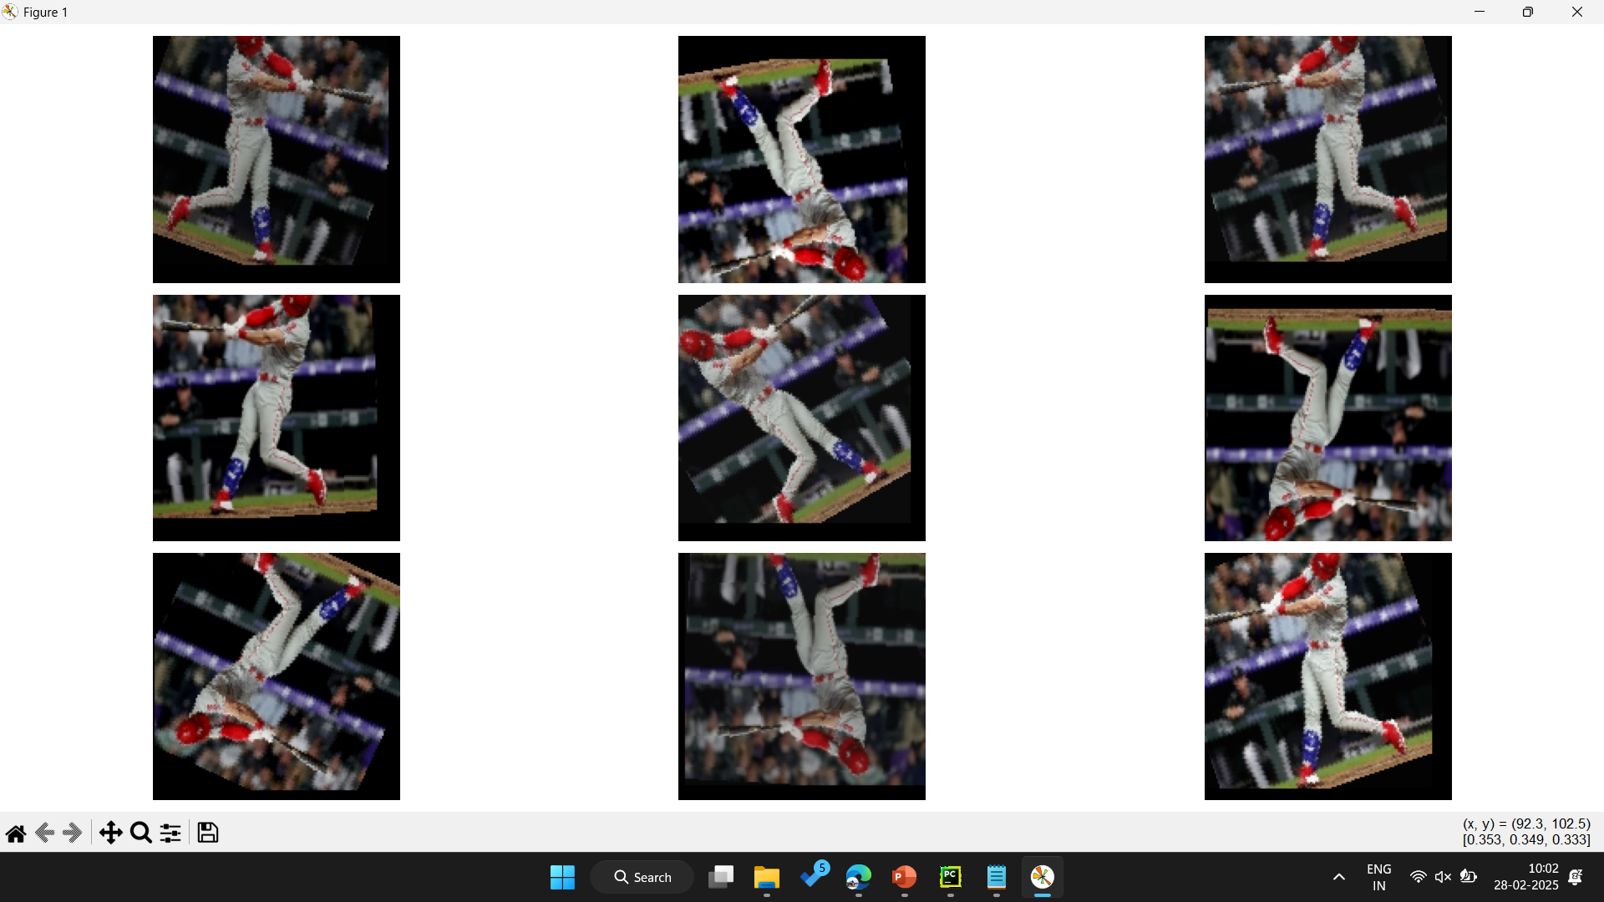

Slide 11
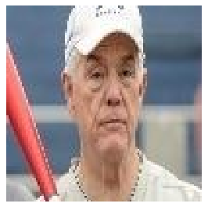
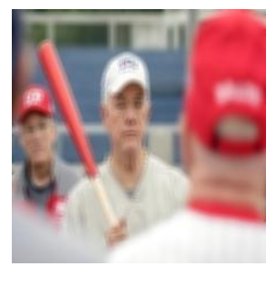
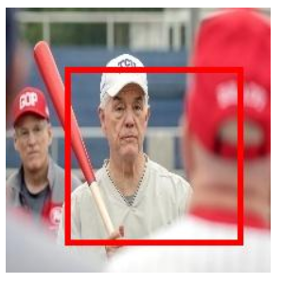
Blurred CROPPED draw rectangle

Slide 12
Binary Sequential model
Objective
Train a binary classification model on image data.
Use data augmentation to improve model generalization.
Implement a SimpleANN model with one hidden layer.
Monitor performance using training loss, validation loss, and accuracy.
Task
Training Process
Forward pass: Compute predictions using model(inputs).
Loss Calculation: Uses CrossEntropyLoss() for multi-class classification.
Backpropagation: Compute gradients and update weights using Adam optimizer (lr=0.001).
Epoch-based Training: Train for 10 epochs, updating weights at each step.

Slide 13
Code
import torch import torch.nn as nn import matplotlib.pyplot as plt class SimpleANN(nn.Module): def __init__(self, input_size, num_classes): super(SimpleANN, self).__init__() self.fc1 = nn.Linear(input_size, 128) # First fully connected layer self.relu = nn.ReLU() # Activation function self.fc2 = nn.Linear(128, num_classes) # Output layer def forward(self, x): x = x.view(x.size(0), -1) # Flatten the input x = self.fc1(x) x = self.relu(x) x = self.fc2(x) return x def compute_accuracy(model, val_loader, device): """Computes accuracy of the model on a given dataset""" model.eval() correct = 0 total = 0 with torch.no_grad(): for images, labels in val_loader: images, labels = images.to(device), labels.to(device) outputs = model(images) _, predicted = torch.max(outputs, 1) correct += (predicted == labels).sum().item() total += labels.size(0) accuracy = 100 * correct / total if total > 0 else 0 # Avoid division by zero return accuracy def plot_loss_accuracy(train_losses, val_losses, val_accuracies) plt.figure(figsize=(12, 5)) # Plot Losses plt.subplot(1, 2, 1) plt.plot(train_losses, label="Train Loss") plt.plot(val_losses, label="Val Loss") plt.xlabel("Epochs") plt.ylabel("Loss") plt.legend() plt.title("Loss over epochs")

Slide 14
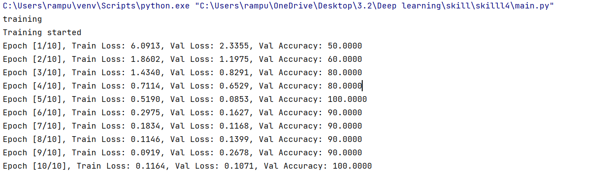
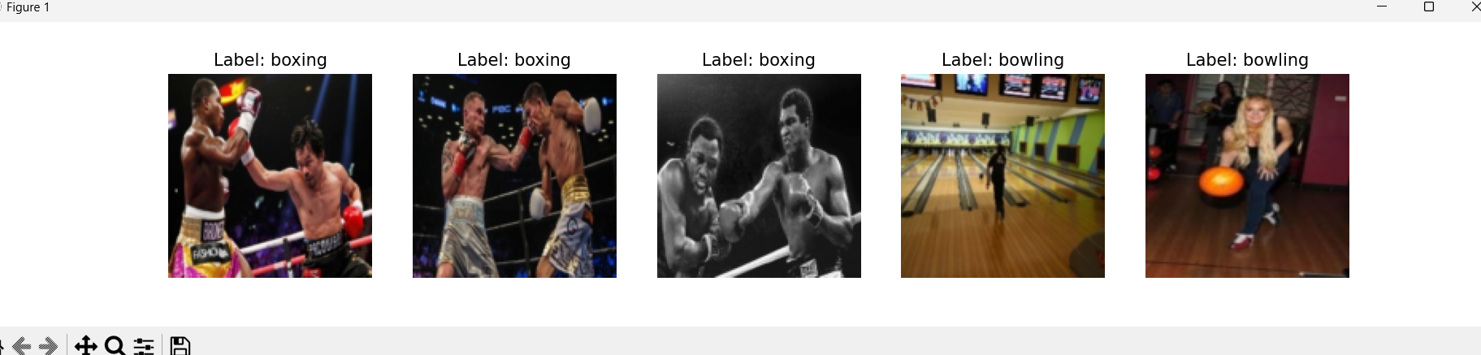
output

Slide 15
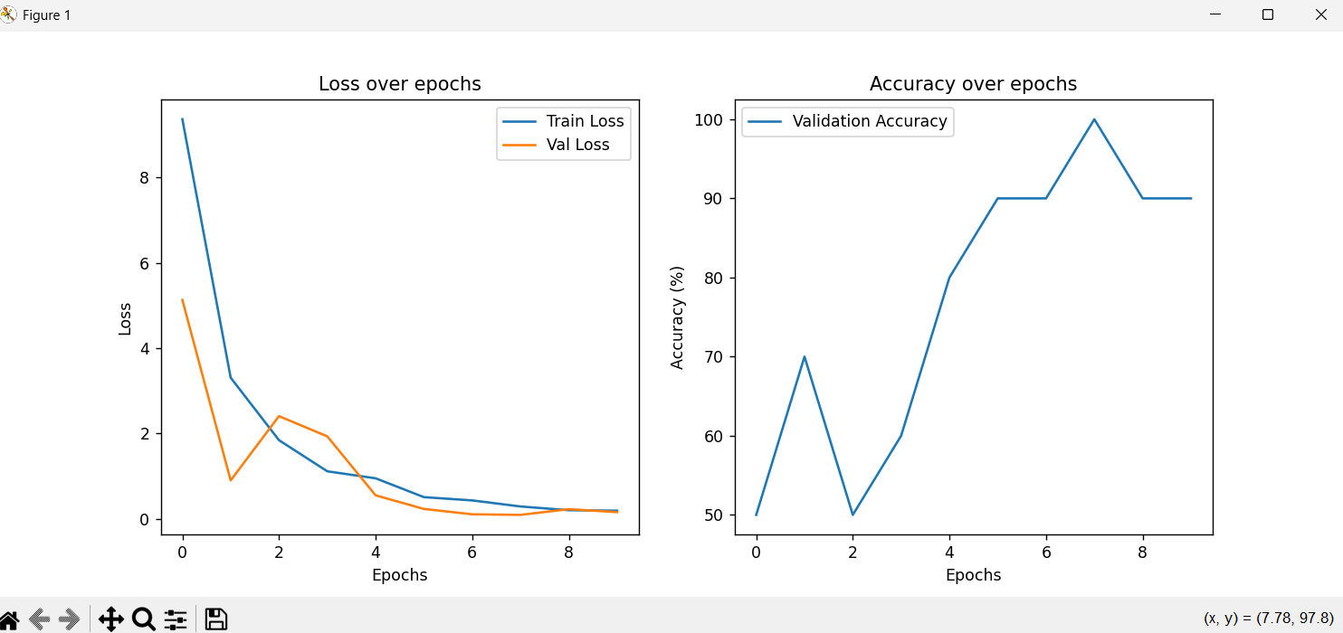

Slide 16
Optimization Techinques ADAM,SGD,RMSPROP
def compare_optimizers(task_type, num_classes, train_loader, val_loader, device, epochs=10, lr=0.001): optimizers = ["SGD", "Adam", "RMSprop"] results = {"optimizers": [], "val_losses": [], "val_accuracies": []} for opt_name in optimizers: print(f"\nTraining with {opt_name} optimizer...\n") model = models.get_model(task_type, num_classes).to(device) optimizer = models.get_optimizer(opt_name, model, lr) criterion = nn.CrossEntropyLoss() if task_type == "multi" else nn.BCEWithLogitsLoss() train(model, train_loader, optimizer, criterion, device, epochs) val_loss, val_accuracy = evaluate(model, val_loader, criterion, device) results["optimizers"].append(opt_name) results["val_losses"].append(val_loss) results["val_accuracies"].append(val_accuracy) return results def main(): device = torch.device("cuda" if torch.cuda.is_available() else "cpu") # path_to_data = r"C:\Users\user\PycharmProjects\DL_skill2\DATASET" path_to_data = r"C:\Users\rampu\Downloads\Images1" train_loader, val_loader, classes = pre.load_data(data_dir=path_to_data, batch_size=32, augment=True) print("\n🔹 Displaying Sample Images from Dataset...") pre.visualize_data(train_loader, classes) task_type = input("Enter classification type (binary/multi): ").strip().lower() if task_type not in ["binary", "multi"]: raise ValueError("Invalid input! Choose 'binary' or 'multi'.") num_classes = len(classes) if task_type == "multi" else 1 print("\nComparing optimizers...\n") results = compare_optimizers(task_type, num_classes, train_loader, val_loader, device, epochs=10, lr=0.001) print("\nFinal Optimizer Performance Comparison:") for opt_name, val_loss, val_acc in zip(results["optimizers"], results["val_losses"], results["val_accuracies"]): print(f"{opt_name}: Validation Loss = {val_loss:.4f}, Validation Accuracy = {val_acc:.2f}%") pre.plot_results(results)

Slide 17
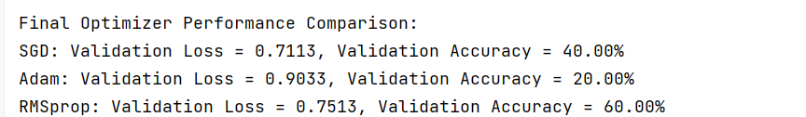
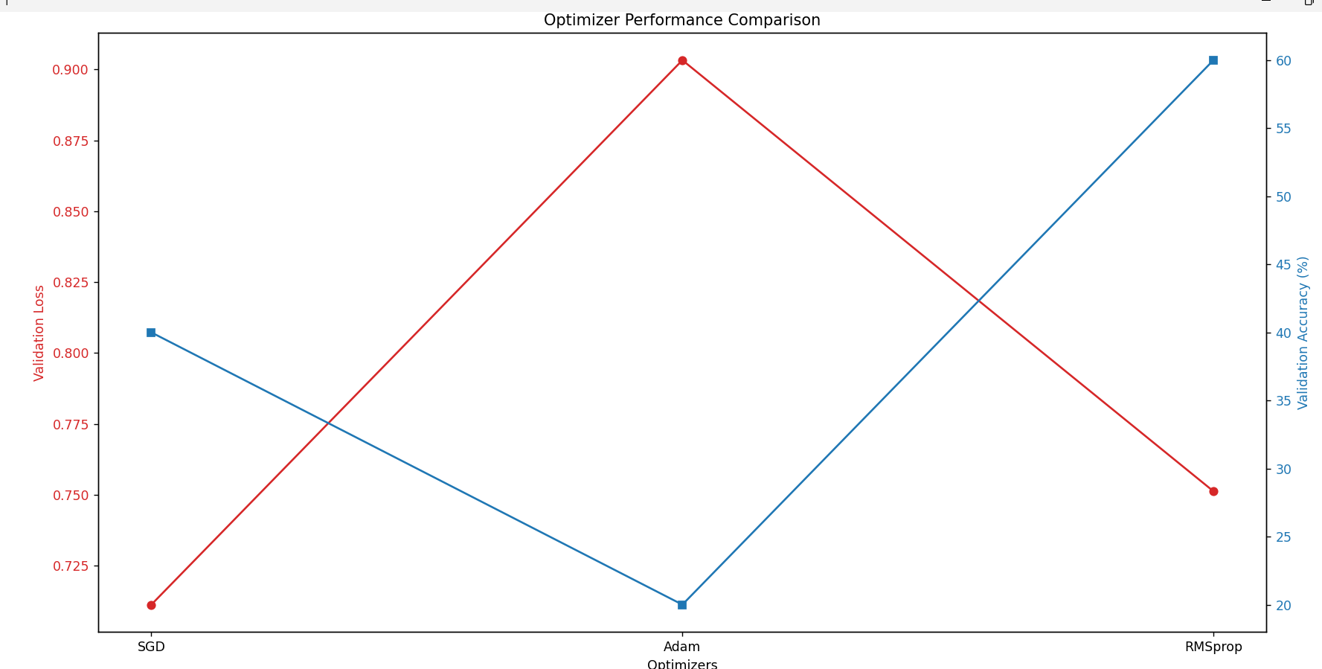
output

Slide 18
Random –mini –batch evalution
Objective:
Random mini-batch evaluation refers to the process of training a model by splitting the dataset into smaller batches of random samples, instead of using the entire dataset or a fixed subset at each iteration. This is particularly useful in stochastic gradient descent (SGD) and its variants.
TASKS
Shuffling Data: Randomly shuffle the dataset to ensure unbiased mini-batches.
Mini-Batch Creation: Split the shuffled dataset into smaller, randomly selected batches.
Model Training: Train the model using each mini-batch, compute gradients, and update parameters.
Model Evaluation: Evaluate the model's performance on a validation set after each batch or epoch.
Learning Rate Adjustments: Optionally adjust the learning rate to improve convergence and prevent overshooting.

Slide 19
CODE
def train_model(model, train_loader, val_loader, criterion, optimizer, device, num_epochs=10): model.to(device) train_losses = [] val_losses = [] val_accuracies = [] print("Training started") for epoch in range(num_epochs): # Training phase model.train() running_loss = 0.0 total_batches = 0 # Track the number of batches print(f"\nEpoch {epoch+1}/{num_epochs}") for batch_idx, (inputs, labels) in enumerate(train_loader): inputs, labels = inputs.to(device), labels.to(device) # Forward pass outputs = model(inputs) loss = criterion(outputs, labels) # Backward pass and optimization optimizer.zero_grad() loss.backward() optimizer.step() running_loss += loss.item() total_batches += 1 train_loss = running_loss / total_batches train_losses.append(train_loss) # Validation phase model.eval() val_loss = 0.0 total_batches = 0 # Reset for validation with torch.no_grad(): for batch_idx, (inputs, labels) in enumerate(val_loader): inputs, labels = inputs.to(device), labels.to(device) outputs = model(inputs) loss = criterion(outputs, labels) val_loss += loss.item() total_batches += 1 val_loss /= total_batches val_losses.append(val_loss) # Compute validation accuracy val_accuracy = cm.compute_accuracy(model, val_loader, device) val_accuracies.append(val_accuracy) # Print epoch progress print(f"Epoch [{epoch + 1}/{num_epochs}]:" f"Train Loss: {train_loss:.4f}, " f"Validation Loss: {val_loss:.4f}, " f"Validation Accuracy: {val_accuracy:.2f}%") cm.plot_loss_accuracy(train_losses, val_losses, val_accuracies) return model

Slide 20
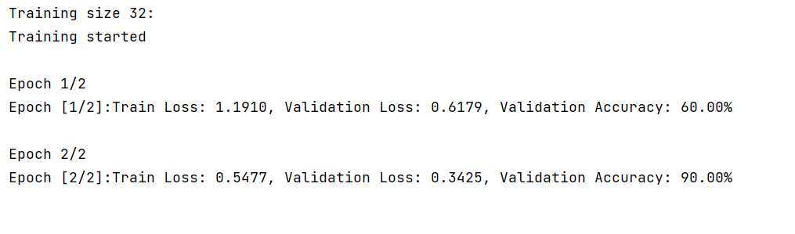
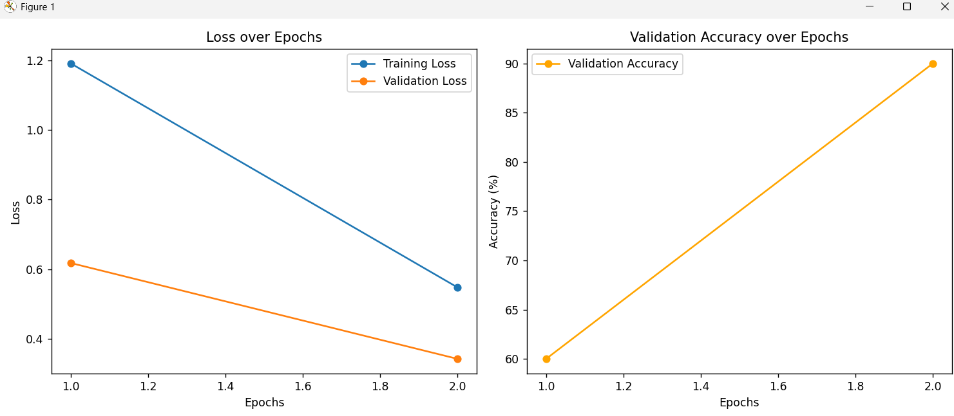

Slide 21
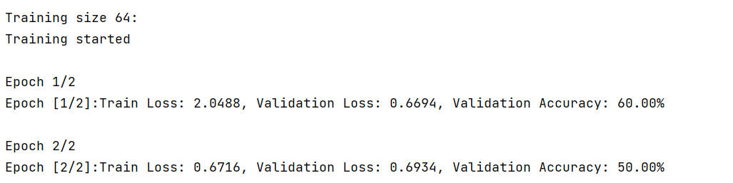
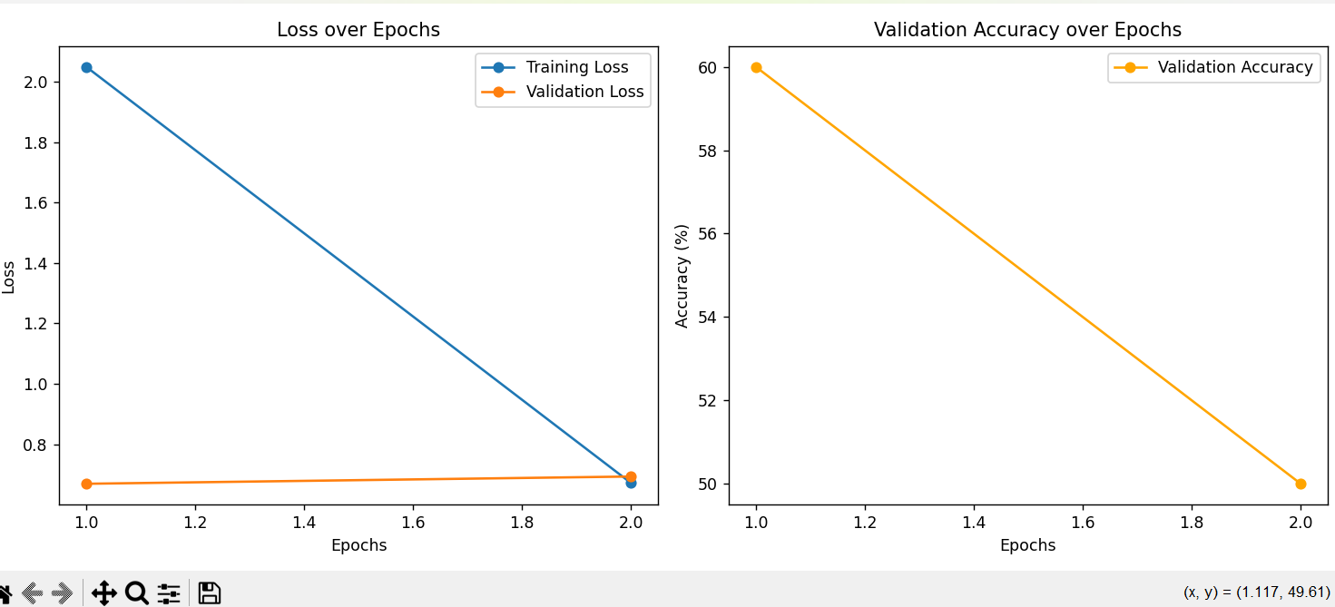

Slide 22
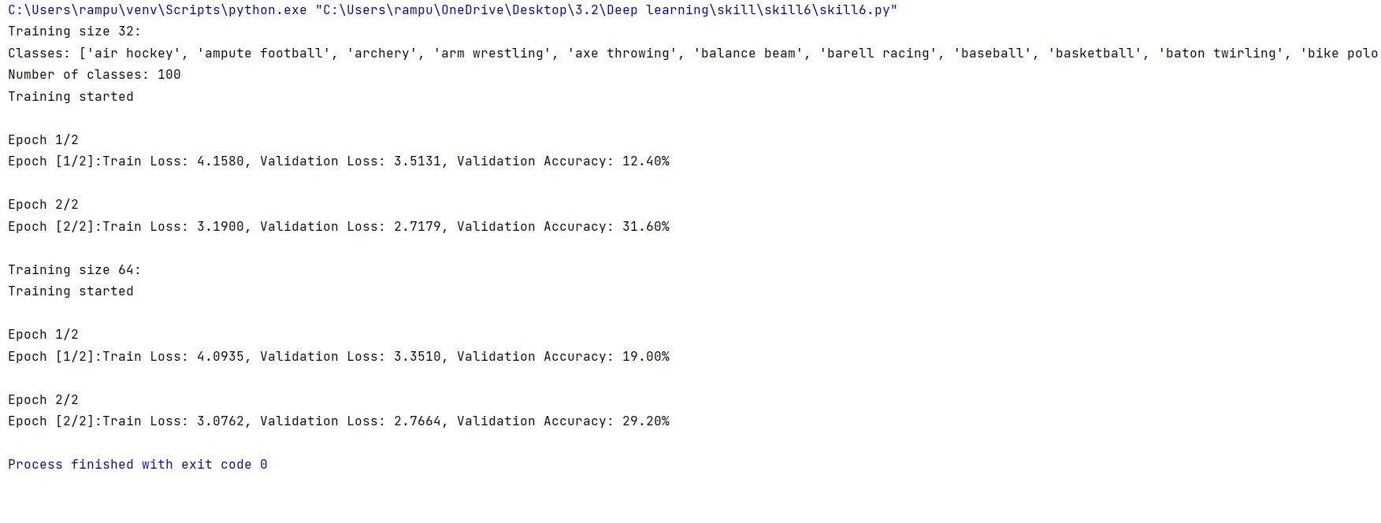
For 100 classes

Slide 23
CNN
def main(): device = torch.device("cuda" if torch.cuda.is_available() else "cpu") path_to_data = r'C:\Users\rampu\Downloads\Imagess' train_loader, val_loader, classes = pre.load_data(data_dir=path_to_data, batch_size=32, augment=False) pre.visualize_data(train_loader, classes, num_samples=5) num_classes = len(classes) model = cm.CNN(num_classes=num_classes) criterion = nn.CrossEntropyLoss() optimizer = optim.Adam(model.parameters(), lr=0.001) print("Training the model") trained_model = train_model(model, train_loader, val_loader, criterion, optimizer, device, num_epochs=10) if __name__ == "__main__": main()

Slide 24
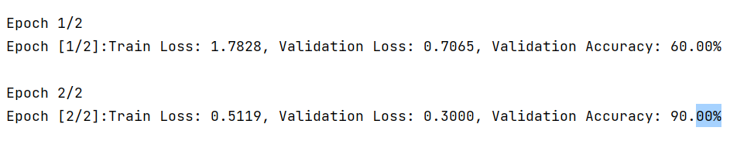
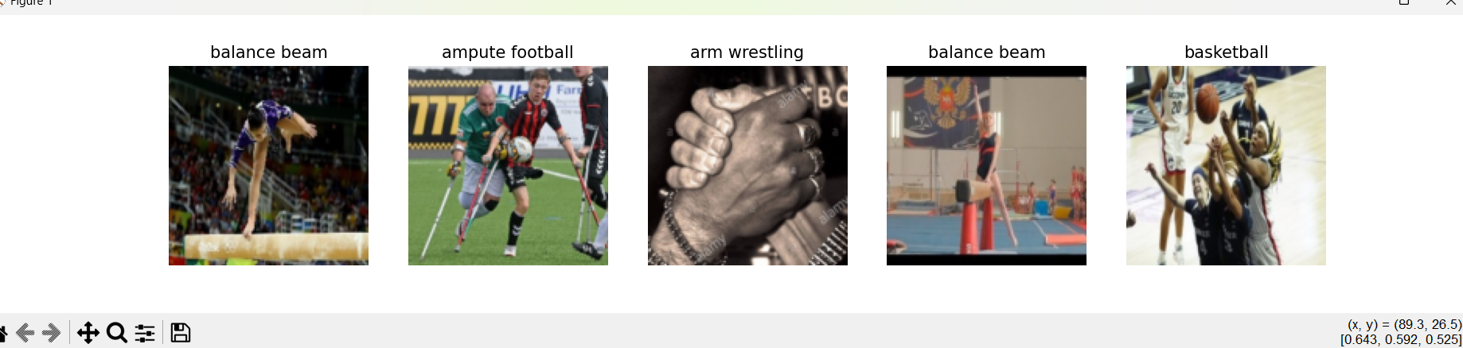
Output

Slide 25
Conclusion
In this project, we successfully implemented a 100 Sports Image Classification model using a Binary Sequential Model and various optimization techniques (Adam, SGD, RMSprop). The dataset, consisting of 14,493 high-quality images across 100 sports, was carefully processed to ensure a clean and unbiased training environment.
Key takeaways: ✅ Data Quality & Preprocessing: The dataset was well-prepared, ensuring no duplicate or low-quality images, improving model reliability. ✅ Model Architecture: A Binary Sequential Model was implemented for classification tasks, ensuring efficiency in learning features from the dataset. ✅ Optimization Techniques: Multiple optimizers (Adam, SGD, RMSprop) were tested to enhance model convergence and generalization. ✅ Mini-Batch Training: Random mini-batch evaluation was used to balance computational efficiency and model performance, helping prevent overfitting and improving training stability. ✅ Performance Analysis: The model’s accuracy and loss were evaluated across training, validation, and test datasets to ensure robustness and effectiveness.

