Slide 1
AUTISM DETECTION
USING
DEEP LEARNING

Slide 2
What is Autism?
Autism Spectrum Disorder (ASD) is a neurodevelopmental disorder characterized by a spectrum of symptoms.
It affects social interaction, communication, behavior, and sensory processing.
ASD typically appears in early childhood, often before the age of 3.
It is a lifelong condition, but early intervention and support can significantly improve outcomes.

Slide 3
Challenges faced currently
Heterogeneity: ASD presents as a wide spectrum with diverse symptoms, making diagnosis and treatment complex.
Late Diagnosis: Many individuals are diagnosed later in life, delaying crucial early interventions.
Subjectivity: Diagnosis relies on clinical assessments, which can vary among professionals.
Limited Resources: In some regions, access to specialized ASD diagnosis and intervention services is limited.

Slide 4
Need for DL techniques
Early Intervention: Early detection enables timely interventions and support, which can improve outcomes.
Objective Diagnosis: Deep Learning (DL) techniques can provide more objective and consistent diagnosis results.
Handling Complex Data: DL can process and analyze the vast and complex neuroimaging data associated with ASD.
Scalability: DL models can be trained on large datasets, essential for studying the heterogeneity of ASD.
Research Acceleration: DL can assist researchers in uncovering the neural bases of autism, advancing our understanding.

Slide 5
Methodology
Data Acquisition: The methodology starts with the collection of neuroimaging data, from ABIDE -I dataset, which includes functional and structural brain scans.
Data Preparation: This involves converting NIfTI files to DICOM format for compatibility with deep learning models. This is followed by DICOM to PNG conversion, extraction of informative slices.
Data Preprocessing: Raw data is preprocessed, which involves converting grayscale images into RGB images, resizing the images to standard 224x224, normalization using mean and standard deviation.
DCNN Model: A DCNN model is designed for feature extraction and classification. The model typically consists of multiple convolutional layers, each followed by activation functions like Leaky ReLU and Batch Normalization.

Slide 6
Data Acquisition
ABIDE Dataset: The Autism Brain Imaging Data Exchange (ABIDE) initiative provides a rich source of neuroimaging data for ASD research.
ABIDE-I: ABIDE-I is the first phase of the ABIDE initiative, involving 17 international sites and collecting resting-state functional magnetic resonance imaging (rs-fMRI), anatomical, and phenotypic datasets.
Large-Scale Samples: The ABIDE dataset comprises 1112 datasets, including 539 from individuals with ASD and 573 from typical controls, covering a broad age range (7-64 years).
Neuroimaging Data: The dataset includes functional and structural brain imaging data, which are crucial for understanding the neural bases of autism.

Slide 7
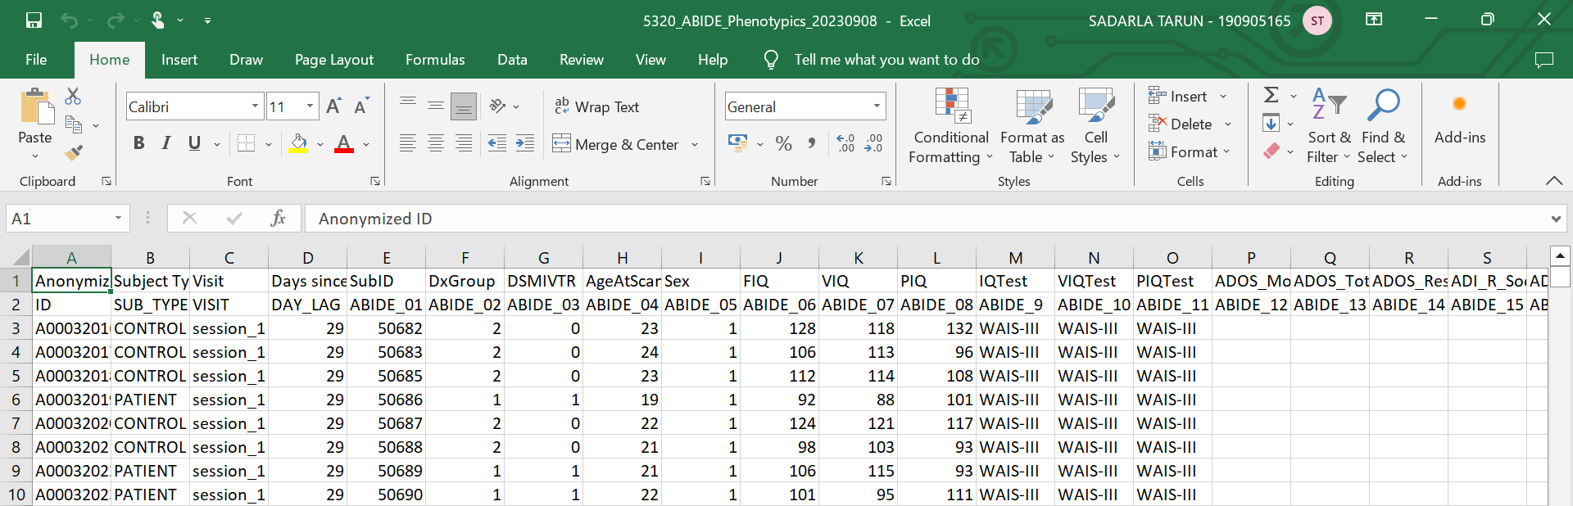

Slide 8
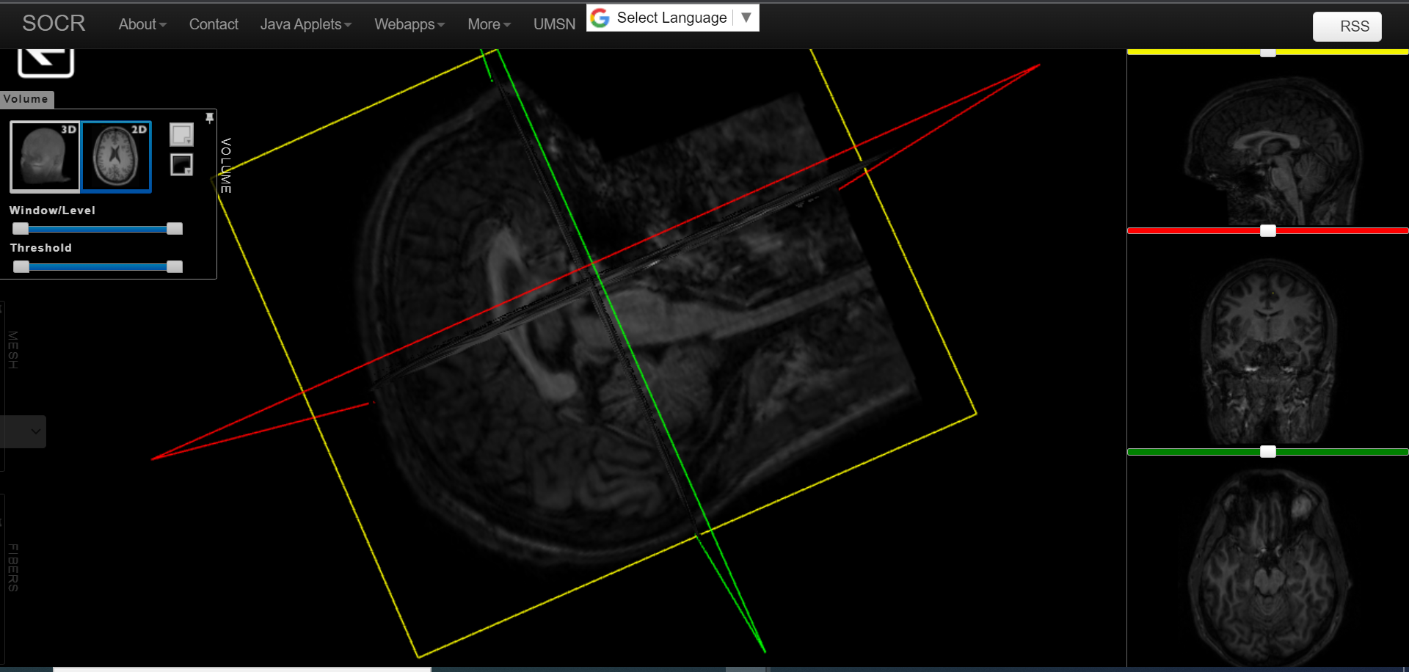

Slide 9
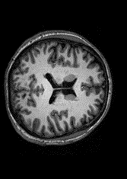

Slide 10
Data Preparation
Neuroimaging File Format: NIfTI is a standard file format used in neuroimaging for storing MRI and functional MRI (fMRI) data. It supports 3D and 4D data, allowing the storage of multi-dimensional brain imaging data.
Digital Imaging and Communications in Medicine: DICOM is a widely used standard for storing, transmitting, and sharing medical images, including MRI, CT, and X-ray scans. It supports the organization of images into series, which is crucial for medical diagnosis and treatment planning.
Converting NIfTI to DICOM is essential to overcome GPU memory limitations and efficiently train CNNs on large neuroimaging datasets.

Slide 11
Slice Extraction
It is essential to focus on specific cross-sectional views of 3D medical images, such as MRI scans.
It reduces computational complexity since processing the entire volume is resource-intensive.
Extracting relevant slices containing anatomical structures of interest simplifies the learning task for the model.
By isolating pertinent slices, noise and irrelevant information are minimized, enhancing model performance.

Slide 12
Data Preprocessing
Resizing is required to standardize image dimensions, making them compatible with the model's input size, thereby preventing computational issues.
Normalization is necessary to bring pixel values within a common range (usually [0, 1] or [-1, 1] ), preventing convergence problems during training.
Mean and Standard Deviation Normalization scales pixel values by subtracting the mean and dividing by the standard deviation. This reduces data distribution disparities and enhances convergence.

Slide 13
DCNN Model
It consists of five convolutional layers followed by max-pooling, batch normalization, dropout, and fully connected layers.
The Leaky ReLU activation function (with a slope of 0.1) is used after each convolutional layer.
Batch normalization is applied after the second, third, and fourth convolutional layers to improve training stability.
Dropout layers are used after each max-pooling operation to reduce overfitting (dropout rate = 20%).
The final layer is a fully connected layer with 100 neurons.

Slide 14
Loss and Optimizer
The project uses the Cross-Entropy Loss (CCE) as the loss function. It is commonly used for multi-class classification tasks but it can be used for binary classification too.
The project uses Adam optimizer with the following hyperparameters
Learning Rate (η): The learning rate determines the step size during gradient descent. A value of 0.001 is chosen, which is commonly used for training deep neural networks.
Beta1 (β1): The first moment (mean) decay rate for the Adam optimizer is set to 0.9. This parameter influences the exponential moving average of gradients.
Beta2 (β2): The second moment (uncentered variance) decay rate for the Adam optimizer is set to 0.999. This parameter influences the exponential moving average of squared gradients.
Epsilon (ε): A small constant (1e-7) is added to the denominator in the Adam optimizer to prevent division by zero and numerical instability.

Slide 15
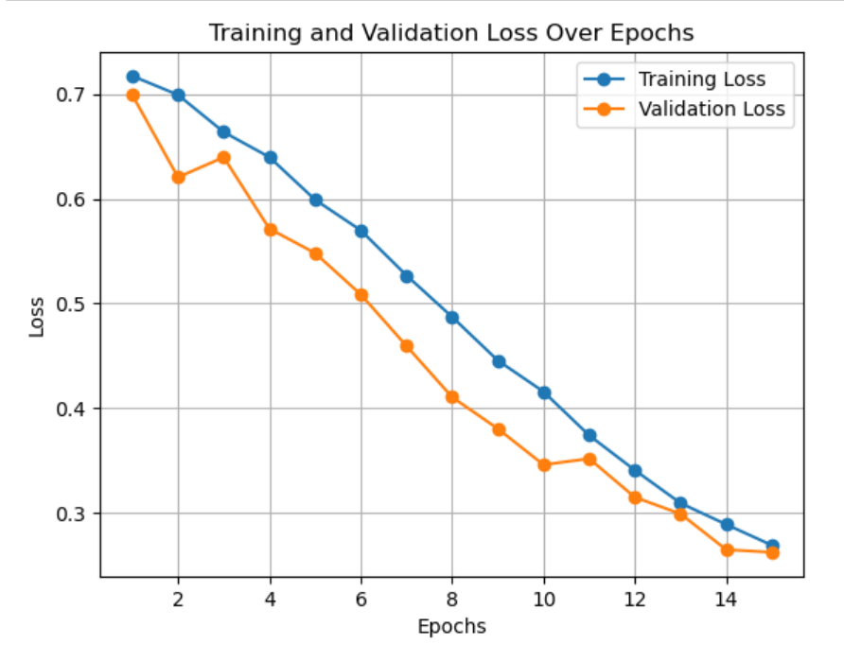
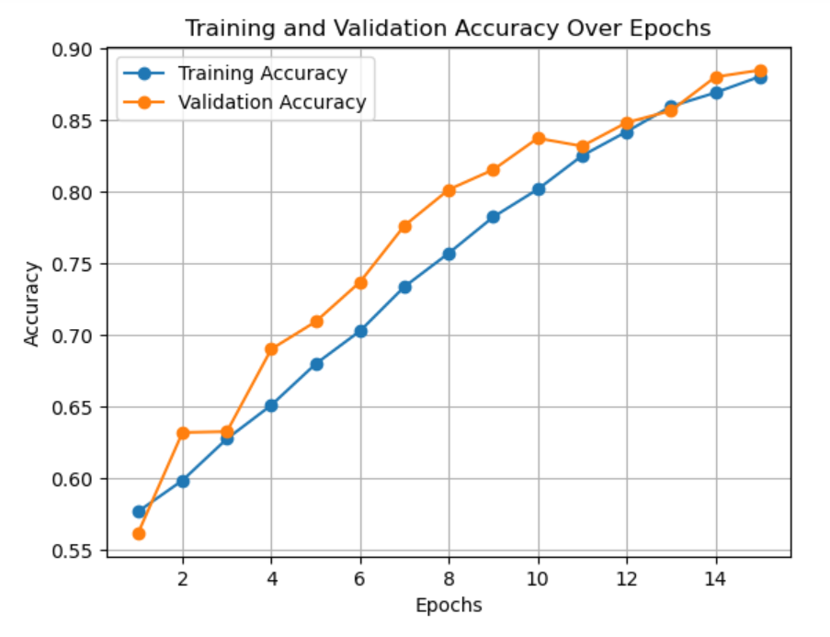
Results

Slide 16
Future work of this project
Main Goal:
Implement a novel transformer model for the project, marking a unique approach in the field of autism detection using deep learning techniques.
Additional Goals:
Test a new methodology for slice extraction, leveraging pretrained ResNet models and extracting the most relevant and informative slices and implement if successful.
Incorporate early stopping mechanisms to prevent overfitting during model training, enhancing the model's generalization capabilities.

Slide 17
THANK YOU

