Slide 1
Deployable Histopathologic Cancer Detection System
Using Deep Learning on Patch-Based Lymph Node Images
Project Manager: Ramyasri Murugesan

Slide 2
Project Overview
Objective: Develop a deployable deep-learning model capable of accurately detecting cancerous regions in histopathologic lymph node images.
Dataset: Utilize image data from Kaggle competition, which consists of 277,483 (96x96 pixel) RGB images of lymph node sections, labeled as cancerous or non-cancerous containing 220,025 training images, and 57,458 testing images.
Models: Employ custom convolutional neural networks (CNNs) and a hybrid CNN- Vision Transformer (ViT) model to process the patch-based images, extracting features and classifying them with high accuracy.
Deployment: Implement the model on cloud platforms using AWS and deploy it through a web interface.
Recording Link: https://drive.google.com/drive/folders/1oYalLjO8AzuRX7https://drive.google.com/drive/folders/1oYalLjO8AzuRX7vOV75bYSnFinFZQ6hu?usp=sharingvOV75bYSnFinFZQ6hu?usp=sharing

Slide 3
Roles
Project Manager - Ramyasri Murugesan
Feature Engineering and Data Preprocessing Specialist - Ziya Mubeen Ahmed Mohammed
Model Developer 1 - Tarun Sadarla
Model Developer 2 - Abdul Rafay Mohd
Deployment Specialist - Darshan Rohit Karkera

Slide 4
Responsibilities
Define project scope, objectives, and deliverables, ensuring alignment with overall goals.
Assign tasks to team members based on skills and capacity, managing time and resources efficiently.
Identify and address risks, mitigating potential issues and solving conflicts as they arise.
Make key decisions to steer the project, ensuring milestones are met and the project stays on track.
Monitor progress throughout the project lifecycle, guiding it from initiation to successful closure.

Slide 5
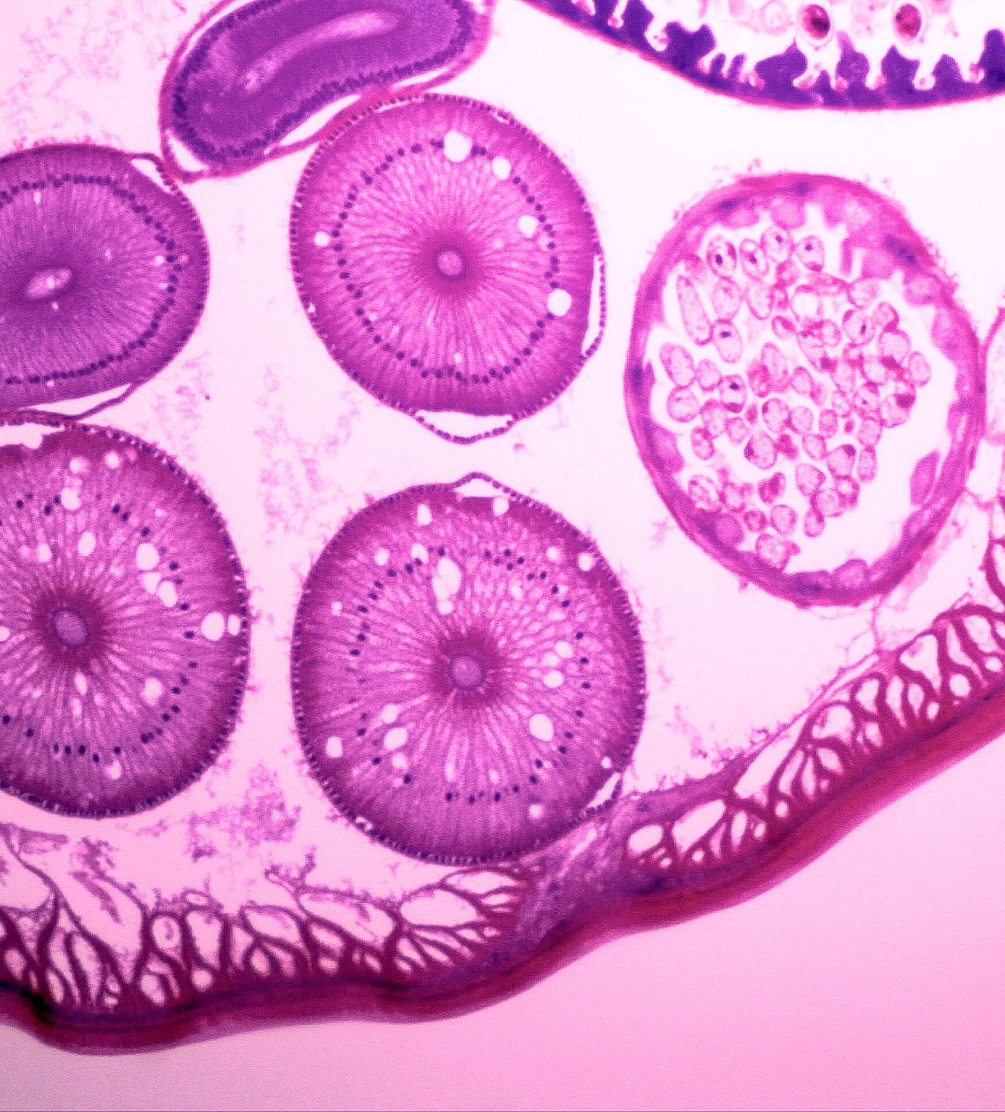
Histopathalogical Cancer Detection
Ziya Mubeen Ahmed – Handling Data-Preprocessing and Feature Engineering.

Slide 6
Exploratory Data Analysis
Dataset Structure:
Reviewed 32x32 pathology image center patches with corresponding labels.
Slight class imbalance (55% non-cancerous, 45% cancerous).
Visualization: Random image samples are visualized to ensure quality.
Class Distribution: Cancer vs. non-cancer cases plotted and analyzed.

Slide 7
Data Preprocessing
Resizing: All images are resized to a standard 32x32 dimension.
Normalization: Pixel intensities normalized to the 0-1 range.
Data Augmentation:
Applied techniques like rotations, flips, and zooming.
Helps expand the dataset and reduce overfitting.

Slide 8
Feature Engineering
Transfer Learning: Planning to use pre-trained models like ResNet or InceptionV3.
Custom Features: Investigated color/texture-based features for further insights.
Next Step: Feature extraction via transfer learning for model input.

Slide 9
Deployable Histopathologic Cancer Detection System Using Deep Learning on Patch-Based Lymph Node Images
Model Developer 1: Tarun Sadarla

Slide 10
Convolutional Neural Network Architecture
Five convolutional layers with increasing filter sizes (16, 32, 64, 128, 256) using 3x3 kernels, each followed by Leaky ReLU activations and dropout for regularization.
Max-pooling layers after each convolutional block, with a 2x2 window to reduce spatial dimensions.
Batch normalization layers applied after every convolutional layer starting from second layer to stabilize training.
Dropout layers with a 20% dropout rate to prevent overfitting.
Fully connected layer with 100 neurons following a flattening of the feature maps from the final convolutional layer.

Slide 11
Optimization and Metrics
Adam Optimizer with starting learning rate = 0.01, beta1 = 0.9, beta2 = 0.999, and epsilon = 1e-7.
Further NAdam and RMSProp will also be used to compare and see which Optimizer gives best results.
Binary Cross-Entropy Loss for binary classification tasks.
Accuracy, Precision, Recall, Specificity, F1 Score, ROC-AUC are the various metric this model will be evaluated on.
Confusion Matrix will be used for visualizing classification performance.

Slide 12
Explainable AI
Explainable AI (XAI) aims to make machine learning model’s decisions more transparent and understandable to humans.
Grad-CAM generates heatmaps to highlight the regions of an image that contribute most to the model's decision, providing insight into what the model is focusing on.
By visualizing the model's attention areas, Grad-CAM helps understand how the model distinguishes between cancerous and non-cancerous tissues.

Slide 13
Ensemble Method for Histopathological Image Classification Using CNN and Vision Transformer
Model Developer 2: Abdul Rafay Mohd

Slide 14
Introduction:
Objective: Enhance histopathological image classification by combining Convolutional Neural Networks (CNNs) and Vision Transformers (ViTs) in an ensemble approach.
Dataset: Histopathological patches (32x32) from Kaggle's "Histopathologic Cancer Detection" competition.
Initial Training: The model will be trained on a random sample of 20,000 images.
Future Plans: If the model performs well, it will be retrained on the entire dataset.

Slide 15
Model Architectures
Convolutional Neural Network (CNN):
Architecture:
Input: 32x32 image patches
Layers:
Conv1: 32 filters, 3x3 kernel
Conv2: 64 filters, 3x3 kernel
Conv3: 128 filters, 3x3 kernel
MaxPooling: Reduces dimensions
Fully Connected: Linear layer with 512 units
Output Layer: Classification (e.g., cancer or non-cancer)
Key Points: Suitable for small patches, hierarchical feature extraction.

Slide 16
Vision Transformer (ViT):
Architecture:
Input: 32x32 image patches
Patch Size: 8x8
Embedding:
Patch Embedding: Converts patches to embeddings
Class Token: Added for classification
Positional Encoding: Adds spatial information
Transformer Layers: Multiple encoder layers
MLP Head: Classification layer
Key Points: Captures global context and long-range dependencies.

Slide 17
Training and Evaluation
Ensemble Model:
Combining CNN and ViT:
Inputs: Pass image patches through CNN and ViT.
Outputs: Combine outputs by averaging predictions.
Advantages: Leverages strengths of both models for improved accuracy.
Training and Testing:
Initial Training:
Dataset: Random sample of 20,000 images
Data Augmentation: Not applied (32x32 patches directly used).
Loss Function: CrossEntropyLoss
Optimizer: Adam
Epochs: 10 (adjustable)
Performance Evaluation:
Metrics: Accuracy
Testing Results: Provide sample results (e.g., Accuracy: 85%)
Future Steps:
Full Dataset Retraining: If the model performs well on the sample, it will be retrained on the entire dataset.

Slide 18
Histopathologic Cancer Detection System Documentation
Using AWS, Django, and ReactJS
Deployment Specialist: Darshan Rohit Karkera

Slide 19
System Architecture
Amazon S3: Store image data
Amazon EC2: Host application and ML model
Django: Backend API
ReactJS: User Interface
Gunicorn: WSGI HTTP Server for Django

Slide 20
Deployment Strategy
EC2 Setup with AMI including necessary libraries
Configure Gunicorn and Django
Establish CI/CD pipeline using AWS CodePipeline and CodeBuild

Slide 21
THANK YOU!

