Slide 1
LIFEQR 2.0: DEEP SYSTEM ARCHITECTURE
Engineering Upgrades, Edge IoT Schematics & Enterprise Clinical Scaling Blueprint
Comprehensive technical strategy to make LifeQR an uncompromised real-world reality: Anti-cloning cryptographic NFC, offline-first encrypted payloads, motorcycle crash beacons, FHIR v4 clinical integration, and intelligent trauma bay resource matching.
HARDWARE SPECIFICATIONS • IOT NETWORK TOPOLOGY • ENTERPRISE ROADMAP

Slide 2
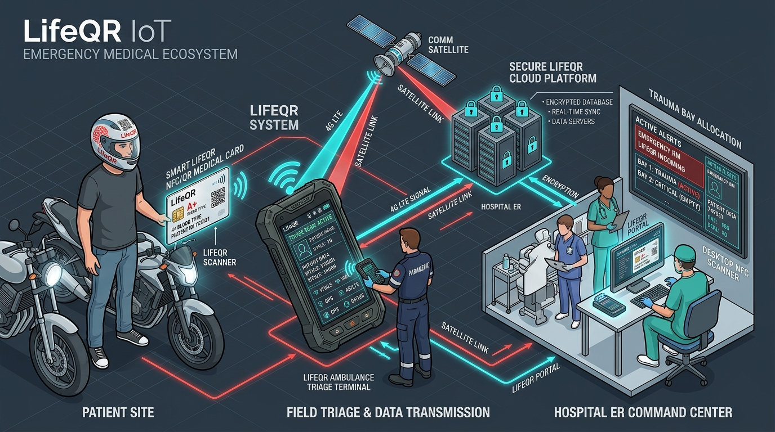
● LIFEQR 2.0 ARCHITECTURE BLUEPRINT | SYSTEM TOPOLOGY
End-to-End Connected IoT Architecture
4-Tier physical-to-cloud resilience from street crash to trauma bay
■ Tier 1: Physical Citizen Edge
NTAG 424 DNA smart cards, 3M helmet decals, and IMU crash beacons. Zero power, permanent passive operation.
■ Tier 2: Field Responder Gateway
Rugged ambulance terminal with dual NFC/2D optical engine, offline SQLite cache, 4G LTE-M & satellite fallback.
■ Tier 3: Cloud & Dispatch Core
Microservices event bus (Socket.IO/Kafka), PostGIS spatial proximity routing, zero-knowledge AES-256 GCM vault.
■ Tier 4: Clinical Triage & Hospital ER
HL7/FHIR v4 EHR interoperability, doctor desktop USB cradle, and live incoming trauma bay reservation radar.

Slide 3
● LIFEQR 2.0 ARCHITECTURE BLUEPRINT | UPGRADE 01: SECURITY
Cryptographic Anti-Cloning NFC (NTAG 424 DNA)
Eliminating credential duplication and identity spoofing with rolling cryptographic signatures
PROBLEM IDENTIFIED
The Vulnerability in Basic NFC
Standard NFC cards (NTAG213) store static NDEF URLs that can easily be duplicated by any consumer smartphone NFC cloner app, posing serious patient identity fraud risks.
ENGINEERING FIX
The NTAG 424 DNA Solution
Upgrading to NXP NTAG 424 DNA chips utilizing Secure Unique NFC (SUN) with AES-128 cryptographic rolling CMAC (Cipher-based Message Authentication Code).
TECHNICAL MECHANISM
Dynamic Rolling CMAC Token
Every single tap generates a cryptographically unique URL with an incrementing interaction counter and dynamic MAC: `https://lifeqr.org/e/?c=00042&m=A9B4C2...`. Impossible to copy or replay.
SECURITY GUARANTEE
Zero-Knowledge Cloud Verification
LifeQR backend verifies the cryptographic signature against the card's master key in real time. Spoofed or cloned cards are instantly flagged and rejected.

Slide 4
● LIFEQR 2.0 ARCHITECTURE BLUEPRINT | UPGRADE 02: RELIABILITY
Offline-First Operation & Satellite Fallback
Solving the highway dead zone: 100% triage uptime with zero cellular connectivity
REAL-WORLD CHALLENGE
Highway Dead Zones
Accidents frequently happen on expressways, mountain passes, and rural roads with 0% cellular signal. Cloud-only architectures fail catastrophically in these moments.
ON-CARD EDGE CACHE
Encrypted On-Card Vitals (EEPROM)
Store a compact 512-byte AES-encrypted binary payload directly inside the card's chip memory (Blood Group, Top 3 Allergies, Chronic Conditions, ICE Phone). The ambulance terminal reads and decrypts it locally in < 0.1s with zero internet.
LOCAL EDGE INTELLIGENCE
Terminal Offline SQLite Database
The ambulance terminal maintains an onboard encrypted local database of regional emergency protocols, drug interactions, and hospital coordinates updated daily via Wi-Fi.
SATELLITE REDUNDANCY
Satellite & LoRa Mesh SOS Fallback
When cellular fails, the terminal automatically falls back to LoRa P2P emergency mesh or direct satellite burst (Iridium / Starlink Direct-to-Cell) to transmit critical coordinates and victim triage.

Slide 5
● LIFEQR 2.0 ARCHITECTURE BLUEPRINT | UPGRADE 03: PROACTIVE DETECTION
Autonomous IoT Motorcycle Crash Sensor Beacon
Detecting unwitnessed crashes and unconscious rider e-calls automatically
★ The Unwitnessed Highway Crash Dilemma
If a rider is ejected 50 feet into a roadside trench at night, nobody knows a crash occurred. Waiting for passerby discovery guarantees Golden Hour mortality.
★ Micro IoT Crash Sensor Architecture
A coin-cell powered BLE 5.3 beacon with integrated 6-axis IMU (Bosch BMI270 accelerometer + gyroscope) mounted inside the helmet or on the bike frame.
★ High-G Impact Algorithm (>15G)
Firmware detects violent deceleration (>15G impact) followed by zero movement, rejecting false positives (e.g. dropping helmet on a table).
★ Automatic Bystander & Cellular E-Call
Automatically wakes up and transmits high-priority BLE emergency advertisement with rider LifeQR ID, triggering automated emergency dispatch.
HARDWARE BEACON SPECIFICATIONS
• Form Factor:
Coin-sized IP68 waterproof disc (32mm diameter x 6mm thick, 14 grams)
• Battery Life:
CR2032 Lithium cell with ultra-low sleep current (2.1 years standby life)
• Crash Detection:
Multi-stage shock threshold: >15G impact + angular rotation + 30s stillness
• BLE Beacon Protocol:
Apple FindMy / Google Fast Pair compatible emergency advertising payload
• Dual Identity Link:
Directly linked to rider's LifeQR Smart Medical ID card and helmet decal

Slide 6
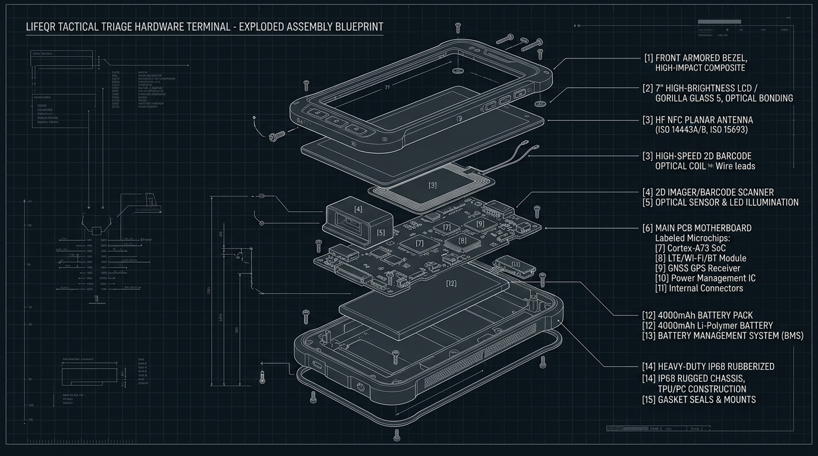
● LIFEQR 2.0 ARCHITECTURE BLUEPRINT | HARDWARE ENGINEERING
Tactical Triage Terminal: Exploded Architecture
Layer-by-layer industrial assembly design for ambulance field reliability
[1] Armored Bezel
High-impact polycarbonate composite with recessed bezel protecting screen against face-down drops on asphalt.
[2] Sunlight IPS Display
Optical-bonded Gorilla Glass 5, 800 nits high-brightness LCD readable in direct midday sunlight.
[3] Planar NFC Antenna
Tuned 13.56 MHz loop antenna designed for omnidirectional card reads from 0-45mm distance.
[4] 2D Optical CMOS Imager
Industrial high-speed camera engine with red targeting reticle for decoding smeared/bloody QR codes.
[5] Multi-Layer PCB Motherboard
ESP32-S3 SoC, Quectel 4G LTE-M modem, GNSS GPS receiver, and ATECC608A crypto element.
[6] Heavy-Duty IP68 Chassis
Overmolded TPU rubber bumpers with hermetic gasket seals resisting decontamination wipes.

Slide 7
● LIFEQR 2.0 ARCHITECTURE BLUEPRINT | SCHEMATICS & BOM
Circuit Architecture & Component Breakdown
Rigorous hardware bill of materials engineered for volume manufacturing
Power Management (PMIC)
• TI BQ25895 PMIC
High-efficiency switch-mode charger with USB Type-C Power Delivery (5V/9V 18W fast charging).
• Dual Battery System
Main 4000mAh Li-Po (18h continuous duty) + 120mAh backup cell enabling hot-swap capability.
• Inductive Qi Dock
15W wireless charging receiver integrated into vehicle mounting dock for automatic top-up.
Processing & Security Core
• ESP32-S3-WROOM-1
Dual-Core Xtensa LX7 @ 240MHz, 8MB Flash, 8MB PSRAM, hardware AES/SHA engine.
• Microchip ATECC608B
Dedicated hardware secure element for storing private cryptographic device certificates.
• Secure Boot & OTA
RSA-3072 signature verification preventing malicious firmware modification in the field.
Sensory & RF Front-End
• NXP PN532 NFC Module
13.56 MHz RF transceiver supporting ISO14443A/B, FeliCa, and active card emulation.
• Newland NLS-EM20-80
Compact 2D CMOS imaging sensor with 60fps continuous scanning and diffuse LED illumination.
• Quectel EC200U LTE
Global Cat-1 LTE-M / NB-IoT with multi-constellation GNSS (GPS, GLONASS, BeiDou).

Slide 8
● LIFEQR 2.0 ARCHITECTURE BLUEPRINT | UPGRADE 04: INTEROPERABILITY
Clinical Integration: HL7 & FHIR v4 Gateway
Zero-friction bridge to hospital Electronic Health Records (Epic, Cerner, OpenEMR)
INDUSTRY BOTTLENECK
The EHR Fragmentation Barrier
Hospitals run proprietary, walled-off EHR systems (Epic Systems, Oracle Cerner, Allscripts, Meditech). Custom proprietary integrations cost millions and delay hospital adoption.
STANDARDIZED CORE
Standardized FHIR v4 Native Export
LifeQR backend exports standardized JSON FHIR v4 resources (`Patient`, `AllergyIntolerance`, `Condition`, `MedicationStatement`, `Encounter`), immediately readable by any modern hospital system.
SEAMLESS INTAKE
1-Click ER Triage Ingestion
When an ambulance arrives, the triage nurse clicks 'Import LifeQR Handover'. Patient demographics, vitals, and surgical alerts auto-populate the hospital chart with zero manual typing.
ZERO-IT OVERHEAD
Driverless Doctor USB Cradle (HID)
The doctor desktop scanner operates as a driverless USB HID keyboard wedge and smart card reader (CCID), working instantly on any hospital Windows/Linux terminal without IT installation barriers.

Slide 9
● LIFEQR 2.0 ARCHITECTURE BLUEPRINT | UPGRADE 05: AI DISPATCH
Resource-Aware Intelligent Trauma Bay Routing
Moving beyond simple GPS distance to match patient trauma with hospital capabilities
FATAL DELAY
Traditional Flawed Routing
Ambulances blindly rush to the geographically nearest hospital, only to find the hospital has no open trauma bay, no on-duty neurosurgeon, or zero O-negative blood units.
SMART MATCHING
LifeQR Resource Matching Algorithm
Our cloud dispatch engine analyzes both patient clinical state (e.g. severe head trauma, low BP) and live hospital telemetry feeds to identify the optimal resuscitation facility.
HOSPITAL TELEMETRY
Real-Time ER Capability Telemetry
Hospital ER dashboards broadcast live operational availability: Open Resuscitation Bays (1-4), CT Scanner readiness, Cath Lab on standby, and Blood Bank inventory.
RESERVATION PROTOCOL
Automated Trauma Bay Reservation
En route, the ambulance terminal sends an authenticated reservation token. Trauma Bay 1 is locked, surgical staff notified, and blood units thawed before the ambulance siren arrives.

Slide 10
● LIFEQR 2.0 ARCHITECTURE BLUEPRINT | UPGRADE 06: EMERGENCY INTEGRATION
Government CAD & Public Emergency Gateway
Bridging LifeQR directly into municipal 911 / 112 / 108 Computer-Aided Dispatch
✔ Direct CAD Webhook Gateway
Standardized RESTful webhook adapter connecting LifeQR events directly with legacy CAD systems (Motorola Solutions PremierOne, Hexagon OnCall, Intergraph CAD).
✔ Automated 911 Call Enrichment
When a bystander or patient triggers an SOS, the LifeQR CAD integration automatically enriches the 911 operator's console with precise GPS coordinates, caller name, blood group, and medical flags.
✔ Multi-Agency Dispatch Sync
Synchronizes police, fire rescue, and medical EMS dispatch simultaneously, ensuring all first responders have identical incident awareness.
✔ Automated SMS/WhatsApp ICE Broadcast
Emergency contacts (spouses, parents) receive automated geographic SMS alerts with live map tracking link and emergency hotline numbers.
INCIDENT CAD DATA FLOW
↓ 1. SOS / Crash Triggered
IMU sensor or bystander QR scan
↓ 2. Cloud CAD Dispatcher
Enriches call with LifeQR medical data
↓ 3. Municipal 911 / 112 Console
Operator dispatches nearest EMS unit
↓ 4. Ambulance Terminal Receives
Navigates to GPS pin with triage ready
↓ 5. Receiving Hospital Notified
Trauma bay prepared before arrival

Slide 11
● LIFEQR 2.0 ARCHITECTURE BLUEPRINT | SECURITY & COMPLIANCE
Zero-Trust Privacy & Tiered Access Governance
Complying with HIPAA, GDPR, and medical confidentiality standards
Tier A: Public / Bystander
Scanning with standard phone camera shows only life-critical data: Blood Group, Emergency ICE Contacts (1-tap dial), and severe anaphylaxis warning. Zero personal identity or addresses leaked.
Tier B: First Responder (EMS)
Paramedic authenticated terminal unlocks detailed clinical profile: active prescriptions, recent surgeries, cardiac history, and specialized emergency physician directives.
Tier C: Verified Hospital Physician
Doctor desktop terminal unlocks full clinical consultation notes, past diagnostic lab reports, AI differential insights, and prescription safety validator history.
Cryptographic Audit Trail
Every tap or scan is cryptographically signed, timestamped, and geotagged. Immutable audit logs recorded in compliance with HIPAA Section 164.312.

Slide 12
● LIFEQR 2.0 ARCHITECTURE BLUEPRINT | COMMUNITY ARCHITECTURE
School District & Pediatric Safety Network
Protecting students with chronic illness (asthma, epilepsy, diabetes, nut allergies)
Central Campus Safety Portal
School administrators and registered school nurses manage enrolled students with documented medical conditions through a specialized LifeQR School Safety Dashboard.
Backpack Tags & Wearable Wristbands
Every student carries an NFC/QR tag attached to their school backpack and silicone sports band for playground and gym activities.
Immediate Bystander Action Protocol
If a child faints or suffers a seizure, teachers, bus drivers, or classmates tap the badge to see instant emergency instructions (e.g. 'Turn on side, do not restrain, administer EpiPen from left pouch').
Instant Parent & School Nurse SOS
Scanning triggers instant automated SMS & phone dispatch to parents and campus first aid personnel with the child's exact playground GPS coordinates.

Slide 13
● LIFEQR 2.0 ARCHITECTURE BLUEPRINT | FINANCIAL FEASIBILITY
Manufacturing Scale & Component Unit Economics
Sustainable cost structure designed for massive grassroots and institutional adoption
Smart NFC Card (NTAG 424)
• Unit BOM Cost: $0.45 • Retail Price: $2.50 • Gross Margin: 82% • Durable PVC/metal composite with laser QR etching.
3M Reflective Helmet Decal
• Unit BOM Cost: $0.18 • Retail Price: $1.50 • Gross Margin: 88% • Weatherproof, gasoline-resistant retroreflective vinyl.
Ambulance Tactical Terminal
• Hardware BOM Cost: ~$68.00 • Fleet Lease: $25 / month • Payback Period: 3.2 Months • High recurring SaaS/HaaS margin with support.
Doctor Desktop USB Cradle
• Hardware BOM Cost: ~$16.50 • One-Time Price: $35.00 • Plug-and-play USB/BLE cradle for clinic desks.

Slide 14
THE LIFEQR 2.0 ARCHITECTURAL ROADMAP
From Digital Proof-of-Concept to Real-World Physical Lifeline
1. Prototyping (M1-M3): Fabricate ESP32-S3 + NXP PN532 custom PCB & 500 NTAG 424 DNA cards. 2. Field Pilot (M4-M6): Equip 20 municipal ambulance units & 5 trauma bay desktop cradles. 3. School & Biker Rollout (M7-M10): 10,000 student bag tags & motorcycle helmet community decals. 4. Statewide Emergency CAD (M11+): Direct integration with 911 / 112 national emergency infrastructure.
ENGINEERING PARTNERSHIP & INVESTOR CONTACT: engineering@lifeqr.org

