Slide 1
LIFEQR: REAL-WORLD CONNECTED EMERGENCY ECOSYSTEM
Saving Lives as Quick as Possible: Unified Patient, Paramedic, and Hospital Doctor Network
An end-to-end physical-to-digital lifesaver: • Patient: 1-Tap SOS, Universal Medical Passport (Gov & Private), Hybrid NFC/QR Smart Card • Paramedic Crew: Tactical Handheld Terminal, Unrecognizable Biker Triage, Offline Vitals Decryption • Hospital & Doctor: Advance Arrival Telemetry, Receptionist Validation, Desktop Cradle & Doctor Transfers
EXECUTIVE PITCH • FULL-STACK PROCESS ARCHITECTURE • HARDWARE SPECIFICATIONS

Slide 2
● LIFEQR MASTER ECOSYSTEM | CORE MISSION
The Real-World Crisis: The Golden Hour Dilemma
Why speed is the single deciding factor between survival and preventable death
CRITICAL WINDOW
The 'Golden Hour' Reality
Trauma mortality spikes by over 300% if surgical resuscitation is delayed beyond the initial 60 minutes after severe impact.
PATIENT VOID
70% Unconscious Victims
Accident victims, seizing students, or stroke patients cannot speak, communicate allergies, or unlock their phones.
BIKER DANGER
Unrecognizable Biker Accidents
High-speed highway crashes leave riders unconscious with heavy gear on; removing helmets risks fatal spinal severance.
HOSPITAL DELAY
Disconnected ER Desks
Ambulances rush to clinics only to discover no open trauma bay or on-duty surgeon is ready, wasting vital minutes.

Slide 3
● LIFEQR MASTER ECOSYSTEM | STAKEHOLDERS
The 3 Stakeholder Roles in LifeQR
Empowering patients, paramedics, and doctors in a continuous lifesaver loop
1. CITIZEN & PATIENT
Universal Medical Passport
• 1-Tap SOS sends precise GPS to nearby ambulances. • Hybrid NFC/QR card carried in wallet. • Helmet decals for riders; bag tags for children. • Accepted across any Government or Private hospital with zero clinical confusion.
2. PARAMEDIC & AMBULANCE
Tactical Triage Crew
• Rugged handheld device for driver & nurse. • Instant 0.2s dual NFC/QR scan of unconscious victims. • Offline on-card EEPROM decryption of blood group & allergies. • Live GPS hospital detection & en route reception validation.
3. DOCTOR & HOSPITAL
Clinical Reception & Care
• Desktop USB/BLE scanner cradle for 1-tap intake. • Advance notification desk: validates doctor availability. • Trauma Bay 1 lockout & blood bank staging. • Seamless doctor-to-doctor transfer and referral channel.

Slide 4
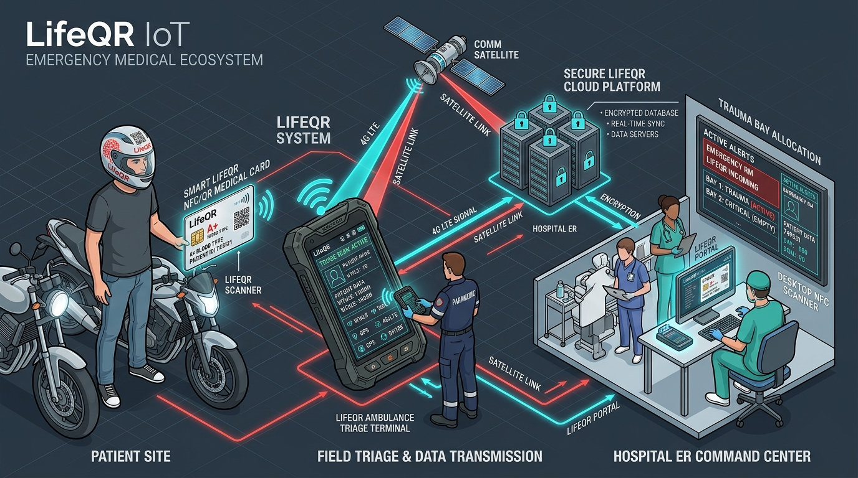
● LIFEQR MASTER ECOSYSTEM | SYSTEM TOPOLOGY
Full-Stack Connected Emergency Ecosystem
The physical-to-cloud infrastructure uniting citizen, responder, and trauma center
THE 4-TIER ARCHITECTURE
■ Tier 1: Citizen Physical Edge
NTAG 424 DNA smart cards, 3M helmet decals, and IMU crash beacons. Zero battery, permanent passive operation.
■ Tier 2: Tactical Responder Gateway
Rugged ambulance terminal with dual NFC/2D optical engine, offline SQLite cache, 4G LTE-M & satellite fallback.
■ Tier 3: Cloud & Dispatch Core
Microservices event bus (Socket.IO/Kafka), PostGIS spatial proximity routing, zero-knowledge AES-256 GCM vault.
■ Tier 4: Clinical Hospital ER
HL7/FHIR v4 EHR interoperability, doctor desktop USB cradle, and live incoming trauma bay reservation radar.

Slide 5
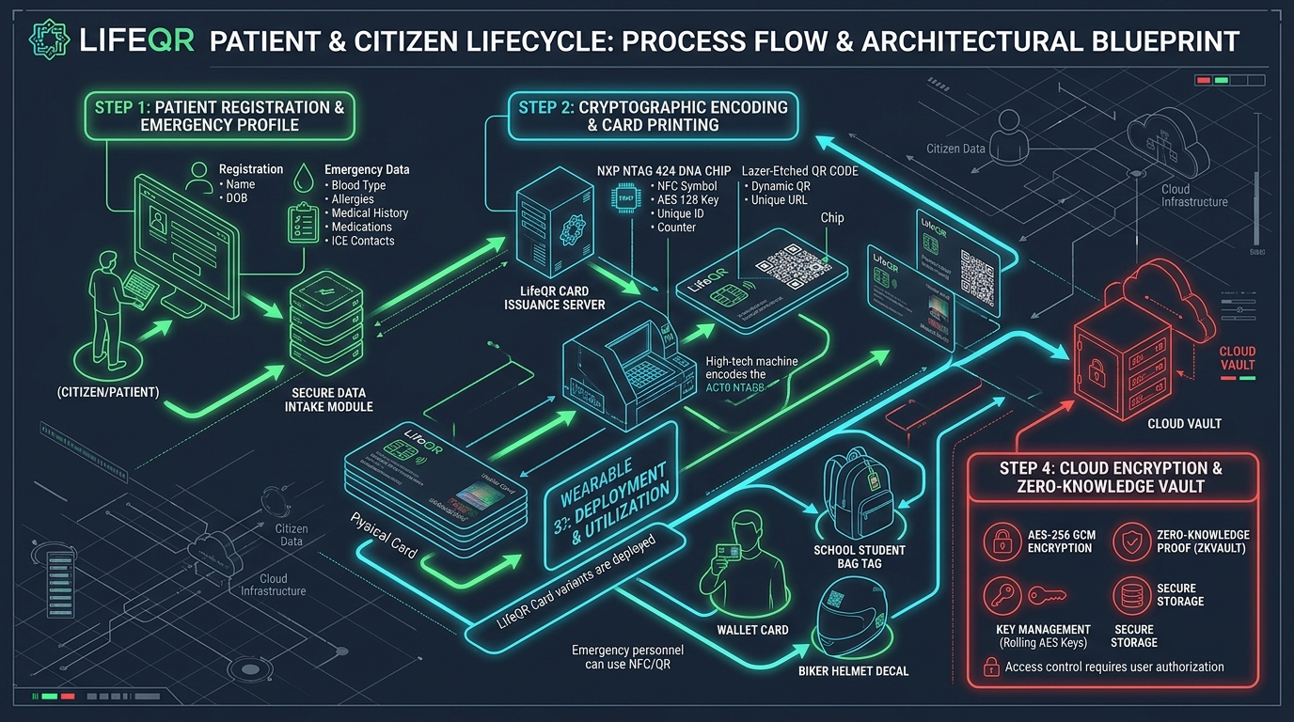
● LIFEQR MASTER ECOSYSTEM | PROCESS ARCHITECTURE 01
Patient & Citizen Lifecycle Blueprint
Registration, NTAG 424 DNA chip encoding, laser QR printing, and zero-knowledge encryption
PROCESS 1 HIGHLIGHTS
✔ Step 1: Intake
Blood group, allergies, chronic ailments, and primary ICE contacts recorded.
✔ Step 2: NTAG 424 DNA
Card issuance encoder writes rolling AES-128 SUN keys to prevent counterfeiting.
✔ Step 3: Wearables
Wallet card, helmet decal, and student backpack tag deployed.
✔ Step 4: Vault
Data secured via AES-256 GCM client-side encryption.

Slide 6
● LIFEQR MASTER ECOSYSTEM | UNIVERSAL PASSPORT
The Universal Hospital Medical Passport
One physical identity card working seamlessly across any government or private clinic
SEAMLESS MOBILITY
Zero Hospital Walled Gardens
Patients visit free public/government hospitals, private specialist centers, or urgent care clinics with identical zero-friction access.
ELIMINATING CONFUSION
Instant Historical Medical Pre-View
Doctors instantly view past surgery notes, chronic diseases, previous lab scans, and lifestyle alerts, eliminating diagnostic confusion.
SAVING EXPENSE & TIME
Zero Redundant Tests
Prevents duplicate blood panels, redundant X-rays, or unnecessary MRI delays, dramatically reducing healthcare costs and treatment delays.
PRIVACY BY DESIGN
Patient-Controlled Consent
Patient decides what data is shared; emergency profile is public, while full clinical consultation charts require patient authentication.

Slide 7
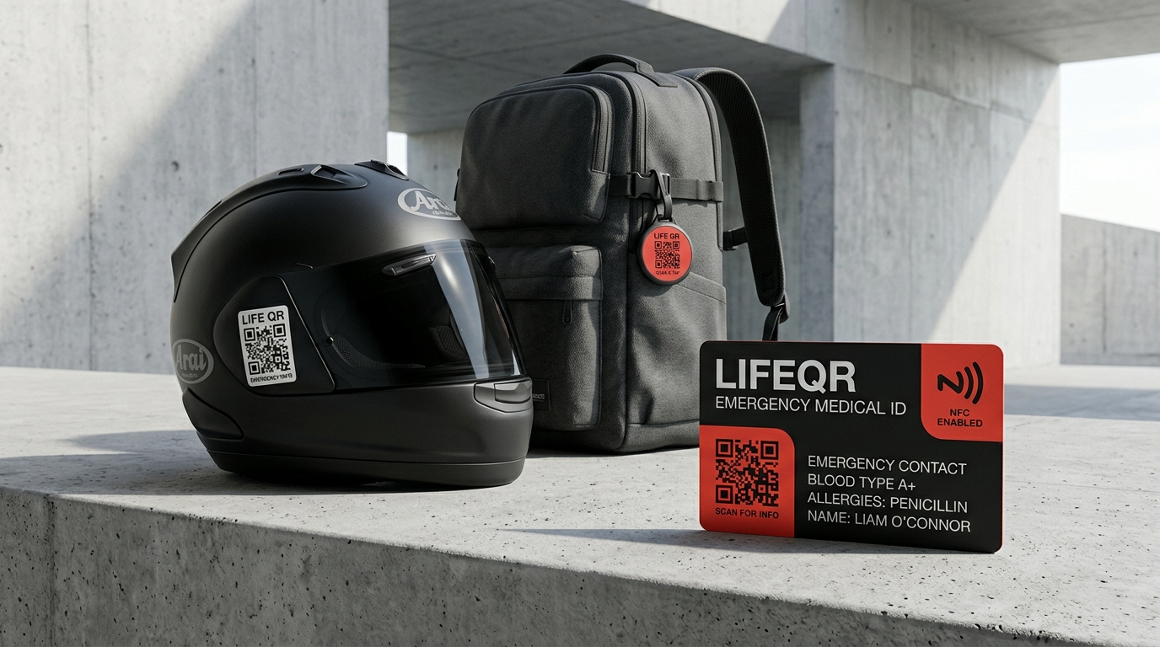
● LIFEQR MASTER ECOSYSTEM | PHYSICAL WEARABLES
Wearables & Everyday Life Protection
Protecting motorcyclists, school students, seniors, and everyday citizens
PHYSICAL FORM FACTORS
✔ Wallet Smart Medical Card
Waterproof composite PVC card with NTAG 424 DNA NFC chip + high-contrast laser QR code. Carried by everyday adults and commuters.
✔ Motorcycle Helmet Crash Decal
3M retroreflective vinyl sticker placed on rider helmets so bystanders or EMS can scan without removing helmets after spinal trauma.
✔ School & Student Bag Tags
Clip-on tag for school backpacks protecting children with epilepsy, asthma, diabetes, or nut allergies. Teachers scan in 1.8s if a child collapses.
✔ Bystander 1-Tap Phone Access
Any passerby taps with their phone $_x000D_ightarrow$ sees critical blood type and immediately clicks 'Call Family Contact (ICE)' with zero app install.

Slide 8
● LIFEQR MASTER ECOSYSTEM | EMERGENCY SOS
Patient 1-Tap SOS & Ambulance Proximity Dispatch
Instant automated dispatch broadcasting exact coordinates to on-duty ambulances
STEP 01
1. 1-Tap SOS Trigger
Patient or bystander clicks SOS on web app or scans NFC card. High-precision GPS coordinates locked in < 1 second.
STEP 02
2. Cloud Dispatch Engine
LifeQR cluster queries on-duty ambulance units within a 15 km radius via WebSocket Socket.IO room `crew:all`.
STEP 03
3. Ambulance Terminal Alert
Nearby ambulance driver's tactical device chimes loudly; screen displays live navigation route and victim triage level.
STEP 04
4. Automated ICE SMS Broadcast
Emergency contacts (spouses, parents) receive automated SMS with live tracking link and ambulance call sign.

Slide 9
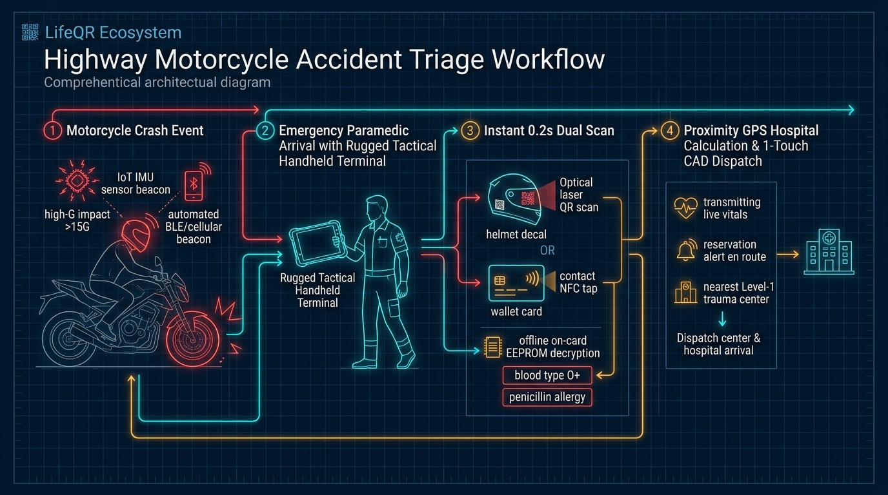
● LIFEQR MASTER ECOSYSTEM | PROCESS ARCHITECTURE 02
Highway Motorcycle Accident Triage Blueprint
IMU crash detection, paramedic tactical dual-scan, offline EEPROM decode & GPS dispatch
PROCESS 2 HIGHLIGHTS
★ 1. Motorcycle Crash
IoT IMU sensor beacon detects >15G impact, broadcasting automated BLE emergency beacon.
★ 2. Paramedic Arrives
Arrives with rugged tactical handheld terminal; no personal smartphone delays.
★ 3. Instant 0.2s Scan
Scans helmet QR decal or taps wallet NFC card; decrypts O+ blood and allergy offline.
★ 4. GPS CAD Dispatch
Auto-identifies nearest Level-1 trauma center & transmits live vitals en route.

Slide 10
● LIFEQR MASTER ECOSYSTEM | BIKER TRIAGE
Triage of Unrecognizable & Unconscious Bikers
Overcoming face-obscuring helmets, shock, and missing physical identification
The Helmet Removal Risk
Removing a full-face motorcycle helmet on an unconscious rider with cervical spine trauma can cause permanent paralysis or death. LifeQR helmet QR decal allows full triage scanning from the outside.
Unrecognizable Facial Identity
Severe facial polytrauma makes biometric face unlock impossible. The NFC chip embedded in wallet or jacket sleeve resolves patient identity in 200 milliseconds.
Critical Contraindication Warnings
Instantly flags lethal contraindications (e.g. administering standard anticoagulants to a hemophiliac or penicillin to an anaphylactic victim).
Paramedic Nurse Medication Lookup
The ambulance nurse accesses the victim's verified daily medications in one touch, preventing fatal drug interactions during roadside resuscitation.

Slide 11
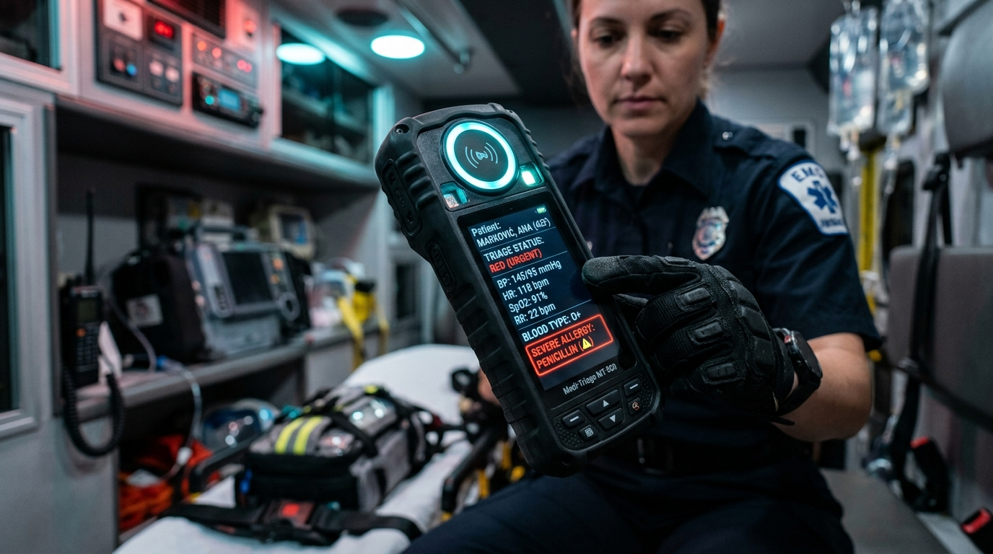
● LIFEQR MASTER ECOSYSTEM | PARAMEDIC HARDWARE
Ambulance Tactical Triage Terminal
Dedicated field device engineered for ambulance drivers and paramedic nurses
TACTICAL FIELD ENGINE
★ Dual Sensor Engine
Top NFC RF halo + 60fps 2D CMOS barcode optical scanner reads cards, tags, and helmet stickers through rain or grime in < 0.2s.
★ Immediate Triage HUD
Instantly projects Blood Group, Lethal Allergies, Current Medications, and Emergency Contacts on 800-nit high-contrast screen.
★ Automated Hospital Detection
Integrated GNSS GPS queries hospital network, calculates traffic-adjusted ETA, and validates ER availability en route.
★ 1-Touch ER Vitals Stream
Nurse enters pulse, SpO2, and blood pressure with 1 touch, transmitting live vitals straight to the receiving trauma bay.
★ Rugged Industrial Design
IP68 dust/waterproof, drop-resistant rubber bumper casing for harsh accident environments.

Slide 12
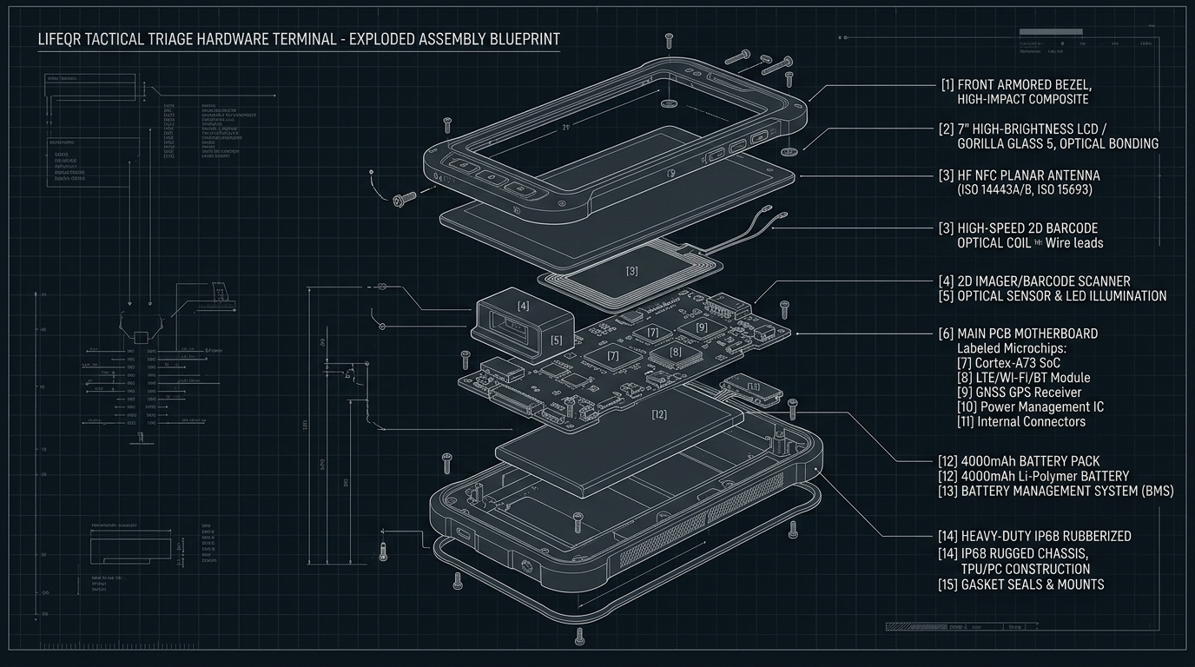
● LIFEQR MASTER ECOSYSTEM | HARDWARE ENGINEERING
Tactical Triage Terminal: Exploded Architecture
Layer-by-layer industrial assembly design for ambulance field reliability
ENGINEERING BOM
• [1] Armored Bezel
High-impact composite protecting against face-down asphalt drops.
• [2] Gorilla Glass 5
Optical-bonded 800-nit sunlight-readable IPS LCD.
• [3] Planar NFC Coil
Tuned 13.56 MHz loop antenna for omnidirectional tap.
• [4] 2D CMOS Engine
Newland optical imager reading scratched QR codes.
• [5] Multi-Layer PCB
ESP32-S3 SoC, Quectel 4G LTE-M, GNSS GPS, ATECC608B.
• [6] IP68 Chassis
TPU rubber bumpers resisting hospital decontamination wipes.

Slide 13
● LIFEQR MASTER ECOSYSTEM | EDGE RESILIENCE
Offline-First Operation & Satellite Fallback
Solving the highway dead zone: 100% triage uptime with zero cellular connectivity
REALITY OF CRASH SITES
The Remote Highway Dead Zone
Severe crashes often occur in rural mountain roads or tunnel corridors with 0% cellular signal. Cloud-only architectures fail catastrophically in these moments.
ON-CARD EDGE VAULT
Encrypted On-Card EEPROM Payload
512 bytes of critical data (Blood Group, Top 3 Lethal Allergies, ICE Phone, Chronic Illness) stored directly inside the card's chip memory. Decrypted locally in < 0.1s with 0 internet.
LOCAL INTELLIGENCE
Terminal Local SQLite Cache
Ambulance terminal maintains an onboard encrypted local database of regional emergency protocols, drug interactions, and hospital directories updated daily via Wi-Fi.
SATELLITE REDUNDANCY
Satellite & LoRa Mesh SOS Fallback
When cellular fails, the terminal automatically falls back to LoRa emergency mesh or direct satellite burst (Iridium / Starlink Direct-to-Cell) to alert emergency dispatch.

Slide 14
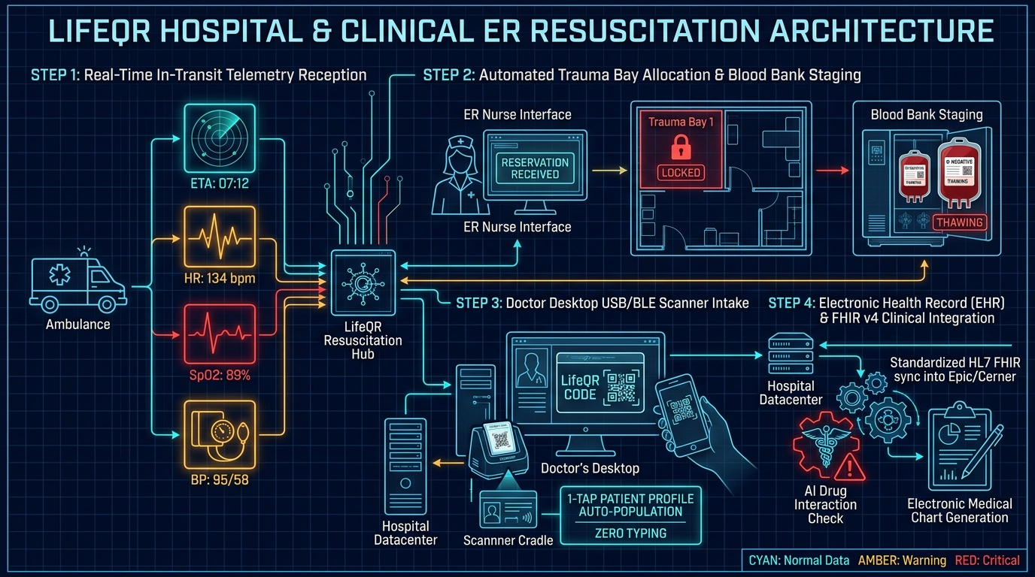
● LIFEQR MASTER ECOSYSTEM | PROCESS ARCHITECTURE 03
Hospital & Clinical ER Resuscitation Blueprint
In-transit telemetry, automated trauma bay reservation, doctor desktop cradle & FHIR sync
PROCESS 3 HIGHLIGHTS
✔ 1. In-Transit Vitals
ER monitor receives live countdown (ETA 07:12) and vitals (HR 134, SpO2 89%, BP 95/58).
✔ 2. Bay 1 & Blood Staged
Trauma Bay 1 locked; blood bank thaws matched O-negative units before siren arrives.
✔ 3. Doctor Desktop Cradle
Doctor taps card on USB/BLE scanner cradle; profile populates with zero manual typing.
✔ 4. FHIR & AI Safety
Auto-syncs into Epic/Cerner EHR; flags penicillin allergy and generates SOAP chart.

Slide 15
● LIFEQR MASTER ECOSYSTEM | RECEPTION TRIAGE
Hospital Pre-Notification & Reception Validation Flow
Confirming doctor availability and clinical capacity before ambulance arrival
STAGE 01
1. Automated Hospital Siren Alert
When ambulance locks destination, the hospital reception desk and ER triage nurse receive a flashing siren alert with victim summary.
STAGE 02
2. Doctor Availability Validation
Receptionist / ER Charge Nurse verifies specialized doctor availability (neurosurgeon, orthopedic trauma, cardiac surgeon on-duty).
STAGE 03
3. Capacity Validation & Acceptance
System verifies available ICU bed and Trauma Bay 1 readiness; transmits an authenticated confirmation token back to the ambulance.
STAGE 04
4. Dynamic Diversion if at Capacity
If ER is at max capacity (divert status), the system instantly alerts the paramedic and re-routes ambulance to the next nearest trauma center.

Slide 16
● LIFEQR MASTER ECOSYSTEM | TRAUMA RESUSCITATION
Trauma Bay 1 Lockout & Advance Blood Staging
Zero-delay surgical handover prepared 7 minutes before the ambulance wheels stop
Trauma Bay Lockout (ETA -7m)
Trauma Bay 1 is electronically locked on the hospital central board. Ventilator circuit, chest tube tray, and ultrasound FAST machine pre-staged at bedside.
Blood Bank Staging (ETA -5m)
Automated reservation signal triggers the hospital blood bank refrigerator to thaw 2 units of uncrossed O-negative PRBCs and 2 units of FFP. Ready at bay bedside.
Trauma Team Summoned
On-call trauma surgeon, anesthesiologist, respiratory therapist, and surgical techs alerted via priority pager with ETA countdown.
Immediate Dock Handover (ETA 0m)
Ambulance backs into trauma bay; victim wheeled straight onto Bay 1 resuscitation gurney. Zero check-in registration delay. Resuscitation begins instantly.

Slide 17
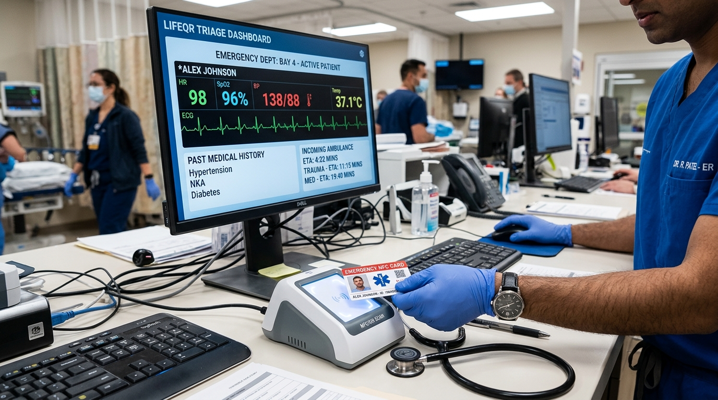
● LIFEQR MASTER ECOSYSTEM | DOCTOR HARDWARE
Doctor Desktop Scanner & Zero-Typing Consultation Flow
Eliminating transcription errors, medication mix-ups, and consultation paperwork delays
PHYSICIAN DESK WORKFLOW
✔ Plug-and-Play USB HID/CCID
Scanner cradle connects via USB Type-C to doctor's PC. Functions driverless as a smart card reader and keyboard wedge.
✔ 1-Tap Patient Record Ingestion
Doctor simply taps the patient's card or scans QR code $_x000D_ightarrow$ complete clinical profile, past surgeries, and active prescriptions populate with zero manual typing.
✔ AI Clinical Safety Copilot
Integrated AI cross-references newly prescribed medication against allergies and current drugs, instantly flagging lethal drug interactions.
✔ Automated SOAP Note Generation
Generates compliant Subjective, Objective, Assessment, Plan (SOAP) clinical encounter documentation ready for physician signature.

Slide 18
● LIFEQR MASTER ECOSYSTEM | DOCTOR COLLABORATION
Doctor-to-Doctor Transfer & Specialist Referral Network
Connecting physicians across departments and hospitals with verified handover tokens
STEP 01
1. In-App Patient Transfer
Attending physician selects 'Refer / Transfer Patient' on the LifeQR Clinical Dashboard, choosing a specialized department or higher-level surgeon.
STEP 02
2. Clinical Handover Dossier
System bundles active vitals, diagnostic notes, imaging reports, and current medication list into a secure cryptographic transfer token.
STEP 03
3. Receiving Specialist Notification
Receiving surgeon receives an encrypted notification. Tapping patient's card or accepting the token imports the complete clinical history without re-interviewing the patient.
STEP 04
4. Inter-Doctor Chat & Tele-Consult
Built-in encrypted physician-to-physician communication channel allows real-time consults, surgical second opinions, and ICU transfer coordination.

Slide 19
● LIFEQR MASTER ECOSYSTEM | SECURITY & INTEROPERABILITY
HL7/FHIR v4 Interoperability & Zero-Trust Security
Universal hospital connectivity with HIPAA-compliant cryptographic governance
Standardized FHIR v4 Gateway
Natively maps clinical data to standard HL7 FHIR resources (`Patient`, `AllergyIntolerance`, `Condition`, `Encounter`), immediately readable by Epic, Cerner, and OpenEMR without custom coding.
Role-Based Dynamic Masking
• Tier A (Public Bystander): Blood group, ICE phone numbers, anaphylaxis warning. • Tier B (Paramedic on Scene): Active medications, chronic conditions, emergency directives. • Tier C (Doctor / ER): Complete clinical records, surgeries, lab tests.
Zero-Knowledge Vault
Patient medical data is encrypted client-side using AES-256 GCM. Master keys are protected in hardware security modules (HSM) with zero plain-text leaks.
Cryptographic Audit Trail
Every tap, scan, and clinical handover is cryptographically signed, timestamped, and geotagged. Immutable audit logs recorded in full compliance with HIPAA Section 164.312.

Slide 20
WHEN SECONDS COUNT, LIFEQR SAVES LIVES.
A Complete, Synchronized, Real-World Emergency Medical Network
By uniting passive hybrid NFC/QR wearables, dedicated ambulance triage terminals, universal hospital medical passports (Gov & Private), doctor desktop scanner cradles, and automated ER pre-notification, LifeQR turns preventable tragedies into survivable emergencies. We are ready to build the physical devices, distribute the wearables, and transform emergency healthcare.
READY FOR HARDWARE FABRICATION & MUNICIPAL EMS INTEGRATION

