Slide 1
LIFEQR PROCESS ARCHITECTURE MASTER
Comprehensive Process Blueprints for Patient Lifecycle, Accident Triage & Hospital Resuscitation
Step-by-step technical architectures with dedicated engineering flowcharts: • Process 1: Patient Registration, NTAG 424 Cryptographic Encoding & Wearable Deployment • Process 2: Highway Motorcycle Crash, IMU Shock Sensing & Tactical Paramedic Triage • Process 3: Real-Time In-Transit Hospital Telemetry, Trauma Bay Allocation & Doctor Desktop Hub
PROCESS SPECIFICATIONS • VISUAL ARCHITECTURE BLUEPRINTS • REAL-WORLD WORKFLOWS

Slide 2
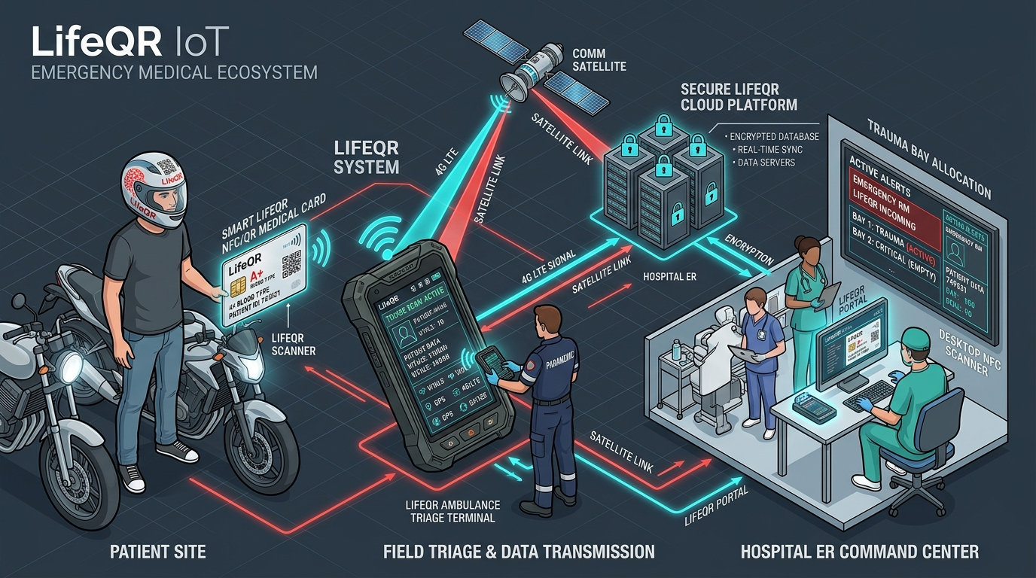
● LIFEQR PROCESS ARCHITECTURE MASTER | MASTER TOPOLOGY
Full-Stack Connected Emergency Ecosystem
The complete synchronized data loop connecting patient, scene, ambulance, and trauma bay
THE 3 CORE PROCESS TIERS
■ Process Tier 1: Patient Lifecycle
Digital registration, NTAG 424 DNA programming, laser-etched QR card, helmet decal, and school student tag.
■ Process Tier 2: Accident & EMS Triage
Crash event, IMU shock trigger, paramedic tactical dual-scan, offline EEPROM vitals read, and GPS hospital dispatch.
■ Process Tier 3: Hospital & Doctor ER
Live telemetry reception, Trauma Bay 1 allocation, blood bank staging, doctor USB cradle intake, and FHIR EHR sync.

Slide 3
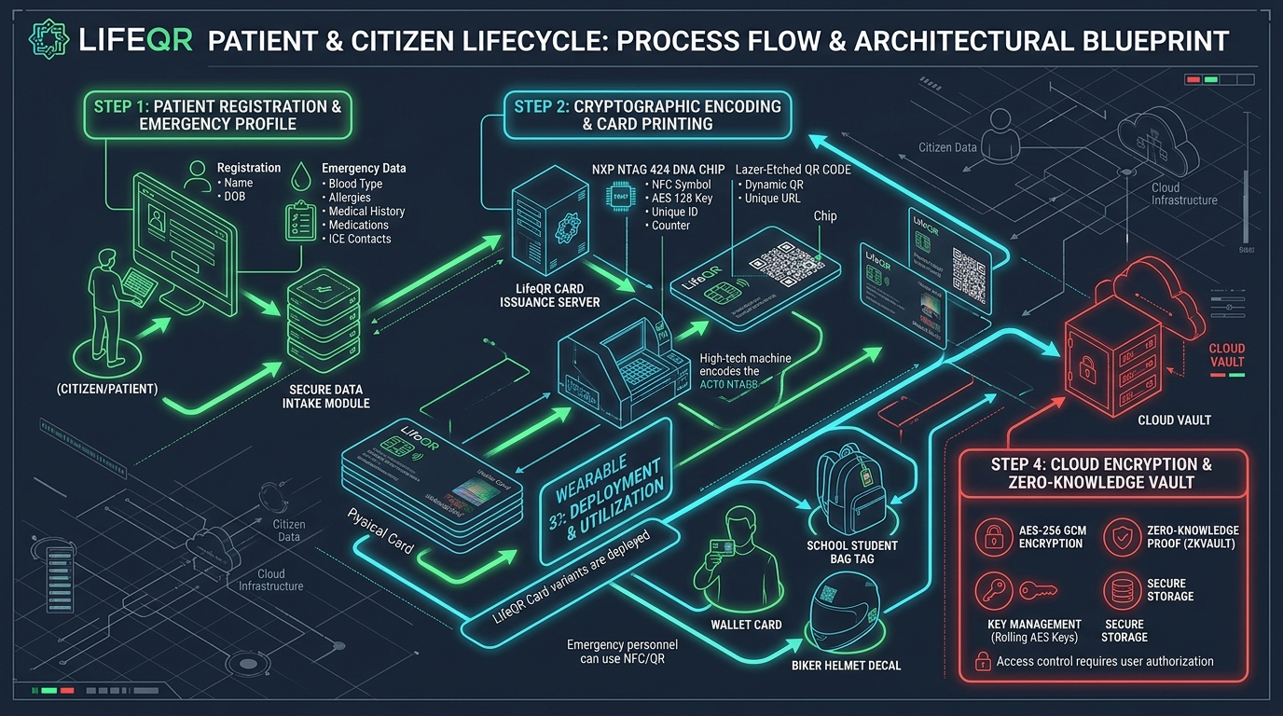
● LIFEQR PROCESS ARCHITECTURE MASTER | PROCESS ARCHITECTURE 01
Patient & Citizen Lifecycle Blueprint
Registration, NTAG 424 DNA chip encoding, laser QR printing, and zero-knowledge encryption
PROCESS 1 HIGHLIGHTS
✔ Step 1: Emergency Intake
Patient inputs blood group, allergies, chronic ailments, and primary ICE phone contacts.
✔ Step 2: NTAG 424 DNA
Card issuance encoder writes rolling AES-128 SUN keys to prevent counterfeiting.
✔ Step 3: Multi-Wearables
Wallet smart card, rider helmet reflective decal, and student backpack tag issued.
✔ Step 4: Encrypted Vault
Data secured via AES-256 GCM client-side encryption with zero-knowledge keys.

Slide 4
● LIFEQR PROCESS ARCHITECTURE MASTER | PATIENT PROCESS DEEP-DIVE
Technical Lifecycle: Registration to Card Issuance
Under the hood of the patient medical onboarding and cryptographic encoding pipeline
PHASE 01
1. Digital Medical Onboarding
• Verified Identity & Consent • Critical Vitals Intake: Blood Group (A+, B+, O+, AB-), Severe Allergies (Penicillin, Nuts), Chronic Conditions (Diabetes, Epilepsy). • ICE Contacts: Primary, secondary, family doctor. • Emergency Directives & DNR flags.
PHASE 02
2. NTAG 424 DNA Encoding
• Issuance terminal programs NXP NTAG 424 DNA. • Generates Master Application Key (K0-K4). • Configures Secure Unique NFC (SUN) with AES-128 CMAC. • Programs 512-byte encrypted offline EEPROM payload for zero-internet emergency access.
PHASE 03
3. Laser Etching & Surface Printing
• Micro-QR code laser-engraved onto composite PVC/PET surface. • Encoded with Level H error correction (withstands 30% physical abrasion or blood). • Distinct high-contrast Swiss Brutalist emergency layout with patient unique alphanumeric ID.
PHASE 04
4. Zero-Knowledge Cloud Storage
• Medical records encrypted client-side using AES-256 GCM. • Master keys stored in hardware security module (HSM). • Role-based dynamic data masking (Public bystander vs paramedic vs physician). • Immutable access log generated on each tap.

Slide 5
● LIFEQR PROCESS ARCHITECTURE MASTER | COMMUNITY PROTECTION
School District & Pediatric Chronic Safety Architecture
Protecting students with epilepsy, severe asthma, type-1 diabetes, and nut anaphylaxis
Step 1: School District Portal
Campus registered nurses and administrators enroll students with documented chronic conditions via the LifeQR School Safety Dashboard.
Step 2: Bag Tag & Wristband Issuance
Children receive durable silicone wristbands and clip-on backpack tags equipped with dual NFC and laser QR credentials.
Step 3: Sudden Classroom / Field Incident
If a student faints or experiences an epileptic seizure on the playground, teachers or bus drivers tap the badge in 1.8s.
Step 4: Instant Protocol & Parent Alert
Displays immediate emergency instructions ('Administer EpiPen from left pouch; do not restrain') and dispatches automated SMS/call to parents.

Slide 6
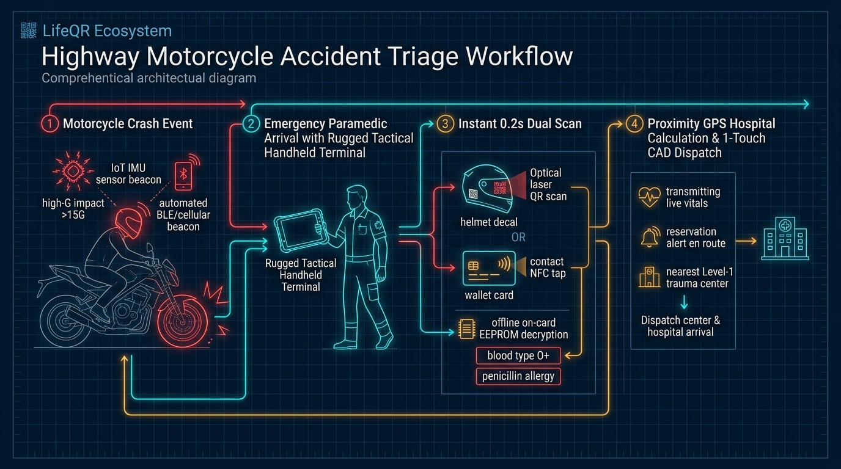
● LIFEQR PROCESS ARCHITECTURE MASTER | PROCESS ARCHITECTURE 02
Highway Motorcycle Accident Triage Blueprint
IMU crash detection, paramedic tactical dual-scan, offline EEPROM decode & GPS dispatch
PROCESS 2 HIGHLIGHTS
★ 1. Motorcycle Crash
IoT IMU sensor beacon detects >15G impact, broadcasting automated BLE emergency beacon.
★ 2. Paramedic Arrives
Arrives with rugged tactical handheld terminal; no personal smartphone delays.
★ 3. Instant 0.2s Scan
Scans helmet QR decal or taps wallet NFC card; decrypts O+ blood and allergy offline.
★ 4. GPS CAD Dispatch
Auto-identifies nearest Level-1 trauma center & transmits live vitals en route.

Slide 7
● LIFEQR PROCESS ARCHITECTURE MASTER | CRASH DETECTION MECHANICS
Autonomous Motorcycle Crash & E-Call Sensor Flow
How the LifeQR IoT helmet beacon identifies high-G crashes and eliminates delay
STEP 01
1. Impact Event (>15G)
Rider strikes barrier or vehicle. 6-axis Bosch BMI270 accelerometer detects severe deceleration spike (>15G) combined with high angular velocity.
STEP 02
2. 30s Stillness Verification
Algorithm verifies post-crash victim stillness for 30 seconds to filter out benign drops (e.g. helmet falling from seat), preventing false 911 calls.
STEP 03
3. Autonomous BLE/E-Call Broadcast
Beacon triggers high-power BLE 5.3 emergency advertisement packet containing the rider's LifeQR ID and GPS coordinates to passing phones & CAD.
STEP 04
4. Bystander / First Responder Scan
When responders or bystanders reach the victim, the 3M retroreflective helmet decal is scanned from 1 meter away without removing the helmet.

Slide 8
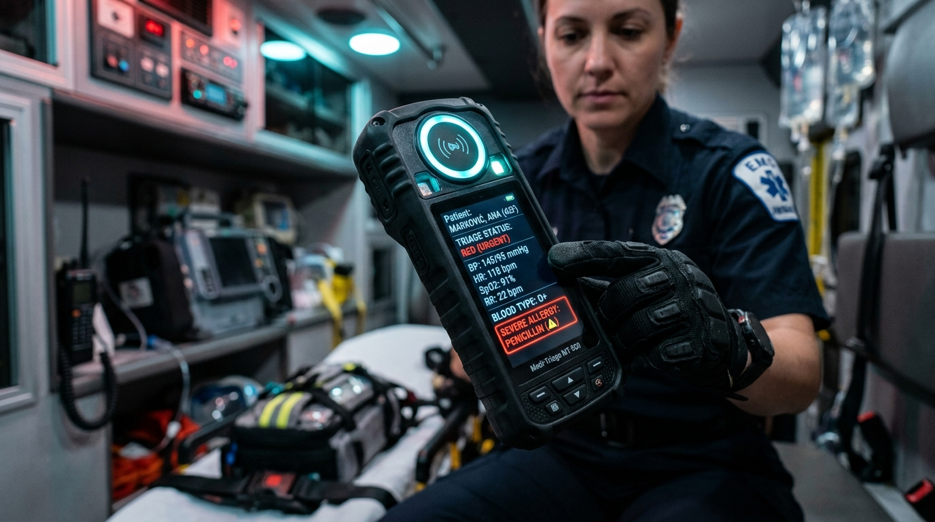
● LIFEQR PROCESS ARCHITECTURE MASTER | AMBULANCE HARDWARE WORKFLOW
Paramedic Tactical Terminal: Field Execution Flow
Zero-latency dual scanning, offline EEPROM decoding, and live vitals telemetry
FIELD RESCUE WORKFLOW
★ Sub-Second Dual Sensor Scan
Paramedic approaches unconscious victim; taps card on top NFC halo or scans helmet QR decal. Sensor responds in < 200 milliseconds even in heavy rain.
★ Offline EEPROM Vitals Decrypt
If cellular reception is 0%, the terminal decrypts the 512-byte payload stored in the card's chip. Projects Blood Type O+ and Penicillin Allergy on screen.
★ 1-Touch Vitals Entry & Stream
Paramedic attaches pulse oximeter and cuff; taps HR (134), SpO2 (89%), BP (95/58). Data streams continuously to hospital ER over 4G/Satellite.
★ High-Contrast Triage HUD
Sunlight-readable 800-nit screen displays Red (Urgent) triage banner, preventing lethal contraindications in noisy, chaotic crash sites.

Slide 9
● LIFEQR PROCESS ARCHITECTURE MASTER | DISPATCH FLOW
Proximity GPS & Hospital Auto-Notification Architecture
Automated trauma center selection, ETA calculation, and advance bay reservation
PHASE 01
1. GPS Spatial Query
Quectel GNSS module fixes exact crash coordinates and queries the regional trauma hospital registry within 25 km radius.
PHASE 02
2. Capability Matching
Evaluates live hospital telemetry: verified on-duty trauma surgeon, CT scanner availability, and O-negative blood stock.
PHASE 03
3. Automated Reservation
Transmits an authenticated reservation token to City Trauma Care ER. Locks Trauma Bay 1 and thaws blood units 7 minutes prior to arrival.
PHASE 04
4. Live In-Transit Radar
Ambulance streams continuous GPS coordinates, speed, traffic-adjusted ETA, and patient vitals to the receiving hospital command desk.

Slide 10
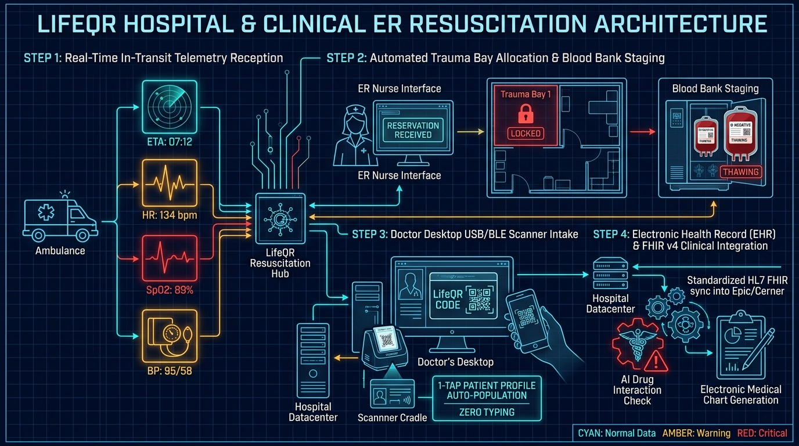
● LIFEQR PROCESS ARCHITECTURE MASTER | PROCESS ARCHITECTURE 03
Hospital & Clinical ER Resuscitation Blueprint
In-transit telemetry, automated trauma bay reservation, doctor desktop cradle & FHIR sync
PROCESS 3 HIGHLIGHTS
✔ 1. In-Transit Vitals
ER monitor receives live countdown (ETA 07:12) and vitals (HR 134, SpO2 89%, BP 95/58).
✔ 2. Bay 1 & Blood Staged
Trauma Bay 1 locked; blood bank thaws matched O-negative units before siren arrives.
✔ 3. Doctor Desktop Cradle
Doctor taps card on USB/BLE scanner cradle; profile populates with zero manual typing.
✔ 4. FHIR & AI Safety
Auto-syncs into Epic/Cerner EHR; flags penicillin allergy and generates SOAP chart.

Slide 11
● LIFEQR PROCESS ARCHITECTURE MASTER | TRAUMA BAY PREPARATION
Advance Resuscitation & Blood Bank Protocol
Converting chaotic hospital arrival into an orchestrated clinical resuscitation
Advance Notification (ETA -10m)
ER charge nurse receives siren alert and telemetry stream on central command console. Victim identified as 28yo male, motorcycle polytrauma, GCS 9.
Trauma Bay Lockout (ETA -7m)
Trauma Bay 1 is electronically reserved on the board. Nursing team pre-sets rapid infuser, ventilator circuit, and emergency chest tube tray.
Blood Bank Staging (ETA -5m)
Hospital blood refrigerator receives automated reservation: thaws 2 units of uncrossed O-negative PRBCs and 2 units of plasma. Ready at bay bedside.
Immediate Handover (ETA 0m)
Ambulance backs into trauma dock; victim moved directly into Bay 1. Zero check-in registration delay. Resuscitation begins immediately.

Slide 12
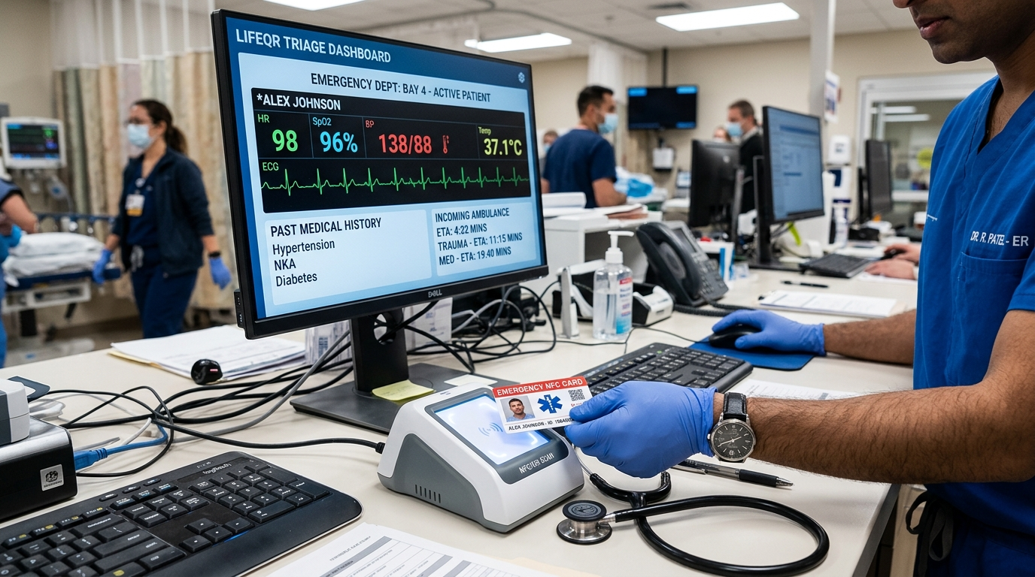
● LIFEQR PROCESS ARCHITECTURE MASTER | CLINICAL INTAKE ARCHITECTURE
Doctor Desktop Scanner & Zero-Typing Consultation Flow
Eliminating transcription errors, medication mix-ups, and consultation paperwork delays
CLINICAL DESK ARCHITECTURE
✔ Plug-and-Play USB HID/CCID
Medical-grade scanner cradle connects via USB Type-C to doctor's PC. Functions driverless as a smart card reader and keyboard wedge.
✔ 1-Tap Patient Record Ingestion
Doctor simply taps the patient's card or scans QR code $_x000D_ightarrow$ complete clinical profile, past surgeries, and active prescriptions populate with zero manual typing.
✔ AI Clinical Safety Copilot
Integrated AI cross-references doctor's newly prescribed medication against patient's allergies and existing drugs, instantly flagging lethal drug interactions.
✔ Automated SOAP Note Generation
Generates compliant Subjective, Objective, Assessment, Plan (SOAP) clinical encounter documentation ready for physician signature.

Slide 13
● LIFEQR PROCESS ARCHITECTURE MASTER | EHR INTEROPERABILITY
HL7 & FHIR v4 Clinical Integration Pipeline
Standardized JSON health exchange connecting LifeQR with global hospital systems
RESOURCE 01
FHIR Patient Resource
Maps legal name, MRN, date of birth, emergency contacts, and blood group according to US Core & international HL7 standards.
RESOURCE 02
FHIR AllergyIntolerance
Directly transmits critical anaphylactic risks (penicillin, sulfa, latex, nuts) with verification status: 'confirmed' and criticality: 'high'.
RESOURCE 03
FHIR Condition & History
Standardized SNOMED-CT and ICD-10 medical condition encoding (e.g. Type-1 Diabetes E10.9, Severe Asthma J45.9).
RESOURCE 04
FHIR Encounter & Handover
Encapsulates paramedic field vitals (HR, SpO2, BP), Glasgow Coma Scale, and incident timestamp into an active emergency encounter record.

Slide 14
● LIFEQR PROCESS ARCHITECTURE MASTER | SECURITY & COMPLIANCE
Zero-Trust Privacy & Multi-Tiered Access Governance
Complying with HIPAA, GDPR, and medical confidentiality standards
Tier A: Public / Bystander
Scanning with a smartphone camera shows only life-critical data: Blood Group, Emergency ICE Contacts (1-tap dial), and severe anaphylaxis warnings. Zero personal addresses, social security numbers, or financial details are exposed.
Tier B: First Responder (EMS)
Paramedic authenticated terminal unlocks detailed clinical profile: active medications, chronic ailments, cardiac history, and specialized emergency physician directives.
Tier C: Verified Hospital Physician
Doctor desktop terminal unlocks full clinical consultation notes, past diagnostic lab reports, AI differential insights, and prescription safety validator history.
Cryptographic Audit Trail
Every tap or scan is cryptographically signed, timestamped, and geotagged. Immutable audit logs recorded in compliance with HIPAA Section 164.312.

Slide 15
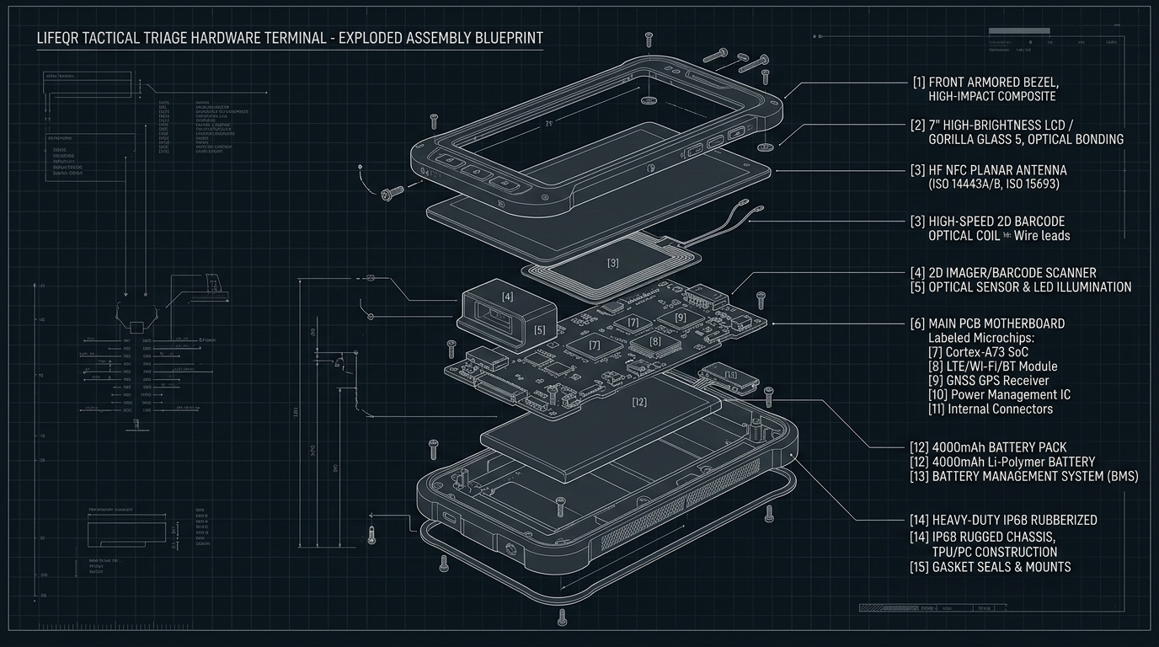
● LIFEQR PROCESS ARCHITECTURE MASTER | HARDWARE SCHEMATICS
Tactical Triage Terminal: Component Architecture
Exploded assembly breakdown for field-grade manufacturing and IP68 certification
HARDWARE SUBSYSTEMS
• Core SoC
ESP32-S3 Dual-Core Xtensa @ 240MHz with hardware crypto engine.
• Dual Sensors
NXP PN532 NFC reader + 60fps 2D CMOS optical barcode imager.
• Comms & GPS
Quectel EC200U 4G LTE-M with GNSS GPS/GLONASS positioning.
• Battery System
4000mAh Li-Po (18h continuous duty) + USB-C PD & Qi wireless dock.

Slide 16
LIFEQR 2.0 PROCESS ARCHITECTURE MASTERED
A Complete, Synchronized, Real-World Emergency Medical Network
By unifying: ✔ Process 1: Zero-battery cryptographic NTAG 424 DNA cards & school student safety tags ✔ Process 2: Autonomous motorcycle crash IMU detection & paramedic tactical dual-scanning ✔ Process 3: Real-time in-transit ER telemetry, advance trauma bay reservation & doctor desktop cradle ... LifeQR transforms emergency survival from a chaotic gamble into an engineered science.
READY FOR HARDWARE FABRICATION & MUNICIPAL EMS INTEGRATION

