Slide 1
LIFEQR CONNECTED HARDWARE ECOSYSTEM
Real-World Emergency Triage, Hybrid NFC/QR Wearables & Dedicated Ambulance IoT Network
Solving the 'Golden Hour' medical data blackout through instant street-side hardware lookup, child & rider accident protection, and automated ER trauma bay pre-notification.
PROJECT ROADMAP & HARDWARE SPECIFICATION • CONFIDENTIAL DECK

Slide 2
● LIFEQR REAL-WORLD ECOSYSTEM | THE REAL-WORLD CRISIS
The Street-Side Medical Data Blackout
Why thousands of accident victims and students suffer preventable trauma deaths each year
CRITICAL GAP 01
70% Unconscious Victims
Accident victims, seizing students, or stroke patients are physically unable to speak, unlock their phones, or communicate identity.
CRITICAL GAP 02
15-25 Min Golden Hour Lost
Paramedics arrive blind without blood group, allergy warnings (penicillin), or chronic diseases (diabetes, hemophilia).
CRITICAL GAP 03
Paramedic Phone Reliance
Responders currently rely on personal smartphones with slow autofocus, low battery, bad rain lighting, or broken glass.
CRITICAL GAP 04
Disconnected ER Desks
Hospital trauma bays only know about critical emergencies when ambulance sirens physically pull into the hospital driveway.

Slide 3
● LIFEQR REAL-WORLD ECOSYSTEM | SYSTEM ARCHITECTURE
The 3 Pillars of Connected LifeQR
A unified, hardware-backed emergency response loop from citizen to trauma center
1. CITIZEN & PATIENT
Hybrid NFC/QR Wearables
Zero-battery smart medical cards, rider helmet crash decals, and student backpack safety tags. Passive, waterproof, permanent.
2. PARAMEDIC & AMBULANCE
Tactical Triage Terminal
Ruggedized field hardware with instant dual NFC tap & 2D laser barcode scanner, GPS proximity detector, and 1-touch ER broadcaster.
3. DOCTOR & CLINICAL ER
Desktop Hub & Live Stream
Doctor USB/Bluetooth NFC scanner cradle + Hospital ER Triage Command Center reserving trauma bays before ambulance arrival.

Slide 4
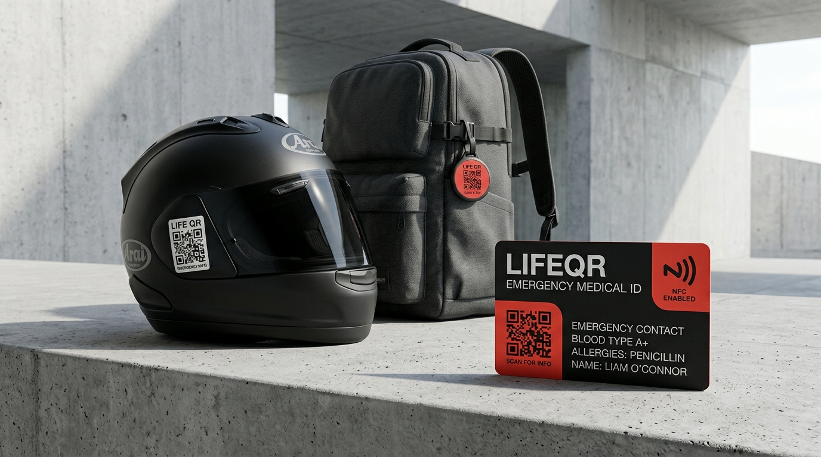
● LIFEQR REAL-WORLD ECOSYSTEM | COMPONENT 01
Citizen Wearables: Hybrid NFC & QR Physical IDs
Zero-battery, tamper-resistant medical credentials for daily protection
✔ NFC Chip Embedded in PVC Card
Passive 13.56 MHz NTAG213/424 chip read by any smartphone or responder hardware in under 0.2 seconds.
✔ High-Contrast Laser QR
Printed on the card surface for instant optical scanning when NFC is obstructed.
✔ Biker & Helmet Crash Decals
Retroreflective, weatherproof decals placed on rider helmets for immediate bystander or EMS access.
✔ Student & Pediatric Bag Tags
Clip-on tags for school bags protecting children with epilepsy, asthma, diabetes, or severe nut allergies.
✔ Zero-Power & Lifetime Durability
No charging required; waterproof, heat-resistant, and functional for 10+ years.

Slide 5
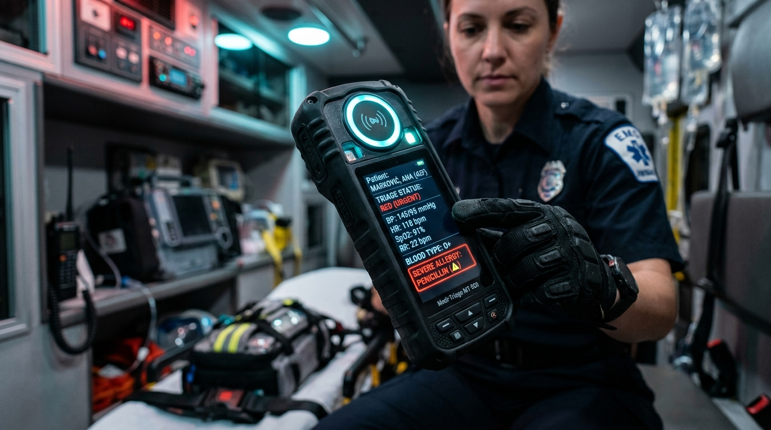
● LIFEQR REAL-WORLD ECOSYSTEM | COMPONENT 02
Ambulance Tactical Triage Terminal
Dedicated field-grade hardware unit for paramedics & emergency crews
★ Dual Sensor Engine
Top NFC halo antenna + 2D CMOS barcode scanner reads cards, tags, and helmet stickers through grime or rain in < 0.2s.
★ Immediate Triage HUD
Instantly projects Blood Group, Lethal Allergies, Current Medications, and Emergency Contacts on high-contrast screen.
★ Automated Hospital Detection
Integrated GPS module detects nearest Level-1/2 Trauma Centers and calculates traffic-aware arrival countdown.
★ 1-Touch ER Dispatch Stream
Transmits live vitals (HR, SpO2, BP) and triage priority (CRITICAL/URGENT) directly to receiving hospital ER desk.
★ Rugged Industrial Design
IP67 dust/waterproof, drop-resistant rubber bumper casing for harsh accident environments.

Slide 6
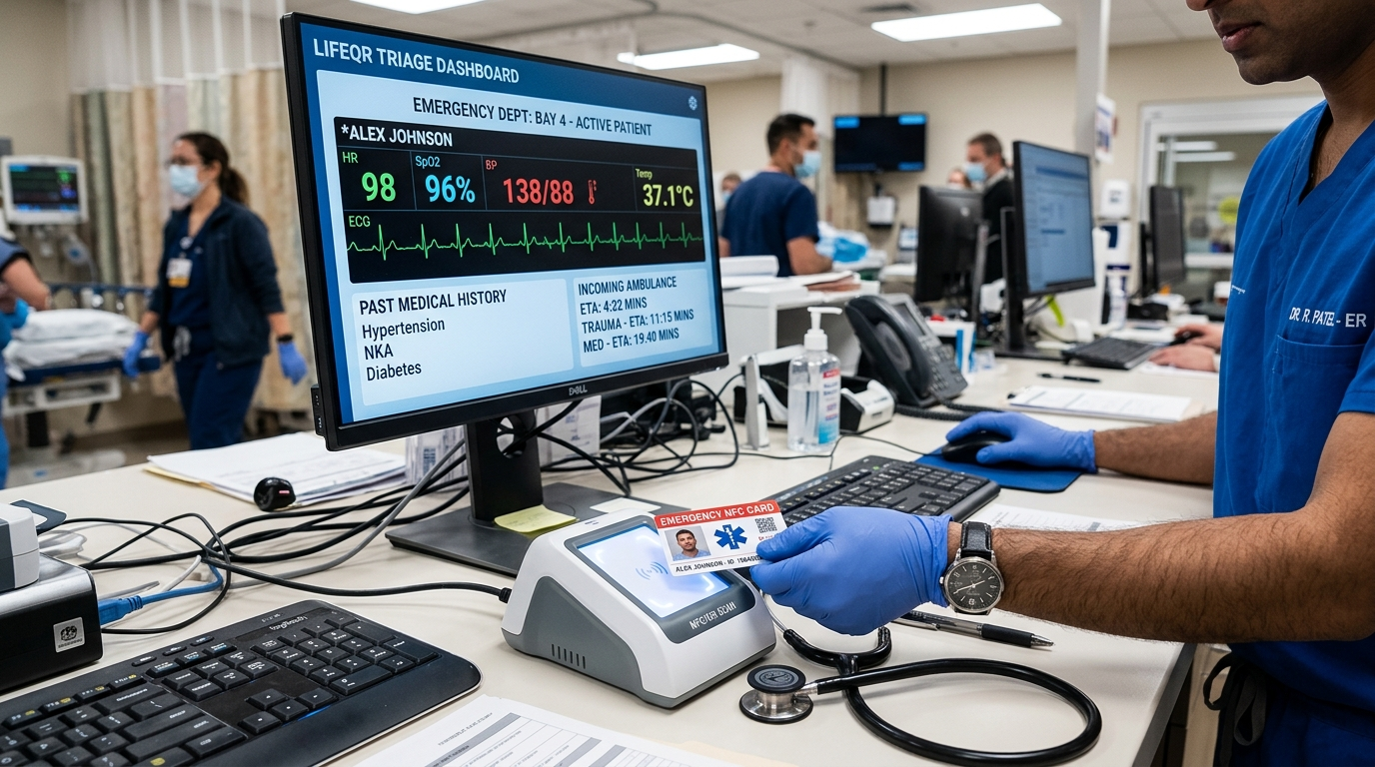
● LIFEQR REAL-WORLD ECOSYSTEM | COMPONENT 03
Doctor Desktop Cradle & ER Command Center
Zero-friction clinic intake and in-transit ambulance telemetry reception
✔ Plug-and-Play USB/BLE Cradle
Medical-grade desktop reader sits beside doctor monitor. Doctor simply taps patient card or scans badge.
✔ Zero-Typing Patient Intake
Auto-populates patient profile, past medical surgeries, and active prescriptions without manual data entry errors.
✔ Live In-Transit ER Radar
Receiving ER staff monitors approaching ambulances, live ETA countdown, and paramedic vitals stream.
✔ Trauma Bay Pre-Allocation
Allows ER charge nurses to reserve Trauma Bay 1/2/3 and stage matched blood units before patient arrival.
✔ AI Clinical Decision Support
Assists physician with AI drug interaction alerts, differential diagnosis, and instant SOAP notes.

Slide 7
● LIFEQR REAL-WORLD ECOSYSTEM | REAL-WORLD WORKFLOW
End-to-End Emergency Incident Timeline
How a motorcycle highway crash is handled from impact to resuscitation
00:00
Crash Occurs
Motorcyclist unconscious on highway. Bystander calls emergency hotline.
00:04
EMS Arrival
Paramedic arrives with LifeQR tactical terminal in hand.
00:05
1-Tap Scan
Paramedic taps helmet QR decal / wallet NFC card. Patient ID resolved in 0.2s.
00:06
Triage Displayed
Terminal shows: Blood O+, Penicillin Anaphylaxis, Severe Asthma. Family ICE notified.
00:08
Auto-ER Alert
Device detects Nearest Hospital (City Trauma Care). Broadcasts vitals & 7m ETA.
00:15
Handover Complete
Patient arrives; Trauma Bay 1 pre-allocated, O-negative blood thawed. Life saved.

Slide 8
● LIFEQR REAL-WORLD ECOSYSTEM | TARGET DEMOGRAPHICS
High-Impact Real-Life Use Cases
Deploying LifeQR cards and decals across vulnerable population groups
Two-Wheeler & Highway Bikers
High crash risk. Helmet QR decal and wallet card provide instant triage when rider is unconscious with protective gear on.
Form Factor: Rider Helmet Decal & Wallet Card
School & College Students
Protects children with chronic conditions (epilepsy, asthma, severe allergies). If student collapses, teachers scan backpack tag immediately.
Form Factor: Backpack NFC Badge & ID Clip
Senior Citizens & Dementia Care
Elderly individuals prone to falls, memory loss, or wandering. Bracelet or card alerts bystanders and contacts adult children instantly.
Form Factor: Waterproof Medical Wristband
Diabetic & Hemophilic Patients
Critical medical condition tags preventing lethal administration of standard emergency drugs by first responders.
Form Factor: Laser-Engraved Metal NFC Card

Slide 9
● LIFEQR REAL-WORLD ECOSYSTEM | BUSINESS & DISTRIBUTION
Sustainable Production & Distribution Strategy
Low manufacturing cost, high societal impact, and self-sustaining revenue
NFC Card Production
Low Unit Cost
• High-volume PVC/PET NFC Card: ~$0.30 - $0.50 per unit. • Weatherproof 3M Reflective Decal: ~$0.15 per unit. • Sold at nominal price ($2 - $3) at partner clinics, pharmacies, and driving license centers.
Hospital & School Supply
B2B Institutional Supply
• Supplied in bulk to school districts for student IDs. • Bundled with two-wheeler vehicle delivery at motorcycle dealerships. • Distributed at hospital discharge for chronic patients.
Hardware-as-a-Service
Ambulance Fleet Model
• Handheld triage terminals leased to private and municipal ambulance services ($25/mo per unit). • Free doctor desktop software & affordable USB scanner cradles ($35 one-time).
Value-Added Services
Emergency Platform
• Automated SMS/WhatsApp multi-contact dispatch. • Secure cloud profile syncing and AI prescription safety check. • Corporate and campus safety subscription packages.

Slide 10
● LIFEQR REAL-WORLD ECOSYSTEM | ENGINEERING SPECS
Hardware Architecture & IoT Specifications
Component-level breakdown for manufacturing the LifeQR terminal and wearables
Ambulance Triage Terminal
• Core SoC:
ESP32-S3 Dual-Core Xtensa LX7 (240MHz) with hardware cryptographic engine
• NFC Reader:
NXP PN532 transceiver supporting ISO14443A/B, MIFARE, and FeliCa (13.56MHz)
• Barcode Scanner:
2D CMOS High-Speed Optical Imager with red aiming crosshair and white fill LED
• Connectivity:
Quectel EC200U 4G LTE-M module with integrated GNSS GPS/GLONASS positioning
• Display & Battery:
3.5-inch High-Brightness Sunlight-Readable LCD; 4000mAh Li-ion (18h field duty)
Doctor Desktop Scanner Cradle
• Interface:
High-speed USB 2.0 Type-C + Bluetooth 5.2 Low Energy
• Sensor:
Contactless NFC flat-bed reader + 120fps overhead QR camera sensor
• OS Compatibility:
Windows 10/11, macOS, Linux, Android Hospital Workstation plug-and-play
• Housing:
Antimicrobial ABS medical-grade plastic chassis resistant to hospital disinfectants

Slide 11
● LIFEQR REAL-WORLD ECOSYSTEM | EXECUTION ROADMAP
Phased Commercial & Field Deployment
From hardware prototyping to municipal emergency system adoption
Phase 1: Prototyping
Months 1-3
• Finalize ESP32 + PN532 + 2D scanner PCB design. • 3D print rugged enclosure. • Produce initial batch of 500 NFC smart cards & helmet decals. • Validate firmware with LifeQR cloud API.
Phase 2: EMS Pilot
Months 4-6
• Field pilot with 20 municipal ambulance units. • Deploy 5 doctor desktop cradles in Level-1 Trauma ER. • Real-world crash response testing & paramedic UX tuning. • Establish average triage latency benchmark (< 5 sec).
Phase 3: Community Rollout
Months 7-10
• Partner with motorcycle riding clubs for helmet decal distribution. • School district safety tag program for 10,000 students. • Partner with private hospital networks for patient onboarding.
Phase 4: Scale & Gov Integration
Months 11+
• Integrate with national emergency dispatch hotlines (911 / 112 / 108). • Commercial mass manufacturing of triage hardware. • Expansion into statewide highway emergency networks.

Slide 12
WHEN SECONDS COUNT, LIFEQR SAVES LIVES.
Bridging Physical Reality and Emergency Healthcare
By uniting passive hybrid NFC/QR wearables, dedicated ambulance triage terminals, and real-time hospital notification networks, LifeQR eliminates the deadly 'Golden Hour' data void. We are ready to build the physical devices, distribute the wearables, and transform accident survival.
CONTACT & PILOT INQUIRIES: info@lifeqr.org • LIFEQR HARDWARE LABS

