Slide 1
LIFEQR 2.0: SYSTEM UPGRADES & ENGINEERING ROADMAP
Transforming the Working Prototype into an Industrial, Fault-Tolerant Life-Saving Standard
A comprehensive strategic blueprint detailing offline mesh satellite telemetry, integrated vital sensors, voice AI paramedic scribing, active E-paper wearables, autonomous blood drone dispatch, and hospital EHR interoperability.
ARCHITECTURAL UPGRADES • HARDWARE BOM • CLINICAL INTEGRATION • REGULATORY PATHWAY

Slide 2
● LIFEQR 2.0 UPGRADE BLUEPRINT | MATURITY ASSESSMENT
Why Upgrades Are Essential for Real-World Success
Bridging the gap between software proof-of-concept and mission-critical life safety
UPGRADE PILLAR 01
Zero-Coverage Blindspots
Accidents frequently happen in highway tunnels, mountain passes, and rural zones with zero 4G/5G cell reception. The terminal must work offline with mesh/satellite fallback.
UPGRADE PILLAR 02
Manual Paramedic Typing
Entering blood pressure or heart rate while speeding at 100 km/h over bumpy roads causes errors. Requires hands-free voice AI and plug-in biometric sensor probes.
UPGRADE PILLAR 03
Passive Wearable Limits
Static printed QR/NFC cards cannot update if daily medication changes. Requires smart active wearables (E-Paper display + BLE crash detection beacon).
UPGRADE PILLAR 04
Blood Bank Bottlenecks
Knowing a patient is O-negative is useless if the receiving ER has zero units in stock. Requires automated blood bank network matching and autonomous drone delivery.

Slide 3
● LIFEQR 2.0 UPGRADE BLUEPRINT | TELEMETRY UPGRADE 01
Zero-Deadzone Mesh & Satellite Comms
Ensuring life-saving telemetry transmits even in mountain valleys and highway deadzones
4G / 5G Primary Cellular
High-Bandwidth Link
• Standard operational state. • Streams HD tele-trauma video and full multi-page hospital records. • Latency: < 150ms to receiving ER triage desk.
LoRaWAN 868/915 MHz Mesh
Long-Range Highway Mesh
• Auto-activates when cellular drops. • 15 km point-to-point range to roadside emergency callboxes or police cruisers. • Transmits compressed triage packet (Blood, Allergies, Vitals, GPS) in < 1 second.
Iridium Satellite Backup
Global Zero-Fail Safety
• Direct Low-Earth Orbit satellite link (Iridium SBD transceiver). • Works in deep forests, deserts, and maritime waterways. • Guarantees distress SOS and critical blood type reach emergency dispatch unconditionally.

Slide 4
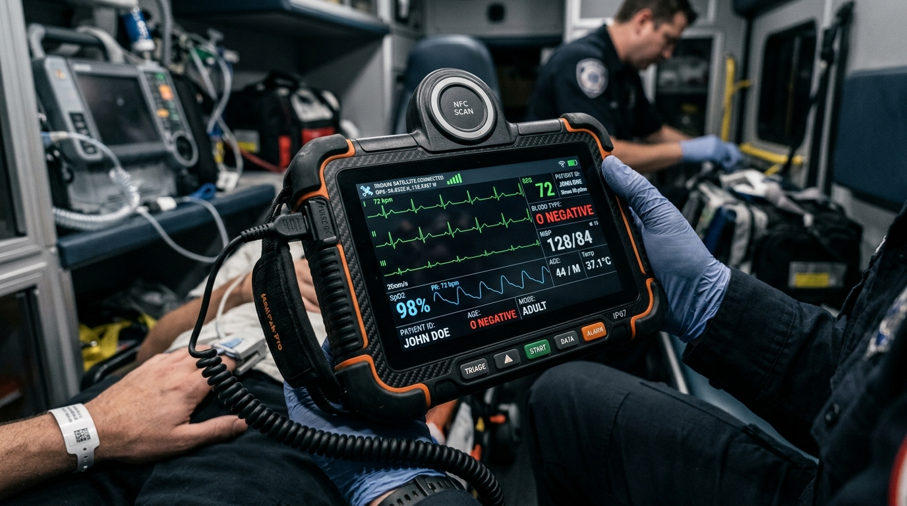
● LIFEQR 2.0 UPGRADE BLUEPRINT | HARDWARE UPGRADE 02
Next-Gen Triage Terminal with Integrated Biometrics
Eliminating manual data entry with live ECG probes, pulse oximetry & voice AI scribe
★ Direct Biometric Sensor Jack
Plug-and-play finger SpO2 clip and 3-lead ECG patches connect directly to terminal. Waveforms stream live to hospital.
★ Voice-Activated Paramedic Scribe
Noise-canceling array microphone allows paramedic to dictate notes hands-free while stabilizing victim: 'GCS 8, bilateral breath sounds diminished, IV saline running.'
★ Dual Hot-Swappable Batteries
2x 2500mAh smart battery packs allow 24-hour non-stop emergency shifts without device power downs.
★ Built-In Sunlight Display & Thermal Camera
High-nits 800-nit screen readable in glaring noon sun + FLIR thermal sensor to detect internal blunt trauma bleeding or shock vasoconstriction.

Slide 5
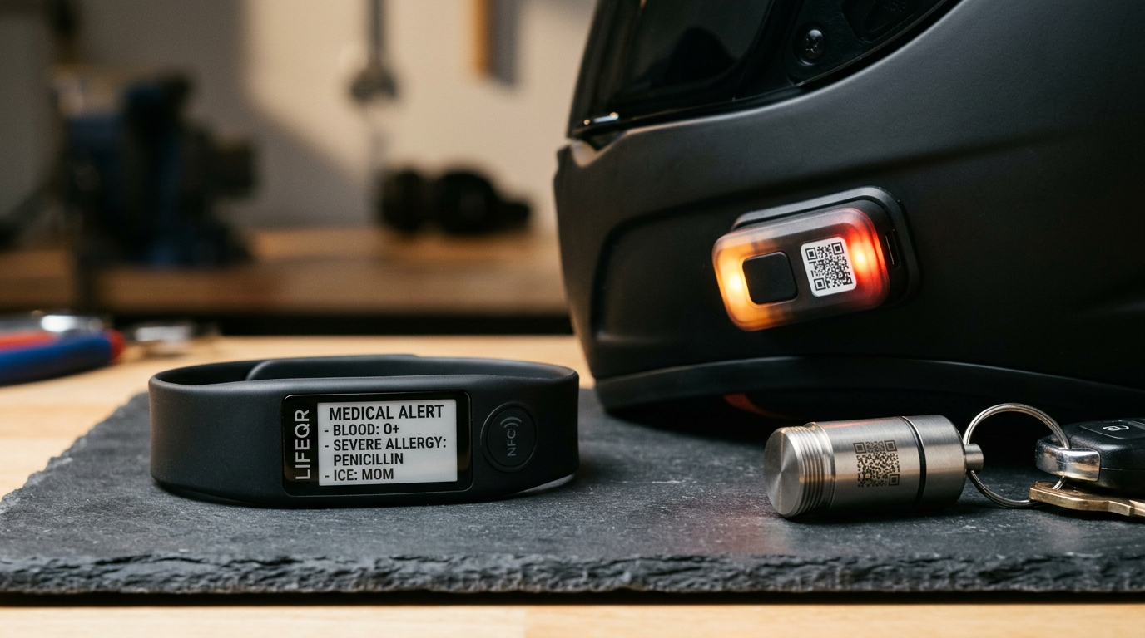
● LIFEQR 2.0 UPGRADE BLUEPRINT | WEARABLES UPGRADE 03
Smart Wearables 2.0: Active E-Paper & Crash Beacons
Dynamic biometric wristbands, impact-detecting helmet beacons, and EDC capsules
✔ Active E-Paper Medical Wristband
Bistable E-Ink screen updates dynamically via patient smartphone. Shows real-time prescription changes, zero battery drain between updates, 100% waterproof.
✔ Crash-Detection Helmet Beacon (BLE 5.2)
Aerodynamic sensor module with 3-axis accelerometer. Upon high-G collision, it flashes emergency red strobe and broadcasts Bluetooth beacon within 50m.
✔ Titanium EDC Emergency Capsule
Waterproof keychain capsule containing critical emergency medication (nitroglycerin, antihistamines) with micro laser-engraved emergency QR code.
✔ NXP NTAG 424 DNA Cryptography
Implements AES-128 cryptographic Secure Unique NFC (SUN) authentication preventing badge cloning or fraudulent identity theft.

Slide 6
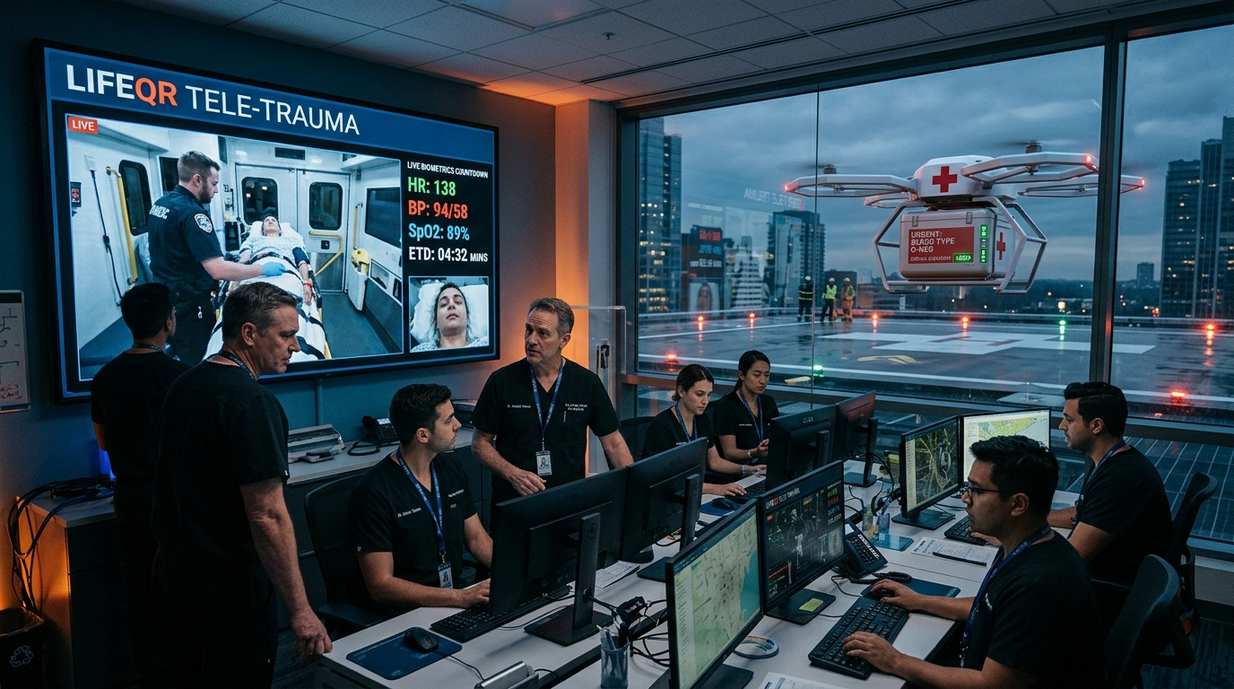
● LIFEQR 2.0 UPGRADE BLUEPRINT | RESUSCITATION UPGRADE 04
Autonomous Drone Blood Delivery & Tele-Trauma
Overcoming rare blood shortages and giving surgeons direct video overwatch into the ambulance
★ Automated Blood Bank Network Query
When an O-negative or rare blood patient is scanned, cloud API instantly verifies stock across regional blood centers.
★ Autonomous Medical Drone Dispatch
If receiving hospital is low on matching units, an electric delivery drone lands on the ER rooftop carrying refrigerated blood before the ambulance arrives.
★ Real-Time Tele-Trauma Video Feed
Trauma bay chief surgeon views ambulance cabin camera via low-latency WebRTC, instructing paramedics on tension pneumothorax decompression.
★ Zero Resuscitation Delay
Blood is cross-matched, thawed, and hanging on IV stands the exact second the gurney wheels through trauma bay doors.

Slide 7
● LIFEQR 2.0 UPGRADE BLUEPRINT | SOFTWARE UPGRADE 05
Hospital EHR Interoperability (HL7 FHIR)
Seamless data integration with Epic, Cerner, Meditech, and National Health Stacks
HL7 FHIR Release 4 Compliance
Standardized RESTful JSON endpoints allowing any hospital clinical system to read LifeQR emergency records without custom software.
Protocol: HL7 FHIR R4 JSON
Epic & Cerner EHR Bi-directional Sync
When a doctor updates prescriptions in hospital Epic software, patient's LifeQR badge is updated automatically via cloud webhooks.
Protocol: EHR Webhook Sync
Pre-Hospital ePCR Automation
Paramedic electronic Patient Care Reports (ePCR) auto-populated from LifeQR, saving 20 minutes of paperwork per shift.
Protocol: NEMSIS 3.5 Compatible
Govt Health ID Integration (ABHA / NHS)
Direct mapping with national digital health accounts (India ABHA, UK NHS Number, US Apple Health Records).
Protocol: National ID Bridges

Slide 8
● LIFEQR 2.0 UPGRADE BLUEPRINT | SECURITY UPGRADE 06
Zero-Knowledge Encryption & Anti-Cloning
Military-grade data protection ensuring medical privacy without slowing emergency triage
SECURITY 01
NTAG 424 DNA (SUN Tokens)
Dynamic cryptographic URL generated on every physical tap. Prevents clone attacks or counterfeit cards.
SECURITY 02
Tiered Privacy Masking
Bystanders scan QR $_x000D_ightarrow$ see only Blood Group, Allergies, ICE Contacts. Full medical surgeries require certified Paramedic/Doctor badge.
SECURITY 03
Ephemeral 24h Access Keys
Medical data access granted during emergency automatically revokes after 24 hours. Full immutable audit trail logged to blockchain/tamper-proof ledger.
SECURITY 04
HIPAA & GDPR Compliance
Zero-knowledge encryption keys held client-side. LifeQR cloud servers never store unencrypted health history or identity documents.

Slide 9
● LIFEQR 2.0 UPGRADE BLUEPRINT | MANUFACTURING & COMPLIANCE
Medical Device Regulatory & Tooling Strategy
Ensuring legal clinical deployment in ambulances and emergency wards
Medical Certification
Global Approvals
• FDA 510(k) Class II Medical Device exemption for triage accessories. • CE MDR (Medical Device Regulation 2017/745) Class I/IIa compliance for Europe. • CDSCO Class B approval for Indian EMS fleets.
Electrical Safety (IEC 60601)
Clinical Robustness
• IEC 60601-1-2 EMC testing ensuring terminal won't interfere with ambulance defibrillators or ventilators. • Defibrillation-proof protection on ECG probe inputs.
Tooling & Injection Molding
Production Scale
• Hardened aluminum molds for 100,000+ unit runs. • Flame-retardant Bayer Makrolon antimicrobial polycarbonate casing. • Target manufacturing BOM: $115 per ambulance unit at 5,000 units.
ISO 13485 Quality System
Factory Auditing
• Contract manufacturing with certified ISO 13485 biomedical facilities. • 100% automated optical inspection (AOI) and RF testing before factory dispatch.

Slide 10
● LIFEQR 2.0 UPGRADE BLUEPRINT | GO-TO-MARKET MODEL
Sustainable Commercialization & Insurance Integration
Why insurance providers and vehicle manufacturers will fund LifeQR card distribution
Auto & Health Insurance Tie-Ups
Insurance companies save an average of $3,800 per trauma admission when triage data prevents malpractice or ICU overstays. Insurers bundle LifeQR cards for free with policy renewals.
Revenue Channel: 5-10% Premium Rebates
Motorcycle Dealership Bundles
Every new two-wheeler sold (Yamaha, Honda, Royal Enfield, Hero) comes with a factory-registered LifeQR helmet sticker and emergency card.
Revenue Channel: OEM Safety Pack
School District & Campus Mandates
Schools adopt LifeQR bag tags as part of student orientation to comply with pediatric allergy and emergency preparedness regulations.
Revenue Channel: District Contracts
Municipal Smart City Grants
City emergency transport departments fund ambulance hardware deployments through traffic safety and smart healthcare public grants.
Revenue Channel: Vision Zero Grants

Slide 11
● LIFEQR 2.0 UPGRADE BLUEPRINT | ENGINEERING MILESTONES
12-Month Technical Implementation Timeline
Structured development milestones to deliver the upgraded ecosystem
Q1: IoT & Sensor Core
• Integrate Semtech SX1262 LoRaWAN & Iridium SBD modules. • Interface MAX30102 pulse oximeter & AD8232 ECG to ESP32. • Build FreeRTOS firmware with offline SQLite caching.
Q2: Voice AI & Tele-Trauma
• Implement whisper.cpp on-device voice transcription. • Deploy WebRTC video streaming from ambulance terminal to hospital. • Field test 5 units in simulated EMS vehicle vibrations.
Q3: Clinical & EHR Integration
• Build HL7 FHIR server adapter for Epic/Cerner. • Connect city blood bank REST APIs for automated stock matching. • Finalize injection mold tooling for terminal chassis.
Q4: Fleet Pilot & Production
• 50-ambulance live municipal emergency trial. • Distribute 25,000 smart cards & helmet decals. • File FDA 510(k) and CE mark certifications.

Slide 12
BUILDING THE GLOBAL LIFEQR STANDARD
From Concept to Life-Saving Physical Reality
By combining satellite/mesh fallback, direct vital sensors, voice AI scribing, active E-paper wearables, autonomous drone blood delivery, and institutional funding, LifeQR becomes an unassailable, mission-critical standard for municipal emergency healthcare.
READY FOR COMMERCIAL PILOTING • HARDWARE ACCELERATOR LABS

