Slide 1
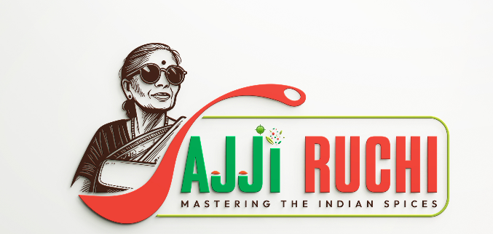
50 YEARS OF AUTHENTIC SOUTH INDIAN RECIPES
Ajji Ruchi
Mastering the Indian spices. Grandmother's kitchen, now packed for yours.
Company introduction and product portfolio

Slide 2
Our story
Ajji Ruchi is a traditional homemade food business inspired by the recipes and cooking of my grandmother, Ajji. We deliver hygienic, preservative-free and nutritious food that brings back nostalgia and comfort.
Trusted for 50 years
Crafted with pure ingredients
Made for busy lives
A family business now stepping into homemade-style packaged products.
Unique, healthy South Indian masala powders from recipes passed down through generations.
Bridging modern lifestyles and traditional cooking for working professionals, students and families.

Slide 3
Vision, mission and promise
Vision: to become a trusted brand for authentic homemade food, preserving traditional recipes while ensuring quality and convenience.
Fresh and hygienic
Regional flavours
Chemical free
Consistency
Fresh, hygienic and nutritious homemade meals.
Preserve traditional recipes and regional flavours.
Quality products with no chemicals.
Customer satisfaction through quality and consistency.

Slide 4
Who we serve and why now
Working professionals
Students
Health-conscious individuals
Families
Bachelors
Retail and wholesale
Export
Healthy food demand
Shift to homemade
Masalas are growing
Growing demand for healthy food as busy lifestyles drive the need for convenience.
Consumers are moving to traditional, homemade, preservative-free food.
Ready-made sambar and rasam masalas offer consistent taste, and blended masalas are among the fastest-growing segments.

Slide 5
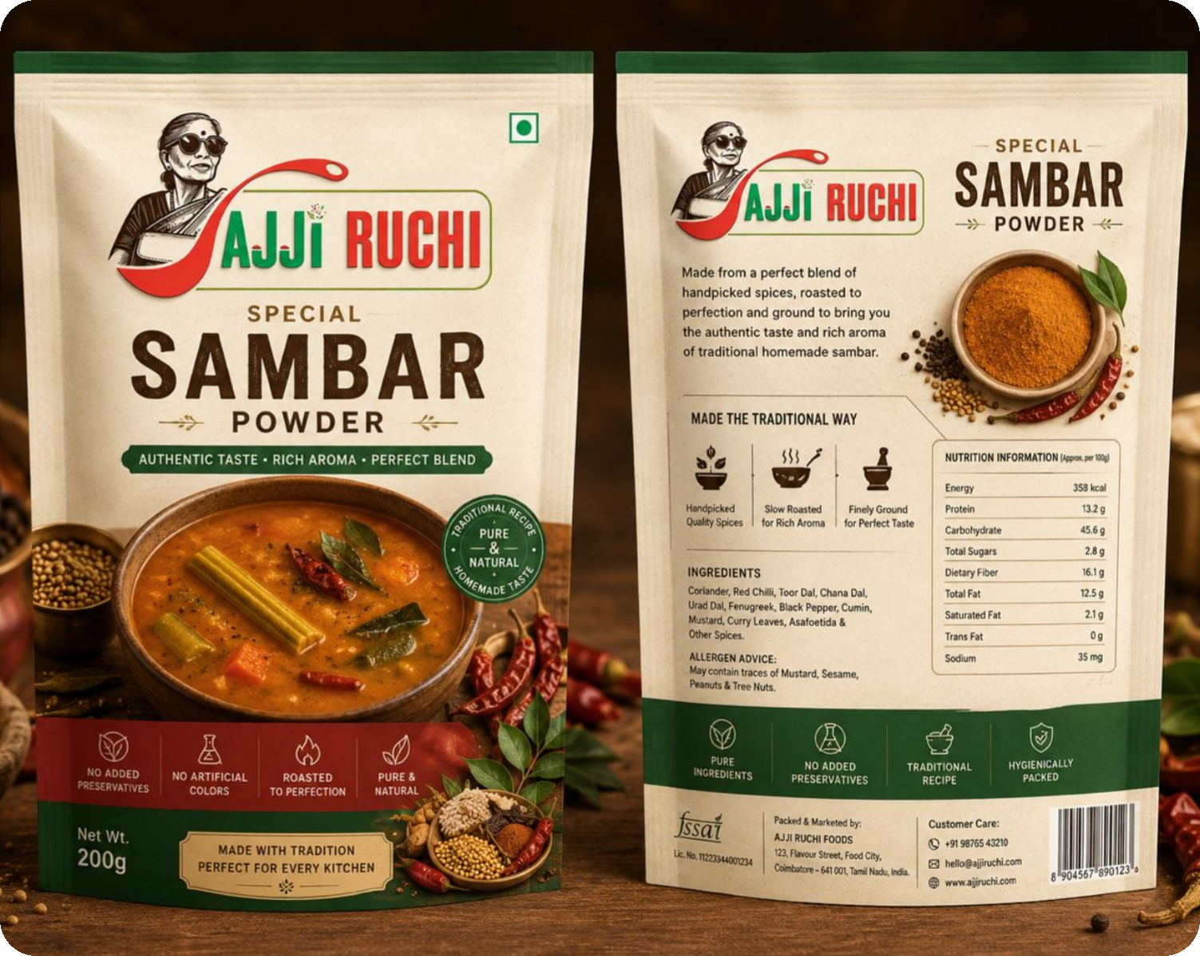
FLAGSHIP PRODUCT
Special Sambar Powder
Handpicked spices, slow roasted and finely ground for the authentic taste and rich aroma of traditional homemade sambar.
Authentic taste · Rich aroma · Perfect blend

Slide 6
The pouch range
AJJI RUCHI
AJJI RUCHI
AJJI RUCHI
AJJI RUCHI
AJJI RUCHI
AJJI RUCHI
Special Sambar Powder
Chilli Powder
Coriander Powder
Turmeric Powder
Palya Powder
Rasam Powder
Pure and natural
Pure and natural
Pure and natural
Pure and natural
Pure and natural
Pure and natural
AJJI RUCHI
AJJI RUCHI
AJJI RUCHI
AJJI RUCHI
AJJI RUCHI
+ 19 more mixes and masalas
Vangi Bath Powder
Bisi Bele Bath Powder
Tomato Bath Powder
Puliyogare Powder
Garam Masala Powder
Pure and natural
Pure and natural
Pure and natural
Pure and natural
Pure and natural

Slide 7
Growth plan
Expand product menu
Partner with apps
Launch packaged products
Open outlets
Franchise stalls
Export traditional foods
Revenue
Also sourcing and trading
Subscriptions, online orders and bulk orders with competitive pricing.
Rice, arecanut, pepper and coffee.
Authentic grandmother-style flavours for modern kitchens.

