Slide 1
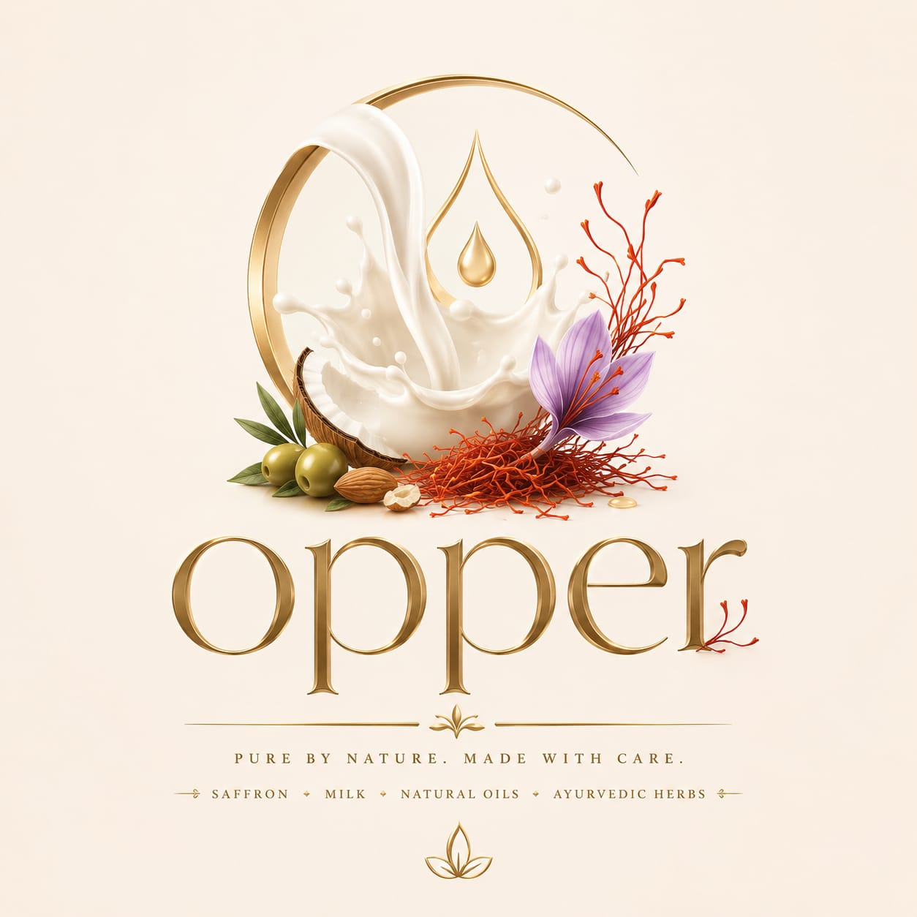
OPPER
ORGANIC SOAP & SKINCARE
An Entrepreneurship Journey
Handmade, Pure & Organic Saffron Soap — shared with MBA students
GEETHA
Founder, OPPER Organic Soap & Skincare
Working Professional • Entrepreneur • Motivator • Dreamer

Slide 2
HI, I'M GEETHA
A working professional, a mother, and a dreamer.
I always believed in living a life of meaning. My journey as an entrepreneur began with a simple desire — to create products and experiences that bring wellness, joy, and sustainability into everyday life. That belief grew into OPPER, my organic soap and skincare brand rooted in nature.
Founder & Motivator
Balancing a professional career with an entrepreneurial journey, with grace.
Purpose-Driven
Building brands that uplift lives and give back to the community.
Present Every Day
Grateful for the journey so far, excited for what's ahead.

Slide 3
Statistics
~50 million new businesses are started globally every year.
Maharashtra, Karnataka, Uttar Pradesh, Delhi and Gujarat are the top startup hubs by the number of recognized startups
Around 50% of startups originate from Tier-II and Tier-III cities, showing entrepreneurship is spreading beyond major metros
India is the 3rd-largest startup ecosystem in the world, with 120+ unicorns valued at over US$350 billion combined
About 20% of new businesses fail within their first year - Lack of discipline and planning in the start ups
Around 50% fail within five years - No market need is the leading reason for startup failure (about 35–42% of cases)
About 65% fail within ten years – For not innovating, upgrading or growth in the existing market / completion ) eg Nokia
Running out of cash is another major reason (about 29–38% of startup failures)
MSMEs contribute 31.1% of India's GDP, 35.4% of manufacturing output, and 48.58% of exports, making them a major pillar of India's economy
Key takeaway
India has one of the world's fastest-growing entrepreneurial ecosystems, backed by a strong startup culture, government support, expanding digital commerce, and a large MSME base. This creates significant opportunities for entrepreneurs starting businesses in manufacturing, services, technology, and consumer products.
Adding to the above I have worked with top MNC – Like IBM, Capgemini, Hp ,TCS ,Shell and Benz co, Apple
Apple started in small Garage along with Setve jobs Founded in a California garage on April 1, 1976,
HP in 1939 – Garage by Bill Hewlette Packard – audio ausiclator , scientific calculator etc.

Slide 4

Every big brand starts with one small, honest reason. Mine was simply the wish to become an entrepreneur Be My Own Boss — to build something of my own, rooted in purity and purpose.
MY STORY
From a Dream to a
Purpose-Driven Journey
"Small or big — dreaming of what you wish to become is an individual choice. I chose to dream of OPPER.“
That passion took shape as OPPER — a handmade, pure and organic saffron soap brand, crafted with goat milk, saffron, ayurvedic herbs, and nourishing oils. Every bar carries a promise: skincare that is natural, chemical-free, and made with care.
The vision didn't stop there — it also gave birth to GEET, a sister brand for eco-friendly, personalized gifting.

Slide 5

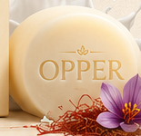
WHAT IS OPPER
Organic Soap & Skincare, rooted in nature
Crafted with the goodness of goat milk, saffron, ayurvedic herbs and nourishing oils — OPPER is my promise of pure, natural, chemical-free skincare that nurtures skin and soul.
Natural Ingredients
Organic Goodness
Chemical Free
Deep Nourishment
Premium Goat Milk & Saffron Bathing Bar
Handcrafted Saffron Bathing Bar
Luxury rooted in nature — my flagship product, handcrafted in small batches.

Slide 6

THE CHALLENGE
Making, packaging, and dreaming were the easy parts.
Entering the Market
The real struggle began when it was time to step out — to introduce OPPER to the market and earn the trust of customers who had never heard the name before. Every conversation, every rejection, every small "yes" was a lesson in persistence.
Zero brand recognition on day one
Convincing customers to trust a new, handmade product
Building distribution one relationship at a time
"Struggles are for real — but they are also where an entrepreneur is truly built."

Slide 7


BUILT WITH PURPOSE
Two brands, one belief — wellness and thoughtfulness in everyday life
OPPER
GEET
Organic Soap & Skincare
Gifting Solutions — "Feel the Love"
Handmade, pure, and organic saffron soap crafted with goat milk and ayurvedic herbs. Natural, chemical-free skincare for everyday nourishment.
Thoughtfulness meets sustainability. Eco-friendly, personalized gifting solutions for every occasion — spreading love while caring for our planet.
Natural
Handmade
Made in India
Eco-friendly
Personalized
Corporate Gifting

Slide 8




WHAT DRIVES ME
PASSION
PURPOSE
BALANCE
BELIEF
For natural living, sustainable products & meaningful impact.
To create brands that uplift lives and give back to the community.
Managing a professional career and entrepreneurial journey with grace.
That small steps toward wellness create a big change in life.

Slide 9

THE MESSAGE I WANT TO LEAVE YOU WITH
Dreaming is a choice
Be ready for the struggle
Small or big, dreaming to become what you wish is an individual choice. Nobody can make that decision for you — and nobody can take it away from you either.
Whatever you choose to build, be ready to face challenges — the struggles are real. Every rejection, every slow month, every hard conversation is part of the price of building something true.

Slide 10


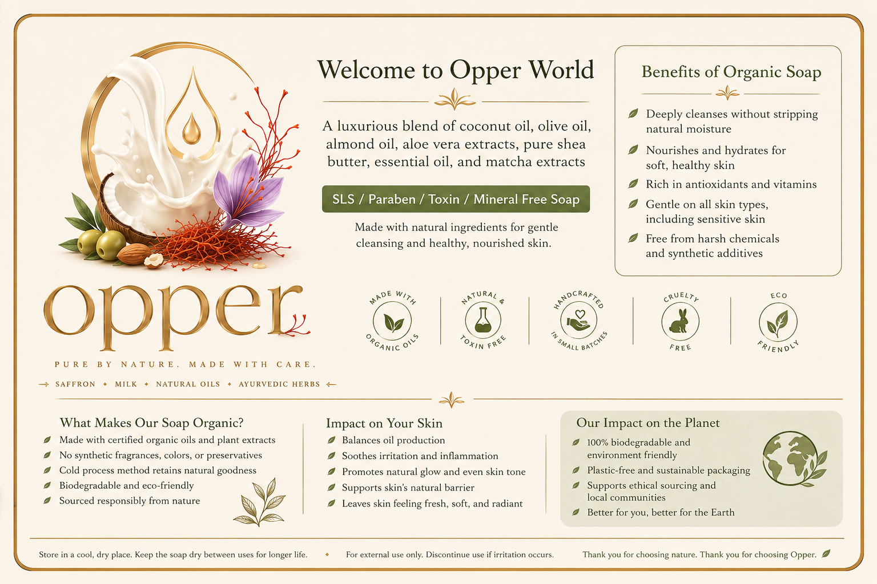
WHERE WE STAND TODAY
Growth built one trusted customer at a time.
Every one of these relationships was earned offline — in person, through word of mouth, through trust built bar by bar. No shortcuts, just consistency.
500+
and growing, one conversation at a time
Steady, relationship-led growth — no paid ads, just trust.

Slide 11
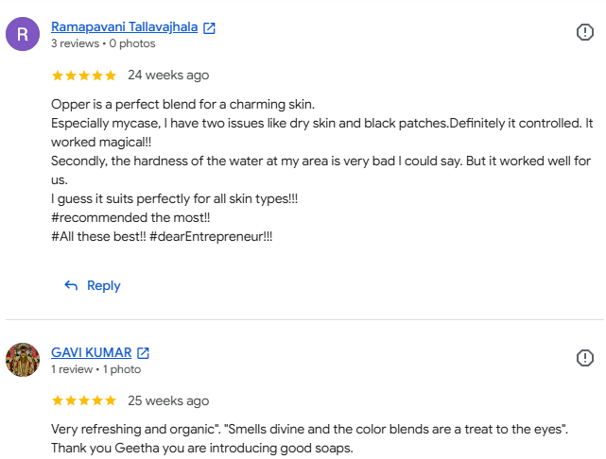

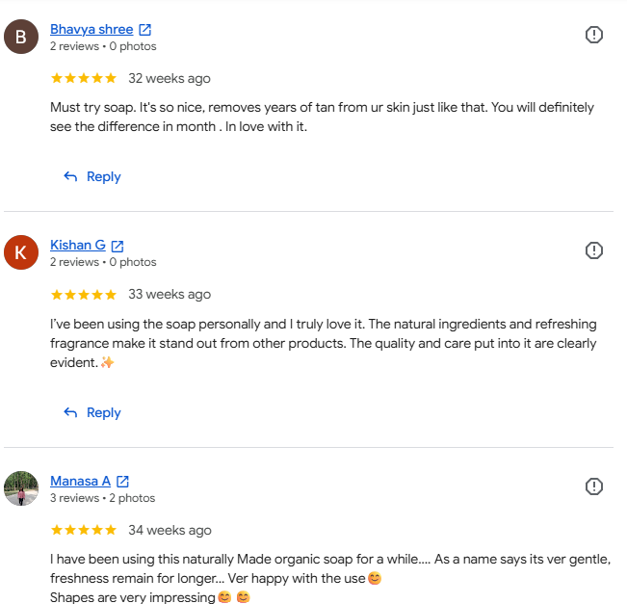
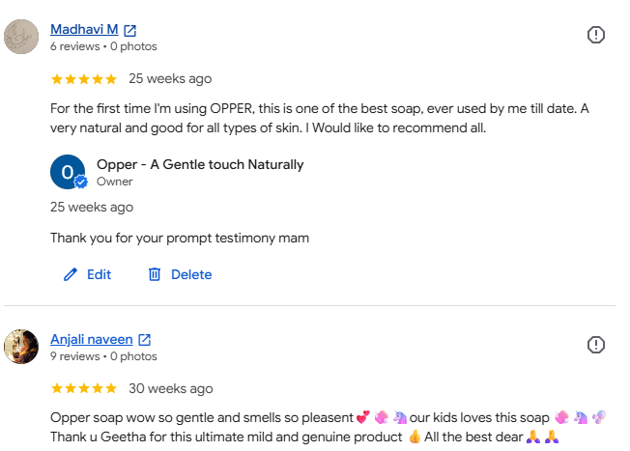
Testimony

Slide 12

But happiness is endless.
Ajji Ruchi aims to bring authentic grandmother-style flavors to modern kitchens. With growing demand for traditional foods and a strong brand story, the business has strong potential for expansion and profitability.
@Ajjiruchi - 7338644404
The struggles are real, yes — but so is the joy of building something from nothing,
of watching a single idea turn into 500 relationships and recognition.
that joy never runs out.

Slide 13

MILESTONE MOMENTS
Recognition Along the Way
Adya Foundation
Anshu Foundation
Startup Award
Powerful Women Achiever Award
For building OPPER from a handmade idea into a growing brand.
For leading with purpose as a woman entrepreneur and motivator.
Sri Adya and VWMCs
Women Power
For Honoring Women , Empowering Future
These recognitions validated what I had believed all along — that a small, idea, built with honest and care, could earn a place on a bigger stage.

Slide 14

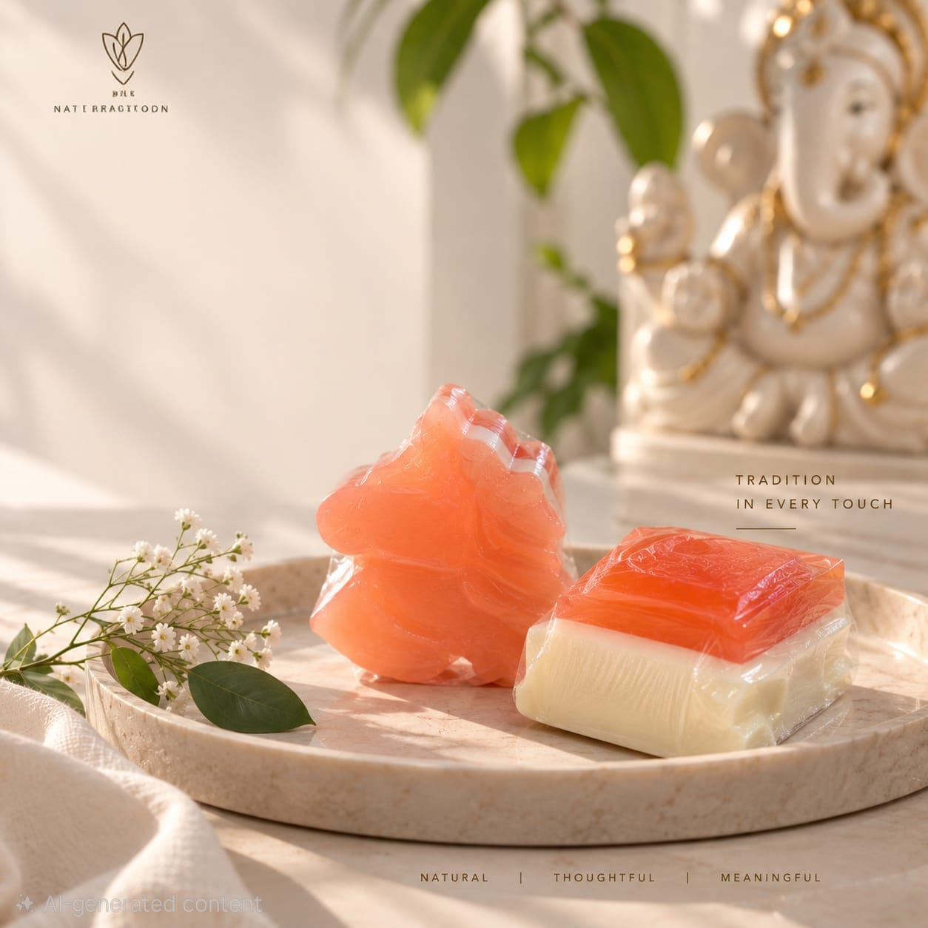
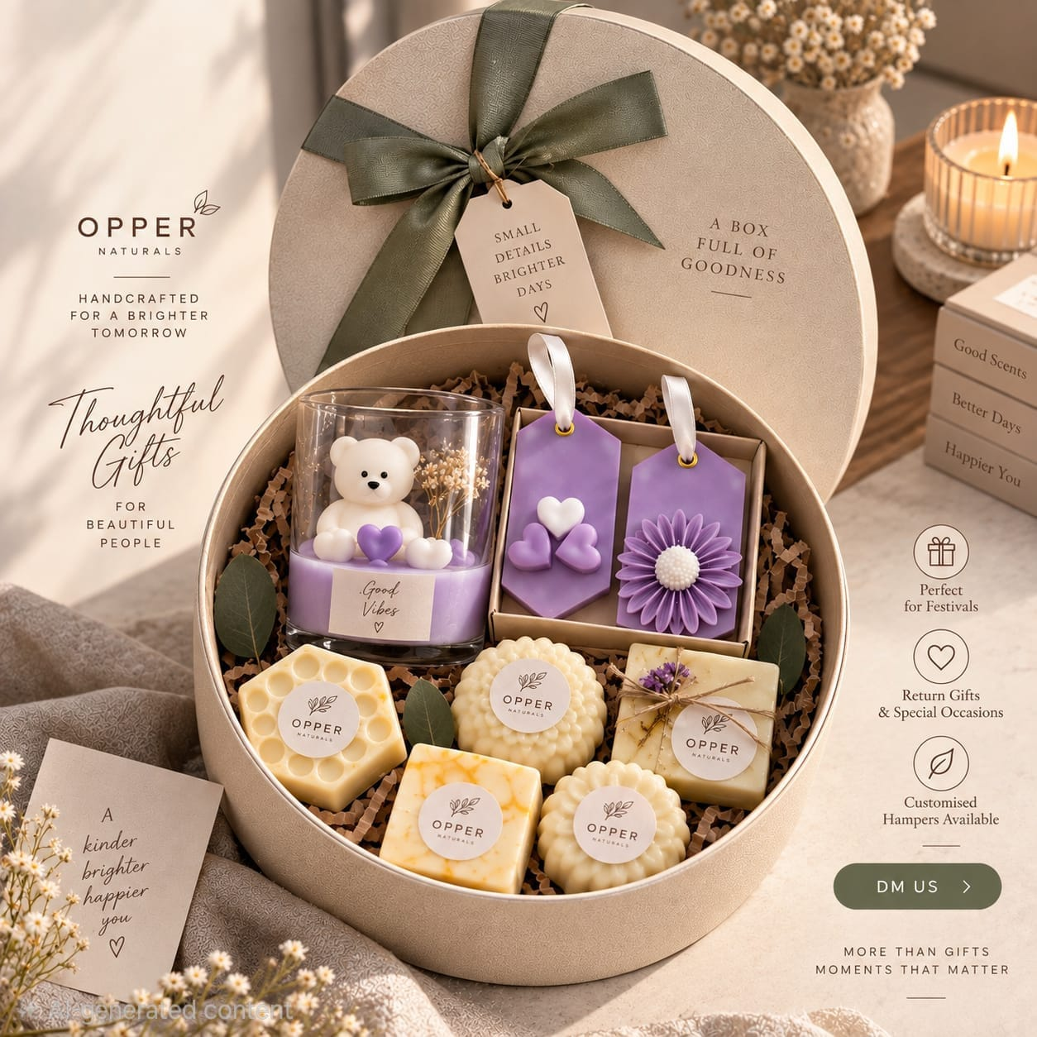
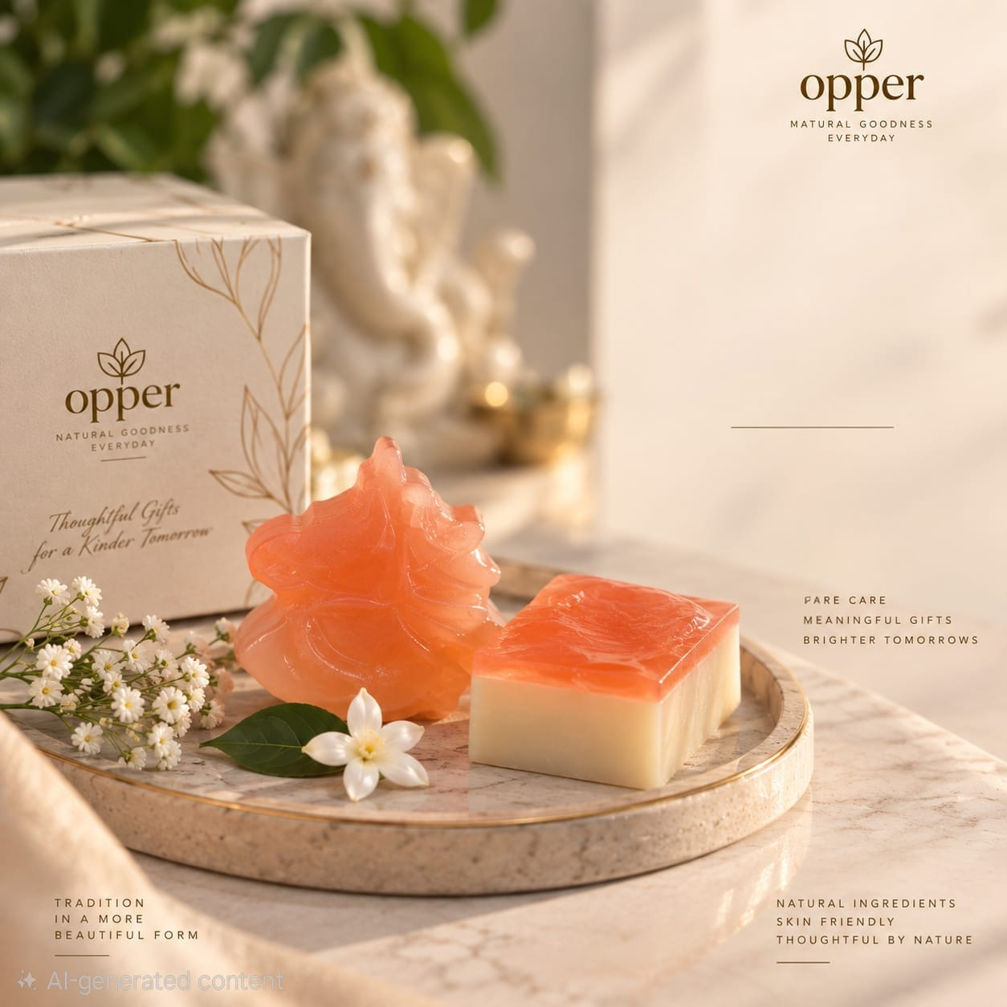
Opper – products
Goat milk Saffron
Carrot and shea butter – also available as gift combo for all your loved one’s event.
Thank You

Slide 15
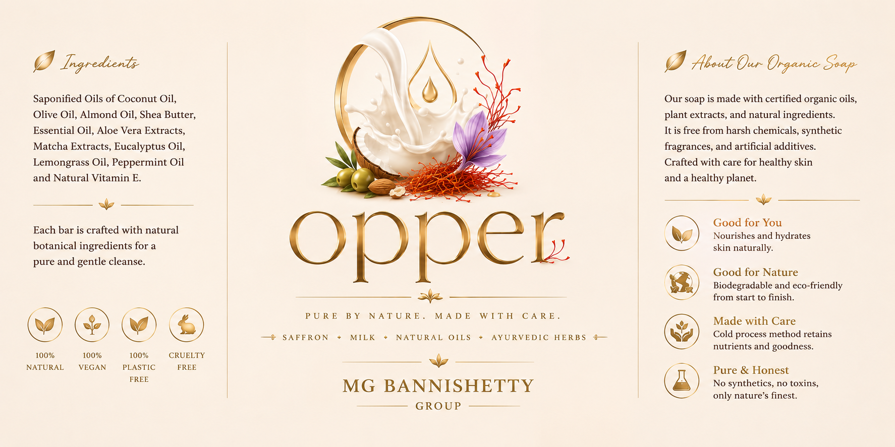
OPPER — Gentle Touch, Naturally
“Take care of your body, It's the only place you have to live in.”
MY MANTRA
Let's build a healthier, happier, and more empowered world — together.
Instagram: Opper_naturals
Thank You

Slide 16
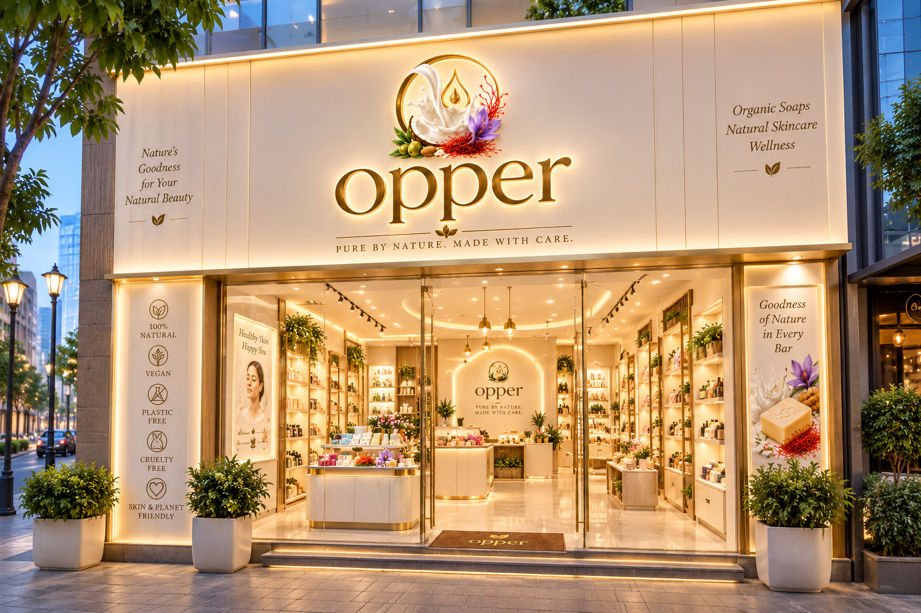

Slide 17
