Slide 1

Sn wflake
-by Shweta Wanjari

Slide 2
Prerequisites
Basic database knowledge
Basic SQL knowledge

Slide 3
Content
Introduction to Snowflake
Snowflake Architecture
Trial account creation , Snowflake Pricing & Editions and Snowflake Web UI
Snowflake Objects
Micro-partitioning and Data Clustering
Stages in snowflake
Fileformats in snowflake
Loading data and Transforming data
Unloading Data
Snowflake Caching
Snowflake CLI
Access Control
Governance and Continuous Data Protection
Zero copy Cloning
Stored procedure
Continuous Data Pipeline(stream/task)
Data Sharing
Search Optimization
Resource Monitor

Slide 4
Introduction
Building traditional data warehouses involved purchasing the required hardware infrastructure and software licenses and maintaining the data in your own data centers. The data warehouse represents a large storage hub for the company’s information, which is integrated from different resources such as sales, marketing and customer accounts. It does not involve those databases utilized in day-to-day transactions; instead, it maintains historical data for analysis reasons so that business firms trace trends and patterns. This is a central platform from where any business firm easily mines all its information for better decision-making.
Snowflake is an excellent choice for companies in modern times seeking ways to store and analyze data. Snowflake, the technology company, facilitates businesses with their data through a cloud data warehouse for storage and analytics, thereby making it easier for them to understand the insights from their data to drive better decisions. Developed in 2012 by Benoit Dageville, Thierry Cruanes and Marcin Zukowski
Snowflake is not just a data warehouse; it’s an all-in-one data hub. It’s good for storing information in a data warehousing fashion, analyzing large amounts in a data lake, creating tools to work with in data engineering, using it to find out trends in data science and even building applications based on it. All this data is shared securely with others in real time.
It is a fully managed SaaS (software as a service) offering that enables data storage, processing, and analytic solutions that are physically separated but logically integrated which are faster, easier to use and far more flexible than traditional offerings.

Slide 5
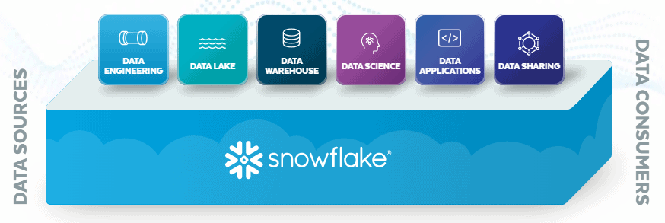
What is Snowflake?
Snowflake is a cloud based data warehousing solution, Founded in 2012.
Snowflake offers data storage and analytics services.
Snowflake does not have their own infrastructure.
It runs on Amazon S3, Microsoft Azure, and the Google Cloud platform.
Snowflake runs completely on cloud infrastructure.
Available as Software-as-a-Service.

Slide 6
Why Snowflake?
Pay for what you use model.
It is a cloud platform, no Infrastructure cost.
Snowflake is more than a Datawarehouse.
It also helps in some transformations, create data pipes, create visual dashboard etc.
High scalability.
Data recovery, backup, sharing, masking.
Can analyze the data present in external files.
Easy integration with Data Visualization/Reporting tolls.

Slide 7
Traditional WH Vs Snowflake
Feature | Traditional WH | Snowflake
Infrastructure cost | yes | No Infrastructure cost
Handle semi structure data | Need ETL tools | Snowflake can process
Data loading and unloading | Need ETL tools | Can be done by using “COPY”
Scalability | Not an easy task | Highly Scalable (support Scale-up and Scale-out)
Database Administration | Highly Required | In-built performance optimization with its micro partitions and cluster keys

Slide 8
Traditional WH Vs Snowflake
Feature | Traditional WH | Snowflake
Infrastructure cost | yes | No Infrastructure cost
Handle semi structure data | Need ETL tools | Snowflake can process
Data loading and unloading | Need ETL tools | Can be done by using “COPY”
Scalability | Not an easy task | Highly Scalable (support Scale-up and Scale-out)
Database Administration | Highly Required | In-built performance optimization with its micro partitions and cluster keys

Slide 9
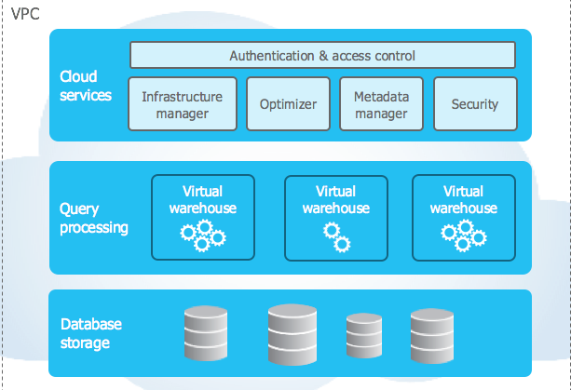
Snowflake Architecture
Cloud Services
Scalable, resilient cloud services layer
coordinates access & management
Independently Scalable Compute
Multiple "virtual warehouses" compute clusters scale horsepower & concurrency
Centralized Storage
Instant, automatic
scalability & elasticity

Slide 10
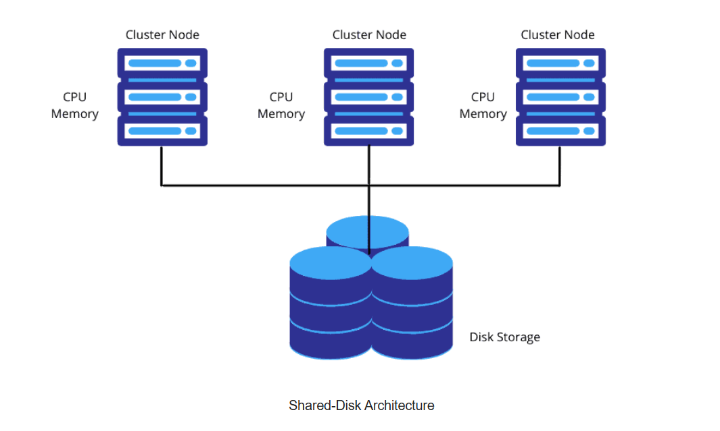
Scalability and performance are limitations.

Slide 11
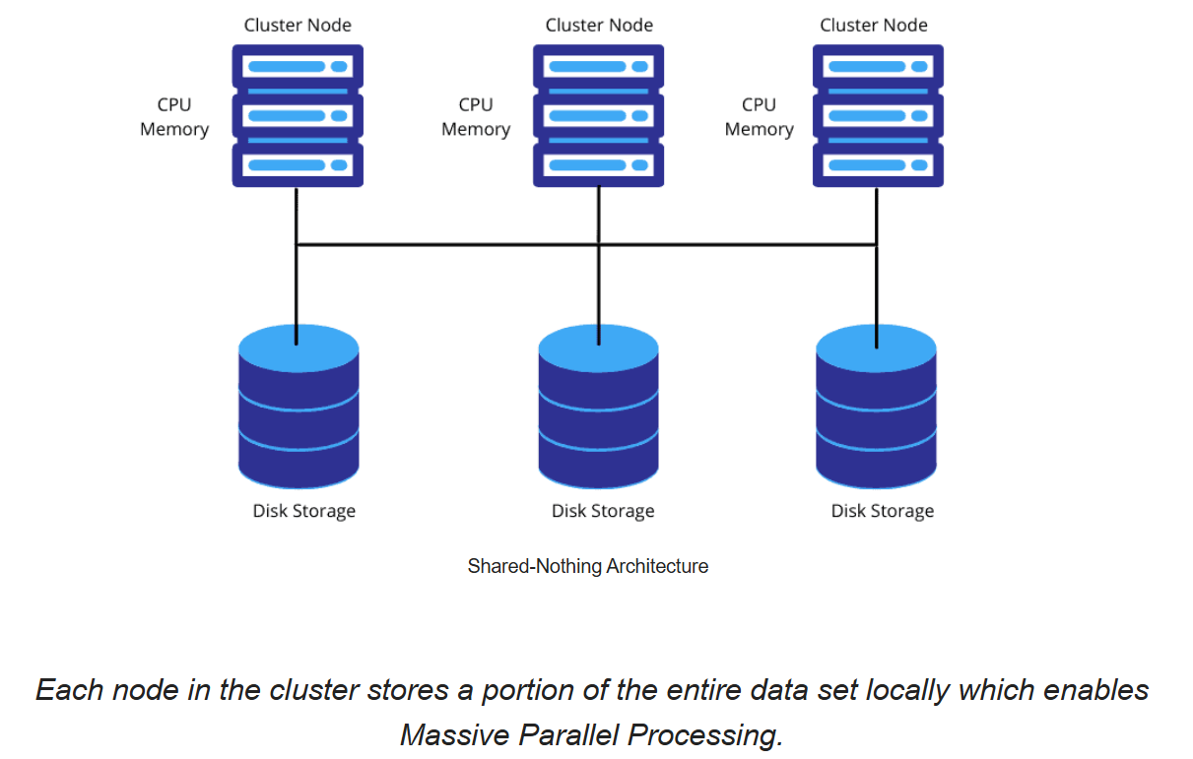
This model might lead to data loss if the copies of partitioned data is not maintained as backup in another cluster nodes, as there is no redundancy.

Slide 12
Cloud services layer
Snowflake cloud services layer is a collection of services that coordinate activities such as authentication, access control and encryption.
It also includes management functions for handling infrastructure and metadata, as well as performing query parsing and optimization, among other features. This global services layer is sometimes referred to as the Snowflake "brain" because all the various service layer components work together to handle user requests that begin from the time a user requests to log in.
The cloud services layer manages data security including the security for data sharing. The Snowflake cloud services layer runs across multiple availability zones in each
cloud provider region and holds the results cache, a cached copy of the executed query results. The metadata required for query optimization or data filtering are also stored in the cloud services layer

Slide 13
Query processing or Compute layer
A Snowflake compute cluster, most often referred to simply as a "virtual warehouse," is a dynamic cluster of compute resources consisting of CPU memory and temporary storage. Creating virtual warehouses in Snowflake makes use of the compute clusters, virtual machines in the cloud, which are provisioned behind the scenes. Snowflake doesn't publish the exact server in use at any given time; it could change as the cloud providers modify their services. The Snowflake compute resources are created and deployed on-demand anytime to a Snowflake user, such as yourself, for whom the process is transparent.
Snowflake's unique architecture allows for separation of storage and compute which means any virtual warehouse can access the same data as another, without any con-tention or impact on performance of the other warehouses.

Slide 14

A ‘Virtual Warehouse’ is a cluster of one or more compute resources used to process queries and other DML operations

Slide 15
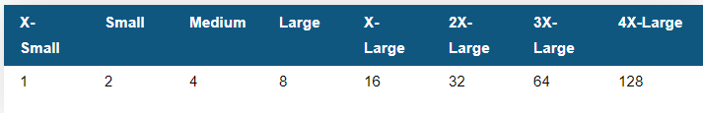
Warehouses come in different sizes.
The size of warehouse determines the number of servers in each cluster in the warehouse.
No. of EC2 Servers on AWS

Slide 16
Database Storage Layer
Centralized (Hybrid-Columnar) Database Storage Layer
Snowflake's centralized database storage layer holds all data, including structured and semi-structured data. As data is loaded into Snowflake, it is optimally reorganized into a compressed, columnar format and stored and maintained in Snowflake data-bases. Each Snowflake database consists of one or more schemas, which is a logical grouping of database objects such as tables and views.
The data objects stored created by Snowflake are not directly visible nor accessible by customers, they are only accessible by running SQL queries from Snowflake.
Snowflake automatically organizes stored data into micro-partitions, an optimized immutable com-pressed columnar format, which is encrypted using AES-256 encryption. Snowflake optimizes and compresses data to make metadata extraction and query processing easier and more efficient.
There are two unique features in the storage layer architecture - time travel and zerocopy cloning.

Slide 17
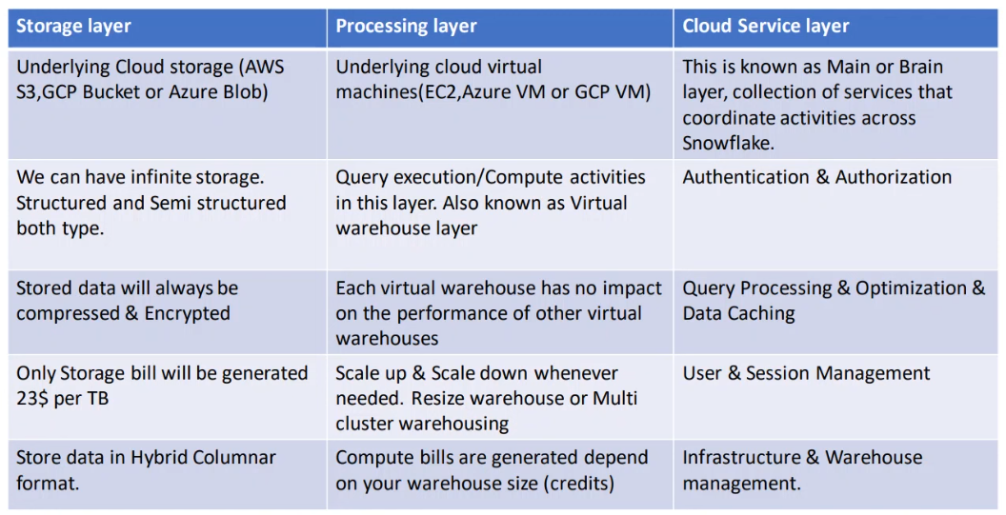

Slide 18
Snowflake Editions
4 Editions:
Standard Edition
Enterprise Edition
Business Critical Edition
Virtual Private Snowflake(VPS)

Slide 19
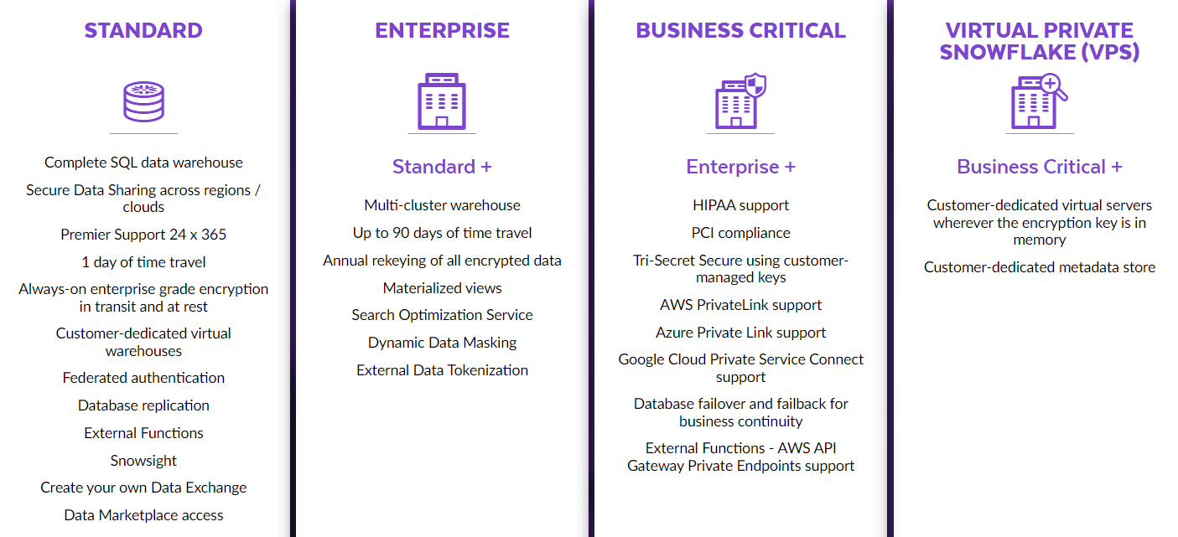

Slide 20
Snowflake Pricing
Cost Depends On?
📌 Tip:
Snowflake cost is dependent on:
Snowflake Edition
Standard - $2.7/Credit
Enterprise - $4/Credit
Business Critical - $5.4/Credit
VPS – Depends on Org
Region where Snowflake account created
Cloud platform where Snowflake account hosted
Virtual Warehouse Size
Cost is dependent on the edition we are choosing
Most of the organizations choose either Enterprise or Business Critical

Slide 21
Types of Costs
Storage Cost
Compute Cost
Cloud Services Cost
https://www.snowflake.com/en/pricing-options/

Slide 22
What is a Snowflake Credit
A snowflake credit is a unit of measure
Snowflake credits are used to pay for the consumption of the resources on Snowflake
It is consumed only when a customer is using resources, such as when using virtual warehouses.
Users receives $400 worth of free usage upon creation of Snowflake free trial account

Slide 23
Connecting to Snowflake
Snowflake supports multiple ways of connecting to the service:
A web-based user interface from which all aspects of managing and using Snowflake can be accessed.
Command line clients (e.g. SnowSQL) which can also access all aspects of managing and using Snowflake.
ODBC and JDBC drivers that can be used by other applications (e.g. Tableau) to connect to Snowflake.
Through native connectors available in ETL tools (e.g. Datastage, Informatica)

Slide 24
Account creation
Create warehouse
Create database
Create schema

Slide 25
Snowflake Objects
Tables
Views

Slide 26
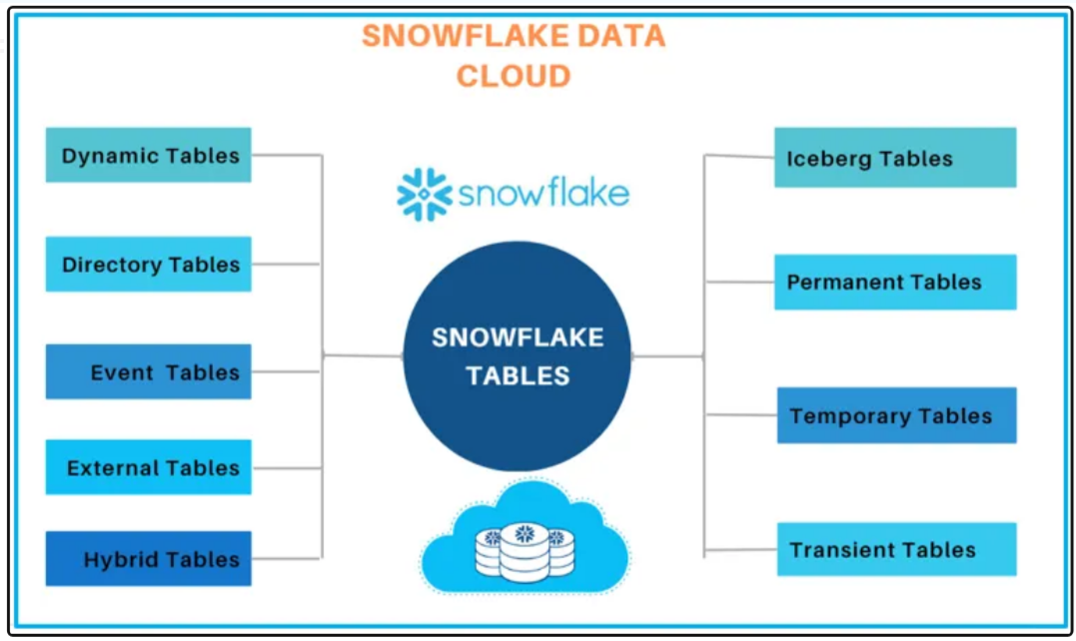
Tables

Slide 27
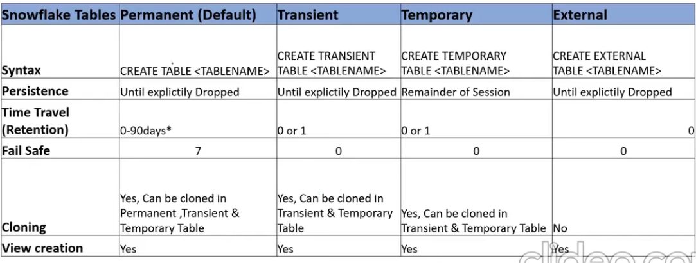
Tables and Their properties

Slide 28
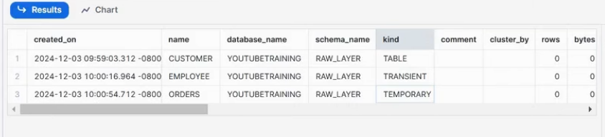
How to find the table type?
Look at the ‘Kind’ filed in SHOW TABLES properties

Slide 29
Views
A View is a database object that contains SQL query built over one or multiple tables.
A View can be considered as a virtual table that can be used almost anywhere that a table can be used (filters, joins, subqueries, etc.).
Whenever you query a view, the underlying SQL query associated with the view gets executed dynamically and will fetch data from underlying tables.
Views serve a variety of purposes like combining, segregating and protecting data.
A view can be created with below syntax
CREATE OR REPLACE VIEW VIEW_NAME
AS SELECT Statement;

Slide 30
Types of Views
In snowflake we can see 3 types of views.
Non-materialized views (Normal views)
Secure views
Materialized views

Slide 31
Secure Views
A Secure View does not allow users to see the definition of the view.
Users can’t see the underlying sql query.
The definition of a secure view is only exposed to authorized users i.e. users who have been granted the role that owns the view.
2 Advantages of secure views
Can protect the data by not exposing to other users.
I don’t want the users to see underlying tables present in our database.
Use SECURE keyword to create secure views
CREATE OR REPLACE SECURE VIEW VIEW_NAME
AS SELECT Statement;

Slide 32
Materialized Views
A materialized view stores pre-computed result set.
Querying a materialized view gives better performance than querying the base tables.
Can create on a single table, can’t build on multiple tables.
Designed for improved query performance when we are using same dataset repeatedly.
Available in Enterprise edition and higher.
Can be created with MATERIALIZED key word
CREATE OR REPLACE MATERIALIZED VIEW VIEW_NAME
AS SELECT Statement;

Slide 33
When to create Materialized Views
Create a materialized view when all of the following are true:
The query results from the view don’t change often
The results of the view are used often
The query consumes a lot of resources means query takes longer time for processing like aggregating data.
Create a regular view when any of the following are true:
The results of the view change often
The results are not used often
The query is simple
The query contains multiple tables

Slide 34
Micro-partitioning
Snowflake has implemented a powerful and unique form of partitioning, called micro-partitioning.
Micro-partitioning is automatically performed on all Snowflake tables.
Tables are transparently partitioned using the ordering of the data as it is inserted/loaded.
Micro-partitions are small in size (50 to 500 MB).
Data is compressed in micro partitions
Snowflake automatically determines the most efficient compression algorithm for the columns in each micro-partition.

Slide 35
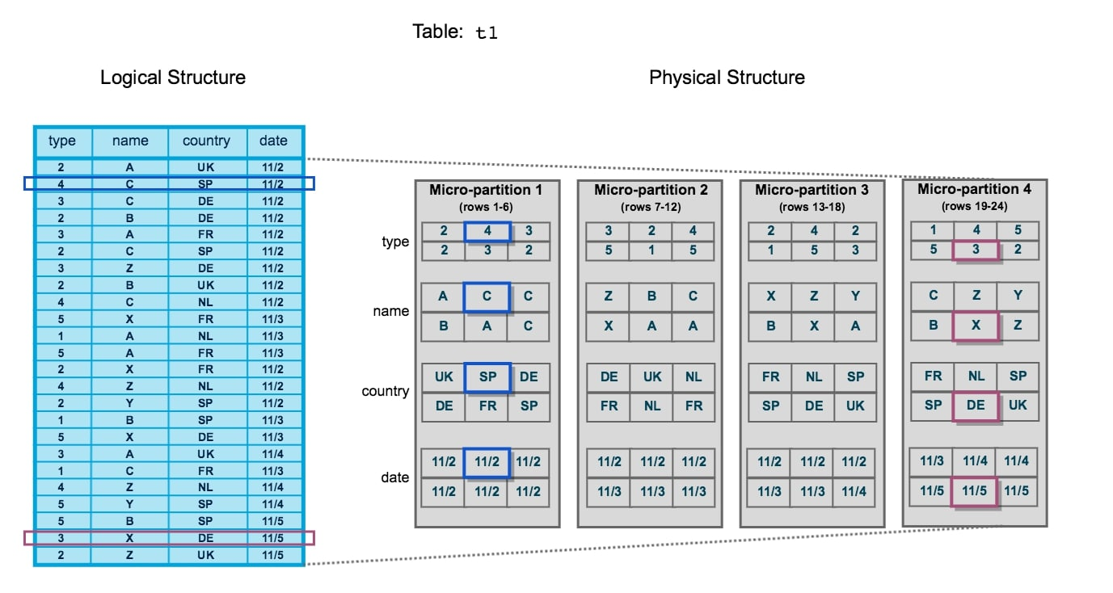

Slide 36
Query pruning
Metadata is also maintained by Snowflake which Includes…
the number of distinct values for each field
the range of values for each field
Other useful information to improve performance.
Metadata is a key part of the Snowflake architecture as it allows queries to determine whether or not the data inside a micro-partition should be queried.
This way, when a query is executed, it does not need to scan the entire dataset but instead only queries the micro-partitions that hold relevant data.
This process is known as query pruning, as the data is pruned before the query itself is executed.

Slide 37
Benefits of Micro partitioning
In contrast to traditional static partitioning, Snowflake micro-partitions are derived automatically; they don’t need to be explicitly defined up-front or maintained by users.
Micro-partitions are small in size (50 to 500 MB), which enables extremely efficient DML and fine-grained pruning for faster queries.
Columns are stored independently within micro-partitions, often referred to as columnar storage. This enables efficient scanning of individual columns; only the columns referenced by a query are scanned.
Columns are also compressed individually within micro-partitions, this optimizes the storage cost.

Slide 38
Clustering
Clustering is a key factor in query performance, It reduces the scanning of micro partitions.
A clustering key is a subset of columns in a table that are explicitly designated to co-locate the data in the table in the micro-partitions.
Initially the data will be stored in micro partitions in the order of inserting records, then will be realigned based on the cluster keys.
We have to choose proper Cluster keys.
We can define cluster keys on multiple columns as well.
We can modify the cluster keys based on our requirements, this is called as re-clustering.
Re-clustering consumes credits, number of credits consumed depends on the size of the table.
📌 Tip:
You should apply clustering only when your data set is more than 1 million records
Don’t define cluster keys on more than 4 columns.

Slide 39
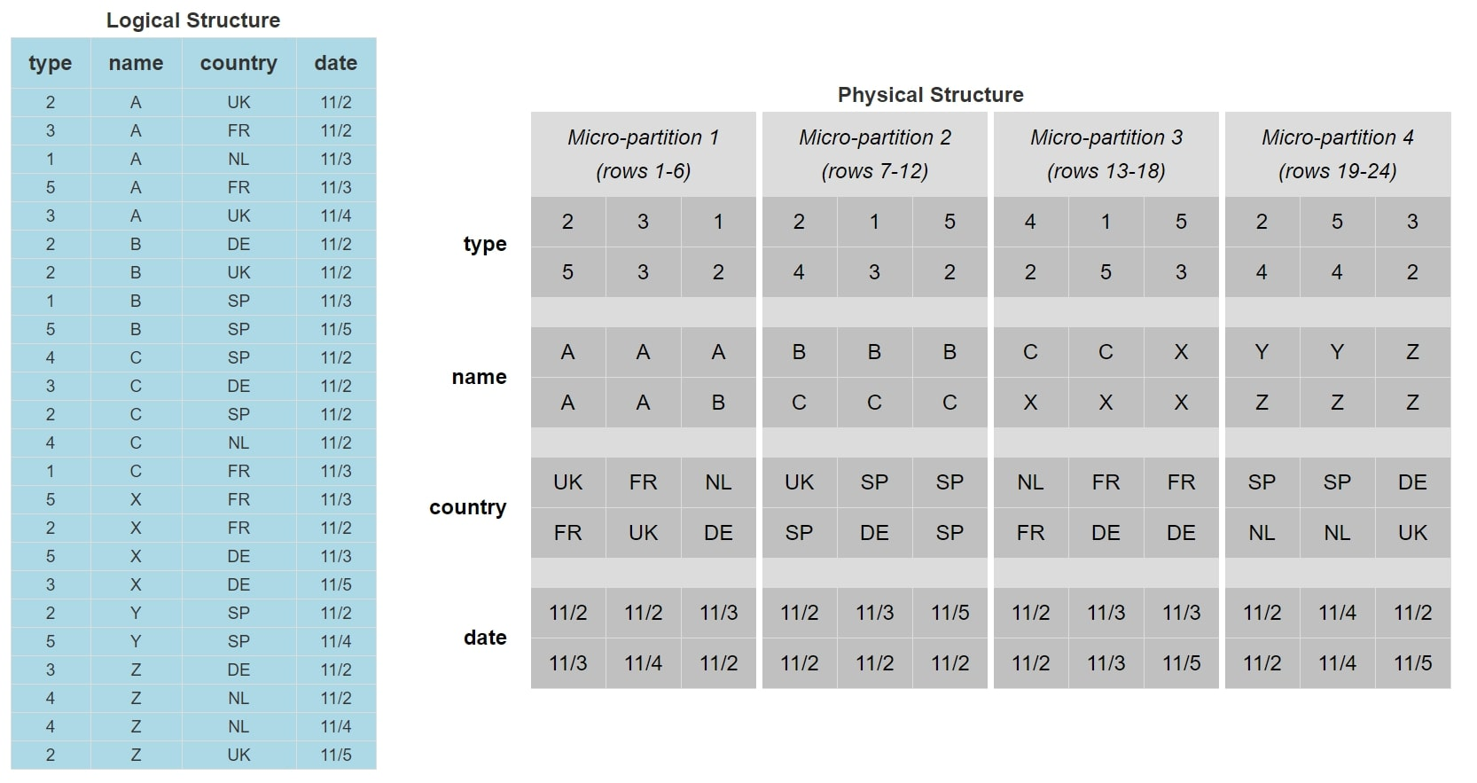
The data is now stored and ordered based on the value of the [name] field.
The micro-partition 4 is now the only micro-partition that contains [name] values of Y.
When we execute our earlier query now, the query pruning will reduce our target data down to just micro-partition 4, which means our query has less data to interpret and thus will perform more efficiently.

Slide 40
Defining Cluster keys
Defining Cluster keys on a new table:
CREATE TABLE MY_TABLE
(
type number,
name string,
country string,
date date,
)
CLUSTER BY (name);
Modifying Cluster keys on existing table:
ALTER TABLE MY_TABLE CLUSTER BY (name, date);

Slide 41
Loading data and Transforming data
Load Types
Bulk loading using Copy
Continuous loading using Snowpipe

Slide 42
Bulk Loading Using the COPY Command
This option enables loading batches of data from files already available in cloud storage(External Stages)
We have to create Storage Integration objects to extract data from these cloud storages.
(Or)
Copying data files from a local machine to an Internal Stage(i.e. Snowflake) before loading the data into table.
Bulk loading uses virtual warehouses
Users are required to size the warehouse appropriately to accommodate expected loads using the COPY command.

Slide 43
What is a Stage?
A stage specifies where data files are stored (i.e. “staged”) so that the data in the files can be loaded into a table.
Stage is a location of files, that can be internal or external to snowflake

Slide 44
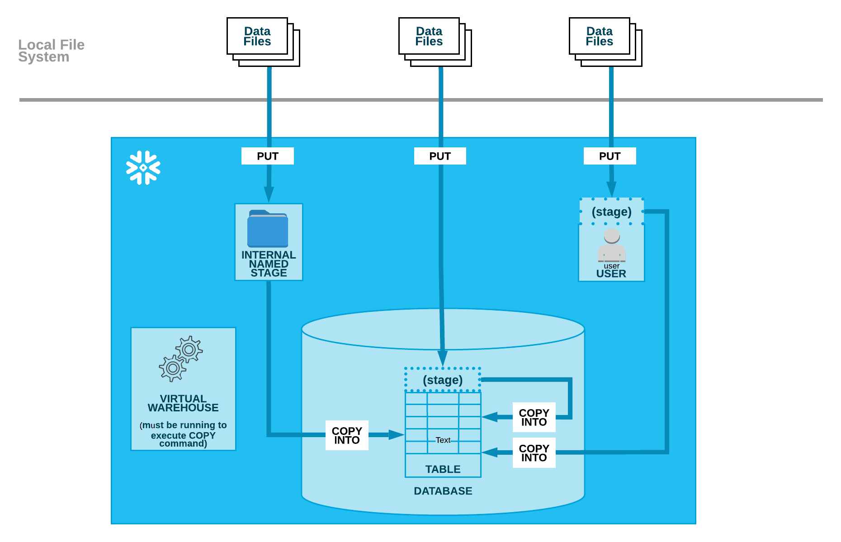

Slide 45
Stage Types
External Stages
Internal Stages
User Internal Stage
Table Internal Stage
Named Internal Stage

Slide 46
External stage
An external stage is the external cloud storage location where data files are stored.
Loading data from any of the following cloud storage services is supported regardless of the cloud platform that hosts your Snowflake account:
Amazon S3
Google Cloud Storage
Microsoft Azure

Slide 47
Internal Stages
Types of Internal Stages:
User Stage
Table Stage
Named Internal Stage

Slide 48
User Stage (@~)
A user stage is allocated to each user for storing files.
To store files that are staged and managed by a single user but can be loaded into multiple tables.
User stages cannot be altered or dropped.
This option is not appropriate if multiple users require access to the files.

Slide 49
Table Stage (@%)
A table stage is available for each table created in Snowflake.
Table stages have the same name as the table.
e.g. a table named mytable has a stage referenced as @%mytable
To store files that are staged and managed by one or more users but only loaded into a single table.
Table stages cannot be altered or dropped.
Note that a table stage is not a separate database object, rather it is an implicit stage tied to the table itself.

Slide 50
Named Internal Stage (@)
A named internal stage is a database object created in a schema
To store files that are staged and managed by one or more users and loaded into one or more tables.
Create stages using the CREATE STAGE command (similar to external stages)
CREATE OR REPLACE STAGE MYDB.internal_stages.sample_stage

Slide 51
FILE FORMAT in SNOWFLAKE
A Snowflake file format is a named database object that encapsulates information about a data file. This information includes the file's type (CSV, JSON, etc.), formatting options, and compression method. Snowflake file formats are used to simplify the process of loading and unloading data from Snowflake tables.
In Snowflake we have to create file format to load data and as per our data/files we can change our Parameteres.
Here are the list of supported Snowflake file formats:
CSV (Comma-separated values): This is the most common file format for loading data into Snowflake.
JSON (JavaScript Object Notation): This is a flexible and lightweight file format that is often used for semi-structured data.
Avro: A binary file format that is efficient for storing and querying large datasets.
ORC (Optimized Row Columnar): A columnar file format that is optimized for analytical queries.
Parquet: A columnar file format that is similar to ORC, but it is more widely supported.
XML (Extensible Markup Language): This is a text-based file format that is often used for storing structured data.

Slide 52
COPY Command for Data loading
Loads data from staged files to an existing table. The files must already be staged in one of the following locations. LOAD data Inot Tables from Stages.
Syntax: COPY INTO <Tablename>
From <stagename>;
PARAMETERS:
ON_ERROR= {CONTINUE | SKIP_FILE | ABORT_STATEMENT }
FORCE=TRUE
VALIDATION_MODE=RETURN_ALL_ERRORS/RETURN_ERRORS;
MAX_FILE_SIZE=BYTES; --COPY INTO LOCATION
RETURN_FAILED_ONLY=TRUE;
PURGE=TRUE
MATCH_BY_COLUMN_NAME=CASE_INSENSITIVE
INCLUDE_METADATA=(Columnanme =METADATA$field)

Slide 53
Metadata columns
METADATA$FILENAME
METADATA$FILE_ROW_NUMBER
METADATA$FILE_CONTENT_KEY
METADATA$FILE_LAST_MODIFIED
METADATA$START_SCAN_TIME

Slide 54
Continuous Loading Using Snowpipe
Designed to load small volumes of data (i.e. micro-batches) and incrementally make them available for analysis.
Live or real time data
Snowpipe loads data within minutes after files are added to a stage and submitted for ingestion.
This ensures users have the latest data for business analysis.
Snowpipe uses compute resources provided by Snowflake, It is a serverless task and there will be separate charge for these serverless tasks.
The COPY statement in the pipe definition supports the same COPY transformation options as when bulk loading data.

Slide 55
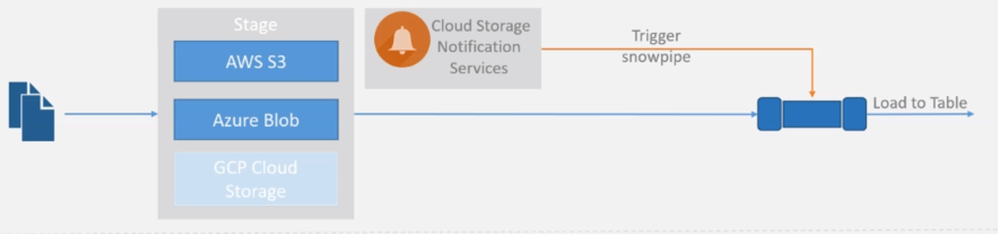
How Snowpipe works?
CREATE OR REPLACE PIPE PIPE_NAME
AUTO_INGEST = [ TRUE | FALSE ] ]
AS
<Copy_Statement>

Slide 56
COPY Command for Data Unloading
The process for unloading data into files is the same as the loading process, except in reverse.
COPY INTO LOCATION: Loads data from table to Stages.
Syntax: COPY INTO <Stagename> From <Tablename>;
PARAMETERS:
VALIDATION_MODE = RETURN_ROWS
INCLUDE_QUERY_ID = TRUE
DETAILED OUTPUT = TRUE
OVERWRITE=TRUE
SINGLE=TRUE
MAX_FILE_SIZE= Default 16MB (16777216)

Slide 57
Unloading Options
OVERWRITE = TRUE | FALSE - Specifies to Overwrite existing files
SINGLE = TRUE | FALSE - Specifies whether to generate a single file or multiple files
MAX_FILE_SIZE = <num> - Maximum file size
INCLUDE_QUERY_ID = TRUE | FALSE - Specifies whether to uniquely identify unloaded files by including a universally unique identifier
DETAILED_OUTPUT = TRUE | FALSE - Shows the path and name for each file, its size, and the number of rows that were unloaded to the file.

Slide 58
Loading Data from AWS
// Creating AWS free account, s3 bucket, IAM Policy, IAM Role
Role ARN from the role summary page.
// Create storage integration object
create or replace storage integration s3_int
TYPE = EXTERNAL_STAGE
STORAGE_PROVIDER = S3
ENABLED = TRUE
STORAGE_AWS_ROLE_ARN = 'arn:aws:iam::555064756008:role/aws_s3_snowflake_intg'
STORAGE_ALLOWED_LOCATIONS = ('s3://bucket-name/path/‘)
COMMENT = 'Integration with aws s3 buckets' ;
// ARN -- Amazon Resource Names
// S3 -- Simple Storage Service
// IAM -- Integrated Account Management

Slide 59
// Create database and schema
CREATE DATABASE IF NOT EXISTS MYDB;
CREATE SCHEMA IF NOT EXISTS MYDB.file_formats;
CREATE SCHEMA IF NOT EXISTS MYDB.external_stages;
// Create file format object
CREATE OR REPLACE file format mydb.file_formats.csv_fileformat
type = csv
field_delimiter = '|'
skip_header = 1
empty_field_as_null = TRUE;
// Create External Stage on AWS S3 location using Cloud Storage Integration.
CREATE OR REPLACE STAGE mydb.external_stages.aws_s3_csv
URL = 's3://awss3bucketjana/csv/'
STORAGE_INTEGRATION = s3_int
FILE_FORMAT = mydb.file_formats.csv_fileformat ;

Slide 60
// Create a table first
CREATE OR REPLACE TABLE mydb.public.customer_data (
customerid NUMBER,
custname STRING,
email STRING,
city STRING,
state STRING,
DOB DATE
);
// Use Copy command to load the files
COPY INTO mydb.public.customer_data
FROM @mydb.external_stages.aws_s3_csv
PATTERN = '.*customer.*';
//Validate the data
SELECT * FROM mydb.public.customer_data;

Slide 61
Snowflake Caching
Cache is a temporary storage location that stores copies of files or data, so that they can be accessed faster in near future.
Cache plays vital role in saving costs and speeding up results.
Improves query performance.
2 Types of caches in Snowflake
Query Results Cache
Local Disk Cache

Slide 62
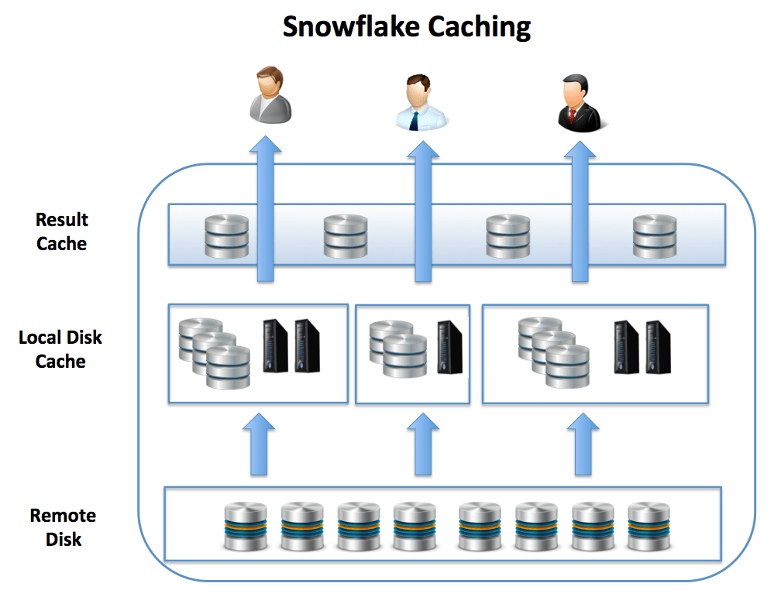
Query ‘RESULTS’
(up to 24 hours)
‘DATA’
(until VW is UP and running)

Slide 63
Results Cache
Results Cache is located in cloud services layer. This Cached data will be available for next 24 hours.
Results Cache will be available and can be accessed across different virtual warehouses.
Query results returned to one user is available to any other user on the system who executes the same query.
Results cache works until underlying data has not changed.
Here mandatory condition is query should be same, won’t work for subset of data, and even won’t work if we re-order columns.

Slide 64
Local Disk Cache
Cached data is only available until the VW is up, once VW is suspended, cache gets deleted.
Even works when we query subset of data that is available in Local disk cache.
Eg. Suppose when we query 10k records for the first time, Local disk cache will hold this 10 k records data and next time if we try to query only 2k or 3k records which is subset of above 10k, it will fetch from Local disk cache itself.
This Cache depends on the Virtual Warehouse Size we are using.
Eg. X-Small VW can’t hold Millions of records, but can fetch part of the data from Local disk cache and remaining from Remote disk.

Slide 65
SNOWSQL/SNOWFLAKE CLI
SnowSQL is the command-line interface (CLI) client designed for connecting to the Snowflake platform. It allows users to execute SQL queries and carry out a wide range of DDL and DML operations, load and unload data, manage databases & warehouses, and perform a whole lot of other administrative tasks.
Here are some key features about SnowSQL:
Available on all OS Linux, Windows, and MacOS
EASY installation
Provides an interactive shell for executing SQL commands
Supports batch mode execution
Includes output formatting options for result sets
Comes with command history
Allows configuration profiles to save connection details
upports variables for parameterizing SQL statements

Slide 66
SNOWSQL COMMANDS
-a: Account Name
-u: User Name
-w: Warehouse Name
-d:Database Name
-r: Role Name
-s: Schema Name
Snowsql-v: Version Name
Snowsql-a <accountname> -u <username> - w <warehousename> -d <databasename>
Pswd:

Slide 67
PUT Command
Uploads (i.e. stages) data files from a local directory/folder on a client machine to one of the following Snowflake stages:
Named internal stage.
Internal stage for a specified table.
Internal stage for the current user.
Syntax: PUT file://<path_to_file>/<filename> internalStage
You must include the drive and backslash in the path (e.g. file://C:\temp\load) If the stage name or path includes spaces or special characters, it must be enclosed in single quotes (e.g. '@"my stage"" for a stage named "my stage")
Folder name with Space:
PUT 'file://C:/Users/91800/Desktop/Snowflake training/Customerdata.csv' @~;
PUT 'file://C:\\Users\\91800\\Desktop\\Snowflake training\\Customerdata.csv' @COPIED_STAGE;

Slide 68
GET Command
Downloads data files from one of the following Snowflake stages to a local directory/folder on a client machine:
Named internal stage.
Internal stage for a specified table.
Internal stage for the current user.
Get does not support download the data from external stages.
Syntax: get @%mytable file:///tmp/data/;

Slide 69
Access Control
What is Access Control?
Access control determines who can access database objects and perform operations on specific objects in Snowflake.
Snowflake supports and combines both of below access control models.
Discretionary Access Control (DAC): Each object has an owner, who can in turn grant access to that object.
Role-based Access Control (RBAC): Access privileges are assigned to roles, which are in turn assigned to users.

Slide 70
Key Concepts
Below are the key concepts of Snowflake Access Control mechanism.
Securable object: An entity to which access can be granted. Tables, schemas, views etc.
Role: An entity to which privileges can be granted. Roles are in turn assigned to users. Note that roles can also be assigned to other roles, creating a role hierarchy.
Privilege: It is level of access that can be granted to any object. Like select, create, drop, insert etc.
User: Specifies the people or system to whom the access granted.

Slide 71
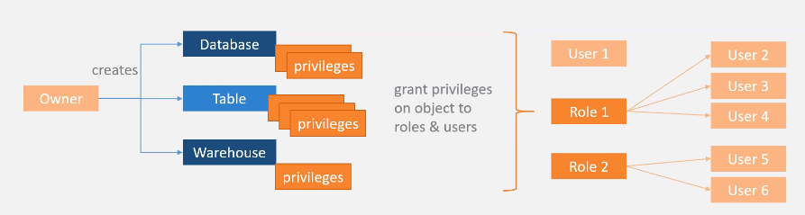
Key Concepts

Slide 72
Privileges
Privilege | Usage
SELECT | Execute a SELECT statement on the table.
INSERT | Execute an INSERT query on the table.
UPDATE | Execute an UPDATE query on the table.
TRUNCATE | Execute a TRUNCATE query on the table.
DELETE | Execute a DELETE query on the table.
ALL [ PRIVILEGES] | Grant all privileges, except OWNERSHIP, on the table.
OWNERSHIP | Grant full control over a table.

Slide 73
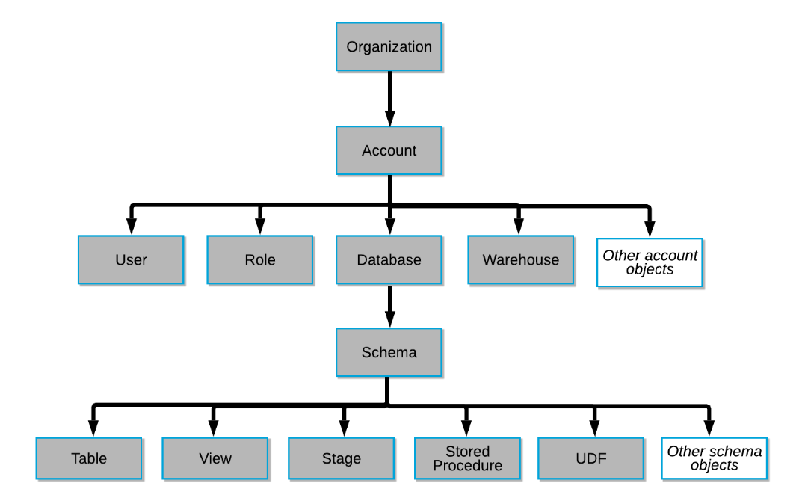
Object Hierarchy

Slide 74
Roles in Snowflake
Roles are the entities to which privileges on securable objects can be granted and revoked.
Roles are assigned to users to allow them to perform actions required for business functions
A user can be assigned multiple roles. This allows users to switch roles.
On Snowflake web UI window the top right corner shows which Role is currently we are using.
Two types of roles
System defined roles
Custom roles

Slide 75
System Defined Roles
ORGADMIN (Organization Administrator): Role that manages operations at the organization level.
ACCOUNTADMIN (Account Administrator):It is the top-level role in the system. Only Account Admin can see all account related things like usage, billing, users, roles, sessions and reader account details. Should be granted only to a limited number of users in your account.
SECURITYADMIN (Security Administrator): Can create, monitor, and manage users and roles.
USERADMIN (User and Role Administrator): Can create users and roles in the account.
SYSADMIN (System Administrator): Role that has privileges to create warehouses and databases and other objects in an account.
PUBLIC: Automatically granted to every user and every role in your account.

Slide 76
Custom Roles
Custom roles can be created by the USERADMIN role (or a higher role) as well as by any role to which the CREATE ROLE privilege has been granted.
Snowflake recommends creating a hierarchy of custom roles, with the top-most custom role assigned to the system role SYSADMIN. This will allow system administrators to manage all objects in the account.
If custom role is not assigned to SYSADMIN through a role hierarchy, the system administrators will not be able to manage the objects owned by that role. Only SECURITYADMIN can view the objects and modify their access grants.
Ex. Developer, Analyst, Report etc.

Slide 77
Continuous Data Protection
Continuous Data Protection (CDP) protect data stored in Snowflake against human error, malicious acts, and software or hardware failure.
At every stage within the data lifecycle, Snowflake enables your data to be accessible and recoverable in the event of accidental or intentional modification, removal, or corruption.
Maintenance of historical data (i.e. data that has been changed or deleted) through Snowflake Time Travel (for querying and restoring data) and Fail-safe (for disaster recovery; can only be performed by Snowflake).
Both Time Travel and Fail-safe require additional data storage, which has associated fees.

Slide 78
Time Travel
Snowflake Time Travel enables accessing historical data (i.e. data that has been changed or deleted) at any point within a defined period.
Restoring data-related objects (tables, schemas, and databases) that might have been accidentally or intentionally deleted.
Query data in the past that has since been updated or deleted.
Duplicating and backing up data from key points in the past.
Analyzing data usage/manipulation over specified periods of time.
No need to enable Time Travel, it is automatically enabled.

Slide 79
Retention Period
Retention is the key component of Time Travel.
It specifies the number of days for which this historical data is preserved.
For Standard Edition, the retention period is 1 day, can set it to 0.
For Enterprise and higher editions it is 90 days, can set it any thing between 0-90 days.
Default is 1, we can set this period at the time of creation of object or can alter later.
A retention period of 0 days for any object means disabling Time Travel for the object.
We can change the retention period by using ALTER command.
Higher retention period, the higher storage cost.

Slide 80
Querying Historical Data
3 Ways to query historical data
At specified timestamp
select * from my_table at(timestamp => 'Fri, 01 May 2015 16:20:00 -0700'::timestamp_tz);
At some time ago
select * from my_table at(offset => -60*5);--------(5 minutes ago)
Before executing any statement/query
select * from my_table before(statement => '8e5d0ca9-005e-44e6-b858-a8f5b37c5726');

Slide 81
Restoring Objects
When a table, schema, or database is dropped, it is not immediately removed from the system.
Instead, it is retained for the data retention period for the object, during which time the object can be restored.
After retention period is completed, we can’t restore the objects.
UNDROP TABLE ‘TABLE_NAME’
UNDROP SCHEMA ‘SCHEMA_NAME’
UNDROP DATABASE ‘DATABASE_NAME’

Slide 82
Fail-safe
Fail-safe provides a 7-day period during which historical data may be recoverable by Snowflake.
This period starts immediately after the Time Travel retention period ends.
We can't query or restore the Fail-safe data.
We need to contact Snowflake Support to restore the data during Fail-safe period.
Data recovery through Fail-safe may take several hours to several days to complete.
After Fail-safe period is over, there is no other way to recover the data.

Slide 83
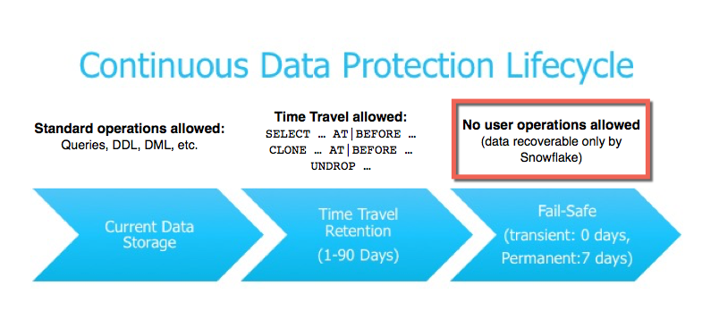
Continuous Data Protection Life Cycle

Slide 84
Data Governance: Access History Overview
This feature falls under “Know your data-who accessed it” category and requires Enterprise Edition (or higher).

Slide 85
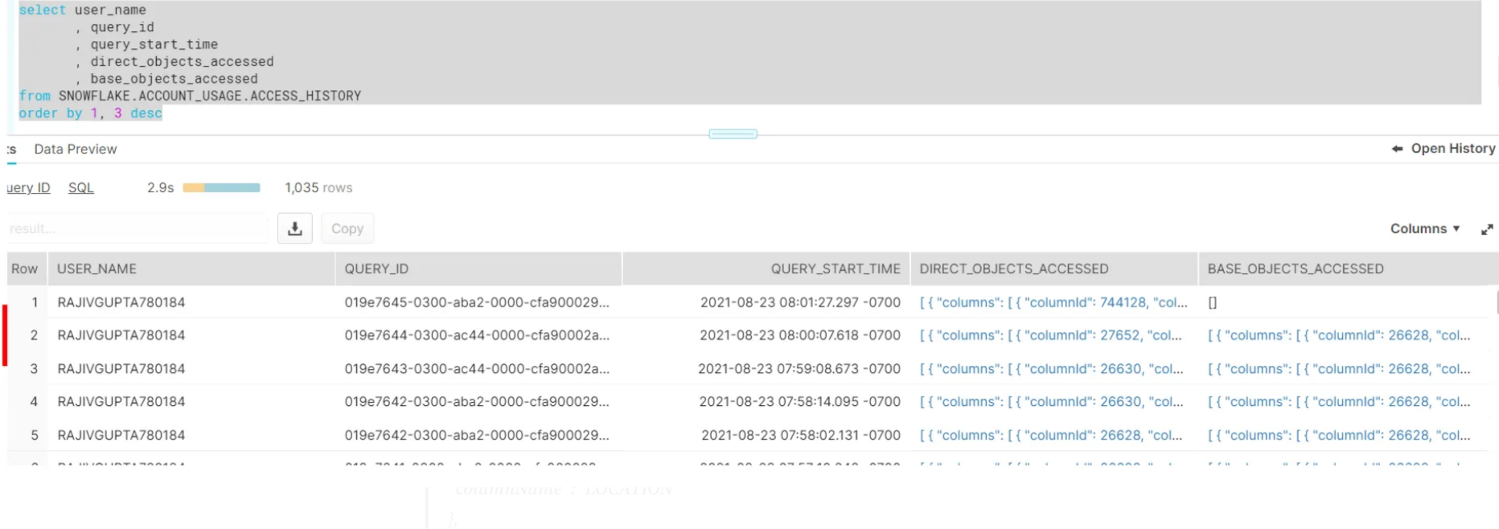

Slide 86
Zero-Copy Cloning
Snowflake allows you to create clones, also known as “zero-copy clones” of tables, schemas, and databases in seconds.
We can maintain multiple copies of data with no additional cost, so call zero copy.
A snapshot of data present in the source object is taken when the clone is created, and is made available to the cloned object.
The cloned object is writable, and is independent of the clone source.
Changes made to either the source object or the cloned object are not part of the other.
Two popular use cases of cloning in real time are
Cloning Prod data into Dev/Test environment for our unit testing in the lower environment
Taking back up of data

Slide 87
Cloning syntax
CREATE OR REPLACE ‘CLONED_OBJECT_TYPE’ ‘CLONED_OBJECT_NAME’
CLONE ‘SOURCE_OBJECT’;
→ Here Clone object type can be
Database
Schema
Table
Stage
File Format
Task
Stream

Slide 88
Streams in Snowflake
A stream object records DML changes made to tables including inserts, updates, and deletes.
Also Stream stores metadata about each change, so that actions can be taken using this metadata.
We call this process as change data capture (CDC).
Streams tracks all row level changes to a source table using offset but doesn't store the changed data.
Once these changes are consumed by the Target table, this offset moves to the next point.
Streams can be combined with tasks to set continuous data pipelines.
Snowpipe + Stream + Task ➔ Continuous Data Load.

Slide 89
Metadata of Streams
Along with the changes made to the source table, Streams maintain 3 metadata fields.
1. METADATA$ACTION: Indicates the DML operation (INSERT, DELETE) recorded.
2. METADATA$ISUPDATE: Indicates whether the operation was part of an UPDATE statement. Updates to rows in the source object are represented as a pair of DELETE and INSERT records in the stream with a metadata column METADATA$ISUPDATE values set to TRUE.
3. METADATA$ROW_ID: Specifies the unique and immutable ID for the row, which can be used to track changes to specific rows over time.

Slide 90
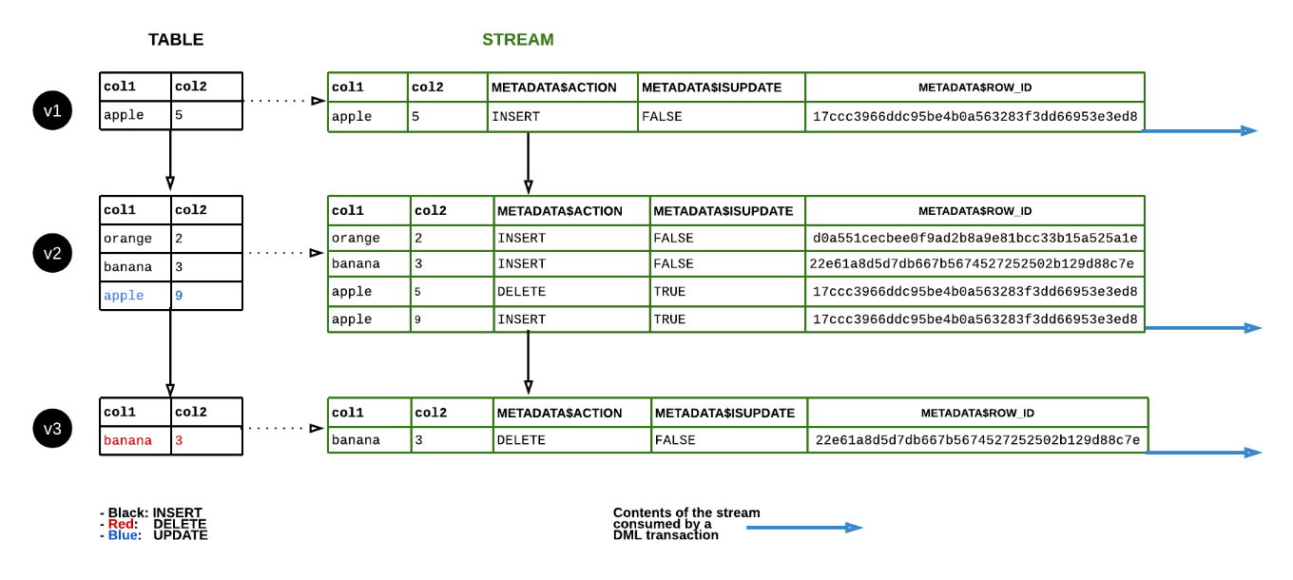
How a Stream works? or Data flow in a Stream

Slide 91
Types of Streams
1. Standard Streams: A Standard stream tracks all DML changes to the source object, including inserts, updates, and deletes (including table truncates).
CREATE OR REPLACE STREAM my_stream ON TABLE my_table;
2. Append-only Streams: An Append-only stream tracks row inserts only. Update and delete operations (including table truncates) are not recorded.
CREATE OR REPLACE STREAM my_stream ON TABLE my_table APPEND_ONLY = TRUE;
3. Insert-only Streams: Supported for External tables only. An insert-only stream tracks row inserts only. They do not record delete operations.
CREATE OR REPLACE STREAM my_stream ON EXTERNAL TABLE my_table INSERT_ONLY = TRUE;

Slide 92
Stored Procedures
Stored procedures allow you to write procedural code that includes sql statements, conditional statements, looping statements and cursors.
Snowflake supports 5 languages for writing procedures.
Snowflake Scripting(SQL)
Java Script
Java
Scala
Python
From a stored procedure, you can return a single value or tabular data.
Supports branching and looping.
Dynamically creating a SQL statement and execute it.

Slide 93
Sample Procedure
Consider a use case where the requirement is to purge the inactive employees’ data from a database table. Let us build a Stored Procedure which performs this activity.
The below Stored Procedure deletes all records with status field value as ‘INACTIVE’ from the employees table.
CREATE OR REPLACE PROCEDURE purge_data()
RETURNS VARCHAR
LANGUAGE SQL
AS
$$
DECLARE
message VARCHAR;
BEGIN
DELETE FROM employees WHERE status = 'INACTIVE';
message := 'Inactive employees data deleted successfully';
RETURN message;
END;
$$;

Slide 94
User Defined Functions
UDF allows you to perform operations that are not available through the built-in, system-defined functions.
Create UDF whenever there is a need to repeat the same functionality.
create function area_of_circle(radius float)
returns float
as
$$
pi() * radius * radius
$$
;
Select area_of_circle(4.5);

Slide 95
Tasks
We use tasks for scheduling in Snowflake.
We can schedule
SQL queries
Stored procedures
Tasks can be combined with streams for implementing the continuous change data captures(CDC).
Tasks require compute resources to execute SQL code, we can choose either of
Snowflake managed compute resources(Serverless)
User managed (Virtual warehouses)

Slide 96
How to create a Task?
By using CREATE TASK Command we can create tasks.
CREATE OR REPLACE TASK task_name
WAREHOUSE = ‘warehouse name’
SCHEDULE = ‘Time or Cron’
AFTER dep_task_name
AS
SQL Statement;
SQL Statement can be a query or a call to stored procedure.

Slide 97
Sample Tasks
// Task to run a query for every 10 minutes
CREATE OR REPLACE TASK CUSTOMER_INSERT
WAREHOUSE = COMPUTE_WH
SCHEDULE = ‘10 MINUTE'
AS
INSERT INTO CUSTOMERS(CREATE_DATE) VALUES(CURRENT_TIMESTAMP);
// Task to call a store proc every day at 9.30 UTC
CREATE OR REPLACE TASK CUSTOMER_INSERT
WAREHOUSE = MYOWN_WH
SCHEDULE = 'USING CRON 30 9 * * * UTC'
AS
CALL PROC_EMPL_DATA_LOAD();

Slide 98
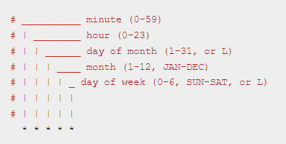
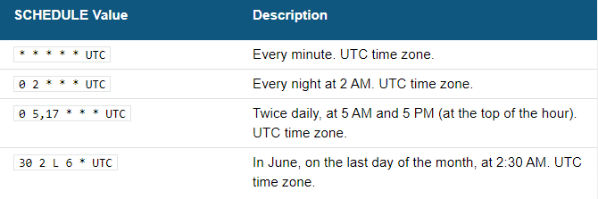
Using Cron

Slide 99
Data Sharing
Data can be shared securely.
Can share data to other snowflake users and to non-snowflake users as well.
For non-snowflake users, we have to create a reader account and share the data.
Provider – Who is sharing the data by creating share object.
Consumer – Who is consuming or using the shared data.
Shared data can be consumed by consumers own compute resources.
All below objects can be shared with other account users.
Tables
External tables
Secure views
Secure materialized views
Secure UDFs

Slide 100
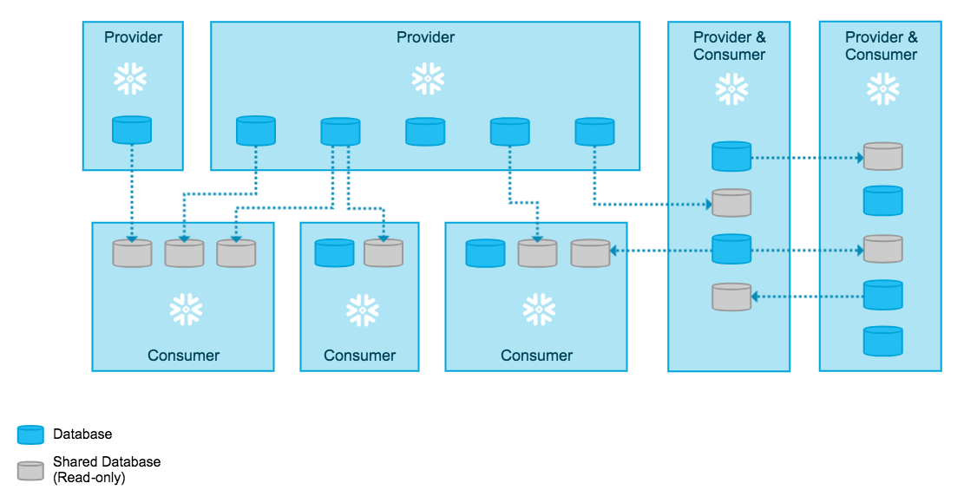

Slide 101
Reader Accounts
Data sharing is only supported between Snowflake accounts.
If we want to share data with non-snowflake users, we can create reader accounts for them.
Reader accounts (known as “read-only accounts”) provide a quick, easy, and cost-effective way to share data without requiring the consumer to become a Snowflake customer.
Each reader account belongs to the provider account that created it.
Readers can't perform any DML operations, they will have only select access.
Billing will be calculated in Provider's account itself.

Slide 102
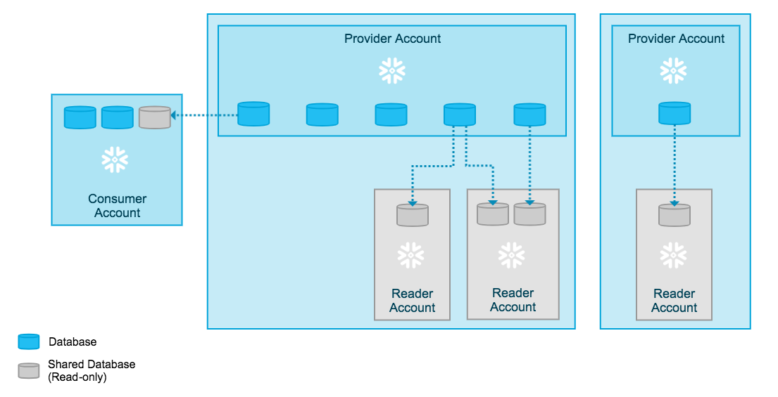

Slide 103
Search Optimization
The Search Optimization Service in Snowflake is a query optimization service that can enhance the performance of certain types of lookup and analytical queries which retrieves a small subset of results from large data volumes.
When Search Optimization Service is enabled on a table, it creates an additional data set called Search Access Path that keeps tracks of all the micro partitions where the values of the table are stored. The Search Access Path improves query performance by reducing the amount of partitions scanned during the table scan operation instead of searching all the partitions of the table.
ALTER TABLE t1 ADD SEARCH OPTIMIZATION ON c1;
ALTER TABLE t1 DROP SEARCH OPTIMIZATION ON c1;

Slide 104
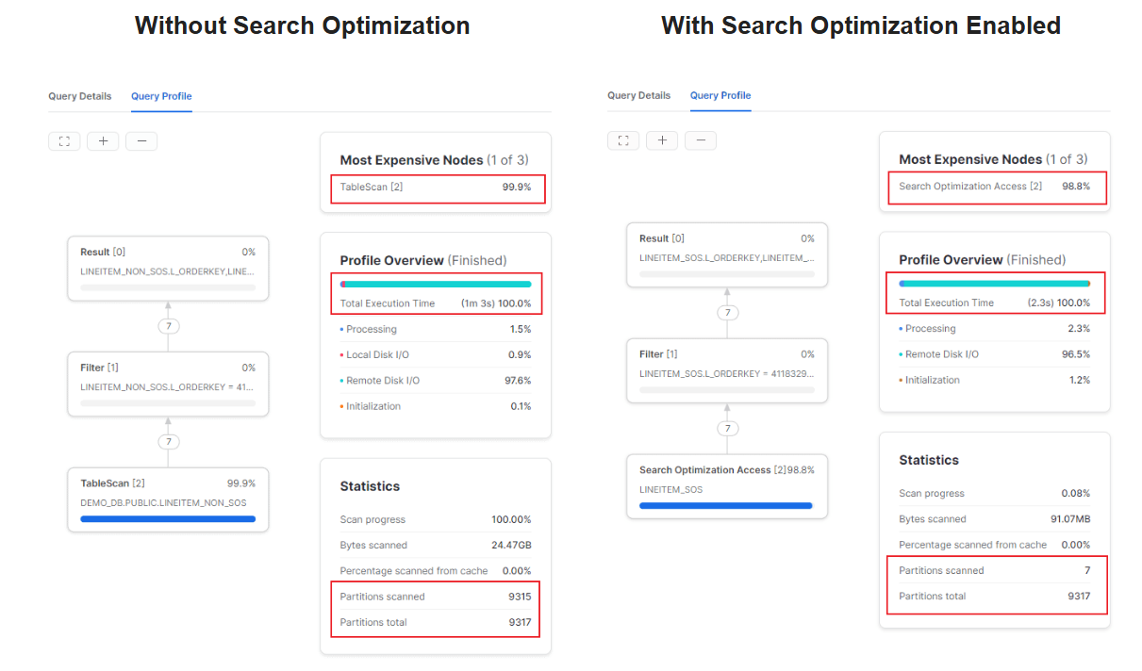

Slide 105
Comparing the stats of the queries
The below images shows the query profile of both queries that ran without and with Search Optimization Service enabled.
There is a huge improvement in the query runtime from 63 seconds to 2.3 seconds with search optimization enabled.
In the query with search optimization not enabled, almost 99% of the partitions scanned by the query. On the other hand, the query with search optimization enabled scanned only 7 partitions out of 9317 partitions which led to massive improvement in the performance and execution time.
The number of bytes scanned by the query dropped from 24.47 GB to 91.07 MB with search optimization enabled.

Slide 106
Resource Monitor
In the Cloud computing era with pay-as-you go resources it is necessary to have a billing alerts set to get notified when there are unexpected spend increases. This is an extremely useful tool to keep a close watch on your resource usage and stay on-budget.
Snowflake provides one such feature to track your resource usage and control your budget using Resource Monitors.
Resource monitors can only be created by Account Administrators (i.e. users with the ACCOUNTADMIN role).
However, Account Administrators can choose to enable users with other roles to view and modify resource monitors using SQL.

Slide 107
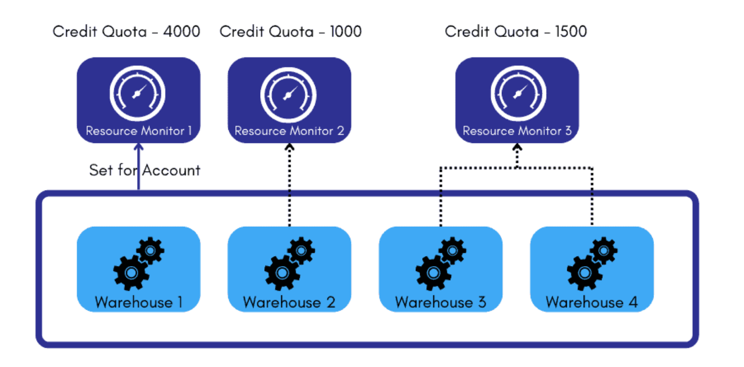

Slide 108
Thank you

