Slide 1
Leave Management System
Tarun Singh
Rohith Rudraswamy Sali
Vennela Gandluri

Slide 2
Introduction
A company has a large number of employees which includes full/part time employees and contractors.
To smoothly manage the leave tracking operations of the company employees and to make the process error free and faster, the management has come up with a proposal to create an on line, web based application called LMS (Leave Management System).
Application, LMS can be accessed through internet round the clock and is also an environment friendly way to avoid paper based processing of employee leave data and leave approval tracking details.
The new system will greatly reduce the amount of time spent in leave processing as manual tracking is very slow.

Slide 3
Users and some Prominent Use Cases
Employee
Apply Leave
Update Leave Application
View Leave Applications
Cancel Leave Application
Manager
Approve/ Deny Leave Request
HR
Add Employee
Delete Employee
View all Employee records

Slide 4
Observer Design Pattern
Used when many other objects are interested to know about the state change of a particular object.
Publish-Subscribe model
Publisher notifies all the registered objects whenever it changes state
Observers/ Subscribers: Manager, Employee
Publisher: Leave Application

Slide 5
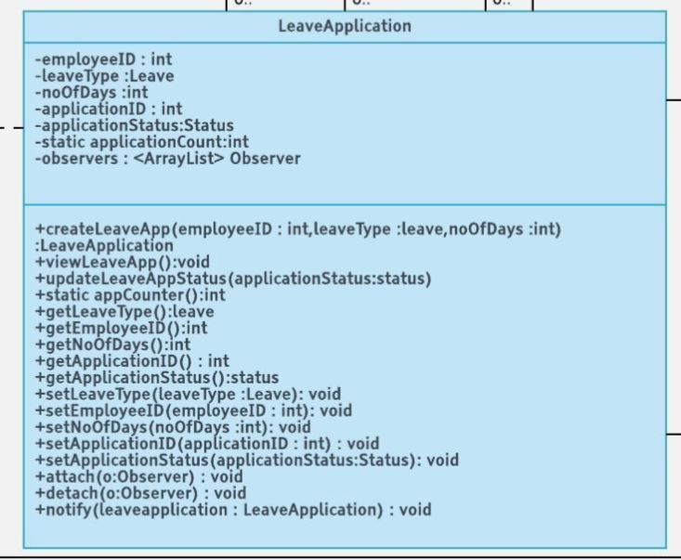
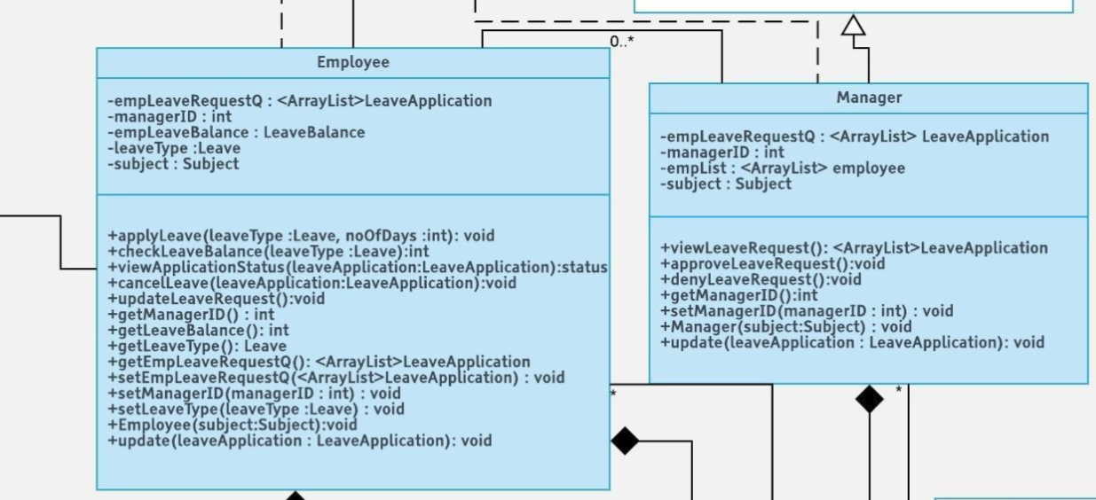
Class Diagram Implementation Observer Design Pattern

Slide 6
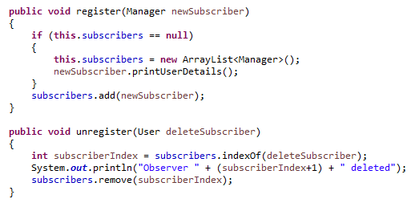
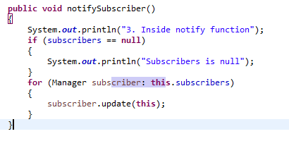
Leave Application Class: Publisher
Notes:
Register function called in the constructor of interested objects
Notify Subscriber is called from the setter

Slide 7
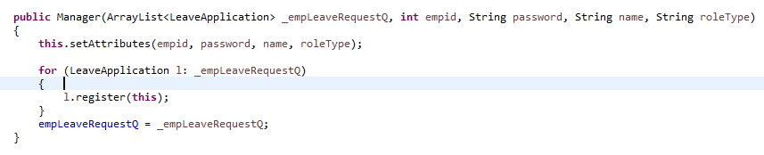
Manager Class: Subscriber

Slide 8
Factory Design Pattern
Method returns one of several possible classes that share a common super class.
Login with a user
Depending on the role type the user is assigned, the factory returns an object based on the role passed
The class is chosen at run time

Slide 9
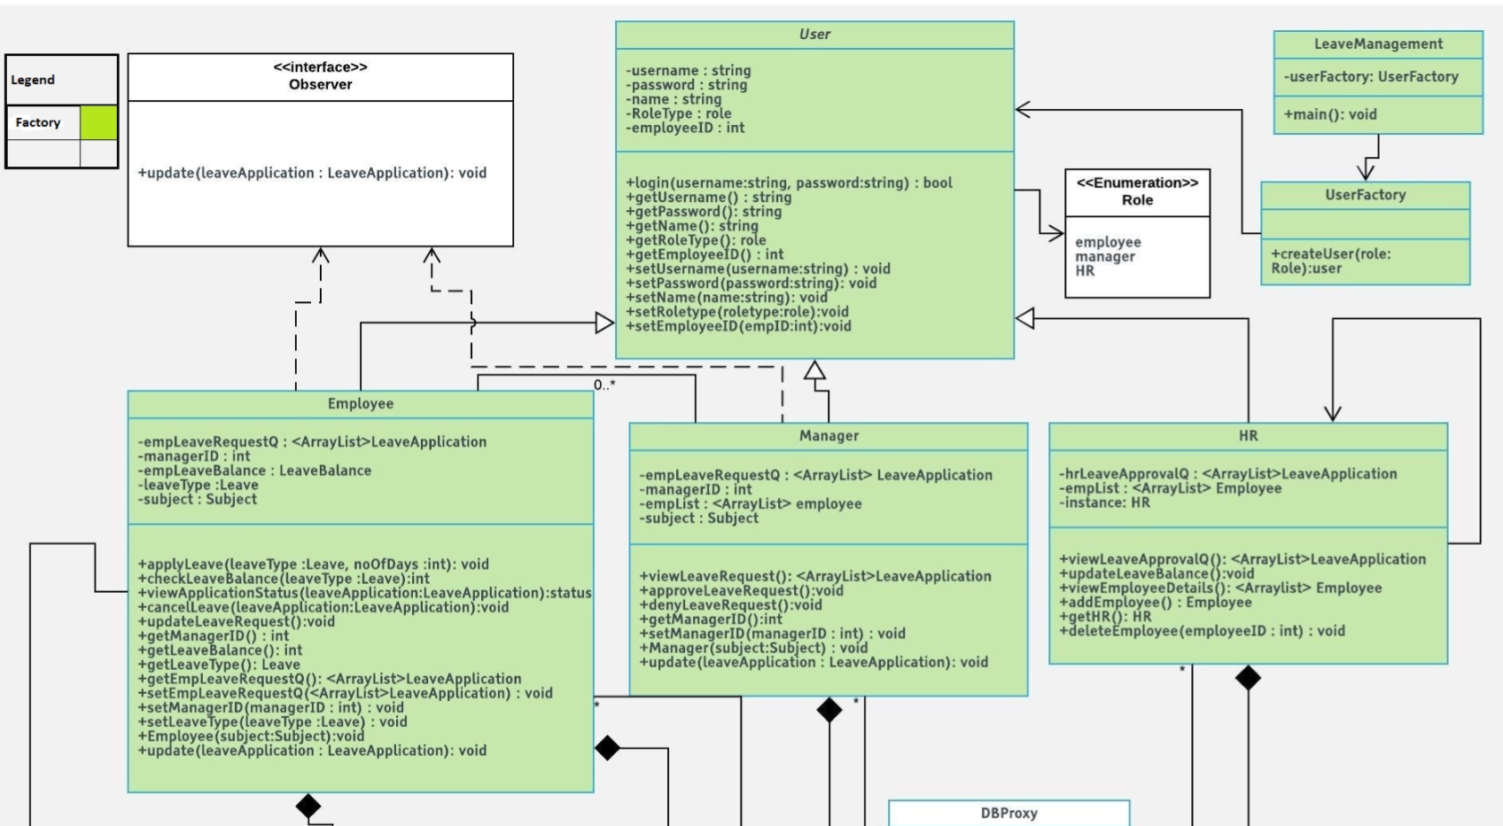
Class Diagram Factory Design Pattern

Slide 10
Singleton design pattern
The singleton pattern is a design pattern that restricts the instantiation of a class to one object.
This is useful when exactly one object is needed to coordinate actions across the system.
Here, HR class has singleton design pattern, since we require only a single HR in the application.

Slide 11
Model View Controller
MVC stands for Model View and Controller. It is an architectural pattern that separates the business logic, presentation logic and data.
Controller acts as an interface between View and Model. Controller intercepts all the incoming requests, which is the Java servlet in this case
Model represents the state of the application i.e. data. It can also have business logic ( all bean classes)
View represents the UI(User Interface), which is all the JSP pages

Slide 12
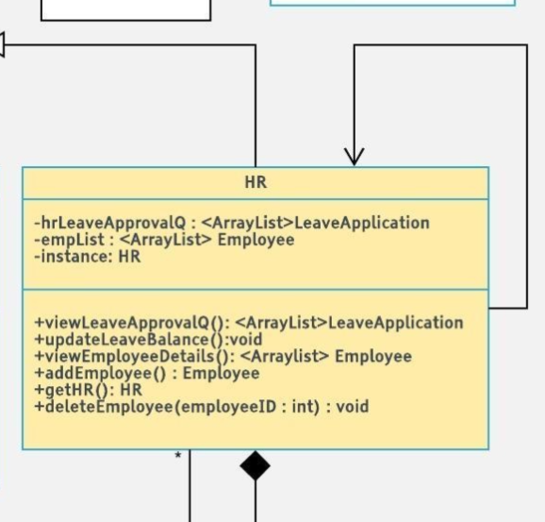
Singleton Design Pattern Class Diagram Implementation

