Slide 1
Predictive ATM Cash Management
• using Big Data Analytics (Apache Spark / PySpark MLlib)
• Classification: High vs Low demand • Clustering: Low / Medium / High ATM tiers
• Code: https://github.com/TarunSitaraman/bde/tree/claude/ecstatic-johnson-b4ik3x

Slide 2
Problem & Data
• Cash-outs hurt customers; over-stocking ties up capital → forecast demand per ATM
• Data: 219,300 daily records • 300 ATMs • 2 years • 7 location types (synthetic, seed 42)
• Fields: withdrawal ₹, txn count, failures, weekend / payday / festival flags
• Spark: group-by roll-ups, window lags, rolling stats, MLlib pipelines (scales to billions of rows)
• Task 1 – classify next-week demand High/Low; Task 2 – cluster ATMs into 3 tiers

Slide 3
Model Selection & Justification (1 mark)
• Classification: compared Logistic Regression, Random Forest, GBT on time-based split (no future leakage)
• Winner: Logistic Regression – best AUC (0.994); simple, fast, explainable; trees ≈ equal
• Clustering: K-Means k=3 on log-scaled volume features
• k=3 = business tiers; silhouette 0.67; beats Gaussian Mixture (0.39)
• Log transform fixes skew: raw K-Means gave tiers of 193 / 102 / 5 ATMs

Slide 4
Coding & Implementation – Classification (2 marks)
• Weekly aggregation of daily data in Spark
• Lag-1/2, 4-wk rolling mean/std via Window functions (past only)
• Calendar features: payday days, festival days, week-of-year sin/cos
• Label threshold = train median (₹1.43M/week)
• Spark ML Pipeline: StringIndexer → OneHot → Assembler → Scaler → classifier
w = Window.partitionBy('atm_id').orderBy('week')
w4 = w.rowsBetween(-4, -1)
feat = (weekly
.withColumn('lag1_wd', F.lag('wd',1).over(w))
.withColumn('roll4_wd', F.avg('wd').over(w4))
.withColumn('woy_sin', F.sin(2*pi*woy/52)))
thr = train.approxQuantile('wd',[.5],.001)[0]
label = (F.col('wd') > thr).cast('double')
Pipeline(stages=[indexer, onehot,
assembler, scaler, LogisticRegression()])

Slide 5
Coding & Implementation – Clustering
• ATM-level profile via Spark groupBy (one row per ATM)
• Features: avg, P90 daily withdrawal, avg daily txns → log1p → StandardScaler
• Elbow + silhouette for k=2..7; final KMeans k=3
• Tiers named by ranking cluster mean withdrawal
• Other metrics (CV, payday uplift…) used only to profile
prof = daily.groupBy('atm_id').agg(
avg('total_withdrawal'),
percentile_approx(..., 0.9),
avg('tx_count'))
# log1p -> StandardScaler
for k in range(2, 8):
KMeans(k=k).fit(data) # elbow+silhouette
km = KMeans(k=3, seed=11).fit(data)
# rank clusters by mean withdrawal
# -> Low / Medium / High

Slide 6
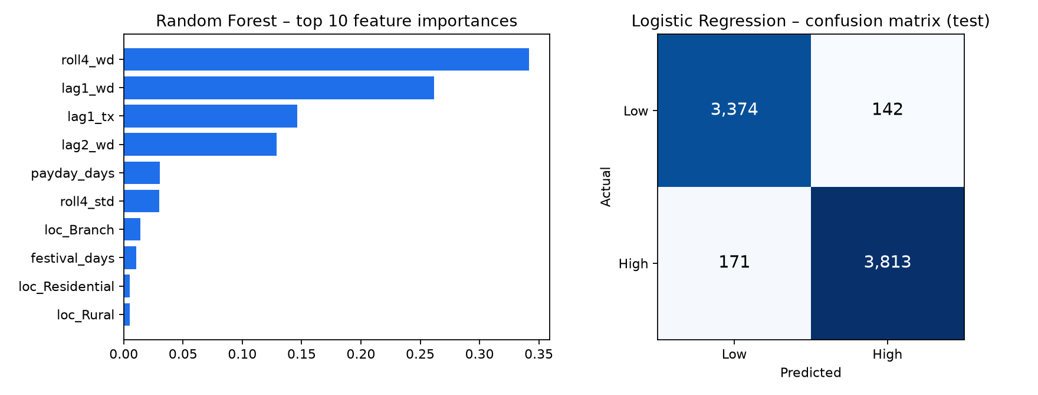
Results – Classification (1 mark)
• Logistic Regression: acc 95.8%, AUC 0.994
• Random Forest: acc 95.1%, AUC 0.992
• Gradient-Boosted Trees: acc 95.1%, AUC 0.992
• Baseline (repeat last week): 90.6%
• High-class recall 95.7%, precision 96.4%

Slide 7
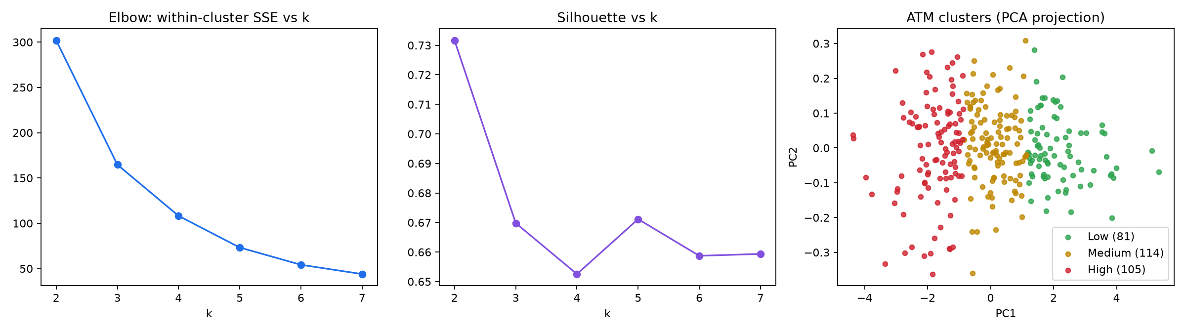
Results – Clustering
• Low: 81 ATMs, ₹96k/day
• Medium: 114 ATMs, ₹198k/day
• High: 105 ATMs, ₹406k/day
• Silhouette 0.67

Slide 8
Analysis & Inference
• Classifier beats naive baseline by 5.2 pts; recent withdrawals drive ~88% of importance
• Missed high-demand weeks = 4.3% → tune threshold to cut stock-out risk
• High tier needs ~4.2× the cash of Low; malls/transit/branches are mostly High
• Low-demand ATMs show strongest payday spike → add month-end top-ups
• Combined policy: tier sets baseline schedule, weekly classifier adjusts it
• Limitation: synthetic data – re-validate on real bank data

Slide 9
Thank You
• Code, results and report: https://github.com/TarunSitaraman/bde/tree/claude/ecstatic-johnson-b4ik3x

