Slide 1
Excel Final Assessment
Sajja Tarun Teja - 4391

Slide 2
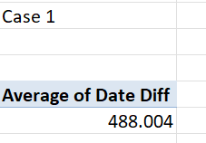
Case Study 1:
The average lead time is coming to be 488.004. This is primarily due to the high presence of No rush Work Orders

Slide 3
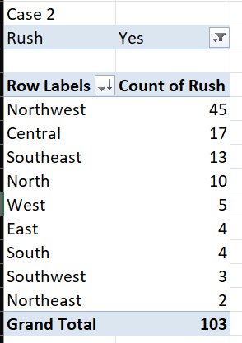
Case Study 2:
Here we can see that the district with the most number of Rush jobs is North West

Slide 4
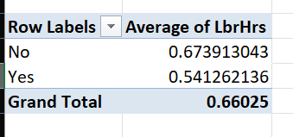
Case Study 3:
The labour hours for a Non rush job is more than the ones for the Rush jobs. This is owing to the faster delivery times for rush jobs and the low priority of No rush jobs

Slide 5
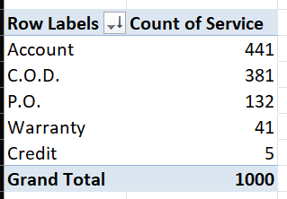
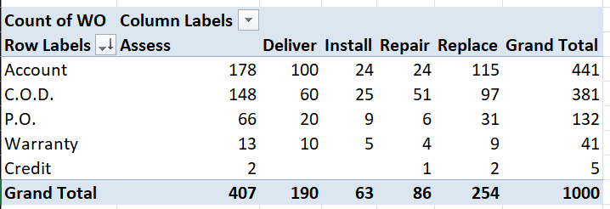
Case Study 4 – Part 1:
Most of the Services have been paid via Account transfer. And the lest chosen option being Credit Card usage. And to highlight the “Assess” service was the most requested service among all work orders for individual payment modes

Slide 6
Case Study 4 – Part 2:

Slide 7
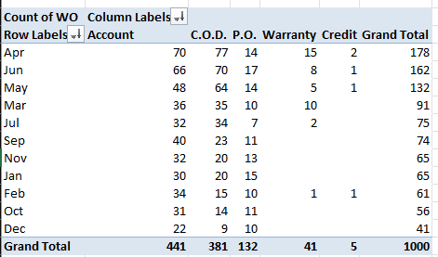
Case Study 5:
There seems to be heavy usage of Account Transfer and COD in the moths ranging from March to July. While these payment options seem to have a huge leap. PO method is consistent. And this also happens to be the time around where Credit payments are happening and no where else.

Slide 8
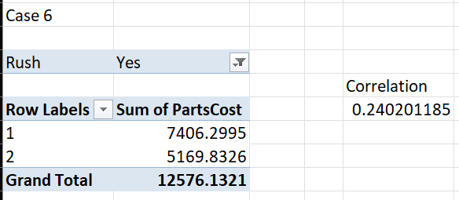
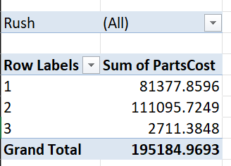
Case Study 6:
The relationship between Number of Technicians and the Parts Cost seem to be very loosely related. This can be clearly observed in the second pivot table where the increase in the technicians didn’t necessarily increase the Parts Cost. And this can also be verified with the help of Correlation. The correlation value is coming out to be 0.2402 which is closer to 0 meaning very small chance of relationship between the two values.

Slide 9
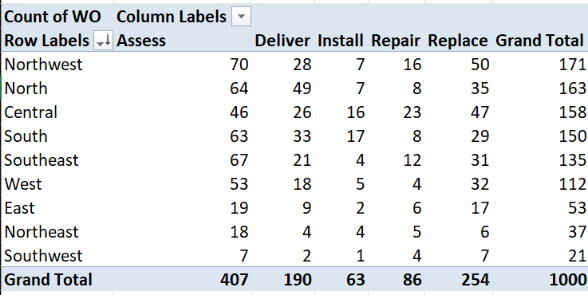
Case Study 7:
In the South District the most requested service is Replace and in the Southwest District both Assess and Replace are the most requested services. And in every other District Assess is the most requested service

Slide 10
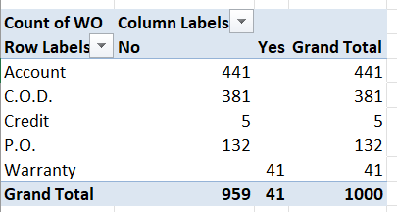
Case Study 8:
There is a clear cut difference in the choice of payment. Whenever the warranty is valid, the customer has chosen to opt for claiming the warranty.

Slide 11
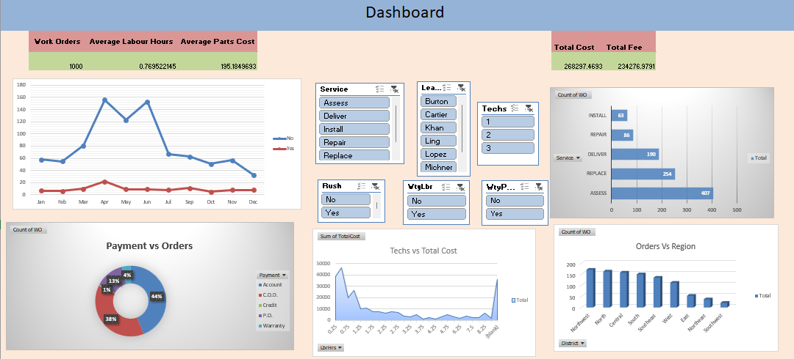
Case Study 9: Dash Board

