Slide 1
MOOC Assistant
Tarun VENKATESH
Supervisors: Laurent TOUTAIN · Baptiste GAULTIER
IMT Atlantique · Academic Year 2025-2026
1 / 10

Slide 2
Introduction
The Challenge
FUN-MOOC forums accumulate hundreds of student questions faster than instructors can respond manually
1
2
3
Auto-extract
forum posts
Generate course-grounded
responses
Route uncertain
cases to instructor
Platform: FUN-MOOC (MicroPython / IoT) · Multi-agent pipeline
2 / 10

Slide 3
Previous Semester Recap
1
MCP + Playwright
Browser automation to log into FUN-MOOC
2
Forum Navigation
Paginated listing pages -> topic URLs collected
3
Post Extraction
DOM-parsed: author, date, content per post
4
Structured Output
Unified post records across multi-page topics
5
Basic AI Responses
Early LLM responses -- no RAG, no validation
3 / 10

Slide 4
Semester 3 -- Implementations
Semantic RAG Pipeline
Forum Post Indexing
HTML/XML ingestion · 600-char chunks · multilingual embeddings
Answered posts appended to RAG index incrementally
Intent-Aware Post Filtering
RAG-Augmented Solution Agent
Skip instructors · route admin/complaints · answer technical posts
Groq (Llama 3.1) · retrieves relevant context · constrained generation
Two-Stage Validation Agent
Human-in-the-Loop (HITL)
Rule-based checks then LLM scoring (relevance, grounding, clarity)
Low-confidence posts routed to Professor Review queue with scores
Streamlit Dashboard Redesign
3 views: Conversations & Responses · Professor Review · Others | Sidebar counters show full pipeline state
4 / 10

Slide 5
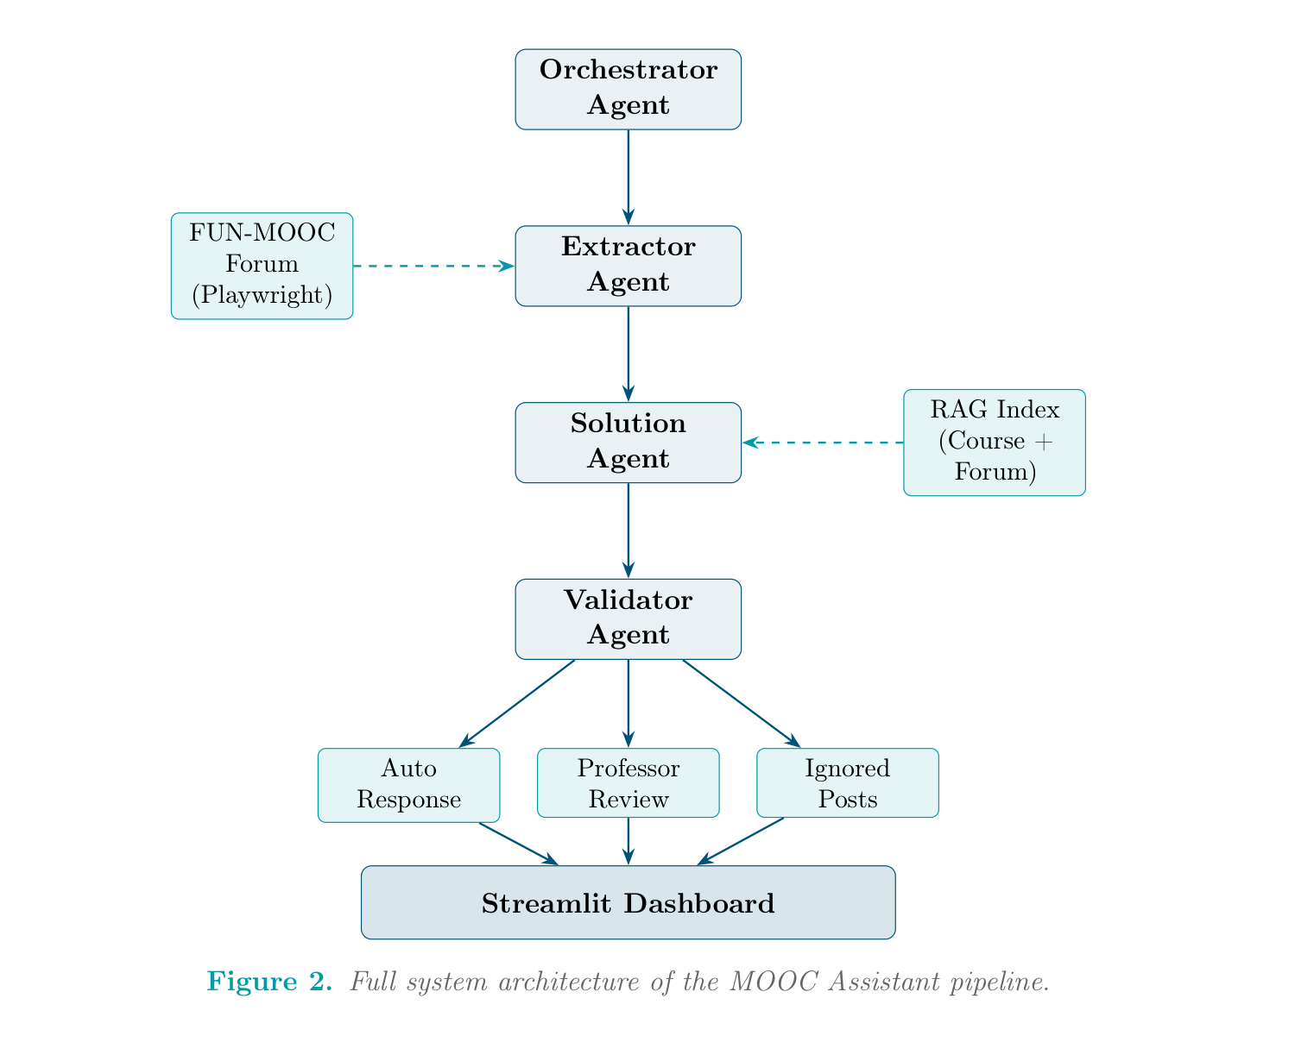
Final System Architecture
Orchestrator directs pipeline · RAG index grows incrementally after each run
5 / 10

Slide 6
RAG Implementation
WHY RAG?
HOW IT WORKS
Plain LLM hallucination risk
No course-specific knowledge
Responses not aligned to MOOC content
TF-IDF failed on paraphrased queries
Switched to semantic embeddings
Ingest HTML lessons + XML exercises
600-char chunks with 150-char overlap
Model: paraphrase-multilingual-MiniLM-L12-v2
384-dim embeddings, cosine similarity
Threshold 0.25, top-k fallback
4,000-char context budget per prompt
Forum posts indexed after each run
6 / 10

Slide 7
Validation Agent
WHY:
A fluent answer can still be factually wrong. Publishing incorrect content is worse than no answer. Safety layer before dashboard publication.
Stage 1 -- Rule-Based Checks
Stage 2 -- LLM Scoring
Fast, deterministic -- no LLM call
Detect fallback phrase: 'Je vais verifier...'
Detect first-person confusion phrases
Replace with polite redirection message
Model: llama-3.3-70b-versatile (Groq)
answer_relevance >= 0.6
grounding_score >= 0.6
clarity_score >= 0.6
fixed_answer -- optional rewrite
Route to HITL if relevance <= 0.4
7 / 10

Slide 8
Problems Faced & Solutions
Over-Aggressive Post Filtering
Session Authentication (HTTP 403)
Problem:
Problem:
Posts starting with 'Bonjour' discarded even with real questions
Forum uses a separate iframe cookie from the main LMS session
Solution:
Solution:
Intent-aware logic: check question markers and issue keywords first
Two-step warm-up: courseware first, then forum section page
Dashboard Count Mismatches
Malformed JSON from Validator LLM
Problem:
Problem:
Posts counted in both 'answered' and 'professor review' buckets
LLM returned JSON wrapped in markdown code fences
Solution:
Solution:
Mutually exclusive category assignment with strict priority order
Regex strip fences; apply default values for all expected fields
8 / 10

Slide 9
Future Enhancements
01
02
03
Live Post Monitoring
Instructor Feedback Loop
Video Transcript Indexing
Scheduled polling every 30-60 min
Compare against persisted post IDs
New posts auto-fed through pipeline
Or: webhook on new-post event
Edited/approved answers added to RAG index
Teacher-level explanations accumulate
Progressively improves auto responses
Lightweight continual learning
Most course knowledge locked in videos
Currently un-indexed -> routes to Prof Review
Index auto-generated transcripts
Dramatically expands retrieval coverage
9 / 10

Slide 10
Conclusion
-> Full pipeline: extraction -> RAG -> validation -> HITL -> dashboard
-> Automation only where trusted -- uncertain cases go to instructor with context
-> RAG index grows incrementally; quality improves over time
-> Right balance of automation and human oversight for education AI
References
[1] P. Lewis et al., RAG for Knowledge-Intensive NLP Tasks, NeurIPS 2020.
[2] N. Reimers & I. Gurevych, Multilingual Sentence Embeddings, EMNLP 2020.
[3] Z. Ji et al., Survey of Hallucination in NLG, ACM Computing Surveys, 2023.
[4] E. Kasneci et al., ChatGPT for Good? LLMs for Education, 2023.
[5] B. Gaultier, MCP Browser Agent, IMT Atlantique GitHub, 2024.
[6] Microsoft, Playwright, GitHub, 2024.
10 / 10

