Slide 1
Popper
01
OUR PROBLEM → EVERY TEAM’S PROBLEM
We got the fix in minutes.
Proving it took longer.
US
EVERY TEAM
We became the
review bottleneck.
Coding agents make this
everyone’s bottleneck.
TRUST IS NOW THE SCARCE RESOURCE
Notes:
We felt the problem ourselves: AI gave us plausible fixes almost instantly, but we were still responsible for proving them. Generalize immediately—every team adopting coding agents inherits the same review bottleneck.
[Sources]
- /Users/NithinAwasome/Downloads/Daytona-Hacksprint/AGENTS.md — parallel AI-agent build workflow and human gate requirements
- /Users/NithinAwasome/Downloads/Daytona-Hacksprint/README.md — Popper product premise

Slide 2
Popper
02
THE FALSE PASS
A passing check can still prove nothing.
One test. Two revisions. The result looked reassuring.
BEFORE THE FIX
AFTER THE FIX
PASS
PASS
≠ PROOF
If it passed before the change, it did not prove the change.
Notes:
This is the moment that pushed us to build Popper. A normal green result is not enough: if the same test passes before and after, it is inconclusive—not evidence that the fix works.
[Sources]
- /Users/NithinAwasome/Downloads/Daytona-Hacksprint/AGENTS.md — “A test that passes on both revisions proves nothing”
- /Users/NithinAwasome/Downloads/Daytona-Hacksprint/lib/pipeline.ts — before/after verdict logic

Slide 3
Popper
03
WHAT POPPER DOES
Every PR claim has to earn trust.
Popper turns a pull request’s promise into an adversarial experiment.
01 / ATTACK
02 / EXECUTE
03 / COMPARE
Fireworks
Daytona
CodeRabbit
Extract the claim.
Generate tests to falsify it.
Run each test on the
before and after code.
Set execution evidence beside
an independent review opinion.
Braintrust traces the evidence
CopilotKit lets reviewers interrogate it
A human decides
Notes:
Explain the product in one sweep: Fireworks extracts the behavioral claim and designs attacks; Daytona executes those attacks against both revisions; CodeRabbit supplies a separate review opinion. Braintrust traces the decision, CopilotKit makes it explorable, and the human owns the final call.
[Sources]
- /Users/NithinAwasome/Downloads/Daytona-Hacksprint/lib/pipeline.ts — orchestrated claim, evidence, comparison, and recommendation flow
- /Users/NithinAwasome/Downloads/Daytona-Hacksprint/lib/adapters/fireworks.ts — claim extraction and adversarial test generation
- /Users/NithinAwasome/Downloads/Daytona-Hacksprint/lib/adapters/daytona.ts — isolated before/after execution
- /Users/NithinAwasome/Downloads/Daytona-Hacksprint/app/api/copilotkit/[...slug]/route.ts — CopilotKit runtime

Slide 4
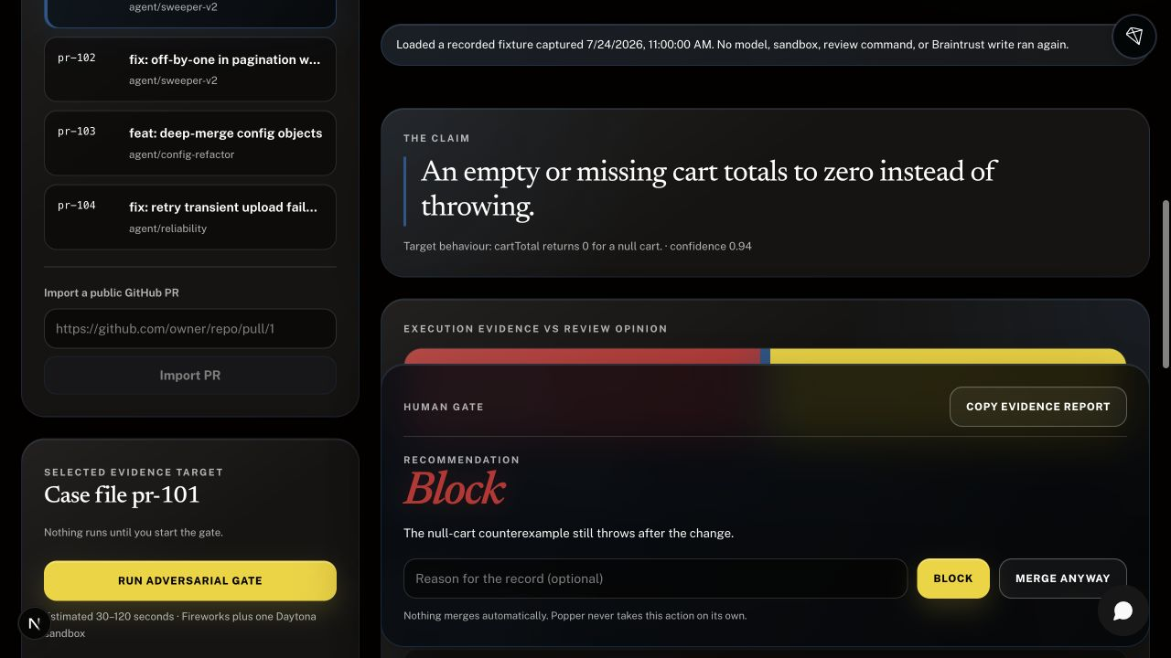
Popper
04
LIVE DEMO
Watch the claim meet the evidence.
90-SECOND DEMO
01
Load a recorded PR run
02
See evidence disagree
03
Let the human decide
daytona-hacksprint.vercel.app
Notes:
Demo only the proof loop. Load the recorded pr-101 run, read the claim, point to the split between execution evidence and review opinion, then end on the human block recommendation. If time remains, open the generated test.
[Sources]
- https://daytona-hacksprint.vercel.app/ — deployed Popper demo
- /Users/NithinAwasome/Downloads/Daytona-Hacksprint/.tmp_popper_deck_v2/popper-evidence-palette.jpg — local screenshot of the redesigned product UI

Slide 5
Popper
05
WHAT WE LEARNED
We had to verify the verifier.
The hard part was preserving the meaning of evidence.
PASS ≠ PROOF
TIMEOUT ≠ FAILURE
OPINION ≠ EVIDENCE
Pass before + after
Sandbox unavailable
Review says “looks good”
That test is inconclusive.
That is missing evidence.
Only execution can prove behavior.
WHEN PROOF IS MISSING, THE GATE STAYS CLOSED
Notes:
These distinctions were our biggest engineering challenge and our most important accomplishment. We kept model opinion, executed evidence, inconclusive tests, and infrastructure failure separate. If Popper cannot gather trustworthy evidence, it blocks rather than pretending to know.
[Sources]
- /Users/NithinAwasome/Downloads/Daytona-Hacksprint/AGENTS.md — evidence/opinion boundary and fail-closed rules
- /Users/NithinAwasome/Downloads/Daytona-Hacksprint/docs/DECISIONS.md — implementation decisions
- /Users/NithinAwasome/Downloads/Daytona-Hacksprint/docs/PROGRESS.md — challenges and verification history

Slide 6
Popper
06
THE PROMISE
AI makes
the claim.
Popper makes it
earn trust.
THE HUMAN STILL DECIDES
daytona-hacksprint.vercel.app
Notes:
Resolve the opening: agents give us speed; Popper gives reviewers executed evidence. The system recommends, but the human remains accountable for the merge.
[Sources]
- https://daytona-hacksprint.vercel.app/ — deployed Popper demo
- /Users/NithinAwasome/Downloads/Daytona-Hacksprint/README.md — product description

