Slide 1

POPPER
Proof for AI-generated fixes.
ADVERSARIAL PR VERIFICATION
Notes:
Open simply: AI coding agents can fix bugs, but they cannot prove the fix works. Popper is the gate that asks for proof.
[Sources]
- /Users/NithinAwasome/Downloads/Daytona-Hacksprint/public/product-thumbnail.png — locally generated project thumbnail
- /Users/NithinAwasome/Downloads/Daytona-Hacksprint/README.md — product description

Slide 2
THE PROBLEM FOUND US FIRST
We became the bottleneck.
BUILDER
REVIEWER
AI gave us fixes
in minutes.
We still had to prove
every one.
The faster agents wrote, the more human trust became the scarce resource.
POPPER · 02
Notes:
Make the problem personal. We used AI agents to build faster, but every convincing patch left us accountable for the merge. Then generalize: every team adopting coding agents inherits this trust bottleneck.
[Sources]
- /Users/NithinAwasome/Downloads/Daytona-Hacksprint/AGENTS.md — documented parallel AI-agent workflow
- Team experience and narrative supplied by the project creators

Slide 3
THE DANGEROUS MOMENT
The test passed.
AFTER THE FIX
PASS
It looked like proof.
POPPER · 03
Notes:
Pause here. This is the result every reviewer wants to see: the generated test passes after the fix.
[Sources]
- /Users/NithinAwasome/Downloads/Daytona-Hacksprint/lib/pipeline.ts — before/after evidence semantics
- /Users/NithinAwasome/Downloads/Daytona-Hacksprint/docs/DECISIONS.md — evidence rules

Slide 4
THE DANGEROUS MOMENT
Then we ran it before the fix.
BEFORE THE FIX
AFTER THE FIX
PASS
PASS
The test never caught the bug.
POPPER · 04
Notes:
Reveal the contradiction quickly. The same test passed before the code changed. The green result was real, but it was meaningless.
[Sources]
- /Users/NithinAwasome/Downloads/Daytona-Hacksprint/lib/pipeline.ts — inconclusive test handling
- /Users/NithinAwasome/Downloads/Daytona-Hacksprint/docs/DECISIONS.md — a test passing on both revisions proves nothing

Slide 5
POPPER'S RULE
Useful evidence has a shape.
BEFORE THE FIX
AFTER THE FIX
FAIL
PASS
+
FAIL BEFORE + PASS AFTER = EVIDENCE
The test must prove it could detect the original failure.
POPPER · 05
Notes:
This is the core idea: a useful test fails on the old code and passes on the proposed fix. Popper measures change, not confidence.
[Sources]
- /Users/NithinAwasome/Downloads/Daytona-Hacksprint/lib/pipeline.ts — conclusive evidence logic
- /Users/NithinAwasome/Downloads/Daytona-Hacksprint/lib/pipeline.test.ts — verdict behavior tests

Slide 6
HOW IT WORKS
Every claim has to fight for entry.
CLAIM
ATTACK
EXECUTE
CROSS-CHECK
HUMAN GATE
What behavior
should change?
Generate tests
to break it
Run before
and after
Evidence vs.
opinion
Explain.
Recommend.
Opinion stays opinion. Executed tests become evidence. A person decides.
POPPER · 06
Notes:
Walk left to right. Fireworks extracts the claim and creates the attack. Daytona executes both revisions. CodeRabbit supplies an independent opinion. Popper compares the methods and gives a human the final gate.
[Sources]
- /Users/NithinAwasome/Downloads/Daytona-Hacksprint/README.md — product architecture
- /Users/NithinAwasome/Downloads/Daytona-Hacksprint/lib/pipeline.ts — orchestration and recommendation logic

Slide 7
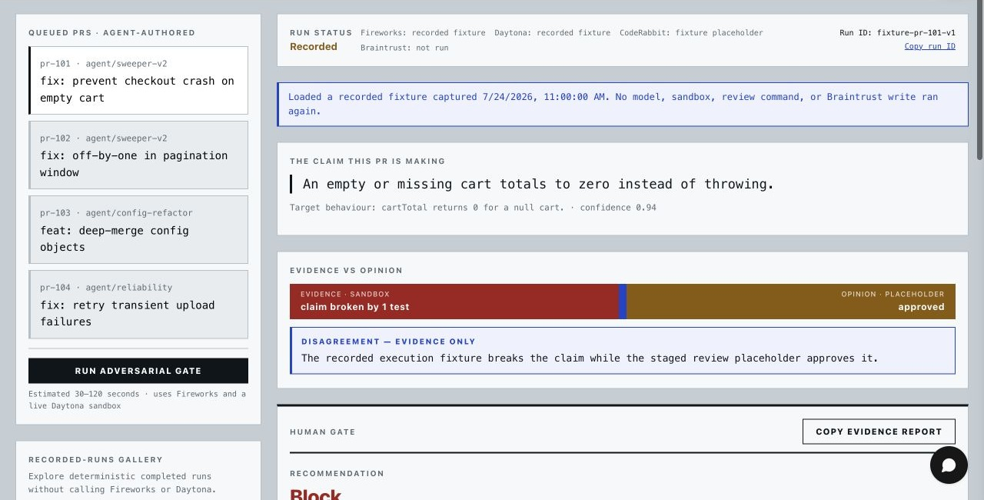
THE MOMENT THAT MATTERS
The review approved. The evidence said block.
Notes:
This is the demo reveal. The pull request claims an empty cart no longer throws. The staged review approves, but the executed counterexample still fails after the change. Popper surfaces the disagreement and recommends block.
[Sources]
- /Users/NithinAwasome/Downloads/Daytona-Hacksprint/.tmp_popper_deck/product-ui-cropped-final.jpg — screenshot captured from the local recorded pr-101 run
- /Users/NithinAwasome/Downloads/Daytona-Hacksprint/lib/fixtures/recorded-runs.ts — recorded demo fixture

Slide 8
BUILT WITH
FIREWORKS AI
5
extract the claim · generate the attack
DAYTONA
run both revisions in isolation
CODERABBIT
sponsor tools
provide independent static opinion
one chain of trust
BRAINTRUST
trace the reasoning and execution
COPILOTKIT
let reviewers question the run
POPPER · 08
Notes:
Do not present this as a logo parade. Each sponsor owns one necessary link: reasoning, execution, independent review, traceability, and reviewer interaction.
[Sources]
- /Users/NithinAwasome/Downloads/Daytona-Hacksprint/README.md — integration summary
- /Users/NithinAwasome/Downloads/Daytona-Hacksprint/lib/adapters — Fireworks, Daytona, CodeRabbit, and Braintrust adapters
- /Users/NithinAwasome/Downloads/Daytona-Hacksprint/app/api/copilotkit — CopilotKit runtime route

Slide 9
THE CHALLENGE
We had to verify the verifier.
01
02
03
A green test
can prove nothing.
A timeout is not
a code failure.
An opinion is not
executed evidence.
When Popper cannot gather trustworthy evidence, the gate stays closed.
POPPER · 09
Notes:
These are the engineering lessons that made Popper trustworthy. We separate inconclusive tests, infrastructure failures, and model opinion. Missing evidence blocks instead of creating false confidence.
[Sources]
- /Users/NithinAwasome/Downloads/Daytona-Hacksprint/docs/DECISIONS.md — evidence boundaries and fail-closed decisions
- /Users/NithinAwasome/Downloads/Daytona-Hacksprint/docs/PROGRESS.md — implementation challenges and verification history

Slide 10
AI agents can make the claim.
Popper makes it earn trust.
THE HUMAN HOLDS THE KEY.
Notes:
Close by resolving the opening. AI gives us speed. Popper gives reviewers evidence. The system recommends, but a human still holds the key.
[Sources]
- /Users/NithinAwasome/Downloads/Daytona-Hacksprint/public/product-thumbnail.png — locally generated project thumbnail
- Closing language adapted from the project creators' approved Popper story

