Slide 1

Healtheonix
Optimizing Healthcare Delivery

Slide 2

Market Assessment
Recognition of communication inefficiencies in the medical field.
Industry challenges include provider opposition, EHR interoperability, and high implementation costs.
IHC Systems aims to transform healthcare communication with an all-inclusive solution.
UNIQUE SELLING PROPOSITION (USP)
Seamless connectivity across diverse healthcare platforms.
Emphasis on user-friendly interfaces catering to administrators, support staff, and physicians.
Strategy to reduce provider opposition for broader adoption.

Slide 3

Profitable Analysis
Comprehensive cost-benefit analysis for financial viability.
Calculation of ROI considering tangible (operational savings) and intangible benefits (time savings, higher efficiency).
Strategic assessment of market share potential and growth opportunities.
Competitor Landscapes
Notable competitors in the market:
Cipher Health: Focuses on patient engagement and care coordination.
Lifecycle Health: Provides a software platform for better care coordination.
Common challenges faced by competitors:
Lack of Standardization
Fragmented Systems
Lack of Integration Standards and Personal Resources
Security Risks

Slide 4

Resources Available
Resource Available with the organization
Technical Team Proficiency
Technical Elements of Our Intellectual Property:
Software Development:
Technical Validation through Pilot Testing
Cybersecurity Measures
Future-proofing and scalability
Strategic Funding Allocation
Resources Required
Operational Guidance
Administrative Resources
Communication Plan Development
Implementation Manuals
Organizational Structure

Slide 5

Action Plan
Product Development
Pilot Programmer
Feedback Loop
Market Launch
Software Development
Pilot Testing
Marketing
Operational Costs

Slide 6

Implementation Plan
Modular Design: Build UI components independently for each system feature (e.g., dashboard, chat, video conferencing).
Integrated Workflow: Ensure seamless interaction between components through intuitive navigation and consistent data flow.
User-Centric Design: Prioritize ease of use with clear information hierarchy, intuitive icons, and accessible features.
Responsive Design: Adapt UI layout and functionality for optimal viewing on desktop, tablet, and mobile devices.
Progressive Enhancement: Implement core features first and gradually add advanced functionalities based on user feedback.

Slide 7

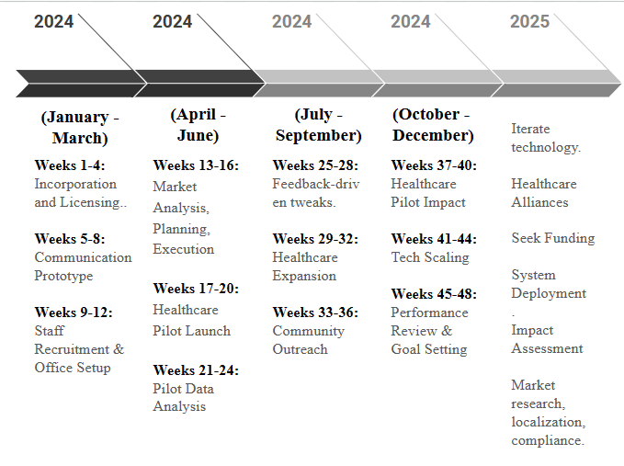
Project Timeline

Slide 8

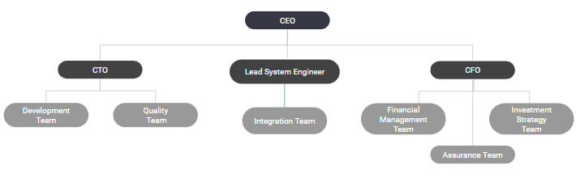
Organizational Workflow

Slide 9

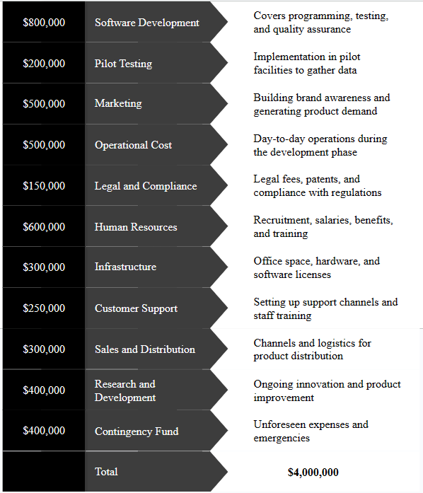
Budgeting

Slide 10

THANK YOU

