Slide 1
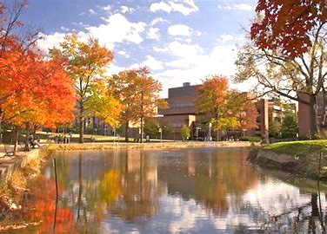
RIH
Counseling

Slide 2
The Counseling Center is a part of Retriever Integrated Health (RIH), the health services branch of UMBC.
Right now, to make an appointment for counseling, a student must call during business hours and a counselor must manually enter the appointment. We find this system to be rife with inefficiencies and opportunities for human error.
To increase automation, minimize error, and more efficiently and effectively serve the needs of UMBC students, we propose creating an integrated self-service scheduling application.
The application developed would be user-friendly for students to schedule their appointments when it is convenient for them, choose a counselor of their choice, and have their paperwork already completed when they arrive for their first appointment

Slide 3
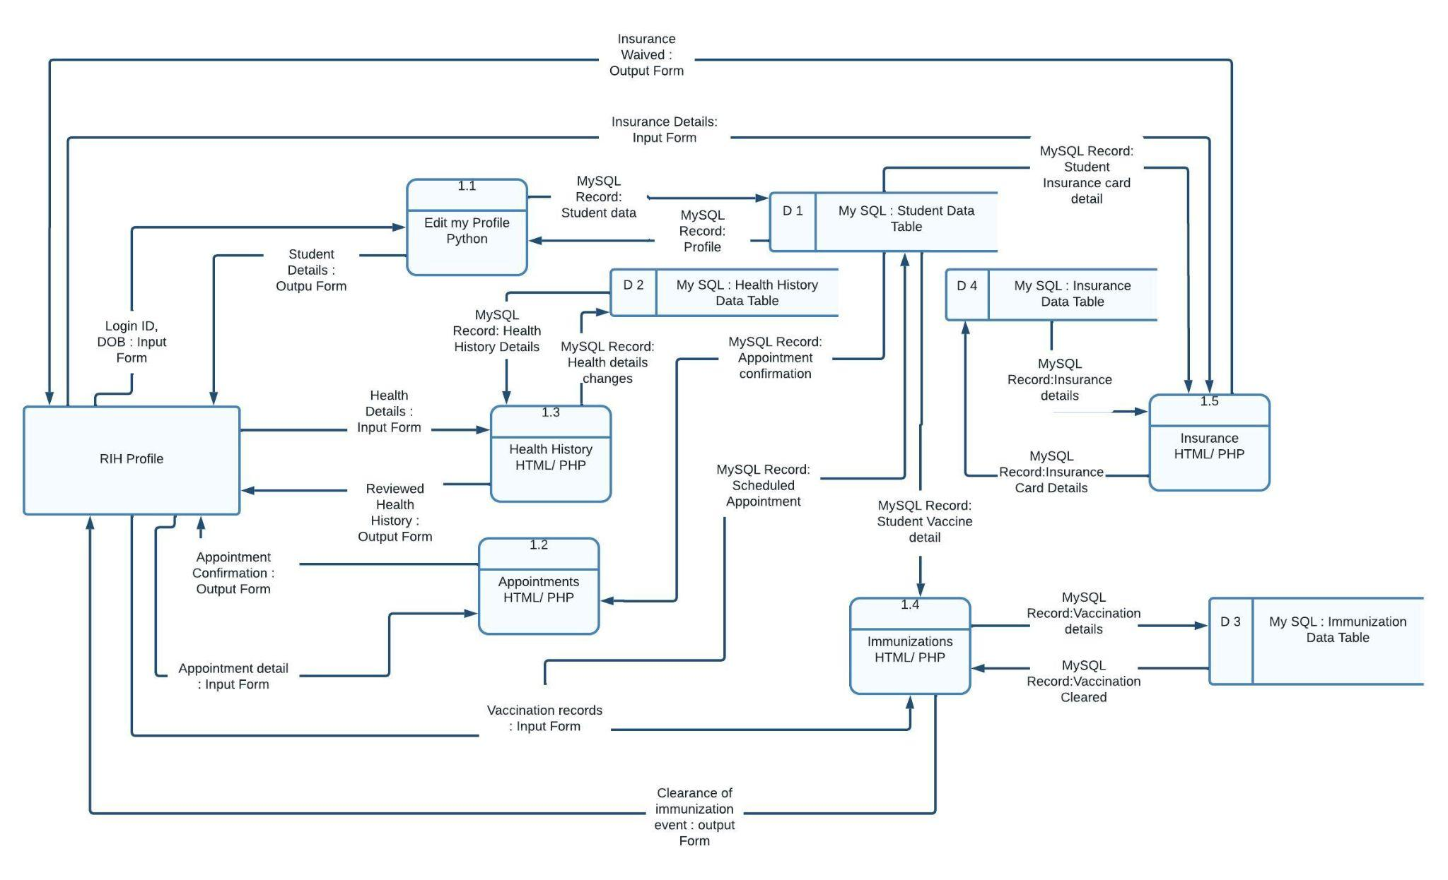
Physical Diagram

Slide 4
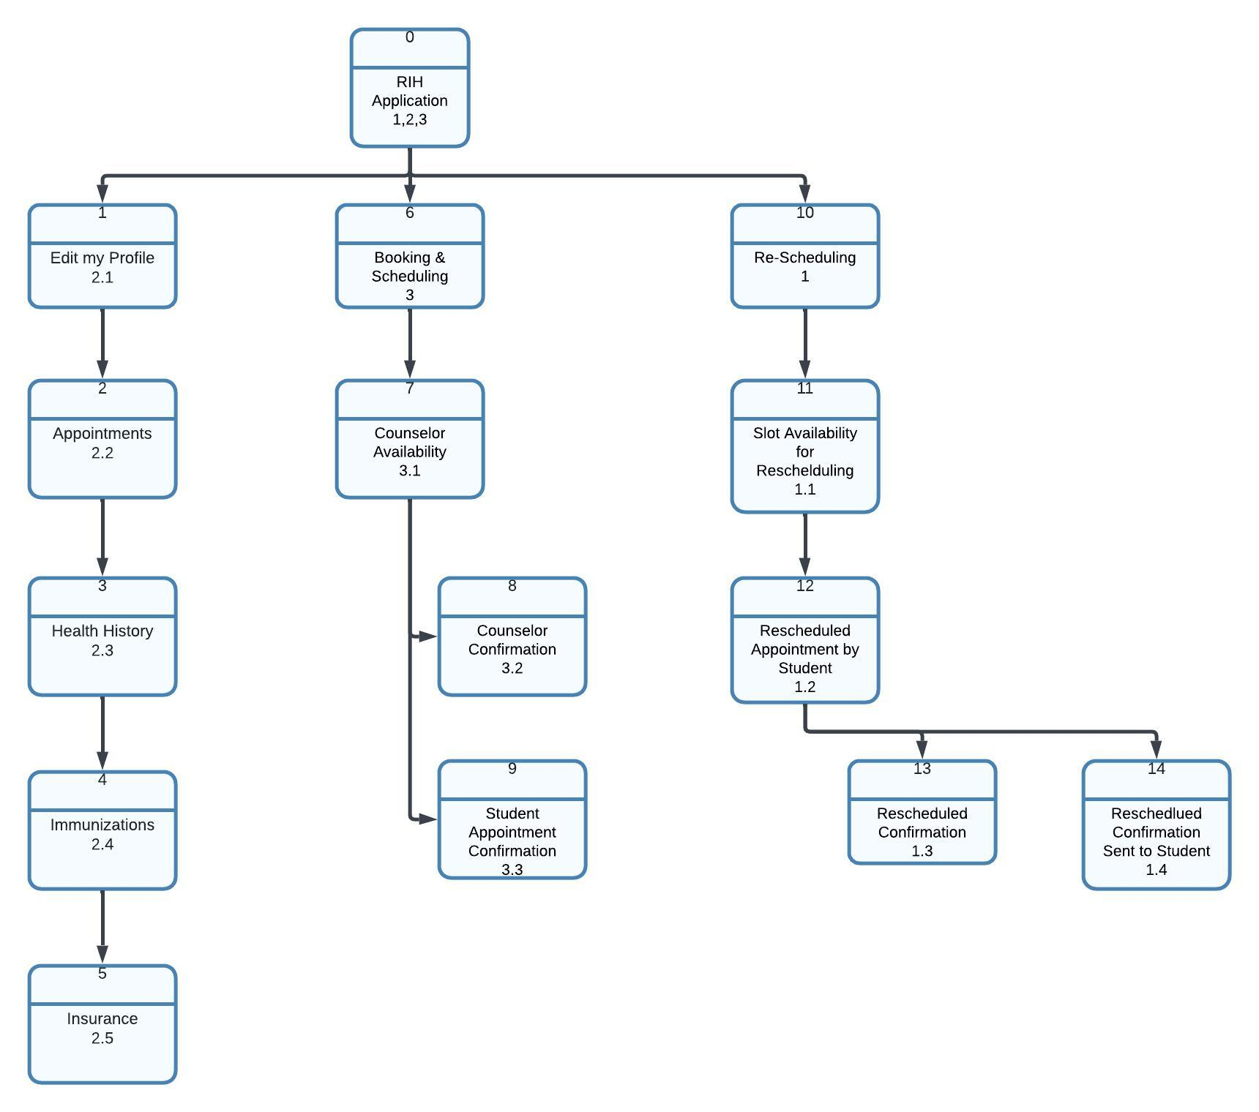
The user interface is designed with a green line that acts as a progress indicator, confirming the user's advancement in the appointment scheduling process.
Icons like the floppy disk for "Save" and the trash can for "Delete" are used consistently, ensuring quick recognition and enhancing user interaction.
The UMBC logo provides quick access to the myUMBC platform, ensuring users can easily navigate to it whenever needed
The live chat feature allows users to seek assistance and provide feedback, ensuring a user-friendly and supportive experience throughout the appointment scheduling process.
Interface Structure Diagram

Slide 5
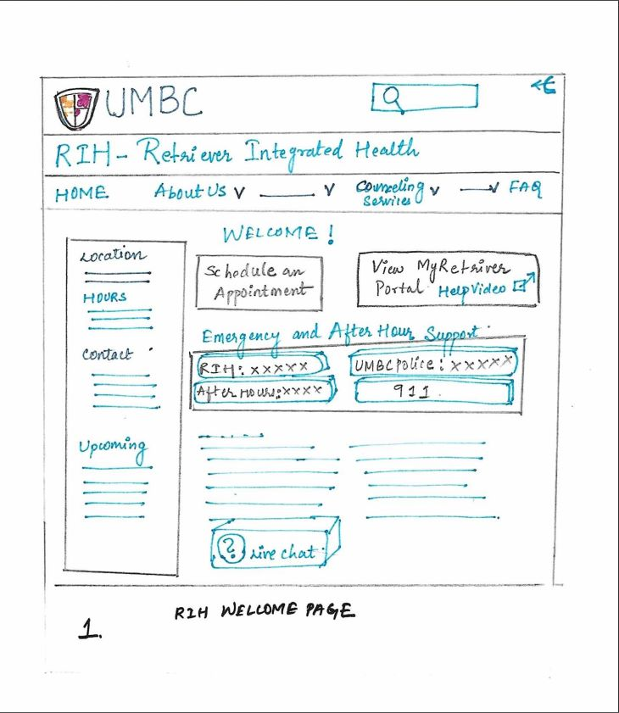
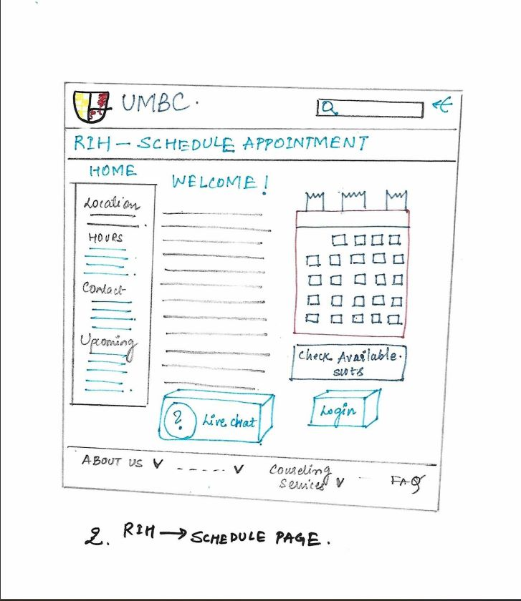
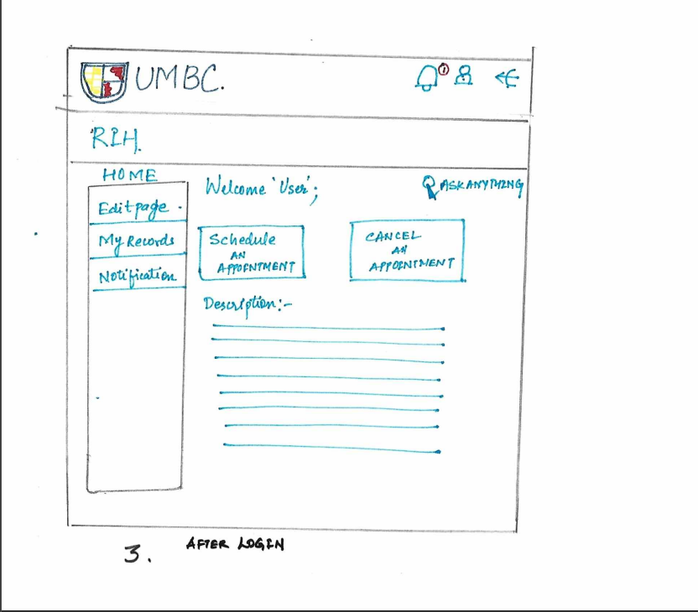
Interface Design Prototype

Slide 6

Thank you

