Slide 1

EXTERNAL REVIEW PRESENTATION

Slide 2
Design and Implementation of APB Interfaced Vedic Multiplier in Verilog
Presented by:
ECE-B, Batch No: 6(VLSI)
A.I.Priya Darshini 22P31A0455
B.Taruna Sri 22P31A0457
R.Swathi Pravallika 22P31A04A8
R.Sathibabu 22P31A04A9
Under the Guidance of
Ms.S.S.V.Kiranmayi,M.Tech,(Ph.D)
Assistant Professor
Department of ECE, ACET(A)

Slide 3
CONTENTS
ABSTRACT
INTRODUCTION
LITERATURE SURVEY
EXISTING METHODOLOGY
PROPOSED METHODOLOGY
MECHANISM OF VEDIC MULTIPLICATION
EXAMPLE OF VEDIC MULTIPLICATION
BLOCK DIAGRAM
MODULES
FUNCTIONAL & NON-FUNCTIONAL REQUIREMENTS
BASIC USER INTERFACE
RESULTS
SAMPLE TESTCASES
CONCLUSION
FUTURE SCOPE
REFERENCES
PAPER ACCEPTANCE

Slide 4
ABSTRACT
A Vedic multiplier based on the Urdhva-Tiryagbhyam sutra is designed and implemented using Verilog HDL. The design utilizes parallel generation of partial products to perform multiplication operations efficiently.
To enable communication with processor-based systems, the multiplier is interfaced with the AMBA APB (Advanced Peripheral Bus) protocol. The APB interface allows structured data transfer through register-based read and write operations.
The complete design is modeled and verified using Xilinx Vivado simulation tools. The results confirm correct functionality of the system, demonstrating successful integration of the Vedic multiplier with the APB interface.

Slide 5
INTRODUCTION
The Advanced Peripheral Bus (APB) is part of the AMBA protocol used for low-bandwidth control accesses.
The Vedic multiplier, based on Urdhva Tiryagbhyam sutra, offers faster multiplication using parallel computation.
This project implements a Vedic multiplier interfaced with APB using Verilog HDL for high-speed arithmetic operations in SoC systems.
The design achieves better throughput and reduced latency compared to traditional multipliers.
The proposed system demonstrates improved area efficiency and scalability, making it suitable for real-time embedded and DSP applications.

Slide 6
LITERATURE SURVEY
Title | Journal Name | Methodology | Merits | Gap Identified
APB Protocol of AMBA Technology | International Journal of Creative Research Thoughts (IJCRT), 2025 | Study of APB signals, architecture, read/write operations | Simple design, low power, easy peripheral integration | Computational blocks like Vedic multipliers are not interfaced with the APB protocol
Design and Implementation of Vedic Multiplier | International Journal of Recent Technology and Engineering (IJRTE), 2020 | Urdhva Tiryagbhyam sutra, VHDL implementation, FPGA synthesis | Reduced delay and faster computation | Multiplier is not integrated with any standard bus protocol such as APB
64-bit Vedic Multiplier with Modified Architecture and Improved Performance | International Journal of Advance Research, Ideas and Innovations in Technology (IJARIIT), 2021 | Modified Vedic architecture using Verilog, CSA and Carry Skip Adders | High speed, reduced delay and power | Lacks APB-based interfacing for SoC-level applications
Realization of Advanced Peripheral Bus (APB) Protocol using Verilog | International Journal of Scientific Research in Engineering and Management (IJSREM), 2024 | Verilog HDL implementation of APB read/write operations | Scalable design, efficient peripheral communication | Does not integrate APB with Vedic arithmetic units for computation

Slide 7
EXISITING METHODOLOGY
APB-Based Peripheral Design: Arithmetic blocks are implemented as APB slave peripherals to enable processor-controlled access.
Register-Based Communication: Read/write transactions are used to transfer operand inputs and result outputs via APB registers.
Simple Control Mechanism: APB offers a non-pipelined, low-power interface that can be used to control arithmetic IPs.
Standalone Vedic Multiplier Design: For fast arithmetic operations, the Urdhva Tiryagbhyam algorithm in Verilog is frequently used to implement Vedic multipliers.

Slide 8
PROPOSED METHODOLOGY
APB Master:
The APB Master initiates all read and write operations. It provides clock and active-low reset. The master sends address, control, and data signals to the APB slave. It controls the timing of data transfer using PSEL and PENABLE.
APB Slave:
The APB Slave receives commands from the APB Master. It decodes the address to select internal registers. The slave acts as an interface between the APB bus and the Vedic Multiplier. It stores input operands and provides multiplication results.
Vedic Multiplier:
The Vedic Multiplier performs fast multiplication using Urdhva Tiryagbhyam algorithm. It receives two operands from the APB slave registers. The computed product is sent back to the APB slave for read operation. This architecture improves speed and reduces delay.

Slide 9
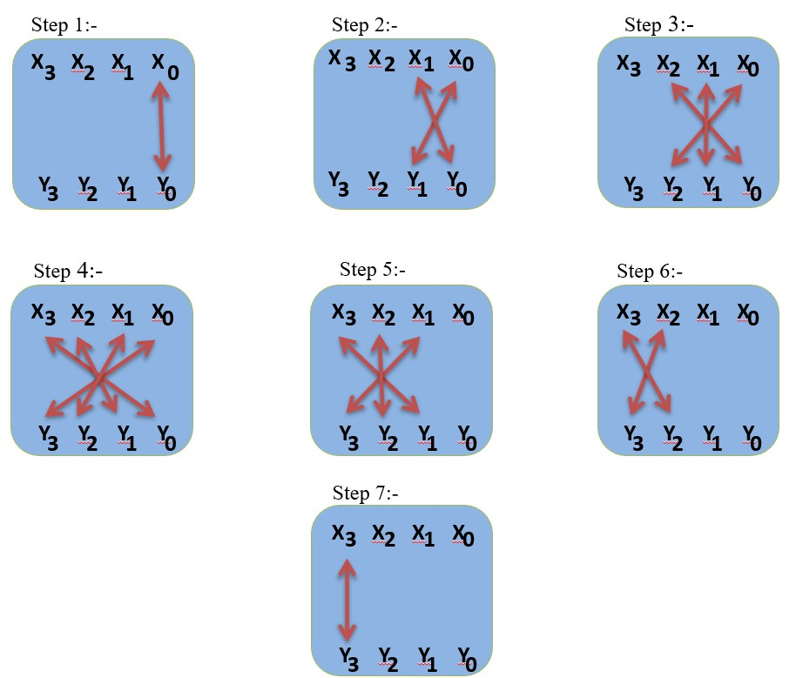
MECHANISM OF THE VEDIC MULTIPLICATION

Slide 10
The Urdhva Tiryagbhyam (Vertical and Crosswise) multiplication algorithm is depicted in the diagram.
At each stage, vertical and crosswise bit combinations are used to multiply the inputs (X_3!-!X_0) and (Y_3!-!Y_0).
Along with carry propagation, partial products are produced in parallel and summed.
This approach reduces multiplication delay and improves speed and efficiency .
The algorithm is efficiently modeled using Verilog HDL, enabling easy simulation, verification, and future integration with the APB interface.

Slide 11
EXAMPLE OF VEDIC MULTIPLICATION
Step 1
Step 2
Step 3
3 1 2
3 4 6 8
Carry
1
3 1 2
3 4 6 8
Carry
2
3 1 2
3 4 6 8
Carry
4
6
1 6
0 1 6
Step 4
Step 5
Step 6
3 1 2
3 4 6 8
3 1 2
3 4 6 8
3 1 2
3 4 6 8
Carry
3
Carry
7
Carry
5
2 0 1 6
2 2 0 1 6
4 2 2 0 1 6
Step 7
3 1 2
3 4 6 8
1 8 4 2 2 0 1 6

Slide 12
The two numbers taken are 5312 and 3468
Two is multiplied by eight, resulting in sixteen. Six is written, and one is carried.
One is multiplied by eight and two by six, resulting in twenty. Adding carry gives twenty one. One is written, and two is carried.
Three is multiplied by eight, one by six and two by four, resulting in thirty eight. Adding carry gives forty. Zero is written, and four is carried.
Five is multiplied by eight, three by six, one by four and two by three, resulting in sixty eight. Adding carry gives seventy two. Two is written, and seven is carried.
Five is multiplied by six, three by four and one by three, resulting in forty five. Adding carry gives fifty two. Two is written, and five is carried.
Five is multiplied by four and three by three, resulting in twenty nine. Adding carry gives thirty four. Four is written, and three is carried.
Five is multiplied by three, resulting in fifteen. Adding carry gives eighteen. Eight is written, and one is carried. The final carry one is written.
The final result obtained is 18422016.

Slide 13
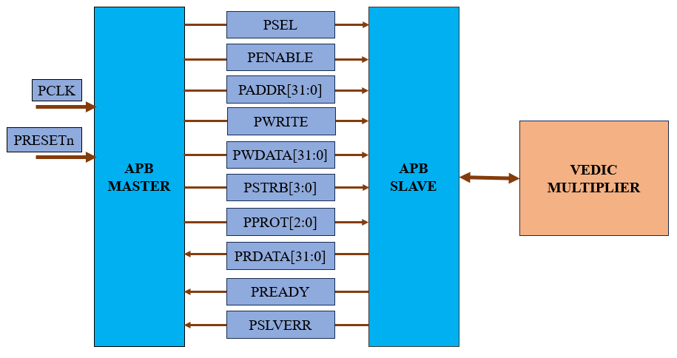
BLOCK DIAGRAM

Slide 14
MODULES
MODULE 1: 2X2 VEDIC MULTIPIER
Implements the Urdhva–Tiryakbhyam multiplication technique.
Generates partial products using simple logic operations.
Provides faster computation compared to conventional multipliers.
Acts as the basic building block for higher-bit Vedic multipliers.
Requires minimal hardware resources for implementation.
MODULE 2: 4X4 VEDIC MULTIPLIER
Constructed using four 2×2 Vedic multiplier blocks.
Parallel generation of partial products.
Reduced computation delay.
Scalable architecture for higher-bit multipliers.

Slide 15
MODULE 3: 8X8 VEDIC MULTIPLIER
Constructed using four 4×4 Vedic multiplier modules.
Parallel generation of partial products.
Improved speed due to hierarchical design.
Produces a 16-bit multiplication output.
MODULE 4: 16X16 VEDIC MULTIPLIER
Constructed using four 8×8 Vedic multiplier modules.
Parallel generation of partial products.
High-speed multiplication due to hierarchical architecture.
Produces a 32-bit multiplication output.

Slide 16
MODULE 5: APB INTERFACED VEDIC MULTIPLIER
Handles communication between the processor and multiplier unit.
Supports APB read and write operations.
Uses internal registers to store input operands.
Provides multiplication result through the APB data bus.
MODULE 4: TESTBENCH
Generates clock and reset signals for simulation.
Performs APB read and write operations.
Applies different test inputs to verify functionality.
Displays multiplication results during simulation

Slide 17
FUNCTIONAL & NON-FUNCTIONAL REQUIREMENTS
FUNCTIONAL REQUIREMENTS
Capture input operands via APB interface.
Process data using Vedic multiplication logic.
Compute high-speed 16-bit multiplication.
Store computed results in registers.
Display/read output through APB read operation.
Reset and control the operation using control signals.
NON-FUNCTIONAL REQUIREMENTS
High performance and low latency.
Low power and area efficient design.
Scalable for different bit widths.
Protocol-compliant APB interface.
Reliable and accurate operation

Slide 18
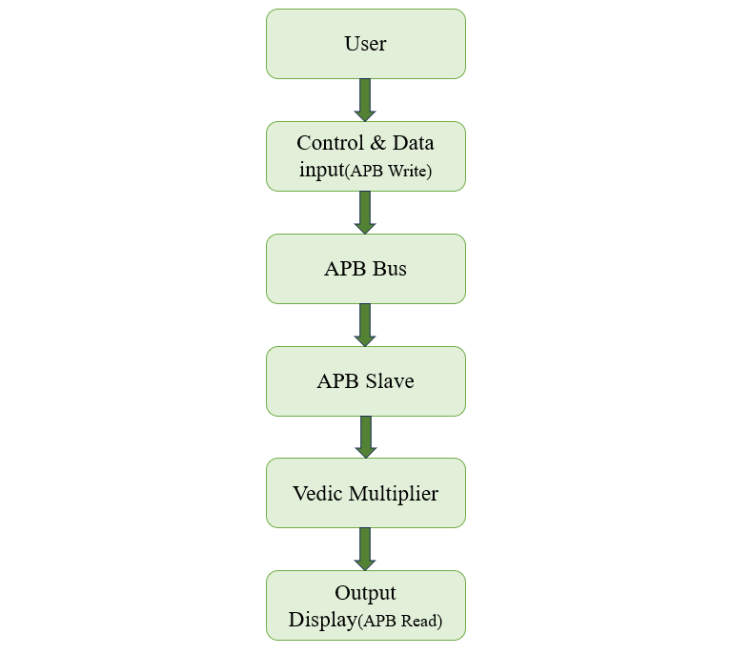
BASIC USER INTERFACE

Slide 19
User : Provides input operands and control signals.
Control & Data Input (APB Write): Sends user data and commands to the bus.
APB Bus: Transfers data and control signals to the APB slave.
APB Slave: Receives data from the bus and interfaces with the multiplier.
Vedic Multiplier: Performs fast multiplication of input operands.
Status & Output Display (APB Read): Shows multiplication result and system status.

Slide 20
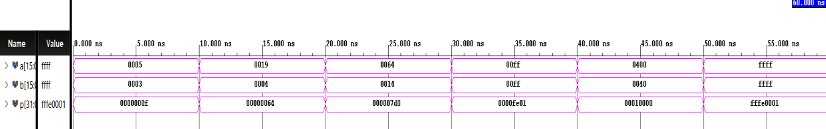
RESULTS
Simulation Waveform without Interfacing

Slide 21
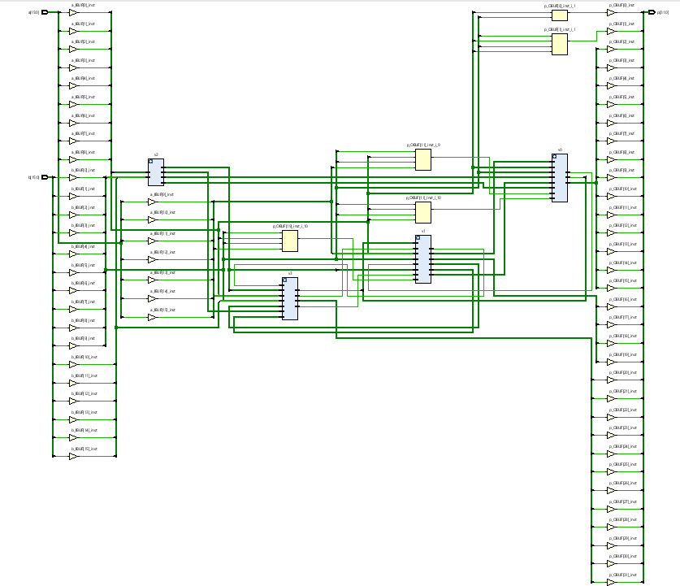
Synthesized Schematic Diagram without Interfacing

Slide 22
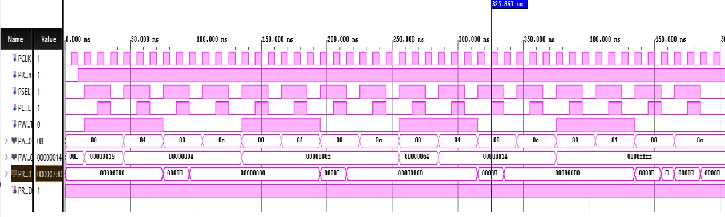
Simulation Waveform with APB Interfacing

Slide 23
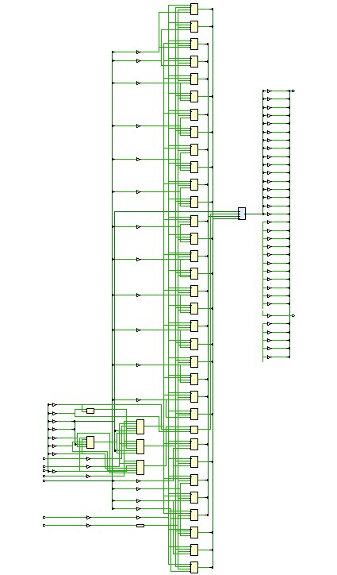
Synthesized Schematic Diagram with APB Interfacing

Slide 24
SAMPLE TESTCASES
TESTCASES | INPUT A | INPUT B | EXPECTED OUTPUT | RESULT
1 | 25 | 4 | 100(64) | PASS
2 | 15 | 15 | 225(E1) | PASS
3 | 100 | 20 | 2000(7D0) | PASS
4 | 65535 | 65535 | 4294836225 (FFFE 0001) | PASS
5 | 1000000000 | 2000000000 | XXXXX | FAIL

Slide 25
CONCLUSION
The APB interfaced Vedic multiplier was successfully designed using Verilog HDL.
The design was simulated and verified using Xilinx Vivado.
The multiplier is based on the Urdhva Tiryakbhyam sutra, enabling fast and area-efficient multiplication.
The APB protocol provides a simple and reliable communication interface between the processor and the multiplier.
The complete system was developed and tested in Xilinx Vivado environment.
Simulation results confirm that the design operates correctly as expected.
The proposed architecture achieves improved performance with low hardware complexity.
The design is well-suited for DSP and embedded system applications.

Slide 26
FUTURESCOPE
The design can be extended to higher bit-width multipliers (32-bit, 64-bit) for advanced applications.
Implementation of the design on real FPGA hardware can be carried out for practical validation.
Power optimization techniques can be applied to further reduce power consumption.
The architecture can be integrated with high-speed buses like AHB or AXI for improved performance.
The design can be applied to complex DSP applications such as FFT, filtering, and image processing.

Slide 27
REFERENCES
Madhabhatthula Prem Kumar, Shiva Nand Singh, 64-bit Vedic multiplier with modified architecture and improved performance using Verilog, International Journal of Advance Research, Ideas and Innovations in Technology,2021.
Akshay Savji, Shruti Oza, Design and Implementation of Vedic Multiplier, International Journal of Recent Technology and Engineering,2020.
Chirag Saxena, Shivansh Prakash, Deepmala Srivastava, APB Protocol of AMBA Technology, International Journal of Creative Research Thoughts,2025.
Dr. B Ravi Kumar, Katte Srisha, Boppana Akhila, Realization of Advanced Peripheral Bus(APB) Protocol using Verilog, International Journal of Scientific Research in Engineering and Mangement,2024.
K. Keshav Sai Chowdary, K. Mourya, S. Ravi Teja, G. Suresh Babu, S. Sridevi Sathya Priya, Design of Efficient 16-bit Vedic Multiplier, 1 3rd International Conference on Signal Processing and Communication,2021.
V Sagar Reddy, Jaini Sachin Rewaria, Ranjith Kumar Thota, Chevella Anil Kumar, Vinay Kumar Chikoti, Design and Verification of APB Protocol, 3rd International Conference on Advancements in Electrical, Electronics, Communication, Computing and Automation,2025.
Padmaprabha Jain, Satheesh Rao, Design and Verification of Advanced Microcontroller Bus Architecture-Advanced Peripheral Bus (AMBA-APB) Protocol, Third International Conference on Intelligent Communication Technologies and Virtual Mobile Networks,2021.
K.G. Venkata Krishna, A. Supriya, R. Akhil, CH. Pavan Kumar, D. Karimulla, Design And Verification of 32-BIT Vedic Multiplier, International Research Journal of Engineering and Technology,2024.

Slide 28
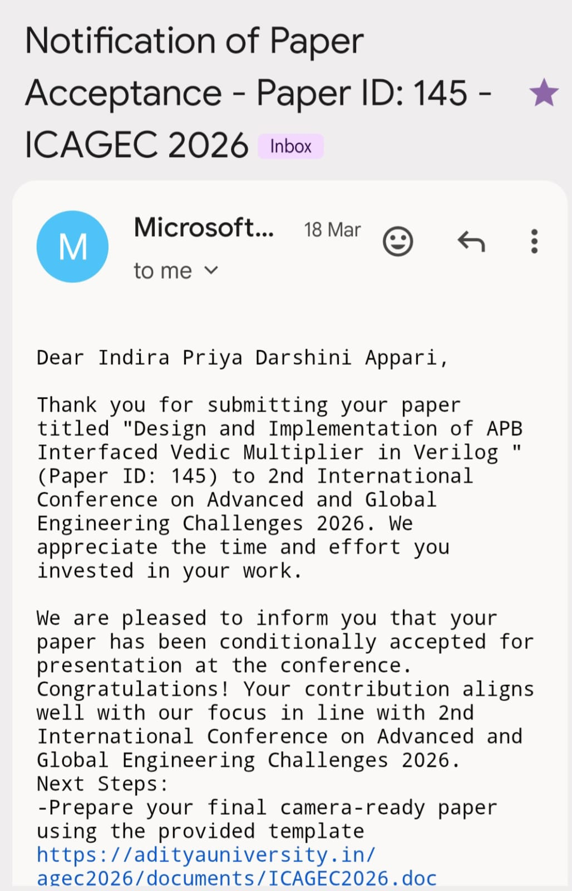
PAPER ACCEPTANCE

Slide 29
THANK YOU

