Slide 1
NORTHWIND DATA ANALYSIS
Presented by: Tarun Prakash Bandi
ROLL NO: BCA232667

Slide 2

1. Which shippers do we have?
select * from [dbo].[Shippers] ;

Slide 3
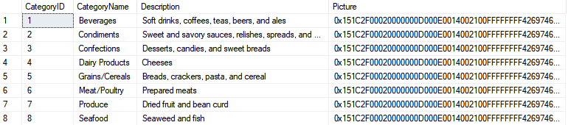
2. Certain fields from Categories
select * from [dbo].[Categories];

Slide 4
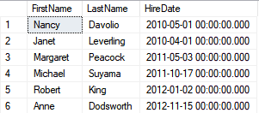
3. Sales Representatives
select FirstName, LastName, HireDate from [dbo].[Employees] where Title='Sales Representative';

Slide 5

4. Sales Representatives in the United States
select FirstName, LastName, HireDate from[dbo].[Employees] where Title= 'Sales Representative' and Country='USA';

Slide 6
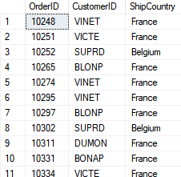
5. Orders shipping to France or Belgium
select OrderID,CustomerID, ShipCountry from[dbo].[Orders] where ShipCountry='France' or ShipCountry='Belgium';

Slide 7
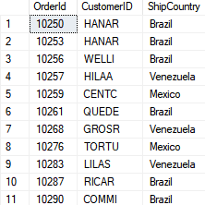
6. Orders shipping to any country in Latin America
select OrderId, CustomerID, ShipCountry from[dbo].[Orders] where ShipCountry in ('Brazil','Mexico','Argentina','Venezuela');

Slide 8
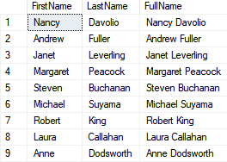
7. Employees full name
select FirstName, LastName, FirstName + ' ' + LastName as FullName from [dbo].[Employees];

Slide 9
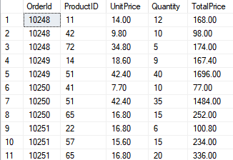
8. OrderDetails amount per line item
select OrderId, ProductID, UnitPrice, Quantity, TotalPrice=(UnitPrice*Quantity) from[dbo].[OrderDetails] order by OrderID, ProductID;

Slide 10

9. Countries where there are customers
select Country from [dbo].[Customers] group by Country having count(CustomerID)>1;

Slide 11
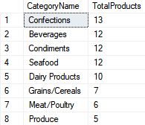
10. Categories, and the total products in each category
select c.CategoryName, count(p.ProductID) as TotalProductsfrom[dbo].[Categories] c join [dbo].[Products] p on c.CategoryID=p.CategoryID group by c.CategoryName order by TotalProducts desc

Slide 12
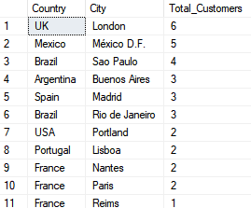
11. Total customers per country/city
select Country, City, count(*) as Total_Customers from [dbo].[Customers] group by City, Country order by Total_Customers desc

Slide 13
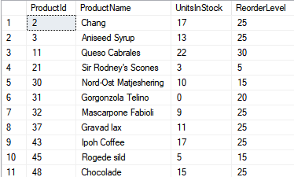
12. Products that need reordering
select ProductId, ProductName, UnitsInStock, ReorderLevel from[dbo].[Products] where UnitsInStock<ReorderLevel

Slide 14

13. Products that need reordering, continued
select ProductID, ProductName, UnitsInStock, UnitsOnOrder, ReorderLevel, Discontinued from[dbo].[Products] where (UnitsInStock+UnitsOnOrder) <= ReorderLevel and Discontinued=0

Slide 15
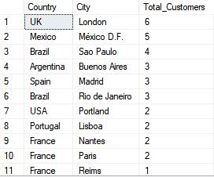
14. Total customers per country/city
select Country, City, count(*) as Total_Customers from [dbo].[Customers] group by City, Country order by Total_Customers desc

Slide 16

15. High Freight charges
select top 3 ShipCountry, avg(Freight) as Average_Freight
from[dbo].[Orders] where OrderDate like '%2015%' group by ShipCountry order by Average_Freight desc

Slide 17
16. Categories, and the total products in each category
select c.CategoryName, count(p.ProductID) as TotalProductsfrom[dbo].[Categories] c join [dbo].[Products] p on c.CategoryID=p.CategoryID group by c.CategoryName order by TotalProducts desc

