Slide 1
CIPHER CONNECT: Cryptographic Encryption of Video and Audio Data
Batch – B Group - 17
21AIE431 – Applied Cryptography

Slide 2
TEAM MEMBERS
Parthvi Manoj
Sakthi Swaroopan
Sanjay Chidambaram
Taruneshwaran
CB.EN.U4AIE21143
CB.EN.U4AIE21159
CB.EN.U4AIE21160
CB.EN.U4AIE21170

Slide 3
PROBLEM STATEMENT
To create a secure video calling application utilizing AES encryption, enabling real-time webcam streaming, encrypted communication, and file sharing among multiple clients. The system ensures robust server-client architecture, end-to-end encryption, and comprehensive monitoring through AES and other security measures.

Slide 4
Tools, Techniques, And Technologies (Java)
Programming Language: Java
Encryption: Advanced Encryption Standard (AES)
Networking: Socket programming in Java
User Authentication: Hashing
User Interface: Swing or JavaFX
Webcam Integration: Webcam-Capture library (sarxos)
Data Serialization: ObjectOutputStream and ObjectInputStream
Dependency Management: Apache Maven
JSON Processing: GSON library
Version Control: Git
Security Measures: Secure key management, input validation, and secure data transmission protocols like HTTPS.

Slide 5
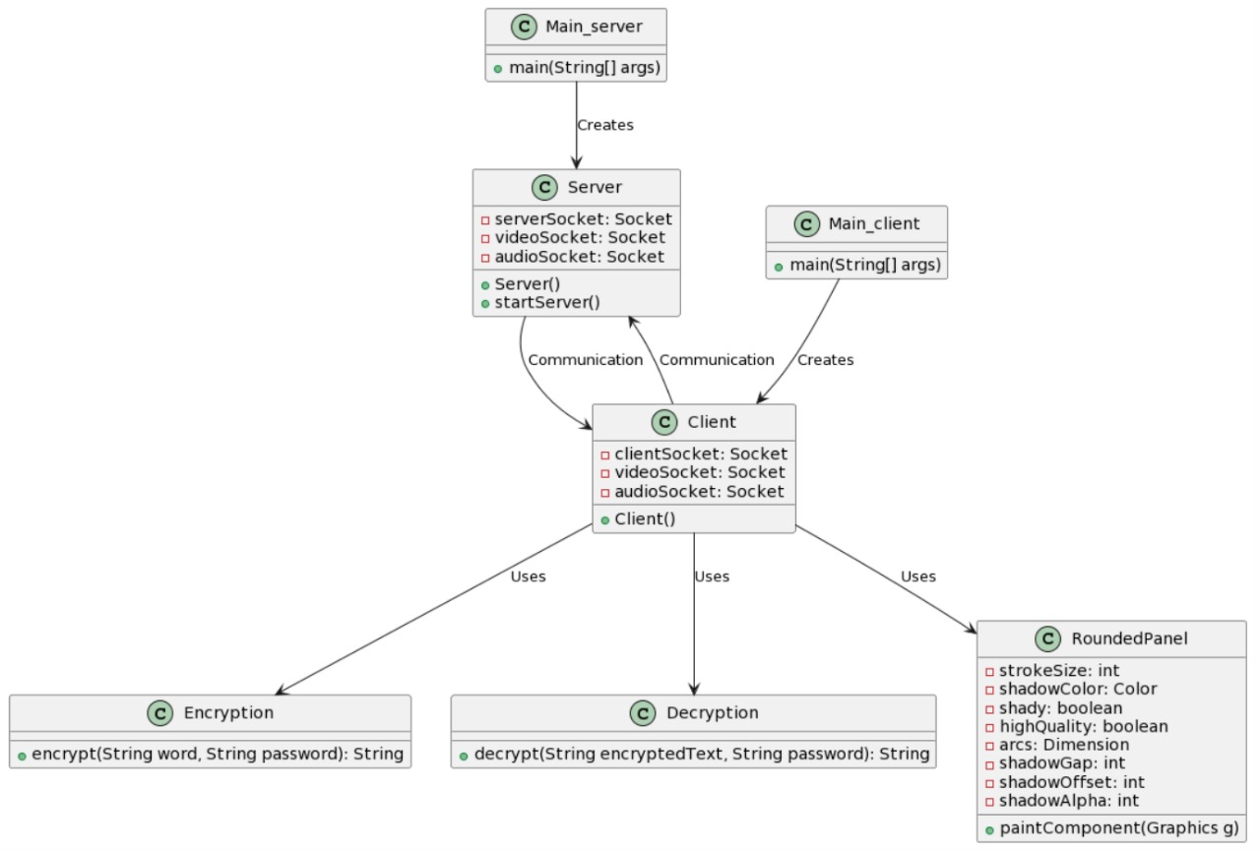
PROJECT OVERVIEW

Slide 6
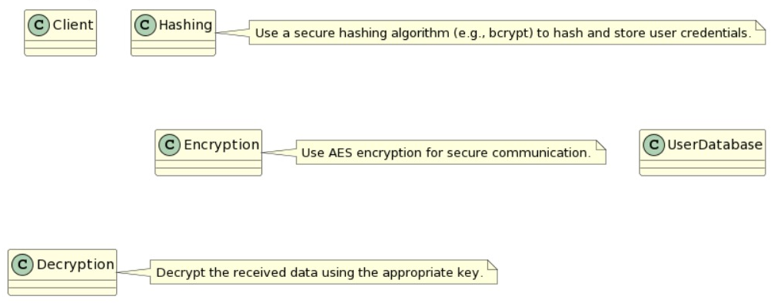
MAIN METHODOLOGY

Slide 7
PROJECT OVERVIEW
Initialization
Server Communication
AES Encryption Initialization
Security Measures and Testing
Chat Communication
Video Communication
Audio Communication
Client-Side Interaction
Error Handling and Monitoring
Deployment and User Interaction

Slide 8
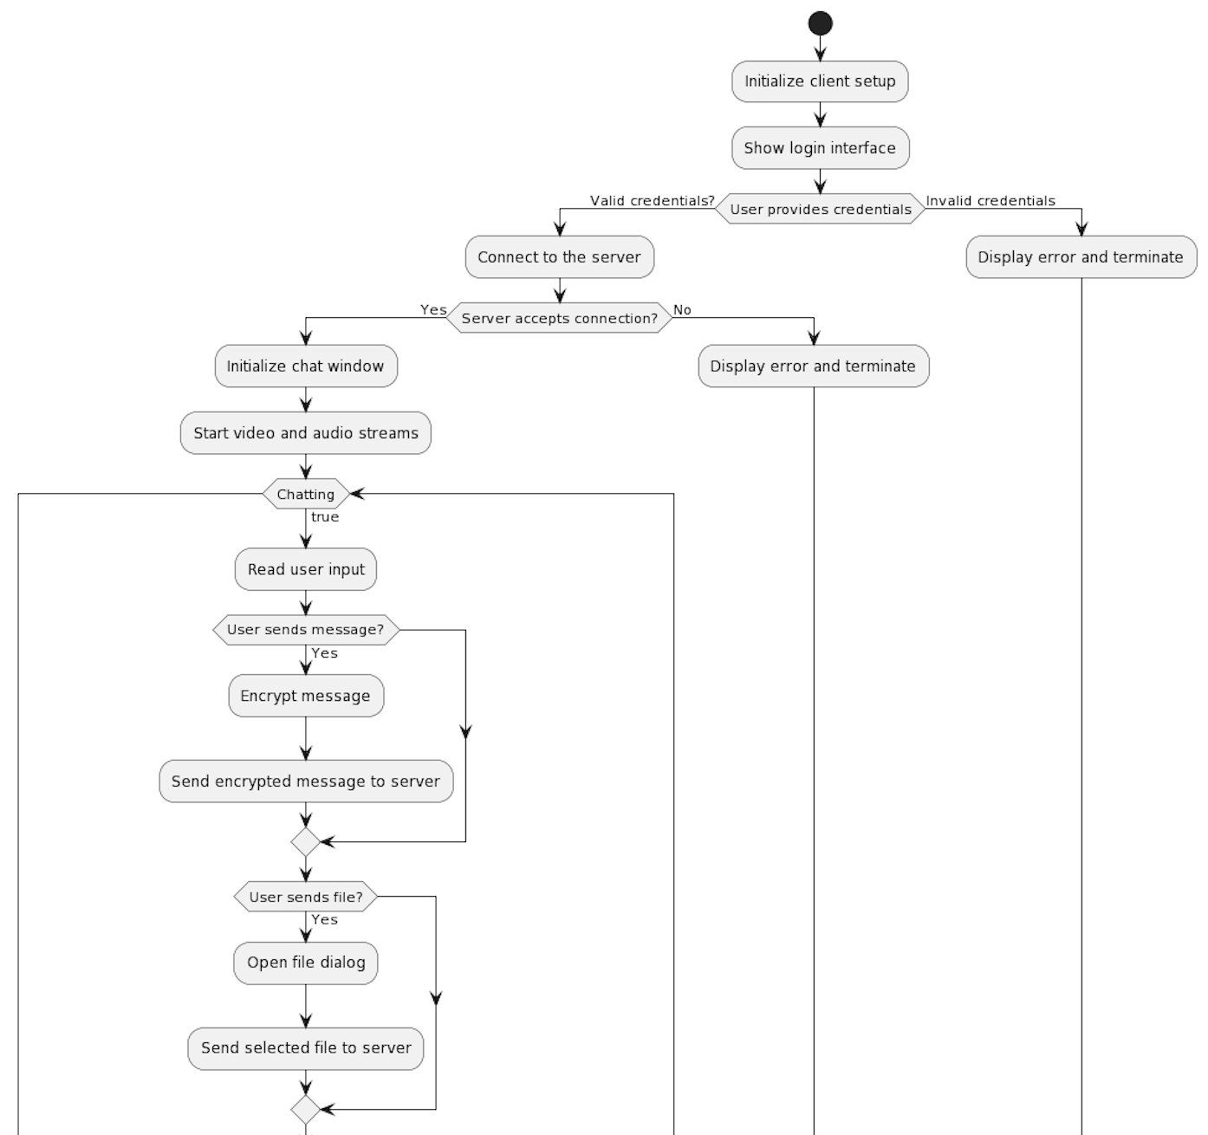
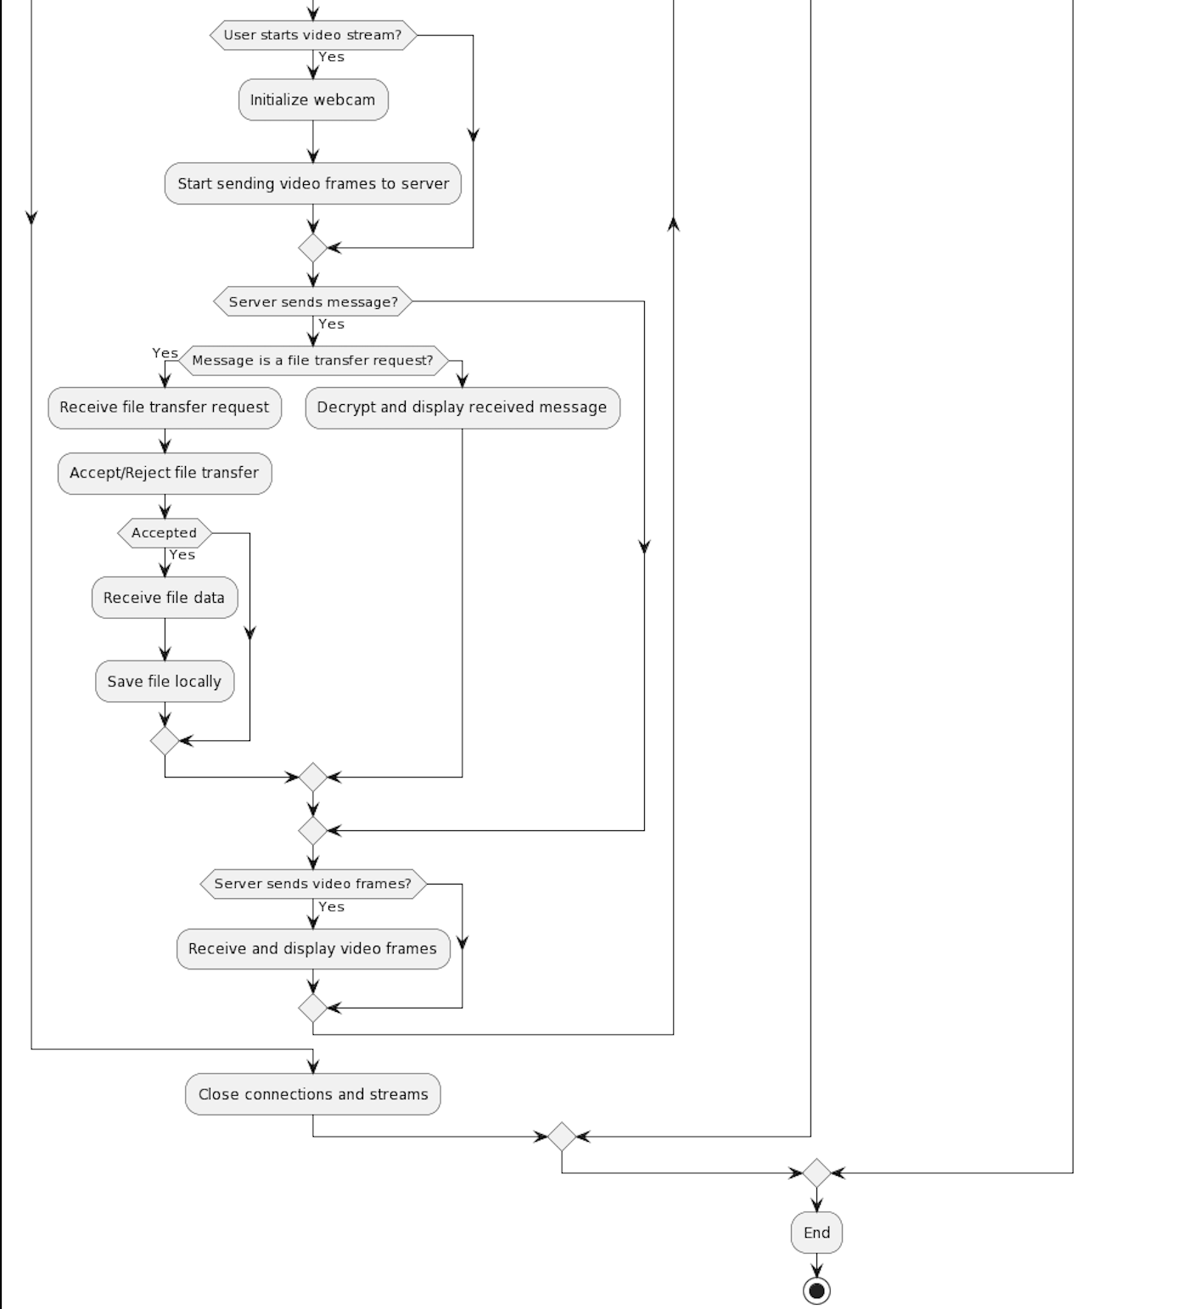
PROJECT OVERVIEW

Slide 9
PROJECT WORKFLOW
Initialization:
The server initializes socket connections for chat, video, and audio communication.
Sets up ports for different communication types (chat, video, audio).
Server Communication:
Listens for incoming client connections on respective ports (chat, video, audio).
Accepts and manages connections, adding clients to appropriate lists.
AES Encryption Initialization:
Generates AES keys for encryption and decryption.
Shares these keys securely with connected clients.
Chat Communication:
Accepts chat client connections, assigns a group name, and exchanges encryption keys.
Facilitates encrypted chat communication among clients.
Handles file transfer requests with AES-encrypted data.

Slide 10
PROJECT WORKFLOW (CONTD…)
Video Communication:
Accepts video client connections and initiates video streaming.
Streams webcam data using AES encryption to connected clients.
Manages end-to-end encrypted video streaming among multiple clients.
Audio Communication:
Accepts audio client connections and initializes audio streaming.
Streams audio data among clients using AES encryption.
Manages real-time encrypted audio communication.
Client-Side Interaction:
Clients join the server's chat, video, and audio channels upon connection.
Encrypts and sends messages, files, video, and audio data to the server and other clients.
Decodes and displays received data, utilizing AES for decryption.

Slide 11
PROJECT WORKFLOW (CONTD…)
Error Handling and Monitoring:
Implements error handling mechanisms to manage disconnections and exceptions.
Logs events, errors, and debug information using Logback for monitoring and debugging purposes.
Security Measures and Testing:
Implements additional security measures such as input validation and secure data transmission protocols.
Tests application functionalities, encryption, and communication security using JUnit or other testing frameworks.
Deployment and User Interaction:
Deploys the server application on a host or cloud service.
Clients interact with the server using the video calling application, engaging in secure video calls, chats, and file sharing.

Slide 12
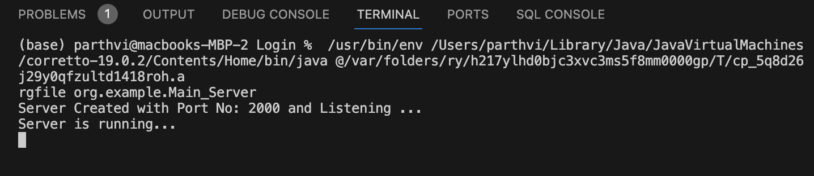
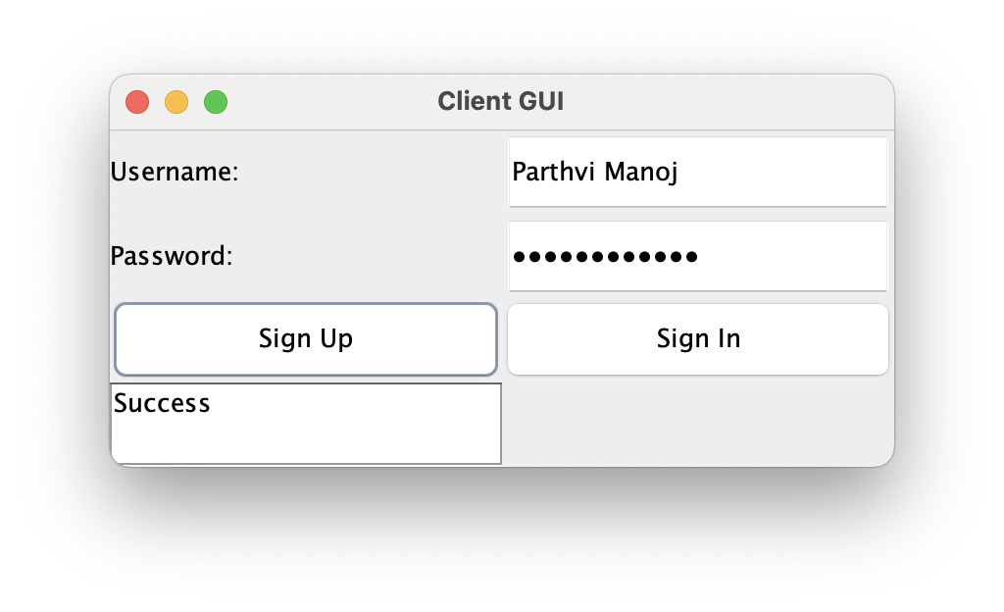
OUTPUT
Running the sever code
Client GUI

Slide 13
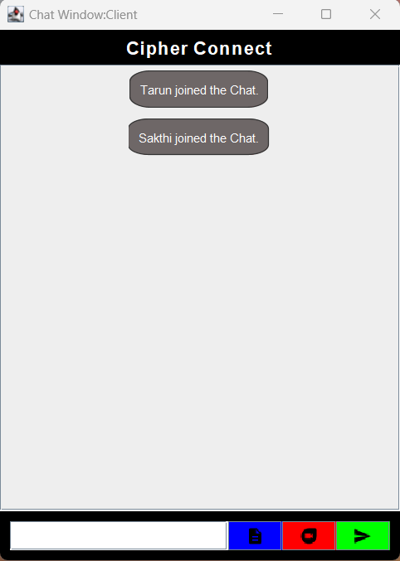
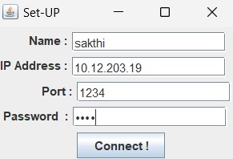
OUTPUT
Set - UP
Chat Window - Client

Slide 14
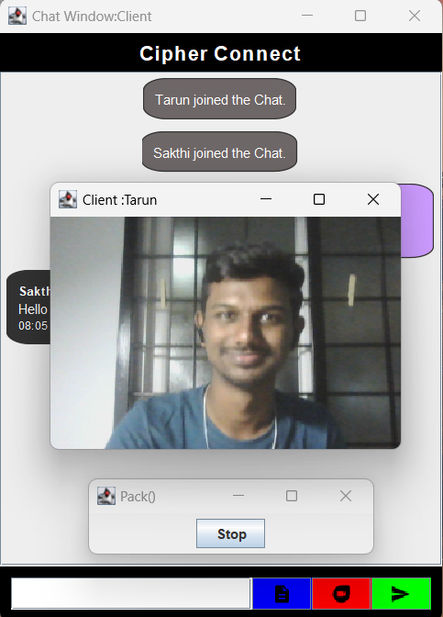
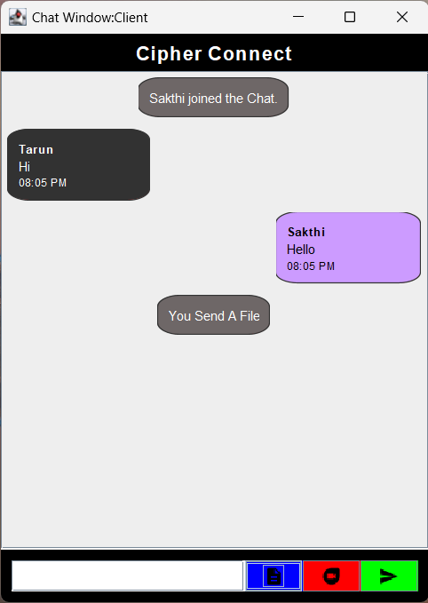
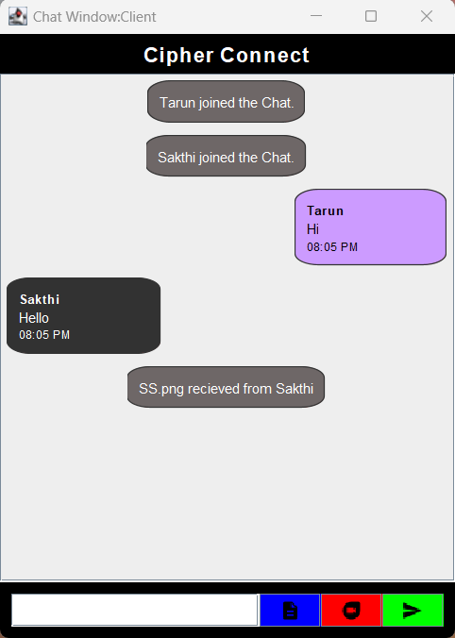
OUTPUT
Chat Window - Video
Chat Window – File Transfer
Chat Window - Chat

Slide 15
Tools, Techniques, And Technologies (PYTHON)
Python: Primary programming language.
AES Encryption: Utilized for encrypting video stream.
Python Object-Oriented Programming (OOP): Structuring code using classes and methods.
Python Tkinter: For GUI

Slide 16
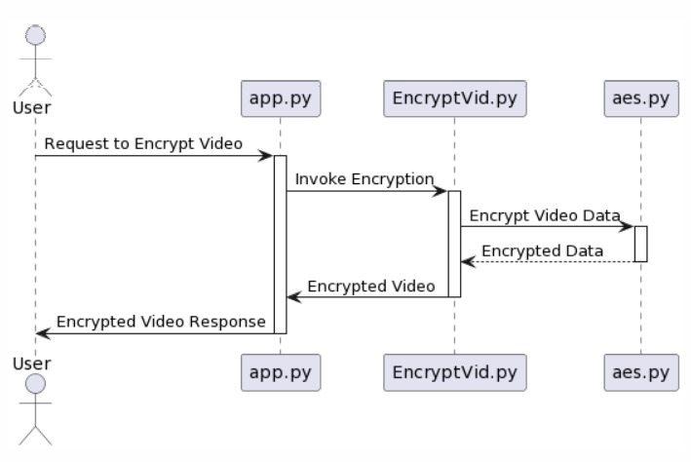
PROJECT OVERVIEW

Slide 17
PROJECT OVERVIEW
Initialization
AES Encryption
AES Decryption
Utility Functions
Main Execution
Testing and Validation

Slide 18
PROJECT WORKFLOW
1. Objective Definition
Define the primary objective: Implement a secure video transmission system using AES encryption and socket programming.
2. Environment Setup
Set up the development environment:
• Choose Python as the programming language.
• Install necessary libraries: OpenCV for video processing, and any other dependencies.
3. Architecture Design
Design the system architecture:
• Define classes for the transmitter and receiver components.
• Plan the multithreading strategy for concurrent execution.

Slide 19
PROJECT WORKFLOW (CONTD…)
4. Encryption and Decryption Functions
Implement AES encryption and decryption functions:
• Create functions for padding and unpadding video data.
• Handle exceptions and errors during encryption and decryption processes.
5. Transmitter Implementation
Implement the Transmitter class:
• Initialize a socket for communication.
• Establish a connection with the receiver using socket programming.
• Use OpenCV for video capture.
• Implement multithreading for video capture, encryption, and transmission processes.

Slide 20
PROJECT WORKFLOW (CONTD…)
6. Receiver Implementation
Implement the Receiver class:
• Initialize a socket, bind it to an IP address and port.
• Implement multithreading for video reception, decryption, and display processes.
• Use OpenCV to display the decrypted video frames in real-time.
7. Testing
Conduct comprehensive testing:
• Perform unit testing for encryption and decryption functions.
• Conduct integration testing to validate end-to-end functionality.

Slide 21
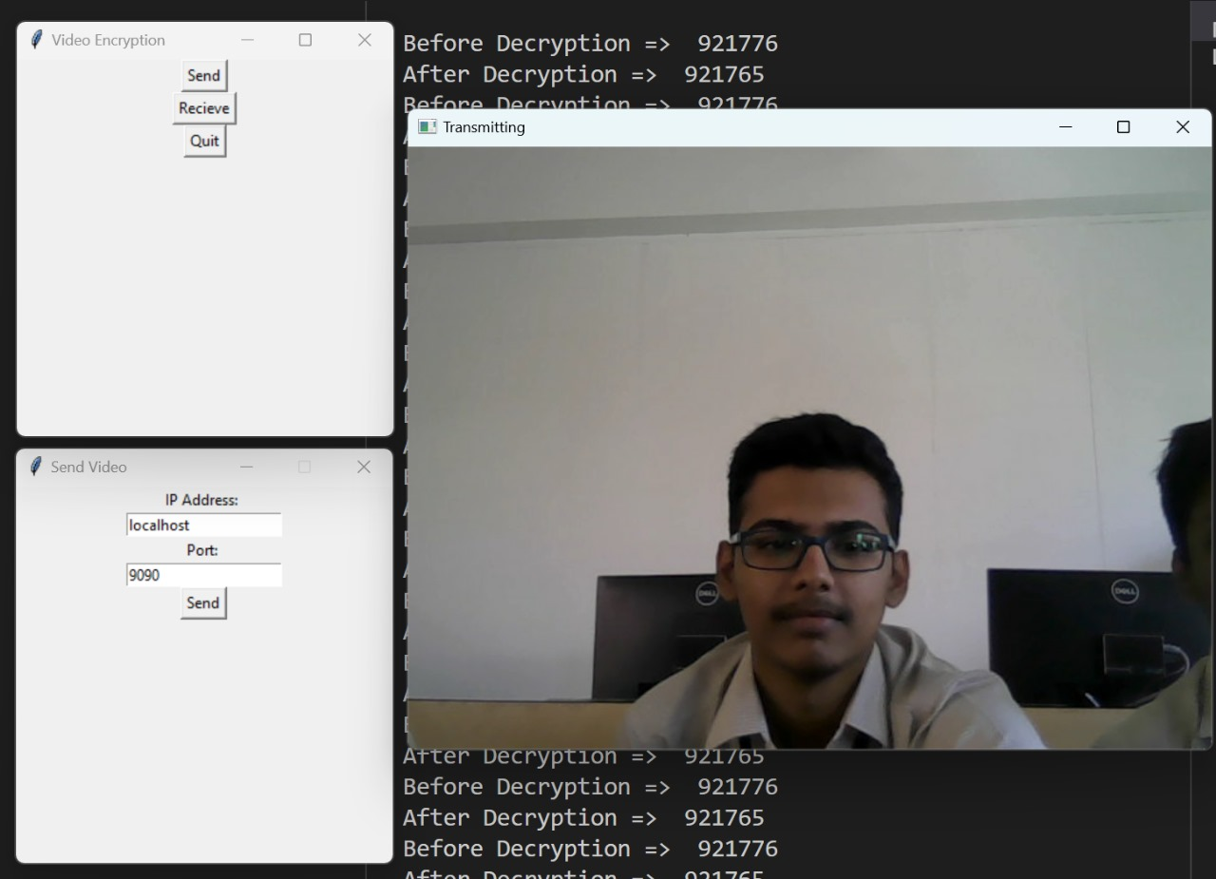
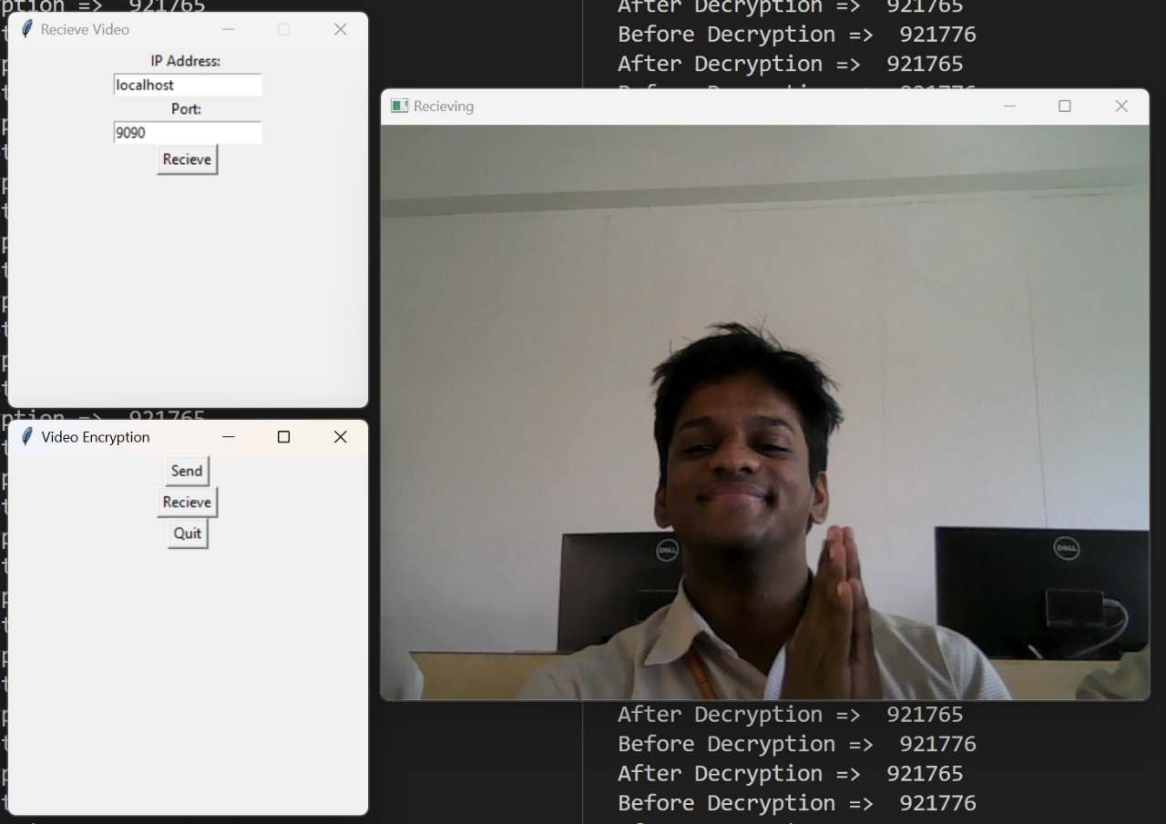
OUTPUT
Transmission Receiver

Slide 22
CONCLUSION
The secure video calling application, utilizing AES encryption, delivers encrypted real-time communication across chat, video streaming, and audio channels. With a robust server-client setup, it ensures data confidentiality and integrity, offering users a protected environment for seamless interactions and file sharing. The integration of stringent security measures and extensive testing guarantees a highly secure platform for reliable video calls and chats.

Slide 23
FUTURE WORK
Future work for this project could involve:
Advanced Encryption Techniques: Explore and implement stronger encryption methods beyond AES for heightened security.
Enhanced User Authentication: Develop multifactor authentication to bolster user verification and system access security.
Improved Media Quality: Focus on enhancing video and audio quality for a more seamless and immersive user experience during calls.
Cross-Platform Integration: Extend application compatibility across diverse devices and operating systems to widen user accessibility.
Optimized Network Performance: Develop and implement protocols to ensure stable calls even in low-bandwidth environments, improving overall user experience.

Slide 24
REFERENCES
https://www.vplayed.com/blog/aes-video-encryption-for-streaming/
https://www.vdocipher.com/blog/2020/11/aes-128-encryption-video-drm-secure/
https://www.backlight.co/blog/streaming/how-to-encrypt-video-files-with-aes-encryption
https://www.haivision.com/blog/all/video-security-aes-encryption/
https://www.dacast.com/blog/aes-video-encryption/#:~:text=The%20AES%20standard%20uses%20key,see%20the%20original%20unencrypted%20data.
https://blog.video.ibm.com/streaming-video-tips/aes-video-encryption-256-vs-128-bit/

Slide 25
THANK YOU!

