Slide 1
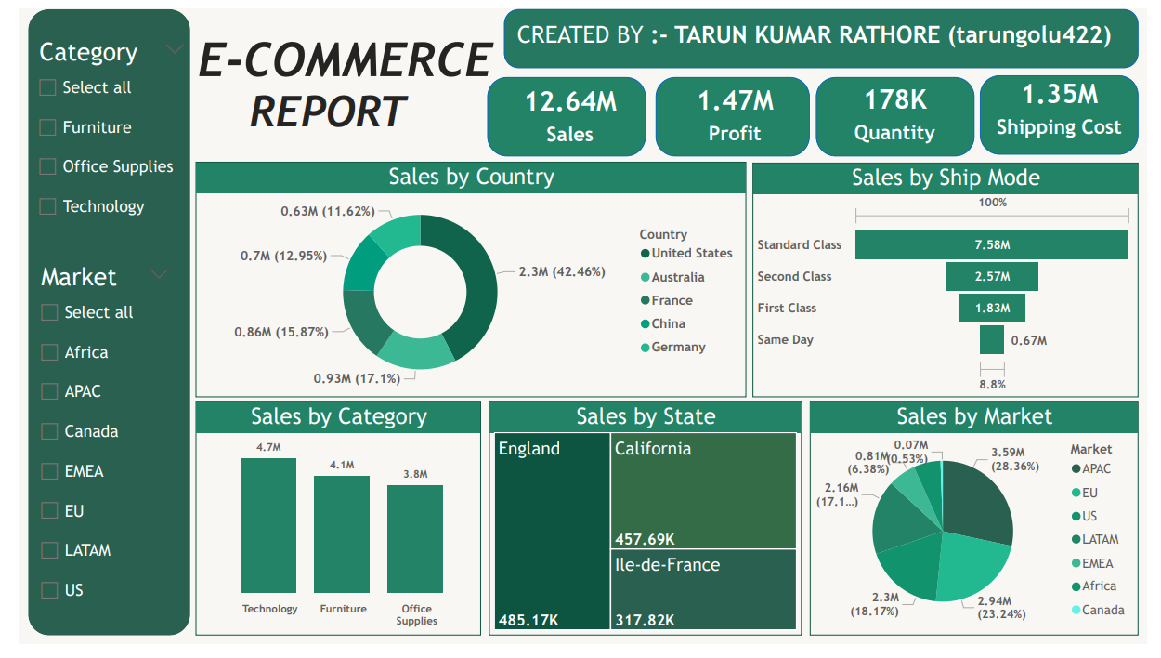
E-Commerce Sales Insight Report
This report analyzes the key metrics and trends from the provided E-Commerce dashboard created by Tarun Kumar Rathore. It focuses on sales performance, profitability, and operational insights to support data-driven decision-making.

Slide 2
Executive Summary
Total Sales: 12.64M, driven primarily by the Technology category and APAC market.
Profit: 1.47M, representing an approximate profit margin of 11.6% (calculated as Profit / Sales).
Quantity Sold: 178K units, indicating strong volume across categories.
Shipping Cost: 1.35M, accounting for about 10.7% of total sales, which may highlight opportunities for cost optimization.
Key Highlights:
Technology leads in sales (4.7M), followed closely by Furniture (4.1M) and Office Supplies (3.8M).
APAC is the top-performing market (3.59M, 28.36%), with the United States as the leading country (2.3M, 42.46%).
Standard Class shipping dominates (7.58M, ~60% of sales), suggesting efficiency in standard logistics but potential for premium shipping upsell.
Recommendations: Focus on expanding in high-growth markets like APAC and EU while optimizing shipping costs and promoting high-margin categories like Technology.

Slide 3
Sales Performance by Category
This section breaks down sales across product categories, revealing Technology as the revenue leader.
Insights: Technology generates the highest revenue, likely due to higher unit prices or demand for electronics and gadgets.
Furniture and Office Supplies are nearly equal, suggesting balanced performance but potential for cross-selling (e.g., bundling office furniture with supplies).
Opportunity: Invest in marketing for Technology to further boost its share, as it may have higher margins contributing to overall profit.

Slide 4
Sales Performance by Market
Markets show regional variations, with APAC and EU as strong performers.
Insights: APAC dominates with over 28% of sales, possibly driven by population density and e-commerce growth in countries like China and Australia.
US and EU together account for ~41%, indicating mature markets with steady demand.
Underperforming regions like Africa and EMEA (combined <7%) may require targeted strategies, such as localized marketing or partnerships.

Slide 5
Sales Performance by Country
Top countries highlight global reach, with the US leading.
Insights: The US is the clear leader, aligning with its market classification and possibly reflecting strong domestic e-commerce infrastructure.
Australia and China contribute significantly, supporting APAC's overall dominance.
European countries (France, Germany) show promise, but growth could be accelerated through region-specific promotions.
Total from top 5 countries: ~5.42M (~43% of overall sales), indicating concentration risk—diversify into emerging markets.

Slide 6
Sales Performance by State/Region
Focusing on top-performing sub-regions for granular insights.
Insights :
England and California are top performers, likely due to urban density and high consumer spending.
Ile-de-France (Paris region) suggests strong French market penetration.
Recommendation: Analyze local trends (e.g., product preferences) to replicate success in similar regions.

Slide 7
Sales Performance by Ship Mode
Shipping modes reveal preferences for cost-effective options.
Insights:
Standard Class handles the bulk of sales, indicating customers prioritize affordability over speed.
Premium modes (First Class, Same Day) are underutilized (~19%), presenting an upsell opportunity for time-sensitive deliveries.
High shipping costs (1.35M total) correlate with volume; negotiate better rates with carriers to improve margins.

Slide 8
Profitability and Efficiency Insights
Overall Profit Margin: 11.6%—solid but room for improvement by reducing shipping costs or focusing on high-margin categories like Technology.
Quantity vs. Sales: 178K units generating 12.64M in sales implies an average unit price of ~$71 (Sales / Quantity), varying by category.
Shipping Efficiency: Costs at 10.7% of sales suggest potential savings through bulk shipping or vendor negotiations.
Trends to Monitor: Without time-series data, assume static snapshot; future reports should include YoY comparisons for growth tracking.
Recommendations and Action Items
Category Focus: Allocate more inventory and marketing to Technology for revenue growth.
Market Expansion: Invest in APAC and EU with localized campaigns; explore untapped potential in EMEA and Africa.
Shipping Optimization: Promote premium shipping to increase average order value while reducing overall costs through efficiency audits.
Regional Targeting: Use state-level data for hyper-local ads (e.g., California-specific promotions).

