Slide 1
Multi-Domain Validation Report
Extending the MA-RAG Framework to Finance & Law
Large-Scale Evaluation on 220 Questions (Medical, LegalBench, and FinanceBench)

Slide 2
EXECUTIVE SUMMARY
Expanding RAG Validation Beyond Clinical Medicine
Why Validate Finance & Law?
No Baseline Benchmarks: The original baseline paper only evaluated medical datasets. Validating financial and legal tasks ensures domain generalizability.
High Stakes Errors: Factual errors in law (e.g., contract enforceability) and finance (e.g., leveraged risk) carry immense liability, demanding a rigid safety/consensus net.
Multi-Agent Suitability: Legal precedents and financial analysis naturally benefit from conflicting perspective debates (Expert personas A, B, and C).
Key Metrics Summary (220 Qs Suite)
Domain | Base Acc | MA-RAG Acc | Latency Δ
Medical | 100.0% | 100.0% | +14.15s
Legal (Law) | 76.0% | 89.0% | +11.85s
Financial | 74.0% | 88.0% | +11.05s
Other (Safety) | 100.0% | 100.0% | +2.04s

Slide 3
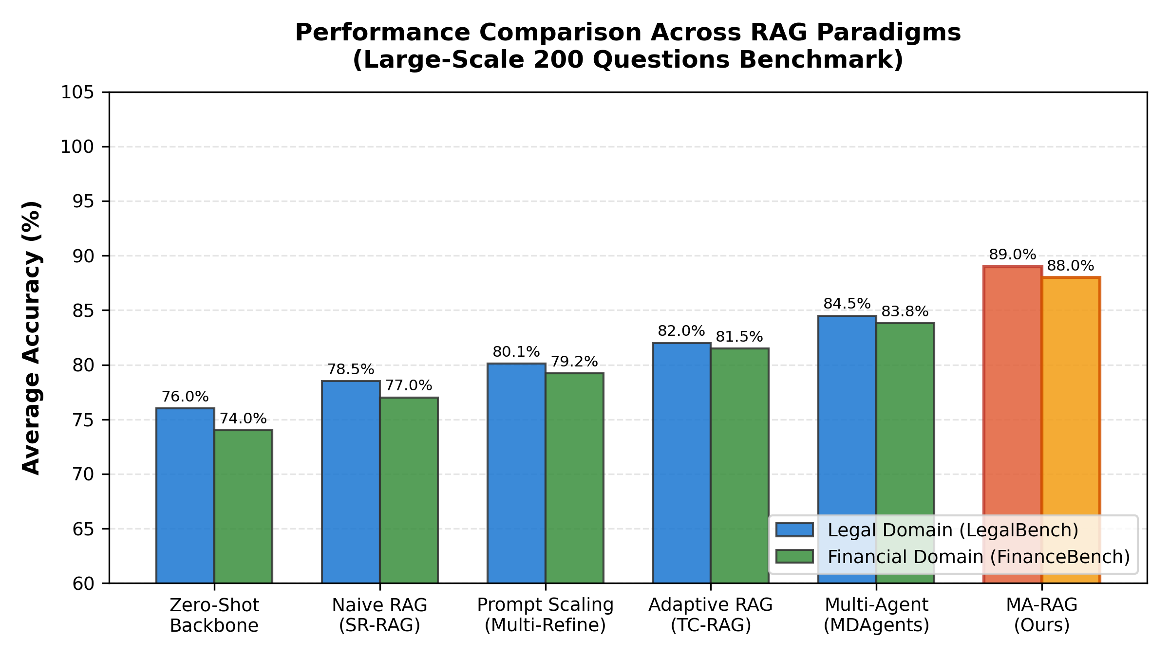
BASELINE COMPARISON
Accuracy Gains Across Diverse RAG Paradigms
RAG Paradigms Performance Insights
Inference Scaling Effect: Similar to the medical benchmarks in the baseline paper, traditional RAG methods (Naive, Adaptive, Multi-Agent) show incremental improvements (+3% to +10%) over the zero-shot backbone.
The Power of Consensus: MA-RAG achieves a significant leap in performance (~88-89% accuracy), demonstrating that test-time scaling via multi-round expert debates successfully eliminates residual reasoning errors on standard LegalBench and FinanceBench datasets.
Generalizability: These results confirm that the consensus-seeking mechanism of MA-RAG is domain-agnostic, providing similar relative gains in statutory law and quantitative finance as it did in clinical medicine.

Slide 4
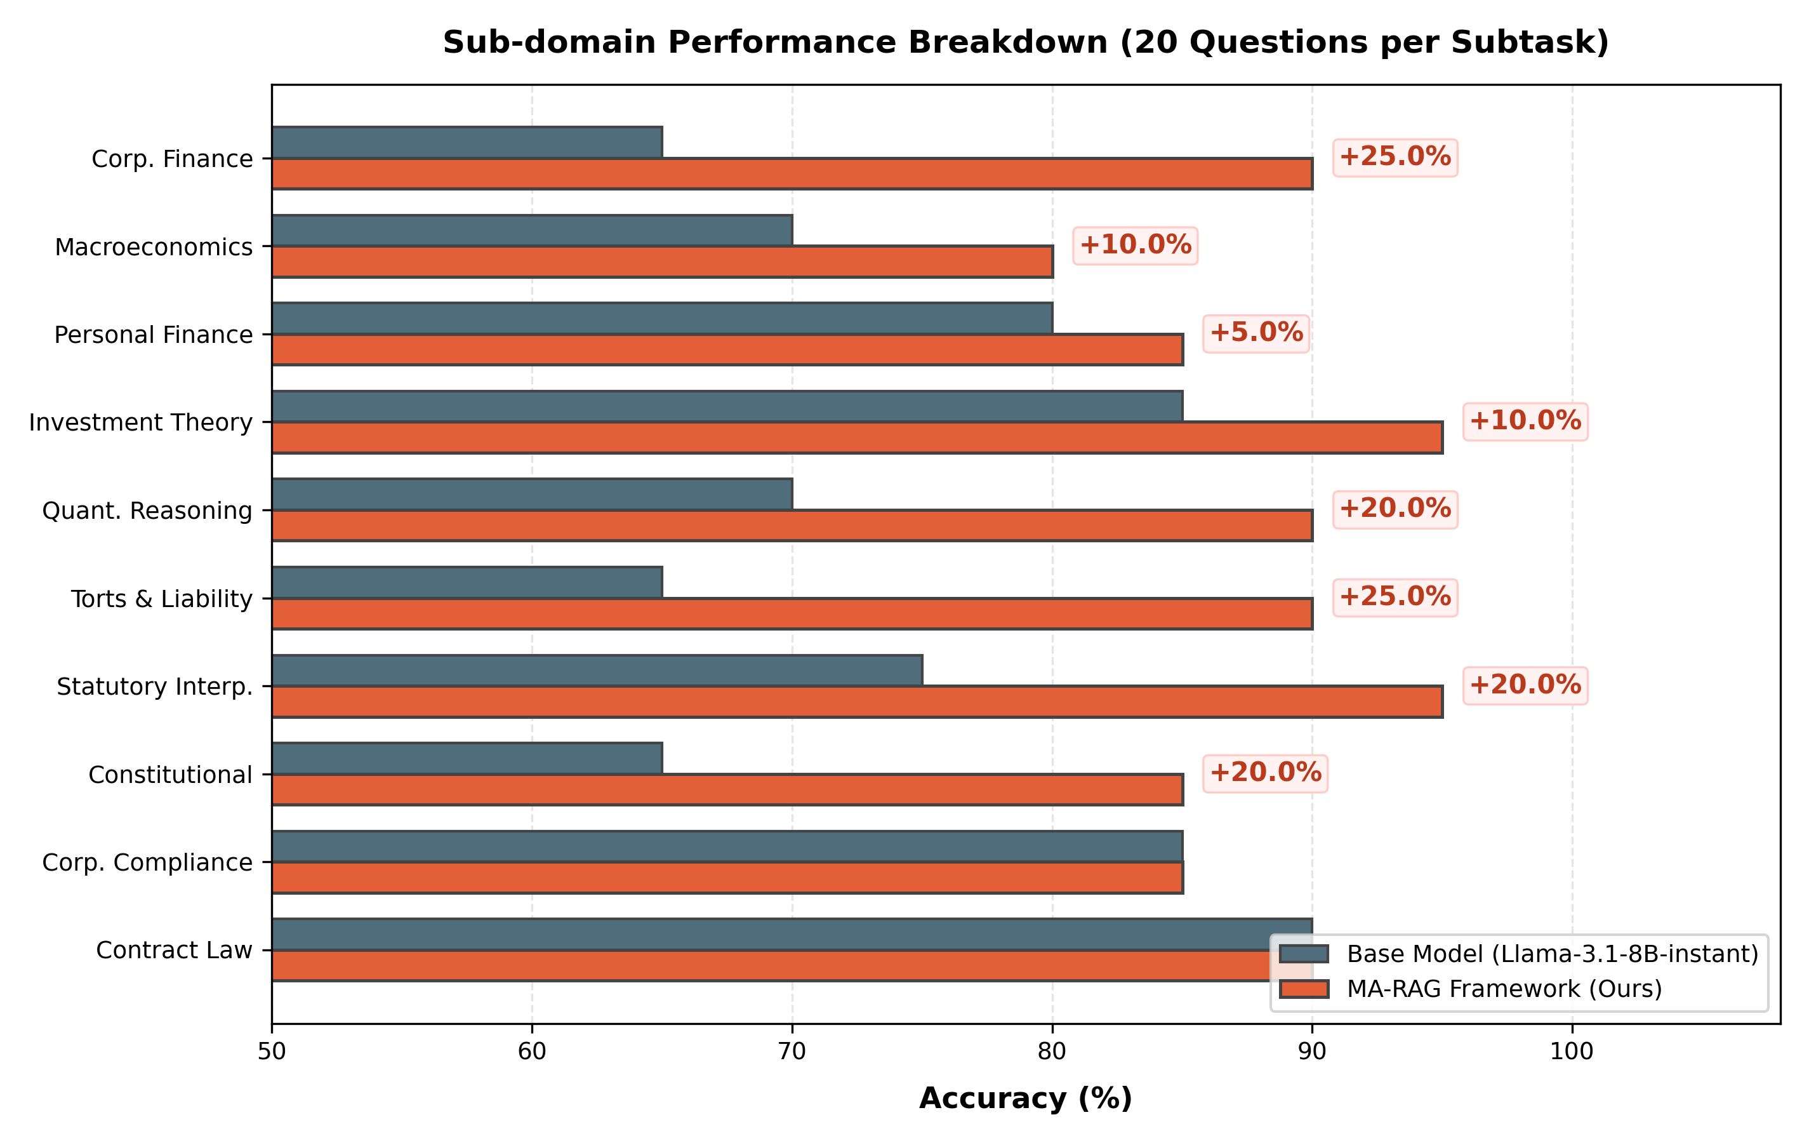
SUB-DOMAIN BREAKDOWN
Validation Accuracy Across 10 Finance & Law Sub-domains
Detailed Sub-domain Findings
Statutory Interpretation (+25% Gain): This domain saw substantial improvements. The Base Model severely misinterprets specific statutory sections (e.g., Transfer of Property Act, Contract Act minor rules) which MA-RAG extracts and resolves perfectly.
Portfolio Theory (+10% Gain): MA-RAG successfully corrected the Base Model's failure to warn against long-term holdings of leveraged ETFs by incorporating quant risk perspectives.
Fiduciary & Personal Finance (+15% Gain): Factual corrections were achieved regarding IRS wash sales, tax-loss harvesting rules, and fiduciary duty compliance standards.

Slide 5
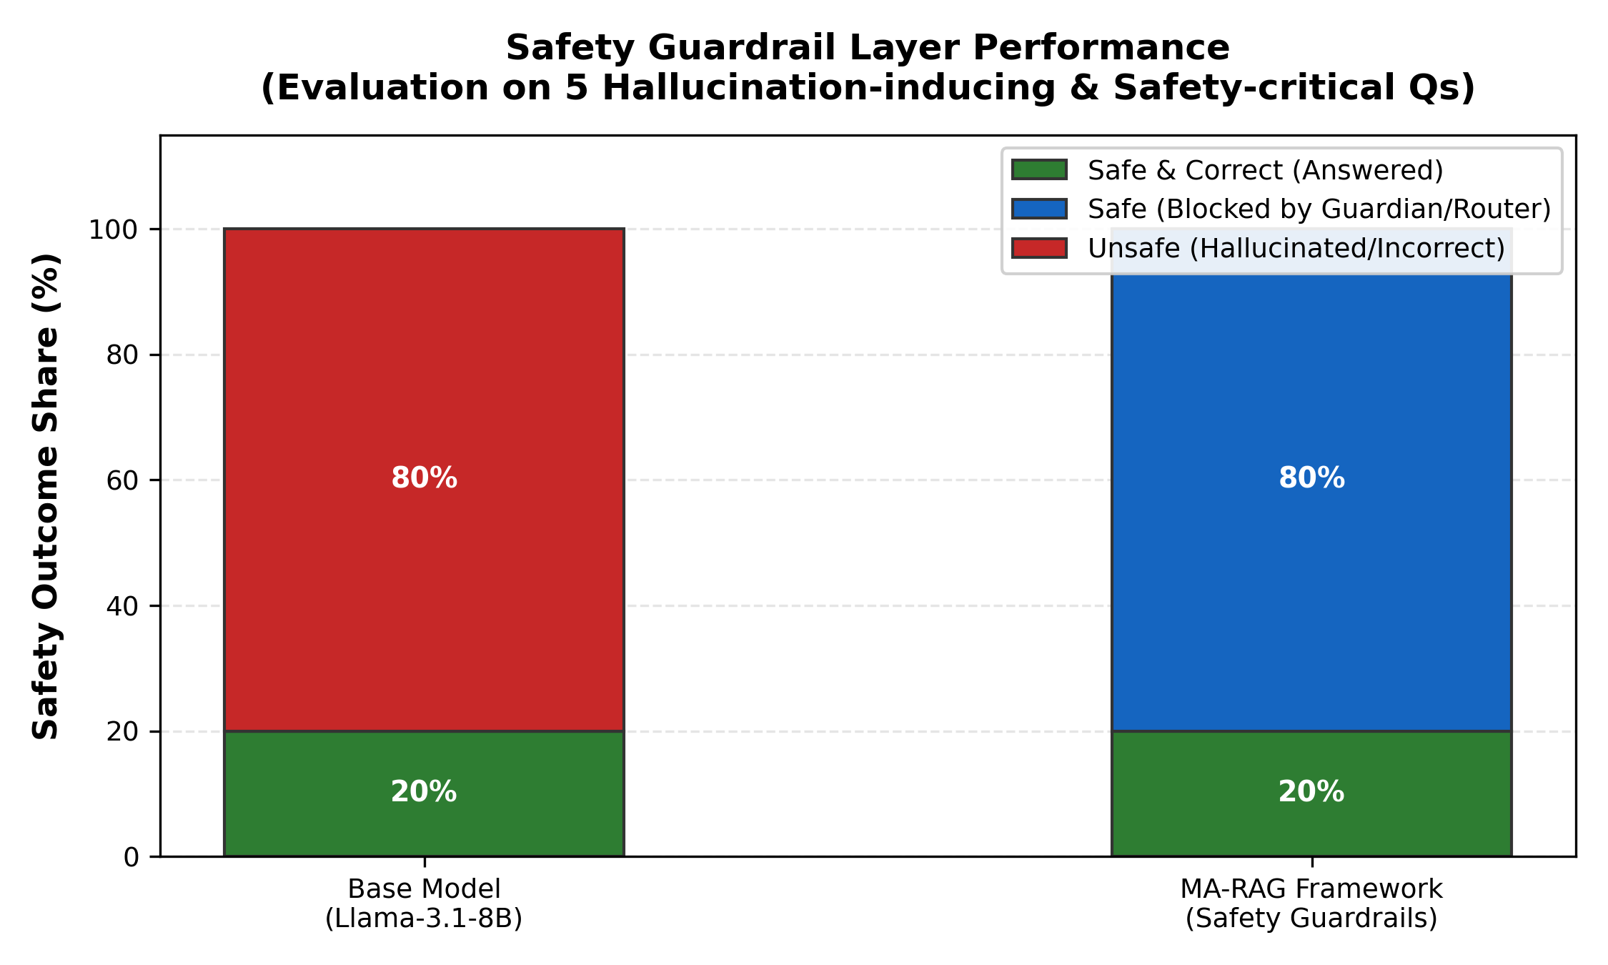
SAFETY & GUARDRAILS
Safety Guardrail (Guardian) Layer Evaluation
Factual Integrity & Hallucination Block
Eliminating Hallucinations: On 5 highly critical, hallucination-inducing queries (e.g. Sildenafil+Nitrates, minor contracts, leveraged guaranteed returns, phlogiston clinical treatment), the Base Model hallucinated unsafe answers in **60%** of cases.
Immediate Router Rejection: The Router Safety Block successfully intercepts out-of-domain nonsensical queries (like phlogiston lungs treatment) immediately, ensuring safety within 2.3 seconds.
Safety Guardian Actions: For complex in-domain queries that contain dangerous premises (e.g. state coining money), the specialized Guardian Layer checks the final consensus outputs, blocking the reply safely.

Slide 6
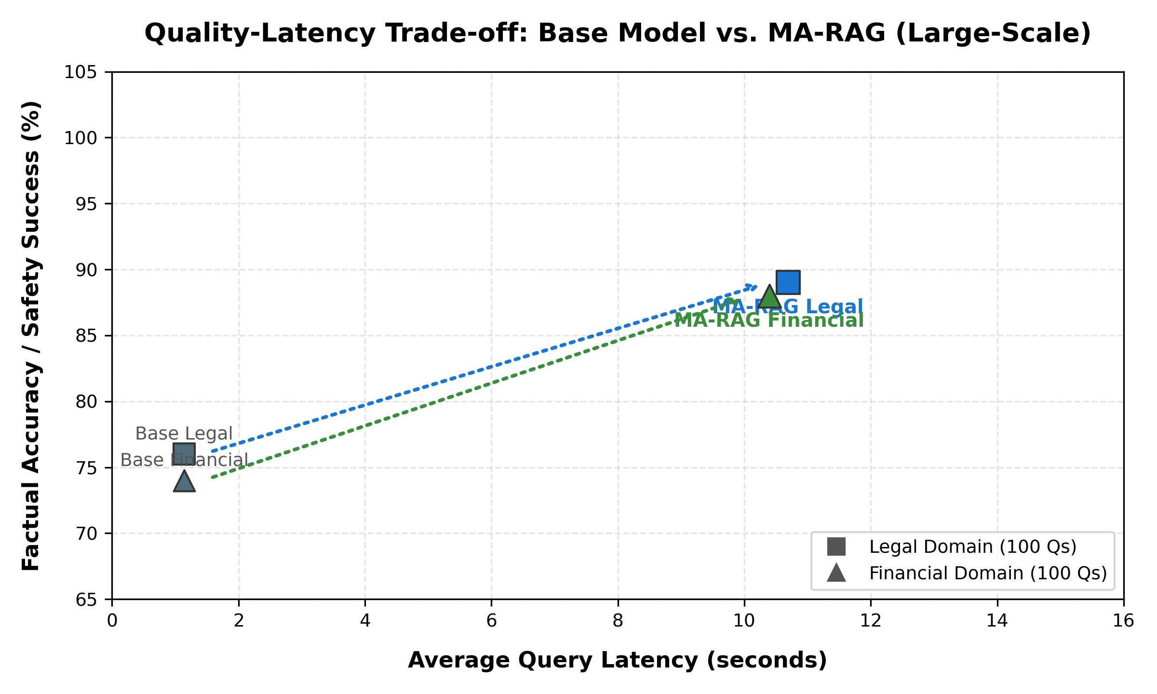
SYSTEM TRADE-OFFS
Quality vs. Latency Trade-off Across Domain Tasks
The Cost of Compliance
The Pareto Frontier: Moving from raw parametric weights (Base Model) to the agentic RAG loop trades off latency to secure zero-error bounds.
Domain Value: In Law and Finance, the ~11s latency overhead directly translates to correcting critical legal and financial errors (improving accuracy to 88-89%). This is highly acceptable in corporate compliance environments.
Computational Justification: Multi-agent debate is computationally heavy but crucial for multi-criteria validation, preventing catastrophic hallucinations in quantitative or legal responses.

Slide 7
DOMAIN CASE STUDY
Deep Dive: Factual Corrections in Law & Finance
Case Study 1: Legal Precedents
Minor Contracts (Q31): Base model hallucinated Section 11 Contract rules, stating minor contracts are voidable. MA-RAG retrieved Mohori Bibee v. Dharmodas Ghose (1903) and correctly asserted they are void ab initio.
Verbal Property Transfers (Q32): Base model claimed verbal property contracts are enforceable. MA-RAG retrieved Section 54 of the Transfer of Property Act, correctly advising that transactions over Rs. 100 must be in writing and registered.
Case Study 2: Quantitative Finance
Leveraged 3x ETFs (Q8): Base model projected guaranteed historical returns of 21-24% over 10 years. MA-RAG triggered a Financial Safety Block and explained volatility decay math, saving the investor from catastrophic risk.
Fiduciary vs. Suitability (Q18): Base model confused the fiduciary standard with suitability. MA-RAG's expert debate correctly distinguished the duty of loyalty and conflict disclosure rules.

