Slide 1

SEP-787: Machine Learning – Classification Model
Final Project
On
IBM HR Analytics Employee Attrition & Performance
By
Abhishek Gambhir (400546232)
Snigdha Pandey (400547068)

Slide 2
Tackling the Challenge of Employee Attrition
Financial Costs: High attrition leads to increased expenditures in recruitment, training, and onboarding new staff. The loss of productivity during the transition period can also have substantial financial implications.
Loss of Skills and Knowledge: Departing employees take with them valuable skills and institutional knowledge, potentially leaving gaps in the organization's expertise.
Morale and Culture: High turnover can impact the morale of remaining employees, leading to a decrease in overall job satisfaction and potentially triggering a cycle of further attrition.
Operational Disruption: Frequent changes in personnel can disrupt operations, affecting project continuity and the quality of services or products.

Slide 3
Objective
Develop an advanced predictive model to accurately forecast potential employee attrition.
Enabling Proactive HR Interventions: By predicting attrition risks, HR can implement targeted strategies to improve employee retention, plan workforce requirements, and maintain a stable and experienced workforce.
Data-Driven Decision Making: Utilize HR analytics to inform strategic decisions, enhancing the effectiveness of human resource management significance.

Slide 4
Dataset Description
Source: The dataset is sourced from Kaggle, a popular platform for data science and machine learning projects.
Composition: Comprising 1470 individual employee records, the dataset provides a comprehensive look into various aspects of the workforce.
Structure: The dataset is organized across 35 columns, each representing different attributes related to employee demographics, job characteristics, and workplace environment
Target Variable 'Attrition' (Yes/No): The primary variable of interest, indicating whether an employee has left the company.
Yes: Represents employees who have left the organization.
No: Represents employees who are currently part of the organization.
Focus of Prediction: The goal is to predict the likelihood of each employee's attrition, which is pivotal for proactive HR interventions and strategic planning.

Slide 5
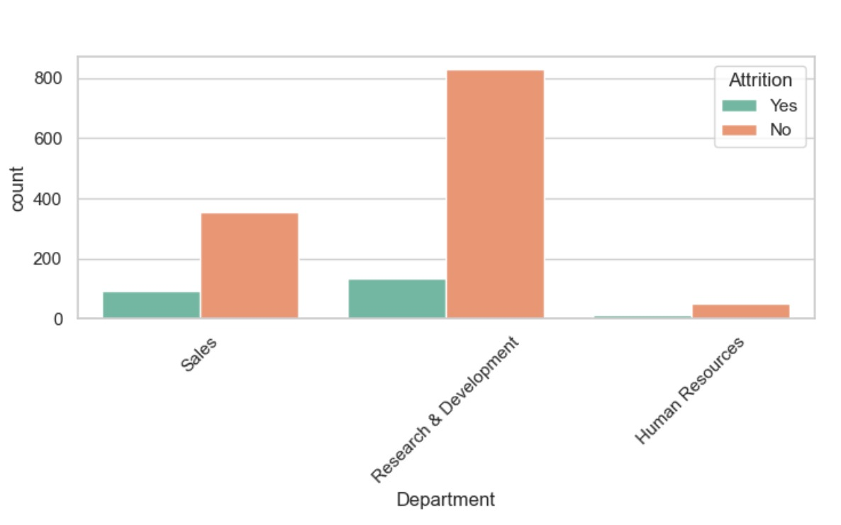
Exploratory Data Analysis (EDA)
Attrition by Department: Visualized department-wise attrition, revealing some departments facing significantly higher turnover than others.

Slide 6
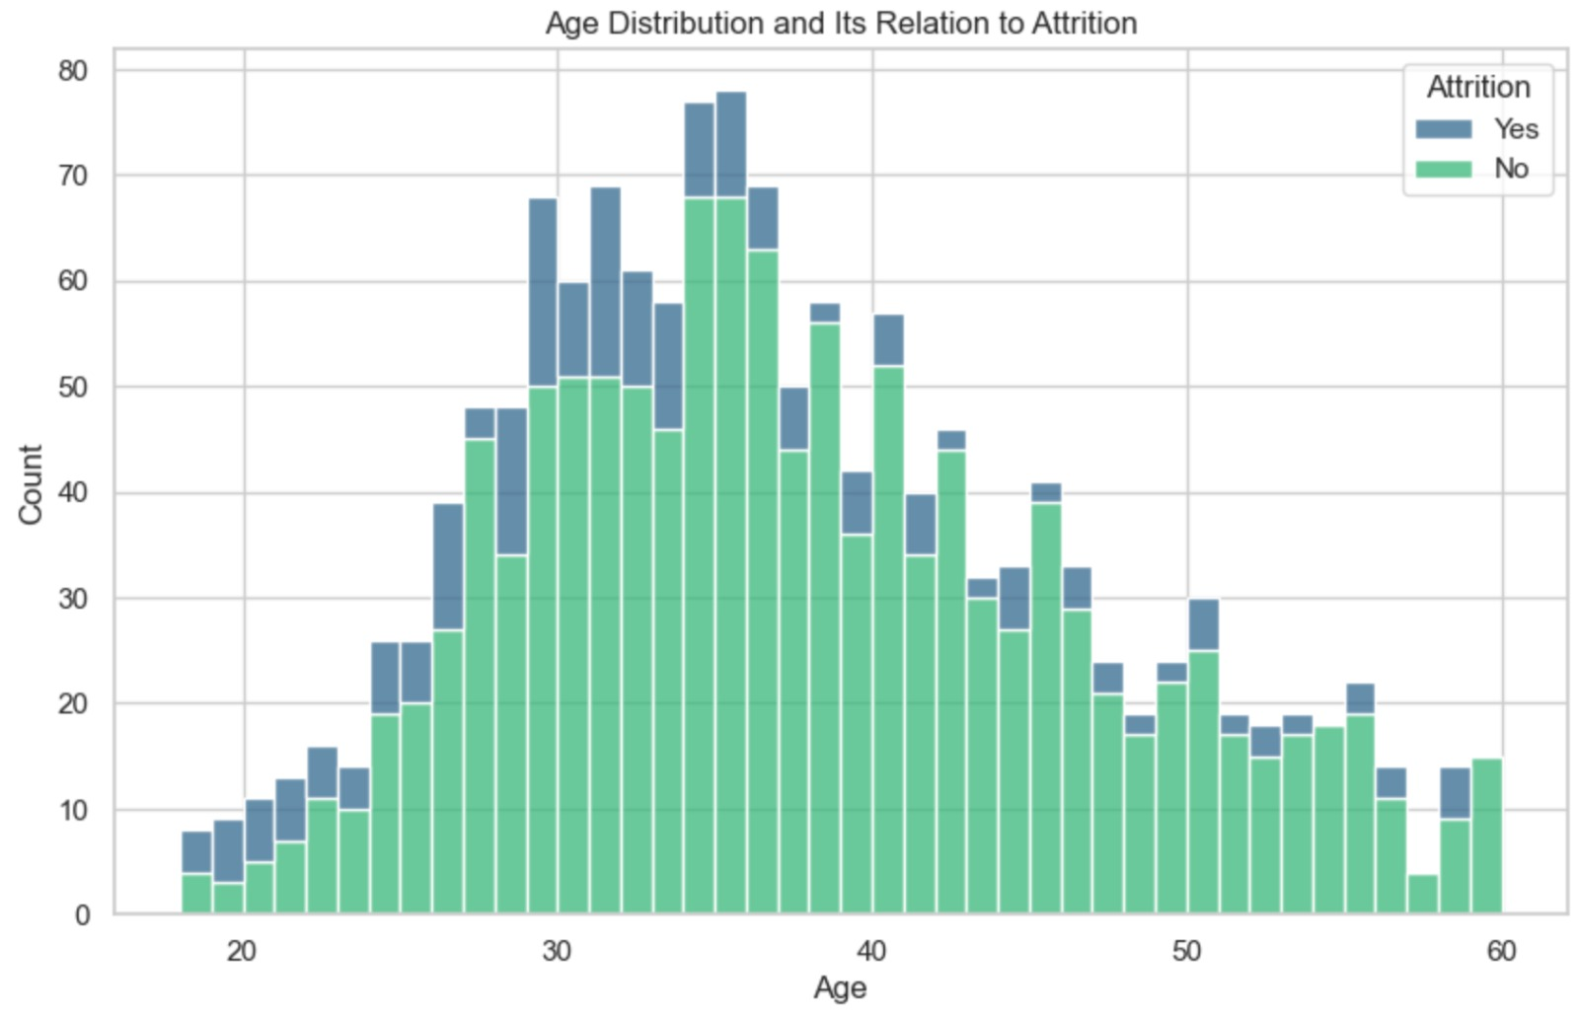
Exploratory Data Analysis (EDA)
Age vs. Attrition: Charted age against attrition, noting a trend where certain age groups showed a propensity for higher attrition rates.

Slide 7
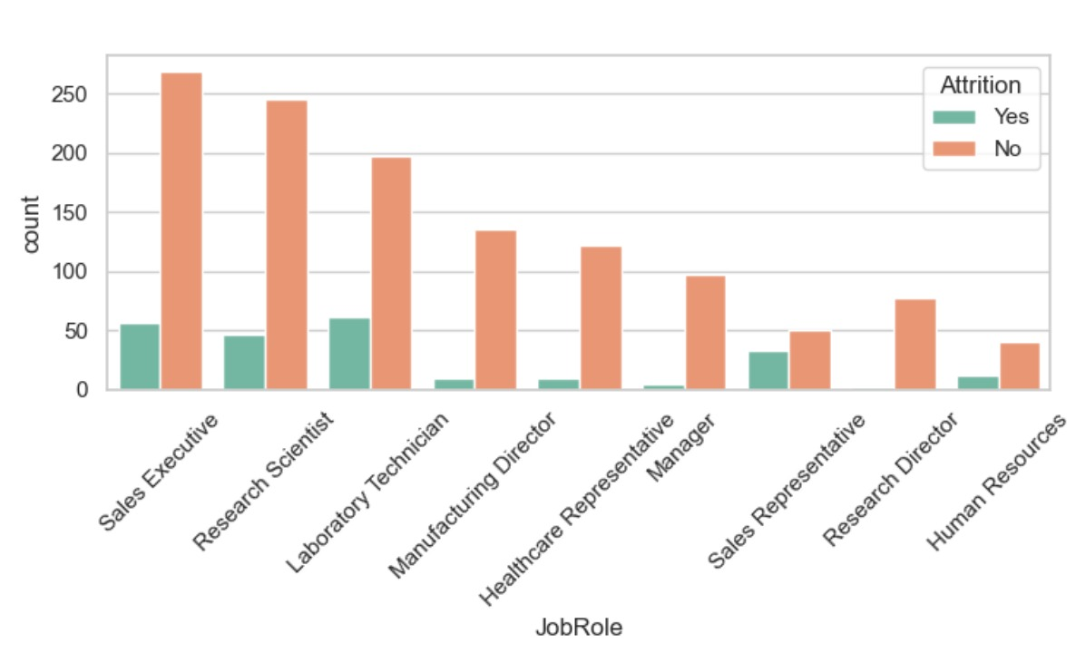
Exploratory Data Analysis (EDA)
Role-Specific Turnover: Analyzed attrition in different job roles, identifying specific roles that experience higher turnover, suggesting potential areas for HR focus.

Slide 8
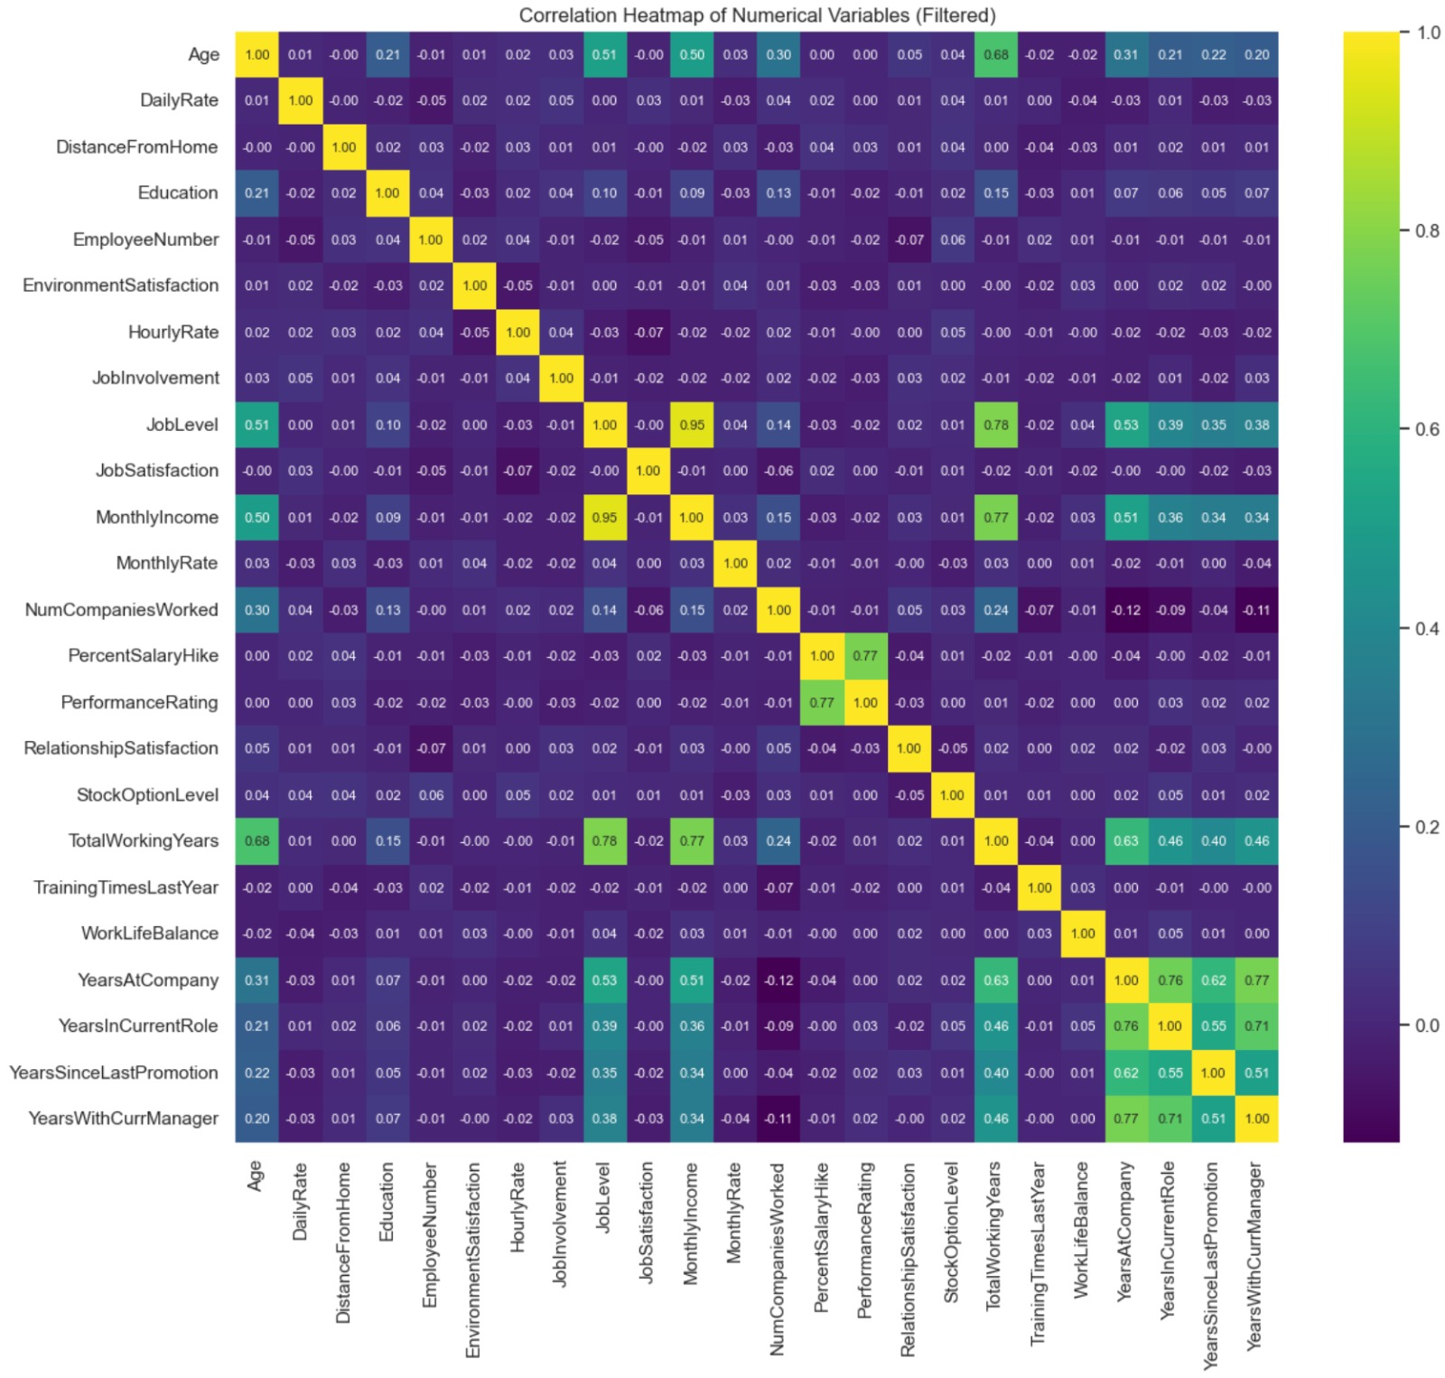
Exploratory Data Analysis (EDA)
Correlation Heatmap: A correlation heatmap was used to visually represent the relationships between different variables. This helped to identify which factors were most strongly associated with attrition, revealing key areas for further analysis and intervention.

Slide 9
Data Cleaning and Feature Engineering
Data Integrity: Confirmed no missing values or duplicates, ensuring data quality.
Outlier Analysis: Used the IQR method to identify outliers, followed by correlation analysis to validate them. Decided to retain extreme values as valid scenarios.
Feature Engineering: Addressed multicollinearity by removing 'MonthlyIncome' and certain 'Years' related features. Applied label encoding to transform categorical variables for model compatibility.
Class Imbalance Solution: Identified a significant imbalance in the 'Attrition' variable. Applied SMOTE to achieve a balanced class distribution, enhancing model effectiveness.

Slide 10
Data Cleaning and Feature Engineering
Data Integrity: Confirmed no missing values or duplicates, ensuring data quality.
Outlier Analysis: Used the IQR method to identify outliers, followed by correlation analysis to validate them. Decided to retain extreme values as valid scenarios.
Feature Engineering: Addressed multicollinearity by removing 'MonthlyIncome' and certain 'Years' related features. Applied label encoding to transform categorical variables for model compatibility.
Class Imbalance Solution: Identified a significant imbalance in the 'Attrition' variable. Applied SMOTE to achieve a balanced class distribution, enhancing model effectiveness.

Slide 11
Model Selection
Model | Initial Parameter Grid | Best Parameter Selected | Top 5 Features
Random Forest | n_estimators: [50, 80, 100, 200] max_depth: [3, 5, 10, 15, 20, 30] min_samples_split: [3, 5, 8] min_samples_leaf: [1, 2, 3, 5, 10] | n_estimators: 50 max_depth: 20 min_samples_split: 3 min_samples_leaf: 1 | JobLevel StockOptionLevel OverTime MaritalStatus JobInvolvement
Gradient Boosting | n_estimators: [50, 80, 100, 200] learning_rate: [0.01, 0.05, 0.1] max_depth: [3, 5, 10, 15, 20, 30] | n_estimators: 200 learning_rate: 0.1 max_depth: 10 | JobLevel StockOptionLevel OverTime MaritalStatus EmployeeNumber
LightGBM | num_leaves: [31, 50] learning_rate: [0.01, 0.05, 0.1] n_estimators: [50, 80, 100, 200] | num_leaves: 31 learning_rate: 0.05 n_estimators: 100 | JobSatisfaction Age EnvironmentSatisfaction DistanceFromHome NumCompaniesWorked
XGBoost | n_estimators: [50, 80, 100, 200] learning_rate: [0.01, 0.05, 0.1] max_depth: [3, 5, 10, 15, 20, 30] | n_estimators: 50 learning_rate: 0.1 max_depth: 10 | JobLevel StockOptionLevel OverTime MaritalStatus Department
Logistic Regression | C: [0.001, 0.01, 0.1, 1, 10, 100] penalty: ['l1', 'l2'] | C: 1 penalty: l2 | JobLevel StockOptionLevel OverTime MaritalStatus Department
SVM | svm_C: [0.1, 1, 10] svm_kernel: ['linear', 'rbf'] svm_gamma: ['scale', 'auto'] | svm_C: 10 svm_kernel: rbf svm_gamma: scale | Department OverTime RelationshipSatisfaction WorkLifeBalance JobInvolvement

Slide 12
Results
Random Forest: Best for Recall.
Accuracy: 87.42%, Recall: 97.65%
Ideal for identifying potential attrition.
2. Gradient Boosting: Balanced Performance.
Accuracy: 86.39%, Recall: 96.08%
Good balance between precision and recall.
LightGBM: Superior in Class Differentiation .
Accuracy: 86.73%, ROC AUC: 61.95%
Effective for class distinction.
XGBoost: Precision-Focused
Accuracy: 86.39%, Precision: 89.67%
Suitable for precise attrition prediction.
5. Logistic Regression: ROC AUC Leader
Accuracy: 74.83%, ROC AUC: 72.46%
Valuable for class differentiation
6. SVM: High Precision
Accuracy: 87.42%, Precision: 90.07%.
Preferred for accurate predictions.

Slide 13
Conclusion
Essential for Proactive HR
High recall models like Random Forest effectively identify real attrition cases, crucial for timely HR interventions.
Strategic Benefits:
Facilitates early retention strategies.
Aids in workforce planning and stability.
Random Forest Advantage:
Stands out with the highest recall.
Empowers employers to preemptively address turnover.
Key Takeaway: Random Forest's high recall is invaluable in HR's proactive management of employee attrition.

Slide 14

Thank You! ☺

