Slide 1
FATHOM
Sound the market. Prove the bottom.
An evidence-grade instrument for the Ontario private-passenger auto insurance market.
ONTARIO ALL-QUOTE AGENT CHALLENGE · TARUN KARNATI, TORONTO
01
Notes:
FATHOM measures the Ontario auto insurance market rather than shopping it. A refusal with its exact reason is as valuable an output as a price — that's the whole thesis in one line.

Slide 2
THE PROBLEM
≈30
real insurers wear about 100 different names in this market.
1 Jul 2026
most accident benefits became optional — two prices are rarely the same product.
0
companies that refuse an applicant appear in a standard comparison tool.
02
Notes:
Two dozen underwriters wearing a hundred storefronts, a rule change that quietly unbundled coverage, and refusals that vanish instead of getting recorded. That's the gap FATHOM measures.

Slide 3
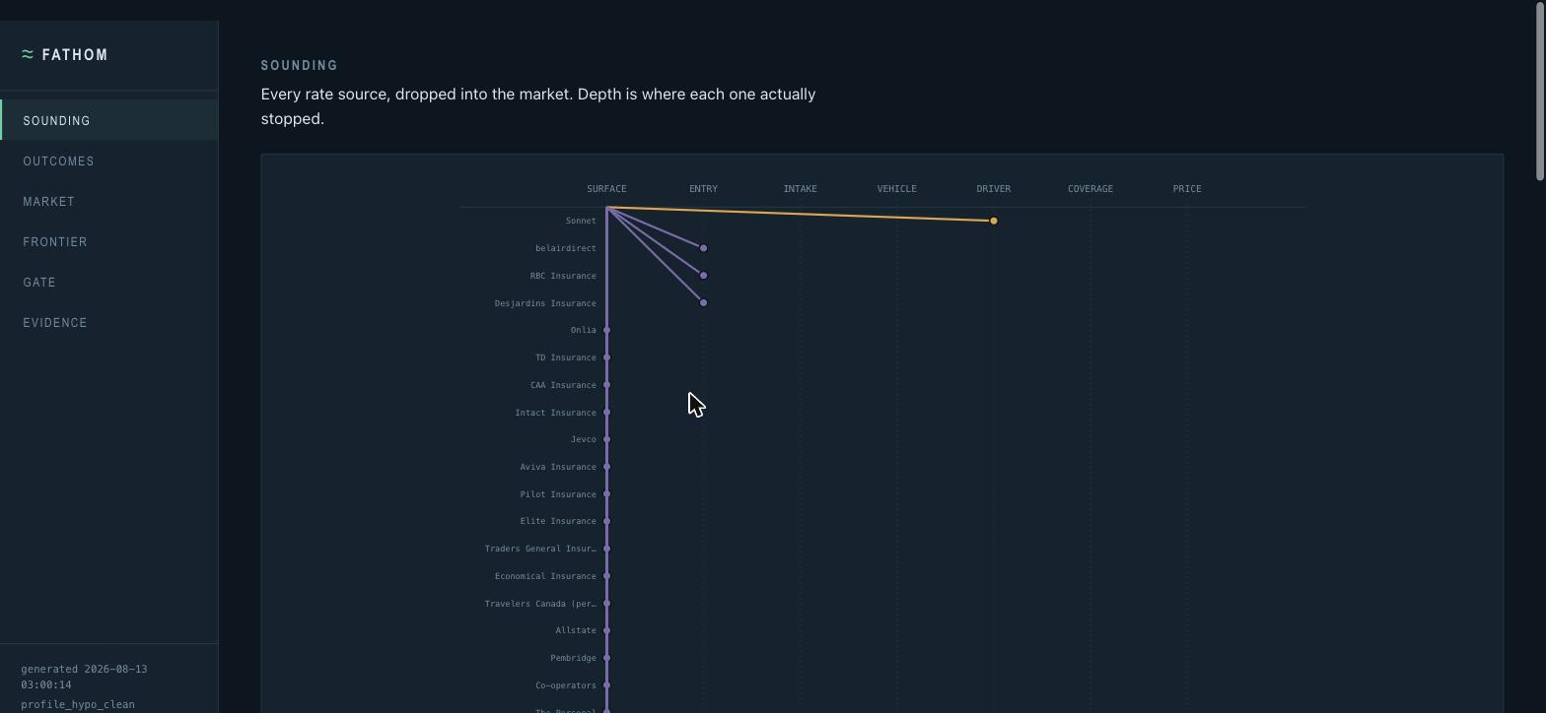
WHAT I BUILT
The Sounding Chart
Every rate source is a sounding line. Depth is how far the agent got. The marker colour is why it stopped.
03
Notes:
This one chart is the whole instrument. Every insurer drops from the surface to wherever it actually stopped — most lines stop almost immediately, one line runs deep. That's the market, honestly rendered.

Slide 4
HOW IT WORKS
One pipeline. One gate everything passes through.
Intake
→
Safety gate
→
Route planner
→
Executors
→
Evidence chain
→
Normalized results
Every proposed action — navigate, fill, submit — is evaluated by the policy engine before it ever reaches a real page.
04
Notes:
Six stages, but the gate is the one that matters — it's not a step in the middle, it's a checkpoint every single proposed action passes through, every time, no exceptions.

Slide 5
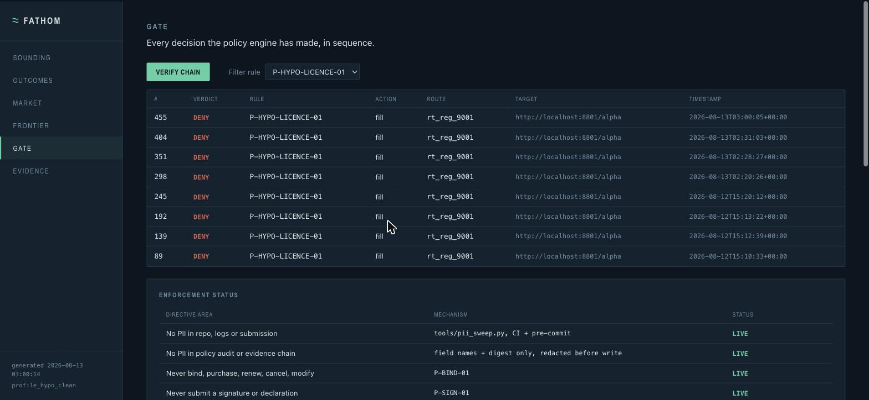
SAFETY BY CONSTRUCTION
The gate is code, not prompting.
22 policy rules — 19 enforced live. It cannot buy, pay, sign, fake a licence, bypass a CAPTCHA, or mix two profiles.
The agent is not trusted to behave — it is prevented.
05
Notes:
Real denials, real rule IDs, hash-chained so no one can quietly edit the log afterward. This is P-HYPO-LICENCE-01 firing every time the hypothetical profile hits a licence-number field — deterministic, not a language model's judgment call.

Slide 6
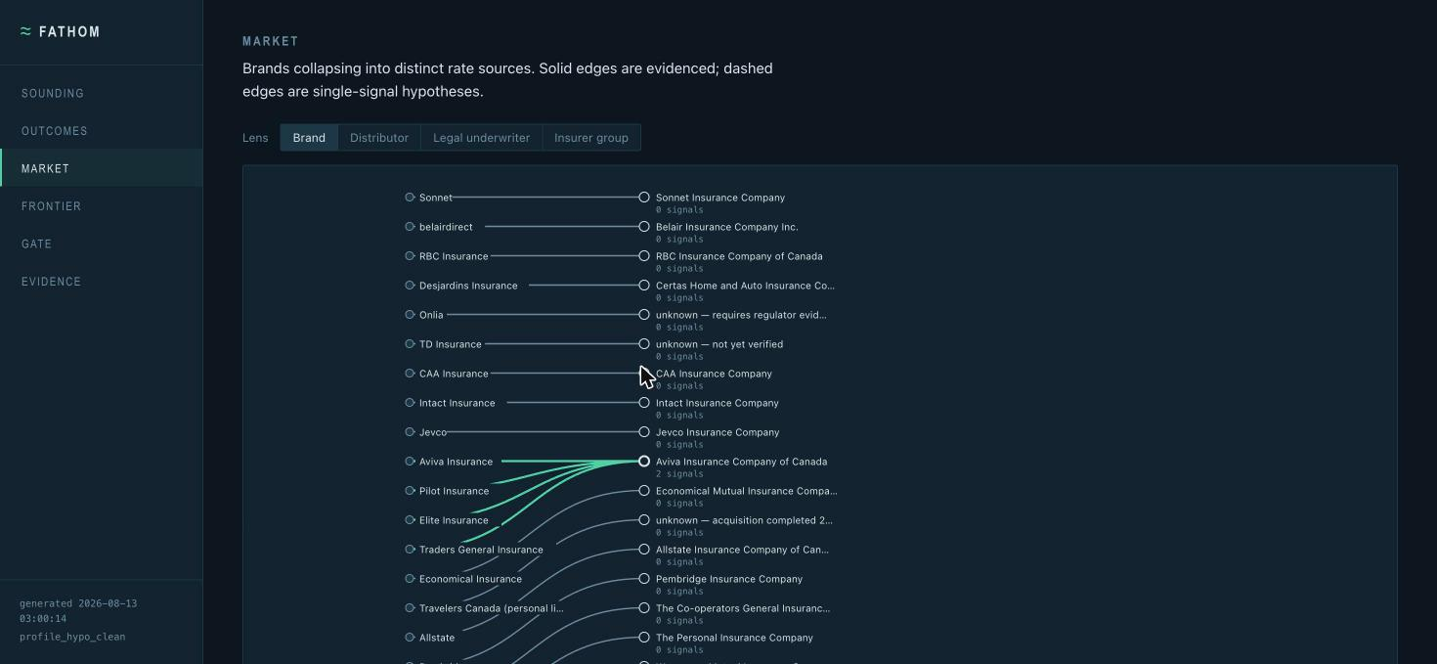
UNTANGLING THE MARKET
70 brands → 67 distinct rate sources
Four Aviva brands are one legal entity since 2026-01-01, merged only on 2 independently evidenced signals.
06
Notes:
A single-signal match is recorded as a hypothesis and never merged — the dedup metric would be trivial to inflate by merging on a guess, and the spec names that as an anti-goal.

Slide 7
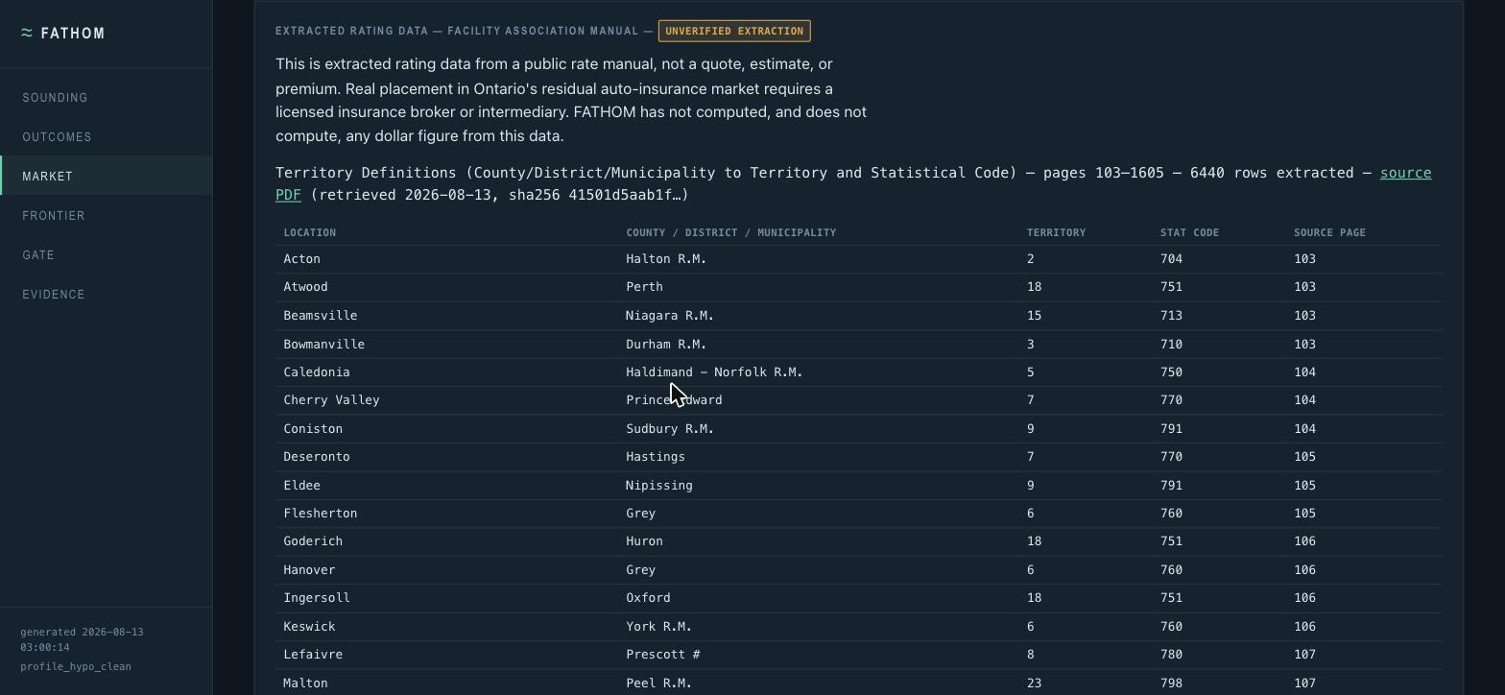
WHAT THE SURVEY FOUND
Four findings, stated confidently.
1
No real route priced a hypothetical profile. Every benchmark-comparable price is tagged SANDBOX.
2
Two comparison sites sit behind bot controls — detected and respected, never bypassed.
3
Sonnet walls at a driver's licence number; three other direct writers hit this build's own page-reading limit.
4
The residual market publishes its rates publicly — 6,440 provenanced rows extracted, page-cited, no premium computed.
UNVERIFIED EXTRACTION
no premium computed or claimed — territory definitions only
Every outcome carries a timestamp, a reason code and evidence. These are findings, not failures.
07
Notes:
Say this with confidence, not apology: an honest zero-price report with four evidenced findings is a stronger result than a report padded with numbers nobody actually returned.

Slide 8
THE MOMENT THAT MATTERS
The fabricated price.
$ make demo-fabrication OLD READER (pre-fix, quarantined, never imported by the executor) fields filled this run = 0 RETURNS: $223.50 ← marketing “recent quotes” ticker, not a response CURRENT READER (live, packages.executors.web.executor) precondition: fields filled this run = 0 RETURNS: None (refused) reason: no field was filled before this figure appeared
The original incident (2026-08-11) returned $177.83 from MyChoice.ca marketing copy with zero fields filled — see docs/SAFETY.md. Reproduced above against a recaptured fixture of the same page, same failure class.
A system that returns numbers is not the same as a system that returns evidence.
08
Notes:
This actually happened during a live run, one step from shipping in a report. The fix is a structural precondition now — a price is only believed if a real field was filled first. Caught by testing, not by luck.

Slide 9
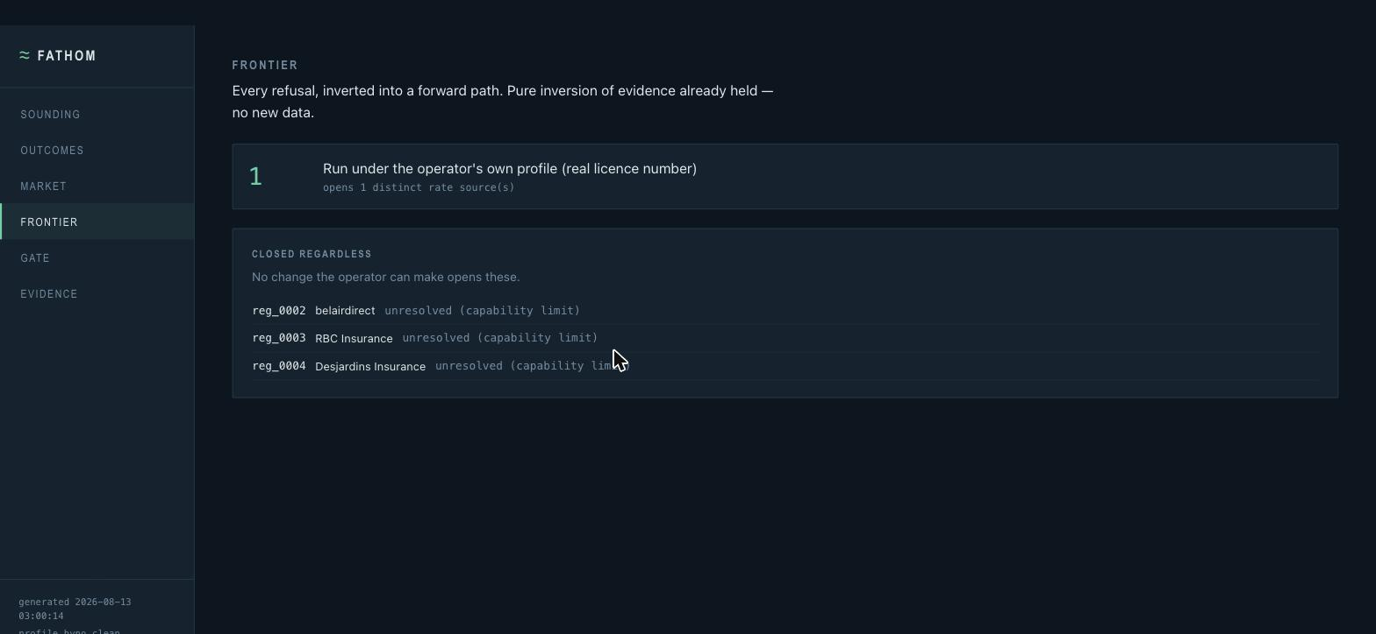
FROM “NO” TO “NEXT”
The Eligibility Frontier
Every refusal carries a reason. Inverted, those reasons become a ladder of what unlocks what.
Honestly thin right now: one real rung, opening one rate source. Three routes stay closed regardless — a capability limit in this build, not a rule the operator could satisfy.
09
Notes:
I'm not going to oversell this one — it's a real, working mechanism with exactly one populated rung today. The ladder is the right shape; it just needs more evidenced refusals feeding it.

Slide 10
HOW AI DID THE WORK
Specific, not generic.
Agentic form navigation across multi-step insurer journeys, mapping each site's questions to one canonical schema
Reading pages structurally rather than by brittle selectors, so layout changes don't break it
Ask Your Findings: retrieval-gated question answering over its own evidence — cites artifacts, and refuses without calling the model at all when nothing retrieves
WHAT AI DELIBERATELY DOES NOT DO
It never decides whether an action is permitted, and it never computes a number that gets reported. Those are deterministic code.
10
Notes:
This is the one people ask about first. The model never touches the permission decision or the reported price — both are plain deterministic code, testable and auditable without an API call.

Slide 11
TECH STACK
Compact and honest.
Python 3.12, stdlib gate
Playwright executor
cryptography (Fernet vault)
content-addressed evidence store
hash-chained audit log
pdfplumber (one-time extraction)
local regex redaction
vanilla JS UI, no build step
Claude API (retrieval-gated only)
161
212
2/2
TESTS PASSING
FILES, PII SWEEP CLEAN
HASH CHAINS INTACT
11
Notes:
492 policy-audit entries and 148 evidence artifacts, both hash-chained and both re-verified in this run — 161 tests green, PII sweep clean across every text file in the repo including the generated docs.

Slide 12
WHAT I DIDN'T BUILD
Stated plainly.
Voice executor
Rulebook compiler (premium calculation)
Benefit price probe
Vehicle inversion
Channel arbitrage
Dark pattern detector
A smaller number of trustworthy results with excellent evidence.
Both the reach and the uncertainty are legible.
12
Notes:
This is the honest close: I'd rather hand over fewer numbers I can stand behind, with every gap labelled, than a fuller-looking report with silent guesses inside it.

