Slide 1
Agentic RAG Chatbot for Multi-Format Document QA using MCP

Slide 2
Project Overview
A chatbot that answers questions based on uploaded documents using an agent-based architecture and Model Context Protocol (MCP)
Key Features:
Multi-format document support (PDF, PPTX, CSV, DOCX, TXT/MD)
Agentic architecture with LangGraph and LangChain
MCP-based communication between agents
Streamlit UI for document upload and Q&A

Slide 3
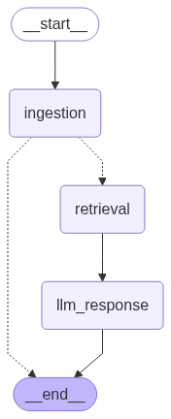
Agent-Based Architecture
Fig.1. Agentic RAG Chatbot Architecture.

Slide 4
Agent-Based Architecture
Agents:
Coordinator Agent: Orchestrates workflow between agents
Ingestion Agent: Parses & preprocesses documents
Retrieval Agent: Handles embedding + semantic retrieval
LLM Response Agent: Forms final LLM query and generates answer
MCP Integration:
Structured message passing between agents
JSON-based protocol with sender, receiver, type, trace_id, and payload

Slide 5
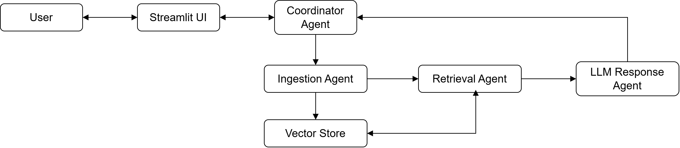
System Flow Diagram
Fig.2. Agentic RAG Chatbot Flow Diagram.
Document Upload Flow:
User uploads document through Streamlit UI
Coordinator sends document to Ingestion Agent
Ingestion Agent parses document, splits into chunks
Chunks are embedded and stored in Chroma vector store

Slide 6
System Flow Diagram
Query Flow
User asks question through Streamlit UI
Coordinator sends query to Ingestion Agent
Ingestion Agent check document is available in vector store or not
If available, Ingestion Agent sends query to Retrieval Agent
Retrieval Agent retrieves relevant chunks from vector store
Chunks and query sent to LLM Response Agent
LLM generates answer based on context
Answer and sources displayed to user

Slide 7
Tech Stack
Frontend: Streamlit
Backend:
LangChain & LangGraph for agent orchestration
Chroma for vector database
Gemini for embeddings and LLM
Document Processing: Document parsing is handled by LangChain community loaders –
PyPDFLoader for PDF
UnstructuredPowerPointLoader for PPTX
CSVLoader for CSV
UnstructuredWordDocumentLoader for DOCX
TextLoader for TXT
UnstructuredMarkdownLoader for MD

Slide 8
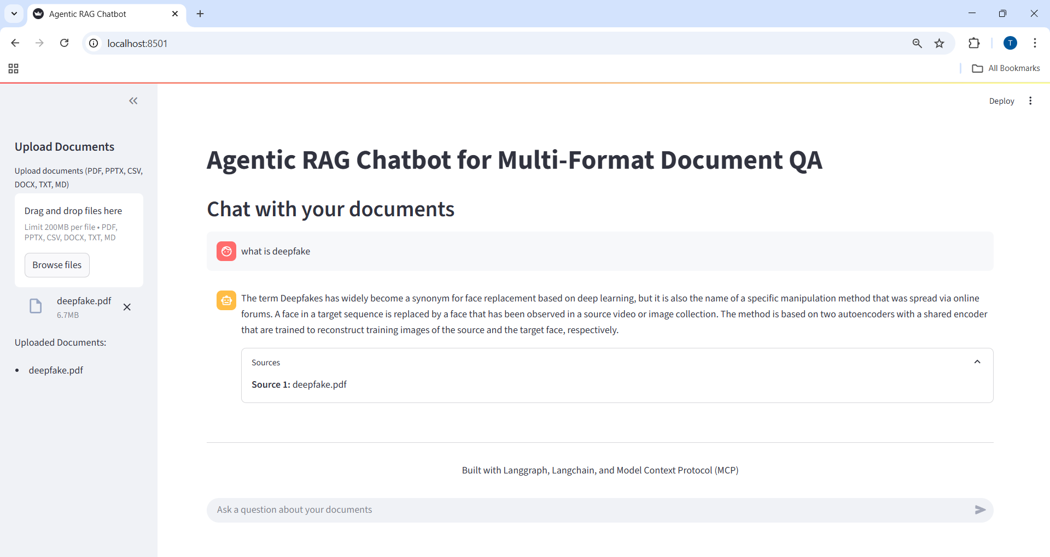
UI Screenshots
Fig.3. Agentic RAG Chatbot UI.

Slide 9
Challenges Faced
Document Parsing: Handling various formats with different structures
Agent Communication: Implementing MCP for structured message passing
Vector Search Optimization: Tuning parameters for relevant retrieval
UI/UX Design: Creating an intuitive interface for document upload and Q&A

Slide 10
Future Scope
Enhanced Document Processing: Support for more formats (HTML, images with OCR)
Advanced Retrieval: Hybrid search combining semantic and keyword search
Multi-Agent Reasoning: More complex agent interactions for better answers

