Slide 1
Java Secure Channel(JSCh)

Slide 2
JSCh: It is a java implementation of SSH2 that allows us to connect to an SSH server and use port forwarding, X11 forwarding and file transfer.

Slide 3
SSH: Secure shell or secure socket shell is a network protocol that allows one computer to securely connect to another computer over an unsecured network. It Authenticates and encrypts data transmitted between clients and servers. Two types of ssh protocols SSH1 and SSH2.

Slide 4
Difference between SSH1 and SSH2
SSH1
SSH2
Founded in 1995
It is a free software
It allows exactly one session channel per connection
Founded in 2006
It is not a free software
It allows none or any number of session channels per connection

Slide 5
SSH protocol has mainly three layers: 1.Transport layer 2.Authentication layer 3.Connection layer

Slide 6
Features of SSH: 1.Remote Access 2.port Forwarding 3.X11 Forwarding 4.File Transfer 5.User and Host Authentication

Slide 7
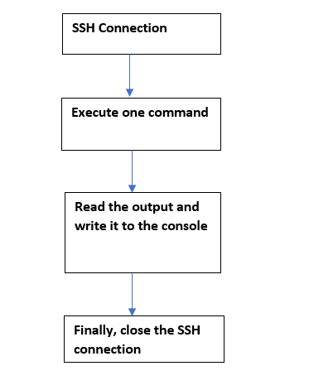
SSH Working FlowChart

Slide 8
Port Forwarding : It is a technique that let devices on different networks communicate with each other.

Slide 9
X11 Forwarding : It is a software that allows for the access of graphical linux programs remotely through an SSH client.

Slide 10
Implementation of JSCh 1.username 2.password 3.host URL 4.SSH Port

Slide 11
JSCh with java can be implemented by using session and ChannelExce 1.Session : A Session represents a connection to a SSH server, and one session can contain multiple channels of various types, created with openchannel. A Session is opened with connect() and closed with disconnect(). Methods of Session: 1.connect() 2.connect(int connect Timeout) 3.disconnect() 4.gethost() 5.gethostkey() 6.getusername()

Slide 12
2.ChannelExec: It is used to communicate with SSH server. In ChannelExec shell commands will be executed and response is to write in console by using OutputStream.

