Slide 1
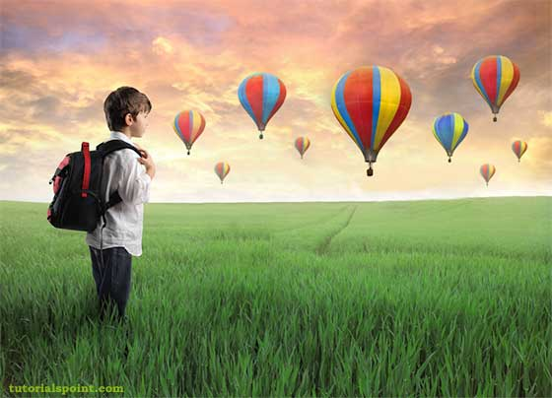
StegIT
Image processing
Subject: Seminar

Slide 2
Group - 5
Batch: C-24
SHEFALI CHHABRIA(143)
TARUN MIRANI (145)
PRITI PATHANI(161)

Slide 3
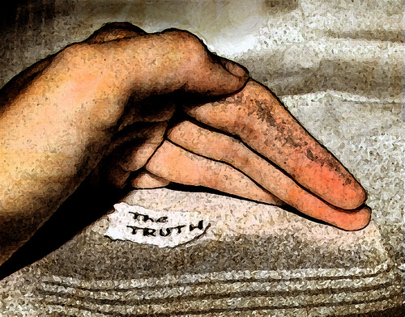
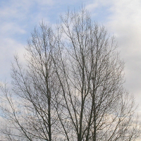
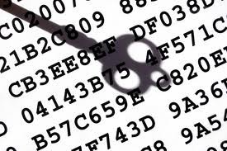
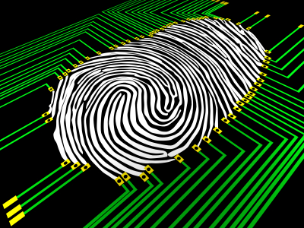
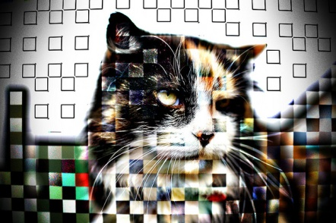
With the growing network communication data security is becoming more important.
Growth of broadcasting technologies requires alternate solutions.
The image file is created and data (image or text) is encrypted in it.

Slide 4
Description
Face recognition that determines the location and sizes of human faces in digital form.
Steganography is the method which will process this digital image with a text you want to hide .
That stegoimage can be extracted.

Slide 5
Cover Image
Stegosystem Encoder
Message
Stegoimage
channel
KEY
Estimate of message
Stegosystem Encoder
Estimate of stegoimage
Notes:
Design:
Functional Block diagram

Slide 6
Images are being dynamically used by face recog. Algorithm.
The hidden message is embedded in the “cover” image.
The proposed recipient need only possess a key in order to reveal the message (not a part of system).

Slide 7
System Requirement
MATLAB
MATLAB includes Image processing toolbox,dsp system toolbox, MATLAB CODER, BLOCK libraries.
Requires 32 bit / 64 bit windows processor and integrated webcam/usb webcam.
Notes:
Implemetation
System requirements

Slide 8
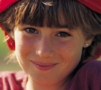
Algorithm-Face Detection
Algorithm – V and J method ( integral Feauture extraction )
calculation method “Rectangle filters”
Rectangle_Feature_value f=
∑ (pixels values in white area) – ∑ (pixels values in shaded area)
f=(8+7)-(0+1) =15-1= 14
1 | 2 | 3 | 3
3 | 0 | 1 | 3
5 | 8 | 7 | 1
0 | 2 | 3 | 6
Notes:
Implementaion..working of module-

Slide 9
Face detection
Pixel values inside
the areas
Shaded area
10 | 20 | 4
7 | 45 | 7
216 | 102 | 78
129 | 210 | 111
White area
F=Feat_val =
pixel sum in white area - pixel sum in shaded area
Example
Pixel sum in white area= 216+102+78+129+210+111=846
Pixel sum in shared area= 10+20+4+7+45+7=93
Feat_val=F=846-93=753
If F>threshold,
feature= +1
Else
feature= -1 End if;
If we can choose threshold =700 , so feature is +1.
A face
Notes:
9

Slide 10
Algorithm-Steganography
Least significant bit (LSB) insertion is a common, simple approach to embedding information in a cover image.
all of the bytes inside an image is changed to a bit of the secret message
LSB makes use of BMP images, since they use lossless compression.
A grid for 3 pixels (RGB)+T of a 24-bit image can be as follows:
(00101101 00011100 11011100)
(10100110 11000100 00001100)
(11010010 10101101 01100011)
When the number 200, which binary representation is 11001000, is embedded into the least significant bits of this part of the image, the resulting grid is as follows:
(00101101 00011101 11011100)
(10100110 11000101 00001100)
(11010010 10101100 01100011)

Slide 11
Code Snippets-FaceDetection
% load an example image
[FileName,PathName] = uigetfile({'*.jpg';'*.png';'*.gif';'*.bmp'},'Select "Gray Scale".');
img = imread( strcat(PathName,FileName) );
% run the detector
pos = fdlibmex(img);
% display the image
imagesc(img)
colormap gray
axis image
axis off
% draw red boxes around the detected faces
hold on
for i=1:size(pos,1)
r = [pos(i,1)-pos(i,3)/2,pos(i,2)-pos(i,3)/2,pos(i,3),pos(i,3)];
rectangle('Position', r, 'EdgeColor', [1,0,0], 'linewidth', 2);
end
hold off

Slide 12
Code Snippets-Steganography
%% STEP 1: Determine Whether User is Encoding or Decoding a Message
enc_dec = input('Welcome to the Steganography Program \nEnter 1 for Encoding, 2 for Decoding:\n');
if enc_dec == 1
%% STEP A: ENCODING VERSION
%% STEP 2A: Select "Canvas Image" and "Message File".
% First Get "Canvas" Image.
[FileName,PathName] = uigetfile({'*.jpg';'*.png';'*.gif';'*.bmp'},'Select "Canvas Image" to Hide Message.');
img = imread( strcat(PathName,FileName) );
% Next get Message File
msg_type = input('Enter 1 for TEXT Message, 2 for IMAGE Message:\n');
if msg_type == 1
[FileName,PathName] = uigetfile('*.txt','Select TEXT MESSAGE.');
testmsg = fopen( strcat(PathName,FileName) );
[msg] = fscanf(testmsg,'%c');
elseif msg_type == 2
[FileName,PathName] = uigetfile({'*.jpg';'*.png';'*.gif';'*.bmp'},'Select IMAGE MESSAGE.');
msg = imread( strcat(PathName,FileName) );
else
error('Invalid Message Type Selection');
end

Slide 13
Code Snippets-Steganography
%% STEP 3A: Prompt User for Encryption Key
enc_key = input('Please Enter an Encryption Key Between 0 - 255:\n');
if enc_key < 0 || enc_key > 255
error('Invalid Key Selection');
end
enc_key = uint8(enc_key);
%% STEP 4A: Allow User to Select SEQUENTIAL
encode = input('Enter 1 for Sequential Encoding :\n');
if encode == 1
% SEQUENTIAL ENCODING: This only needs an Encryption Key Input.
output = stegancoder(img,msg,enc_key);

Slide 14
Code Snippets-Steganography
%% STEP 5A: Write Canvas Image to .BMP File
% BMP, or bitmap format, was chosen because it DOES NOT use
% compression. JPEG compression destroys the message.
secfn = input('Enter File Name for Image + Message:\n','s');
nametest = ischar(secfn);
if nametest == 1
imwrite(output,strcat(secfn,'.bmp'));
else
error('Invalid File Name');
end

Slide 15
Code Snippets-Steganography
elseif enc_dec == 2
%% STEP B: DECODING VERSION
%% STEP 2B: Import "Canvas Image" With Hidden Message.
[FileName,PathName] = uigetfile('*.bmp','Select "Canvas Image" With Hidden Message.');
img = imread( strcat(PathName,FileName) );
%% STEP 3B: Prompt User for Encryption Key
enc_key = input('Please Enter an Encryption Key Between 0 - 255:\n');
if enc_key < 0 || enc_key > 255
error('Invalid Key Selection');
end
enc_key = uint8(enc_key);

Slide 16
Code Snippets-Steganography
%% STEP 4: Writing Message to .TXT or .JPG File
secfn = input('Enter File Name for Image + Message:\n','s');
nametest = ischar(secfn);
if nametest == 1
msgtest = ischar(output);
if msgtest == 1
% TEXT Message CASE
fid = fopen(strcat(secfn,'.txt'),'w');
fwrite(fid,output,'char');
fclose(fid);
else
% IMAGE Message CASE
imwrite(output,strcat(secfn,'.bmp'));
end
else
error('Invalid File Name');
end

Slide 17
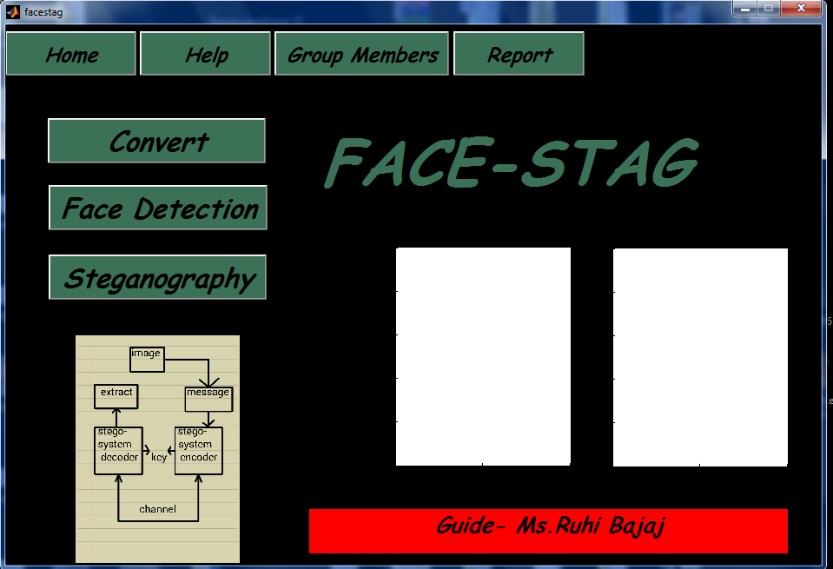
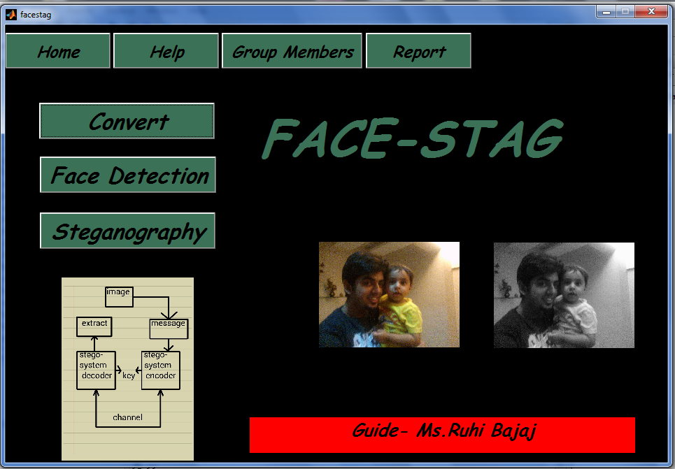
Screenshots – Convert
Notes:
Implementaion snapshots

Slide 18
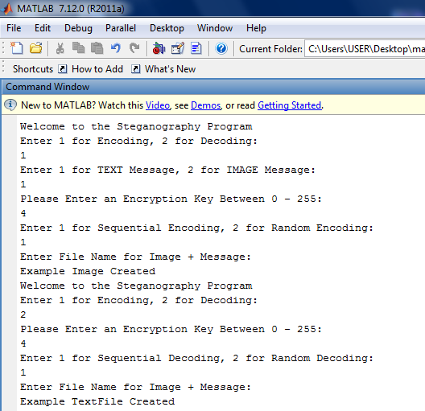
Screenshots – Steganography
Notes:
Implementaion snapshots

Slide 19
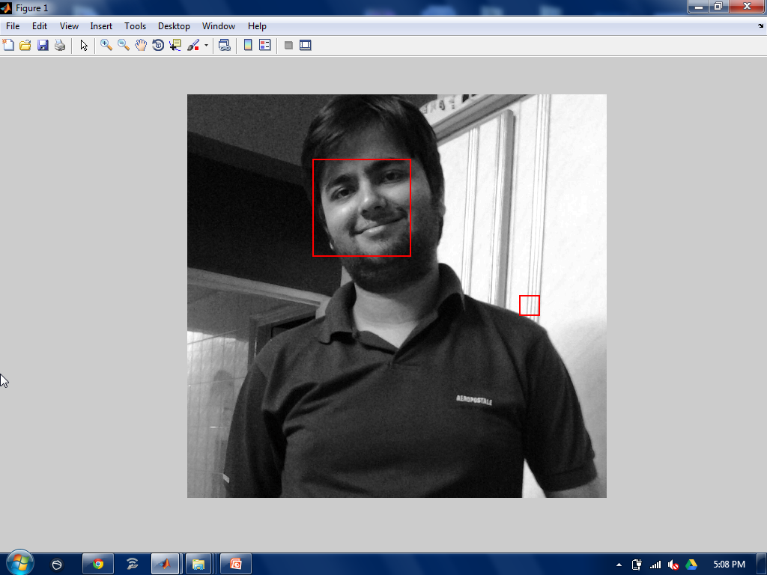
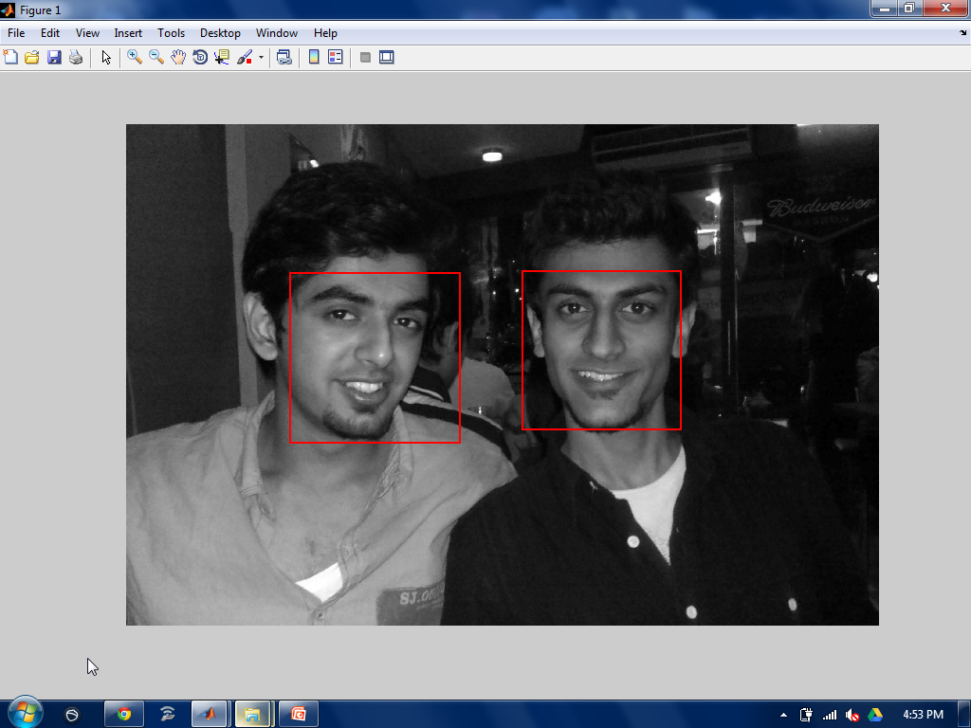
Screenshots – Face Detections
Single face Detection Two Face Detection
Notes:
Implementaion snapshots

Slide 20
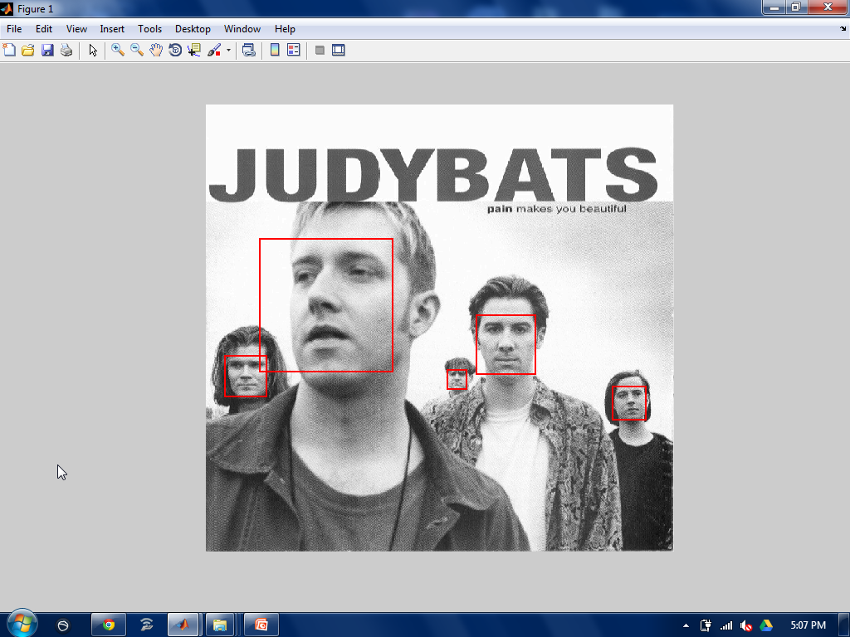
Screenshots – Face Detections
Multiple Face Detections
Notes:
Implementaion snapshots

Slide 21
Applications:
Confidential communication and secret data storing….(secrecy)
Protection of data alteration
Access control system for digital content distribution
Transportation of high-level or top-secret documents between international governments.
Media Database systems(eg:photo album software)
A step to semantic movie retrieval system
Notes:
Applications:
Confidential communication and secret data storing….(secrecy)
Protection of data alteration
Access control system for digital content distribution
Transportation of high-level or top-secret documents between international governments.
Media Database systems(eg:photo album software)
A step to semantic movie retrieval system

Slide 22
Legitimate Use
The watermarking of digital media is constantly improving, primarily in an attempt to provide hardened watermarks or proof of ownership.
One can liken these applications to the use of a deadbolt lock on a door. The deadbolt will keep honest people honest,but those determined to break and enter can simply break a window and gain entry.

Slide 23
Illegal Use
An annual Report on High Technology crime (48) lists nine common types of computer crime :
Criminal communications
Fraud
Hacking
Electronic Payments
Harassment
Gambling and pornography
Intellectual property offenses
Viruses
Pedophilia

Slide 24
Conclusion
Steganography has multitude forms
Based on different forms..(we have)steganographic content on the internet
With growth of network communication there is need for data security there is need for alternatives
Dynamic creation of image file to hide message
Notes:
Conclusion
Steganography has multitude forms
Based on different forms..(we have)steganographic content on the internet
With growth of network communication there is need for data security there is need for alternatives
Dynamic creation of image file to hide message

Slide 25
Further work
Protection of property, real and intellectual
Individuals or organizations may decide to place personal/private/sensitive information in steganographic carriers.
Notes:
Further work
protection of property, real and intellectual
Individuals or organizations may decide to place personal/private/sensitive information in steganographic carriers.

Slide 26
References
W. Bender, D. Gruhl, N. Morimoto, and A. Lu. Techniques for data hiding. IEM Systems Journal, 35(3 & 4), 1996
A.K. Jain. Fundamentals of Digital Image Processing ,Prentice-Hall, Inc., Englewood Cliffs, NJ, 1989.

Slide 27
THANK YOU

