Slide 1

AIHEAL: Medical Chatbot
TEAM:
P TARUN
SHAIK ZAID
SHAIK SADIK
DATE: JAN 2025

Slide 2
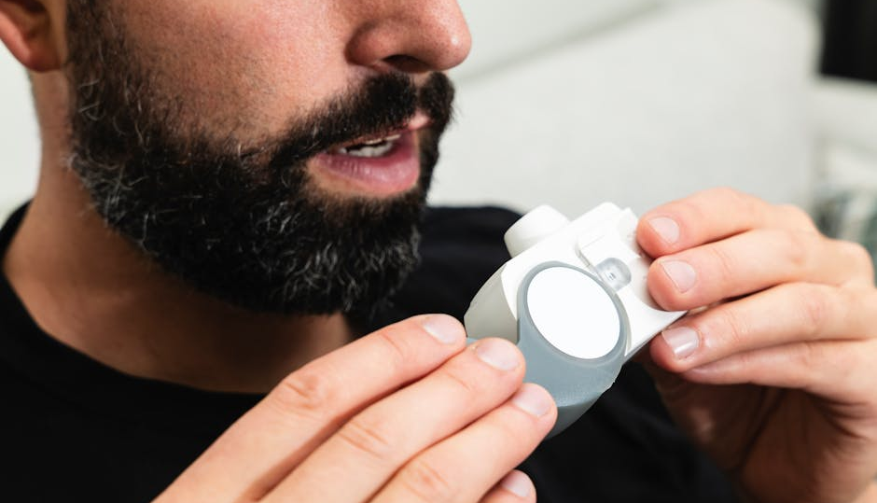
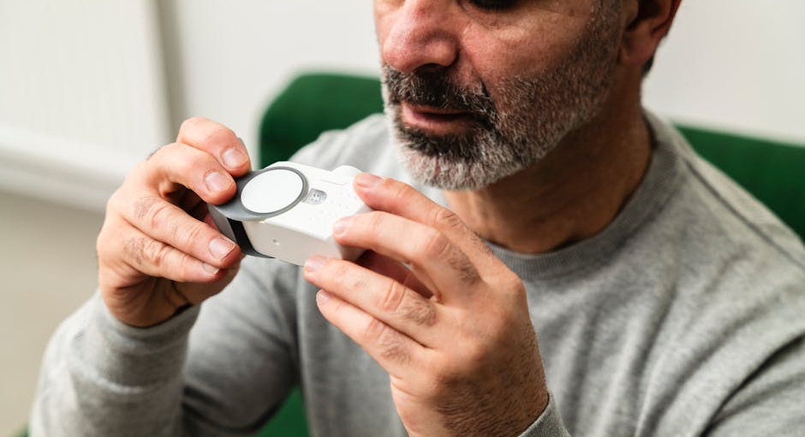
Problem Statement
Challenges in Healthcare Access
Many individuals face hurdles in accessing timely medical advice. Long wait times, distance, and high costs can deter people from seeking necessary healthcare. AIHEAL aims to address these issues effectively.

Slide 3

Solution
AIHEAL's Value Proposition
AIHEAL offers instant, reliable medical advice via a chatbot interface. This technology ensures users receive accurate information without long wait times, promoting overall patient engagement and satisfaction.

Slide 4

Diagnosis and Emergency Reporting Treatment Options
Symptom Assessment
Emergency Reporting
AIHEAL allows users to input symptoms and receive potential diagnoses. This helps users identify the urgency and appropriate steps to take based on the AI's interpretation.
In emergencies, AIHEAL can guide users to seek immediate medical attention and provide crucial information to paramedics, facilitating faster treatment.

Slide 5
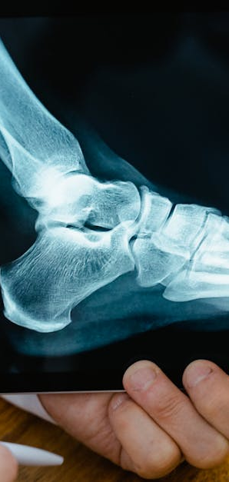
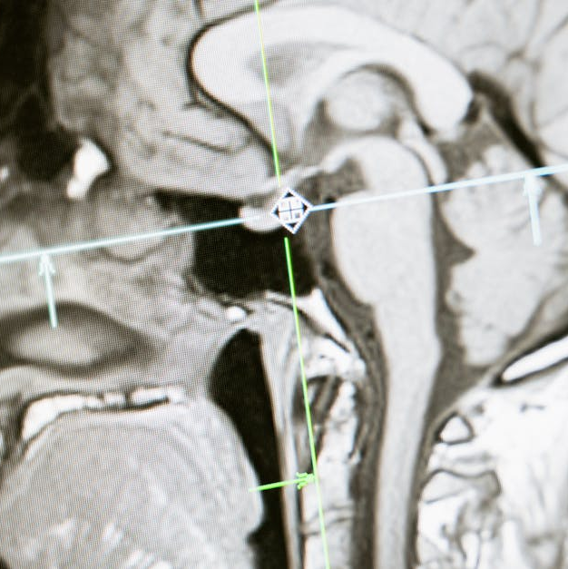
Medical Image Analysis and Home Remedies
Image Analysis Capabilities
AIHEAL can analyze user-uploaded medical images to assist in identifying conditions. This feature enhances diagnostic processes and provides immediate feedback.
Home Remedies Guidance
Users seeking alternative treatments can find tailored home remedies based on their symptoms. AIHEAL promotes self-care and preventive health strategies.

Slide 6

User Interaction, Consulting a Doctor
Interactive Chatbot Features
AIHEAL's interface is designed for user-friendliness, ensuring easy navigation. Interactive features engage users and enhance their experience with prompt, clear communication.
Consultation with Real Doctors
For complex cases, AIHEAL allows users to consult real doctors through the chatbot. This hybrid approach combines technology and human expertise for comprehensive care.

Slide 7

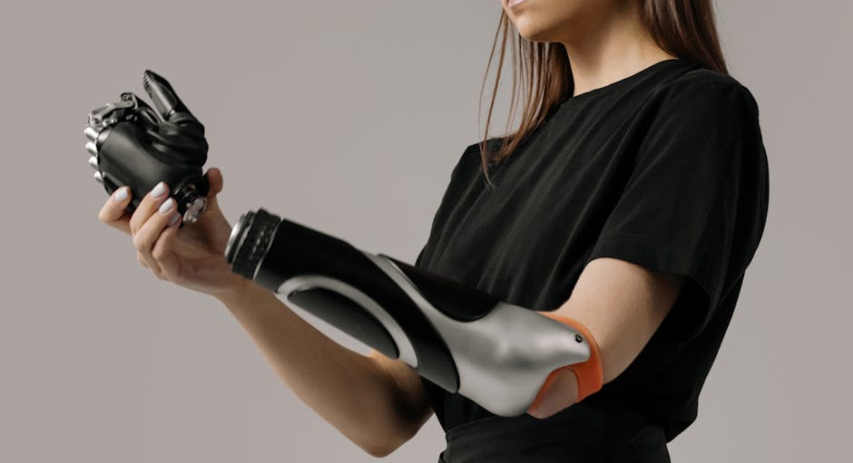
Future Improvements
Enhancements and Features
Future improvements for AIHEAL will focus on expanding language capabilities, integrating more diagnostic tools, and enhancing user customization. Ongoing updates will provide the latest medical information.

