Slide 1

Web scarping And Explanatory Data Analysis on Cars data(Zigwheels)
By
Tarun Reddy MSC(statistics)

Slide 2
Agenda
BUSINESS PROBLEM
DATA COLLECTION
DATA CLEANING
EXPLANATORY DATA ANALYSIS
VISUALIZATION
CONCLUSION

Slide 3
Business Problem:
Analysis on price variation based on brands and version for various cars in INDIA

Slide 4
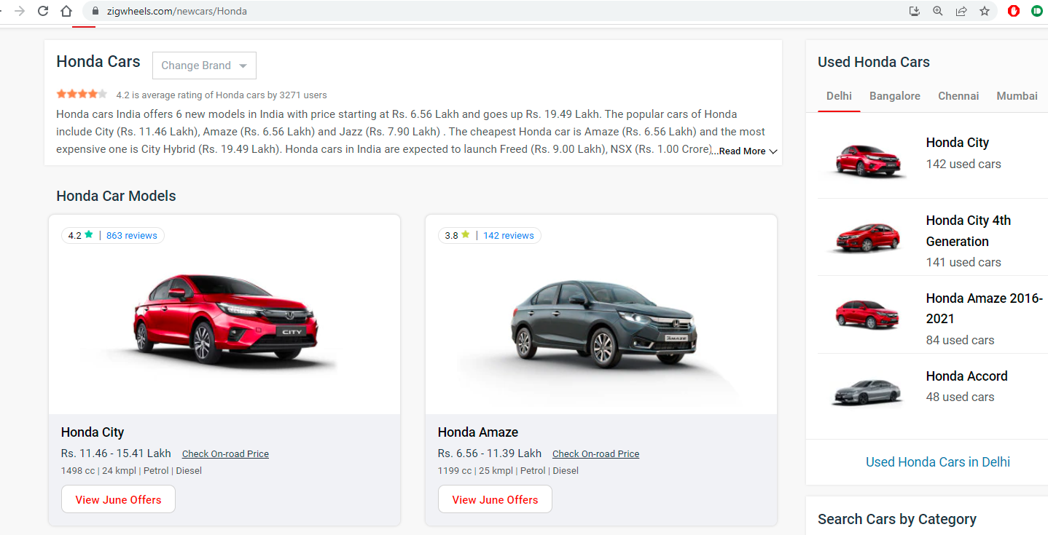
Website:

Slide 5
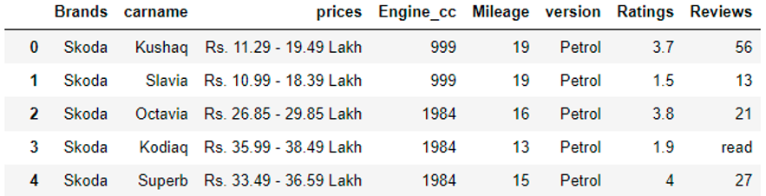
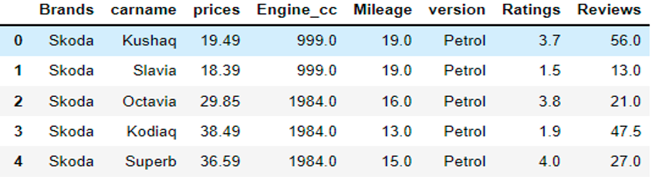
RAW DATA After cleaning

Slide 6
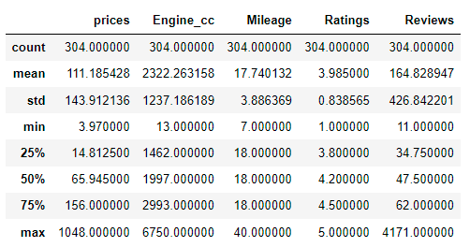
Summary of descriptive statistics of data frame:

Slide 7
Visualization in Univariate Analysis

Slide 8
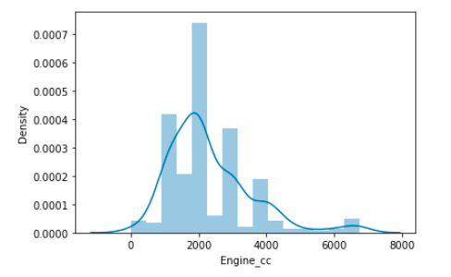
Distribution plot

Slide 9
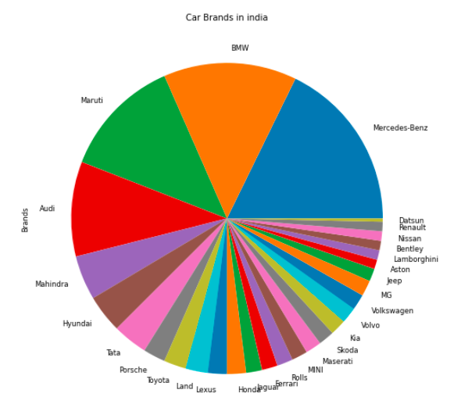
Comparing which Brand has highest cars in India

Slide 10
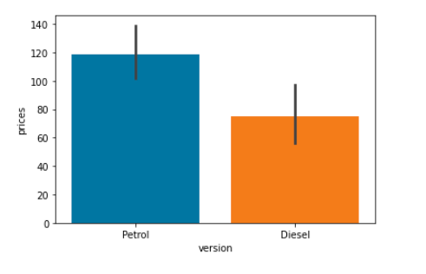
Bi-Variate Analysis Comparing between version and prices

Slide 11
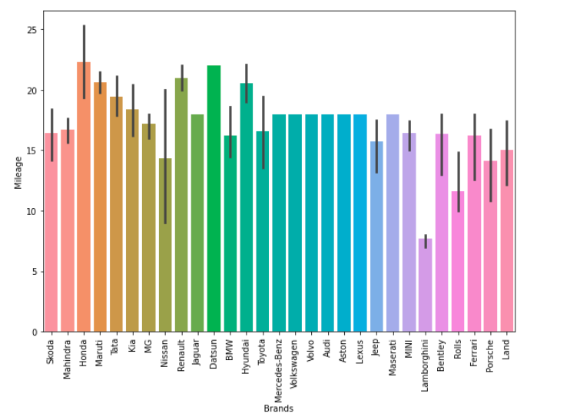
Comparing between Brands and Mileage

Slide 12
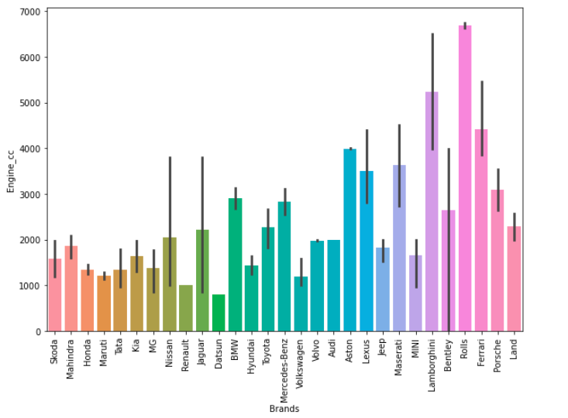
Comparing between brands and Engine_cc

Slide 13
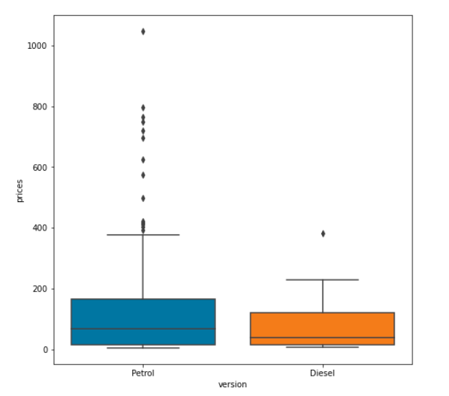
Box plot

Slide 14
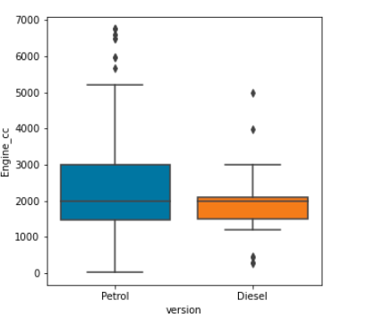
Box plot for version and engine_cc

Slide 15
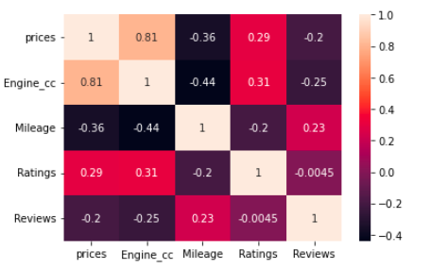
Multi-variate analysis Heat Map

Slide 16
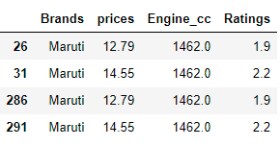
Conclusion:
One of the customer requirements are price should be less than 20 lakhs, Mileage equal to 20,Ratings should be greater 1.5, Engine_cc should be greater than are equal to 1200

Slide 17
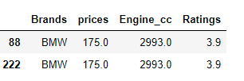
Another customer wants price should be Greater than 50 lakhs, Mileage greater than equal to 24,Ratings should be greater 1.5, Engine_cc should be greater than are equal to 1800

Slide 18
THANK YOU

