Slide 1


Customer shopping data ANALYSIS Tarun s - af0378031

Slide 2

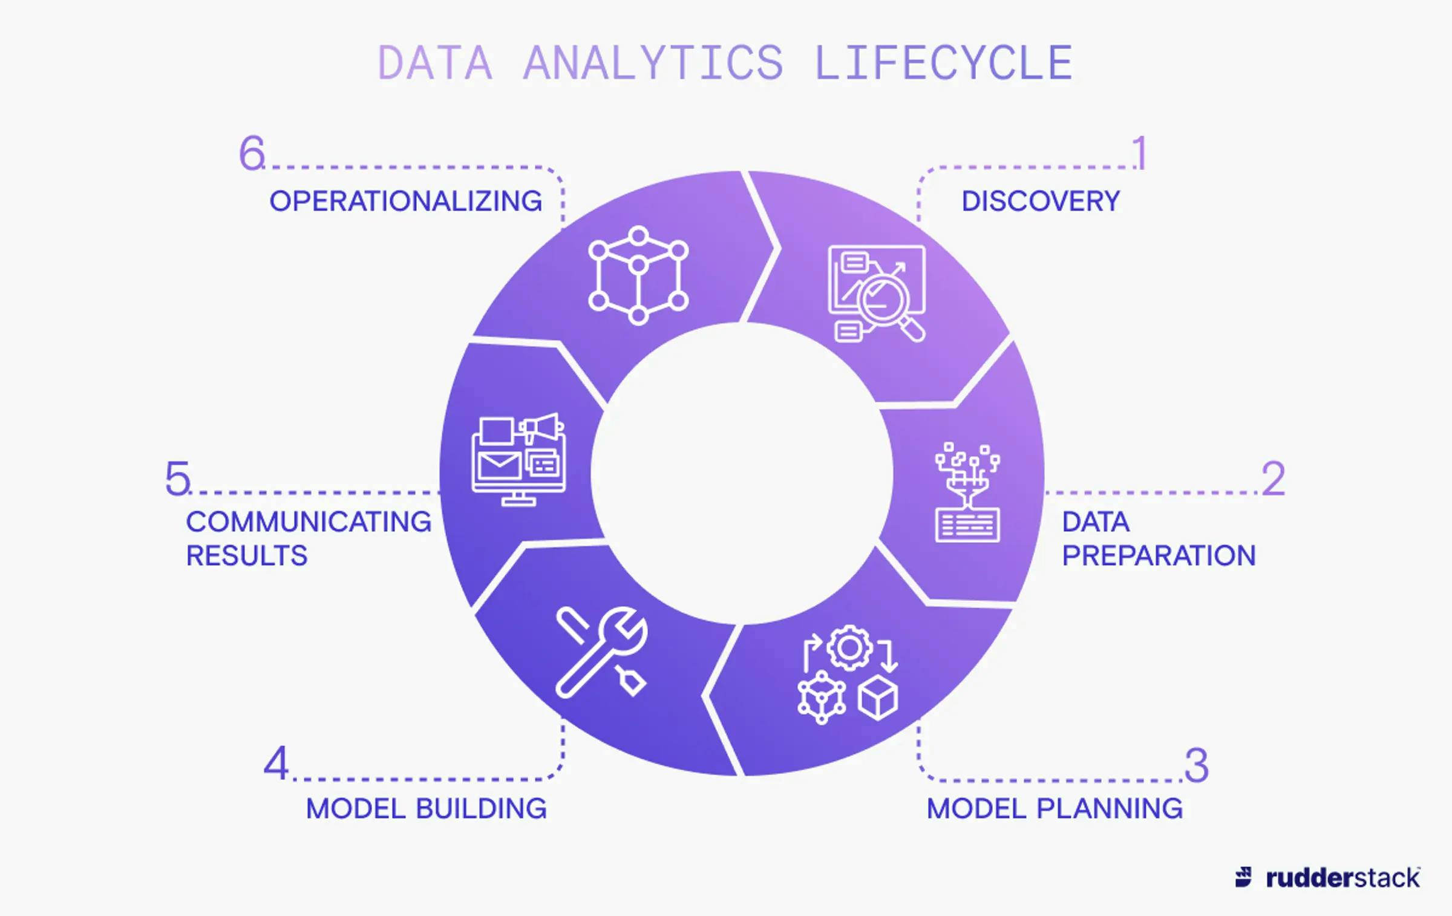
Data analysis lifecycle

Slide 3

What is customer shopping data Analysis ?
Customer shopping data analysis is the process of examining and interpreting information about how customers behave when they shop. Businesses use this analysis to understand their customers better and make data-driven decisions about things like:
Product development and marketing: By understanding what products customers are buying together, how much they're spending, and what demographics they fall into, companies can develop targeted marketing campaigns and make informed decisions about what products to stock.
Sales and promotions: Customer data can help businesses identify which products are most popular during certain times of year, and tailor promotions accordingly.
Customer experience: Analyzing shopping data can help businesses identify areas where the customer experience can be improved, such as by streamlining the checkout process or personalizing recommendations.

Slide 4

Why customer shopping data Analysis ?
Customer shopping data analysis is crucial for businesses in the retail industry to understand their customers' behavior and optimize their strategies. This specific dataset provides valuable insights into shopping habits in Istanbul, focusing on 10 shopping malls between 2021 and 2023.

Slide 5

Problem Statement
The project aims to gain a deeper understanding of customer shopping patterns using the Customer Shopping Dataset. It can help explore customer choices, ideal products, and predict sales volume.

Slide 6

Aim
By analyzing this data, we hope to uncover insights such as:
Customer demographics: Understanding the typical customer profile (age, gender) for different product categories and shopping malls.
Purchasing behavior: Analyzing trends in purchase frequency, quantity, and total spending.
Product popularity: Identifying the most popular product categories across different demographics and shopping malls.
Payment preferences: Understanding the preferred payment methods (cash, credit card, debit card) used by different customer segments.
Seasonal trends: Analyzing how shopping habits vary throughout the year.
Mall performance: Comparing customer behavior and spending patterns across different shopping malls.

Slide 7
methodologies
NumPy: Provides support for efficient numerical computations and array operations.
Pandas: Offers data manipulation and analysis tools through dataframes.
Matplotlib: Enables creating static, interactive, and animated visualizations.
Seaborn:*Builds on Matplotlib to provide a high-level interface for drawing attractive statistical graphics.

Slide 8

Hardware and Software Requirements
Processor: Intel Core i5 or equivalent (minimum), Intel Core i7 or higher (recommended)
RAM: 8 GB (minimum), 16 GB or more (recommended)
Storage: 256 GB SSD (minimum), 512 GB SSD or more (recommended)
Graphics: Integrated graphics for basic visualization, dedicated GPU for more intensive visualizations
Display: Full HD monitor (1920x1080 resolution) or higher
Internet Connection: Stable internet connection for downloading datasets and libraries

Slide 9

SOFTWARE REQUIREMENTS:
Operating System:
Windows 10 or higher
macOS 10.14 (Mojave) or higher
Linux (any modern distribution)
Programming Languages:
Python 3.6 or higher
Python Libraries:
pandas: For data manipulation and analysis.

Slide 10

IDE/Text Editor: Jupyter Notebook/JupyterLab (recommended for EDA) Visual Studio Code PyCharm

Slide 11

Summary
This customer shopping data analysis project offers a valuable opportunity to gain insights into Istanbul's retail landscape. By utilizing Power BI for data visualization, we can effectively uncover trends and patterns that can inform strategic decisions for businesses operating in the city.

