Slide 1
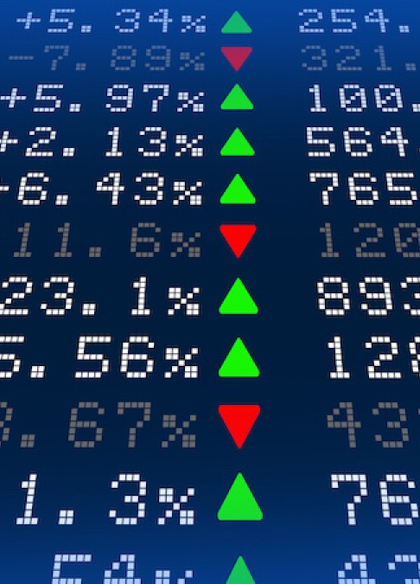
Final Project DATA-1205-01 Stock Exchange Data - Tableau Dashboard Analysis https://www.kaggle.com/datasets/mattiuzc/stock-exchange-data
tArun Sharma
100847226

Slide 2
Data Outline
104224 Rows of Data from 13 Stock Exchanges from 1965 to 2021
Currencies are in different format and to be converted into USD (by using ‘Close USD’) for intra-index analysis
There is more info in ‘indexInfo.csv’ about Country and Exchange names. Therefore ‘indexProcessed.csv’ can be linked to ‘indexInfo.csv’ by using ‘Index’ column as primary key
Volatility can be calculated by subtracting ‘Low’ from ‘High’.

Slide 3
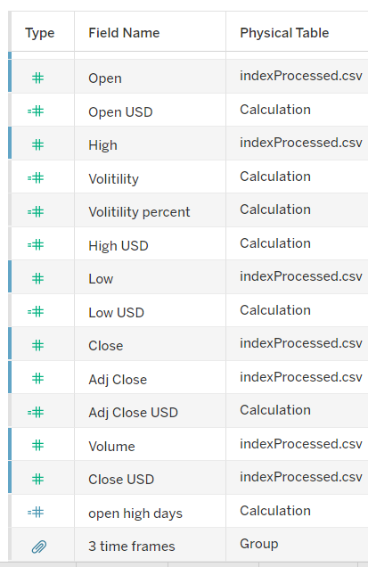
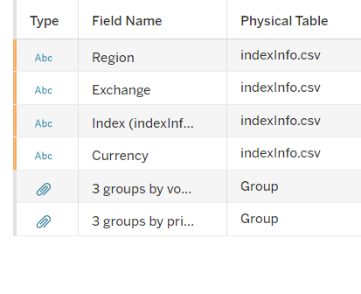
Calculated field and Groups made for visualization

Slide 4
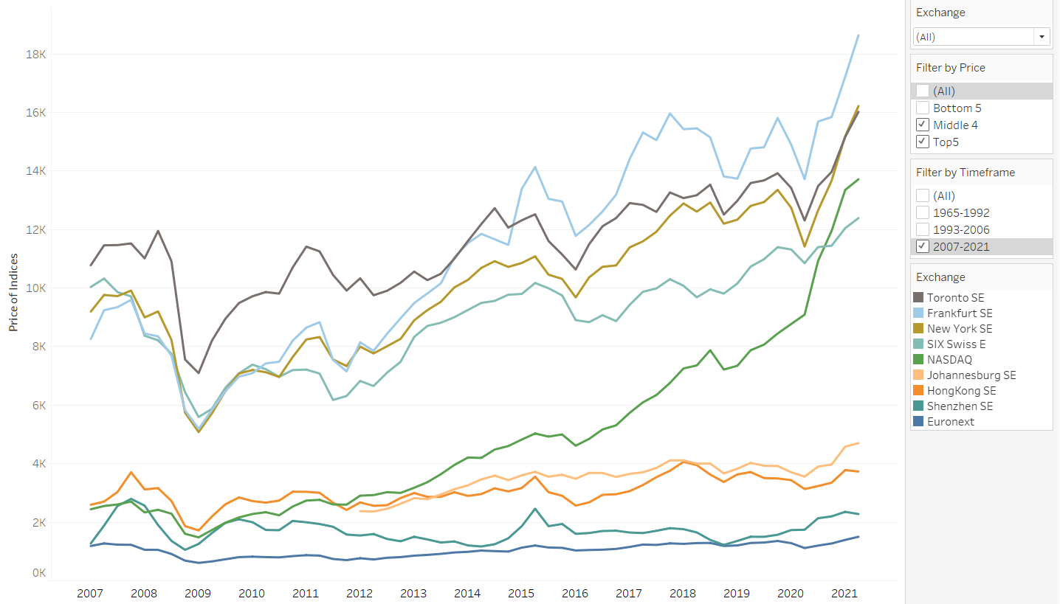
Price of Top 9 Indices after 2007

Slide 5
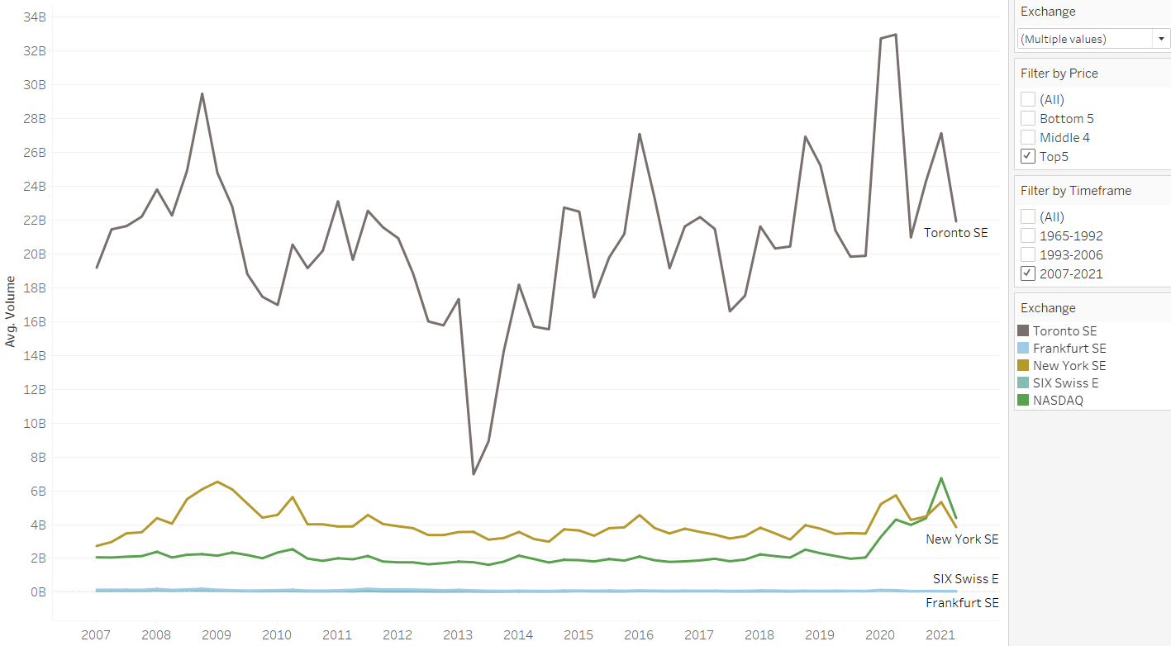
Volume of Top 5 Indices after 2007

Slide 6
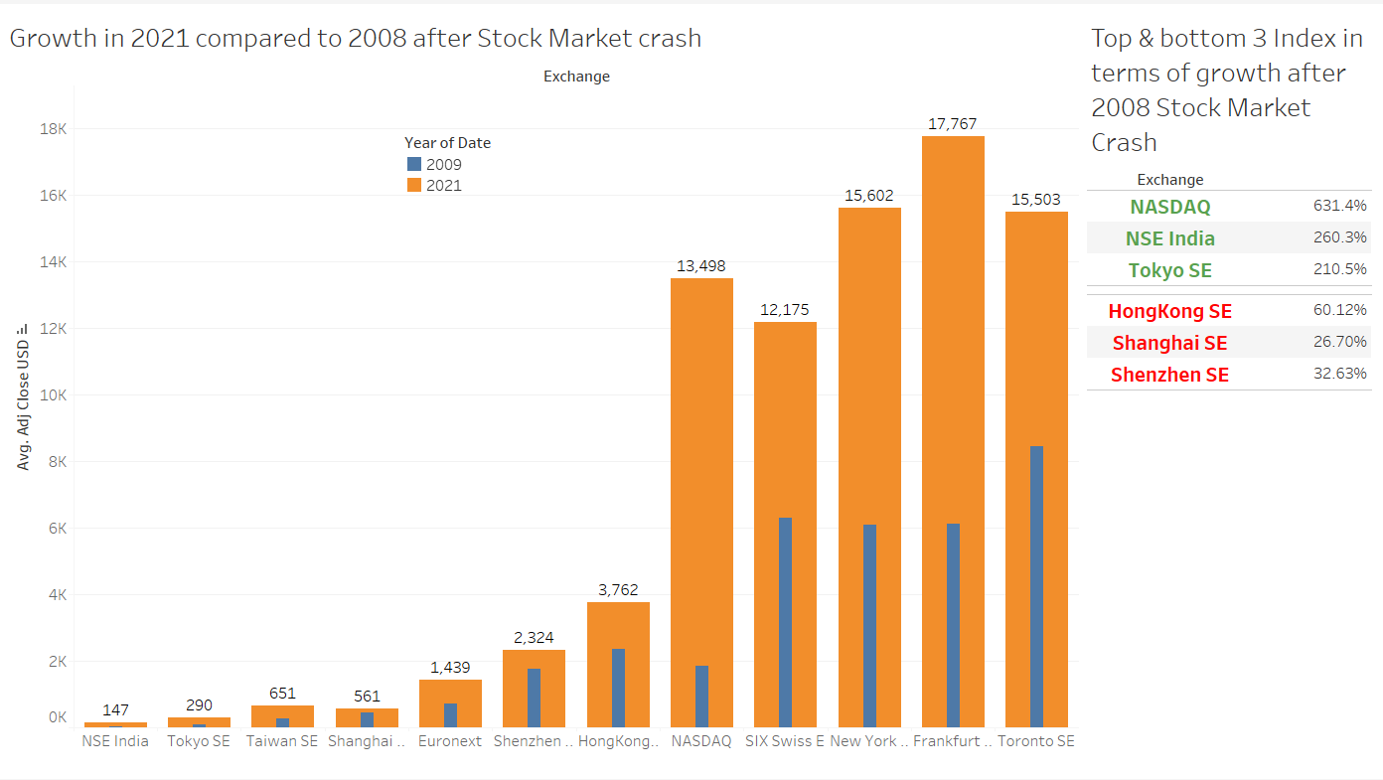
Top & Bottom 3 Exchanges in terms of %Growth after 2008

Slide 7
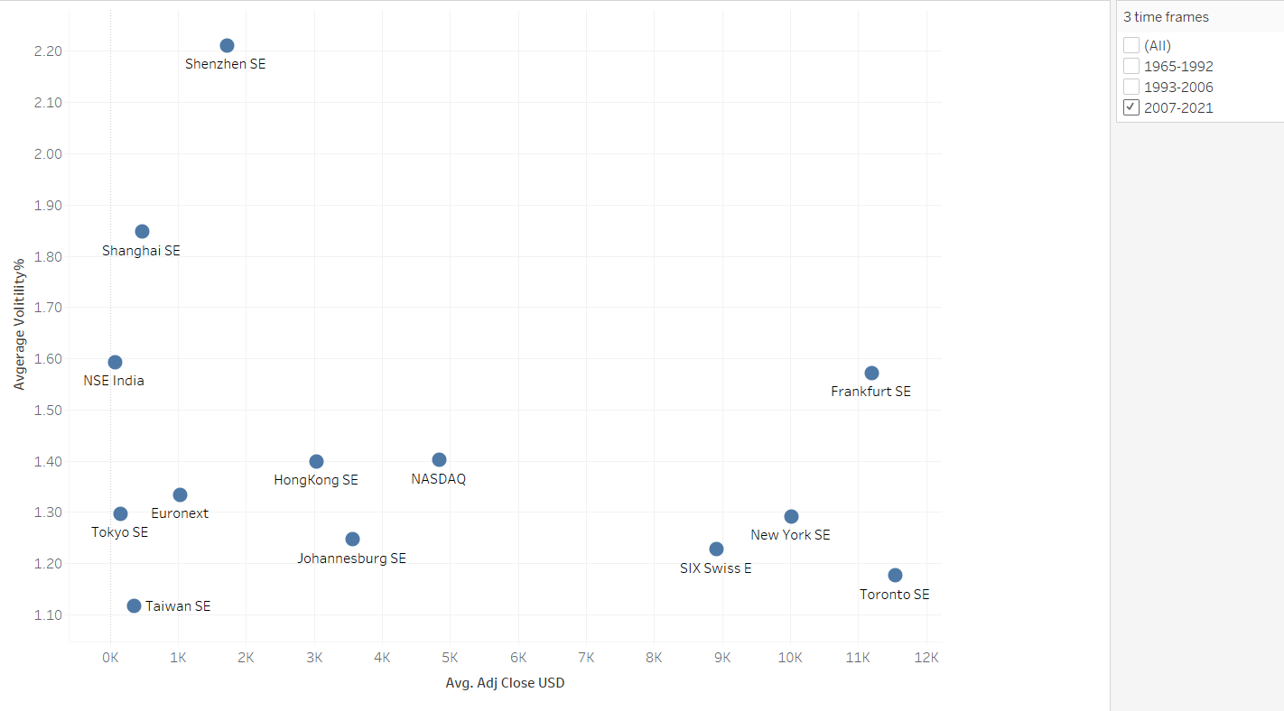
Daily average Volatility compared to Index Price

Slide 8
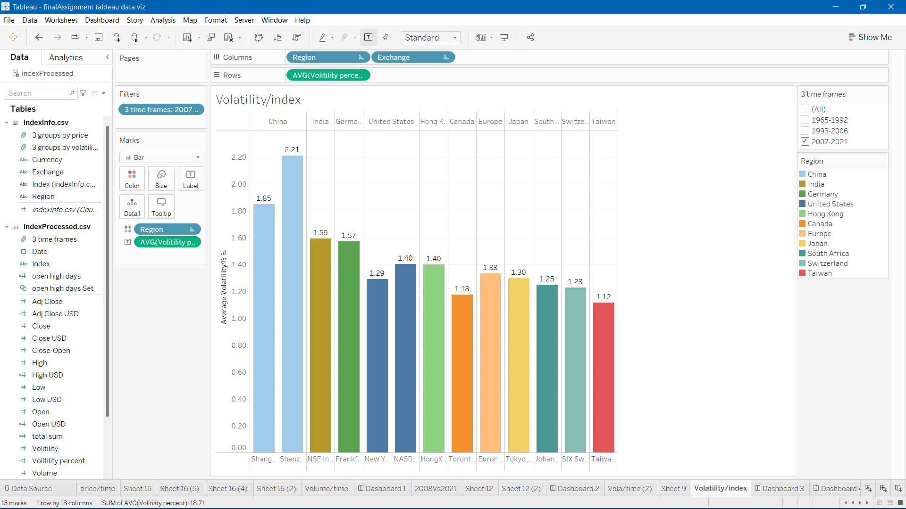
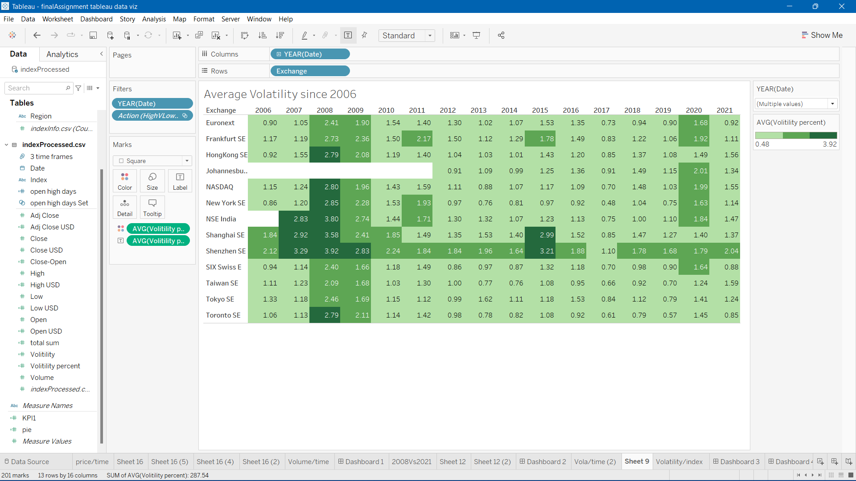
Average Volatility across Years

Slide 9
Dashboards

Slide 10
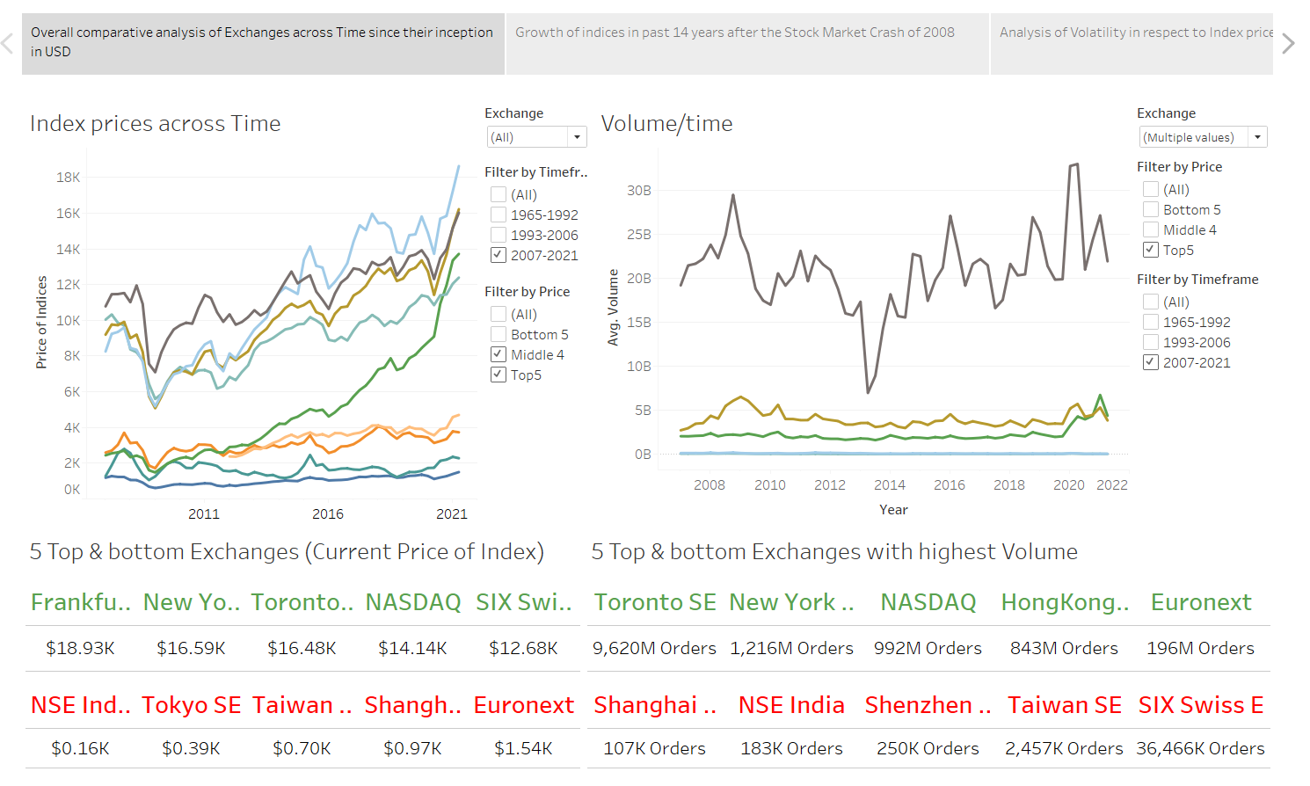
Dashboard for Overall data summary and understanding

Slide 11
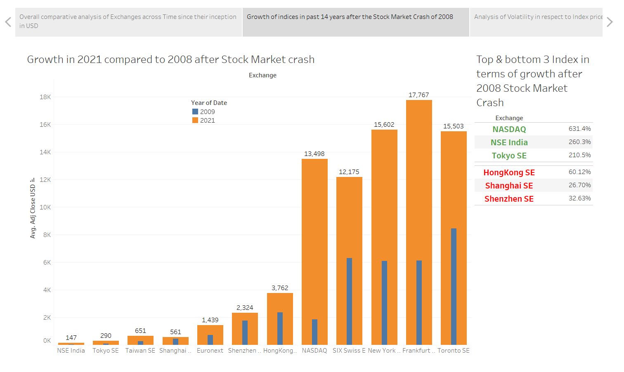
Dashboard for Index performance with KPIs after 2008

Slide 12
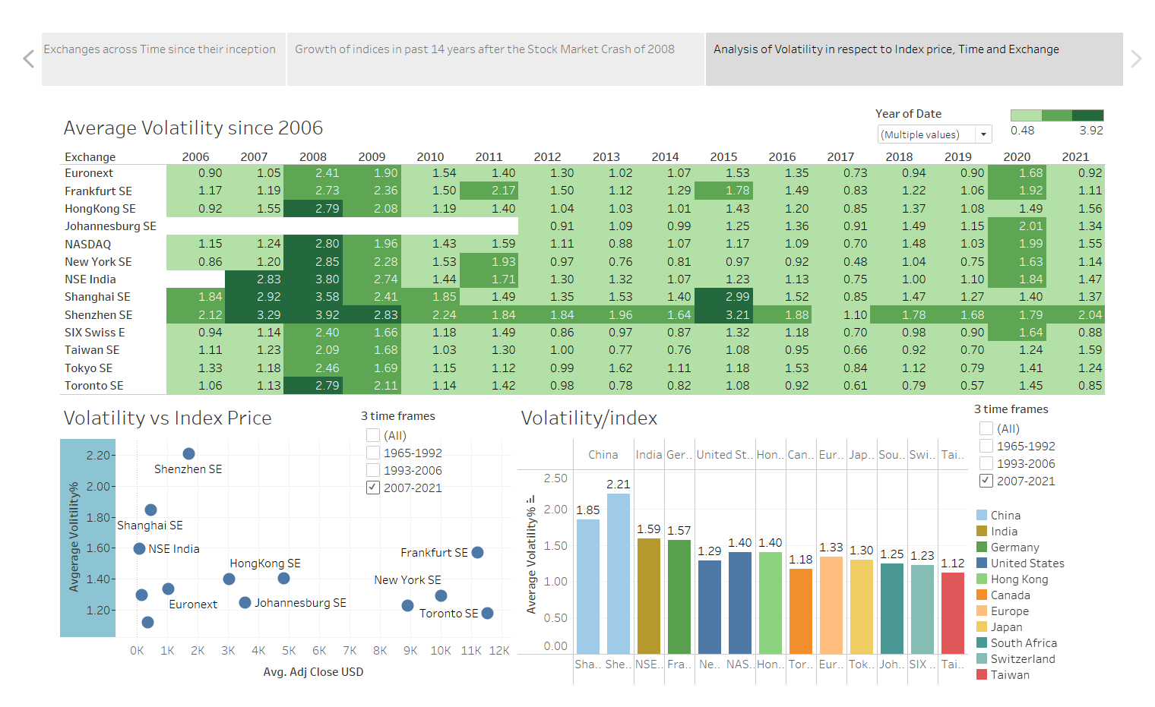
Dashboard for Volatility analysis across many features

