Slide 2

Outline
Dataset
Feature Engineering
Descriptive Statistics
Exploratory Data Analytics
Models
Base model, Decision Tree
Other models
Model Comparison
Hyperparameter Tuning
Conclusion
Limitations
Future Work
References & Further Reading

Slide 3

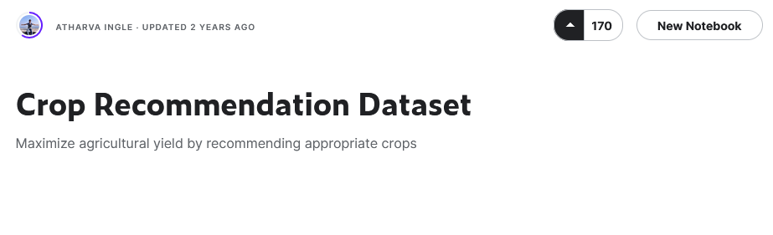
Dataset
Dataset taken from Kaggle user @atharvaingle
2.2k lines of data
22 crops, 100 records each
Features
N, P and K amounts (kg/hectare)
Temperature (Celsius)
Relative Humidity
pH
Rainfall (mm)
Crops ranging from legumes to fruits

Slide 4

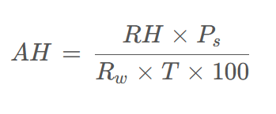
Feature Engineering
Dataset already tabularized
No data cleanup needed
New feature is derived
Absolute humidity from temperature and relative humidity
Limitations of derivation
Pressure assumed constant (no data), ignored in calculations
AH = Absolute Humidity
RH = Relative Humidity
Ps = Saturation Vapor Pressure
Rw = Constant for water vapor
T = Temperature

Slide 5

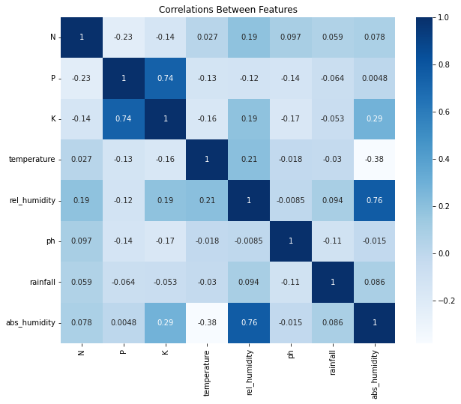
Descriptive Statistics
Correlations
Potassium & Phosphorus
Relative & Absolute Humidity

Slide 6
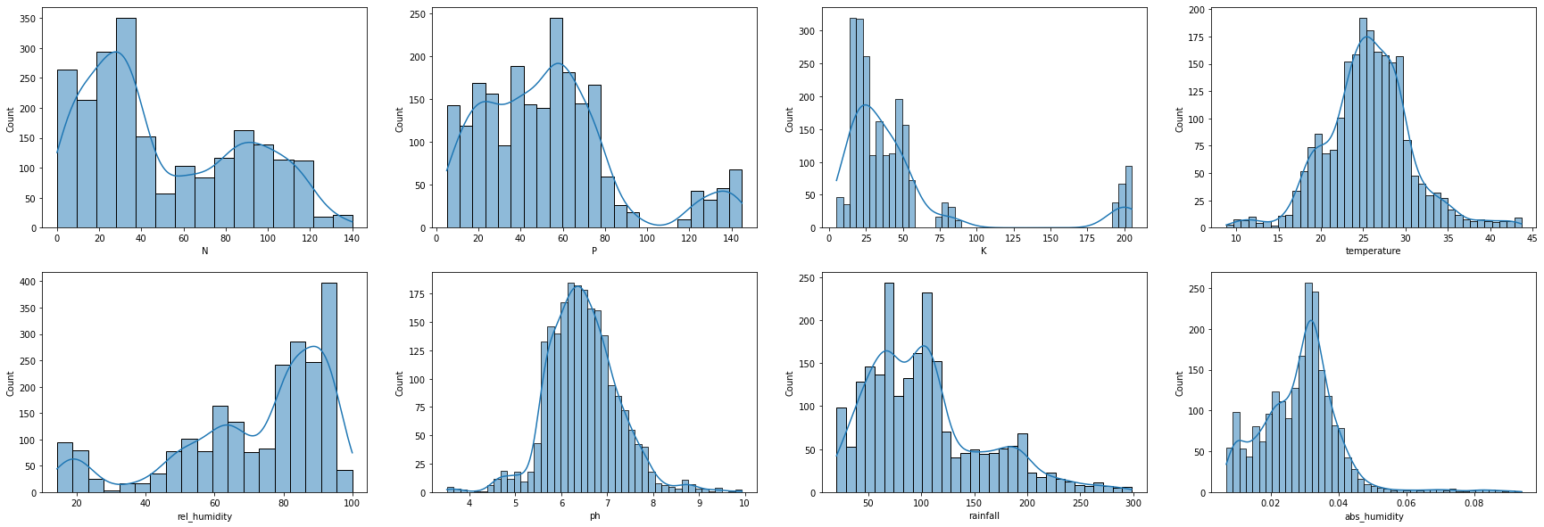
Distributions of Features

Slide 7
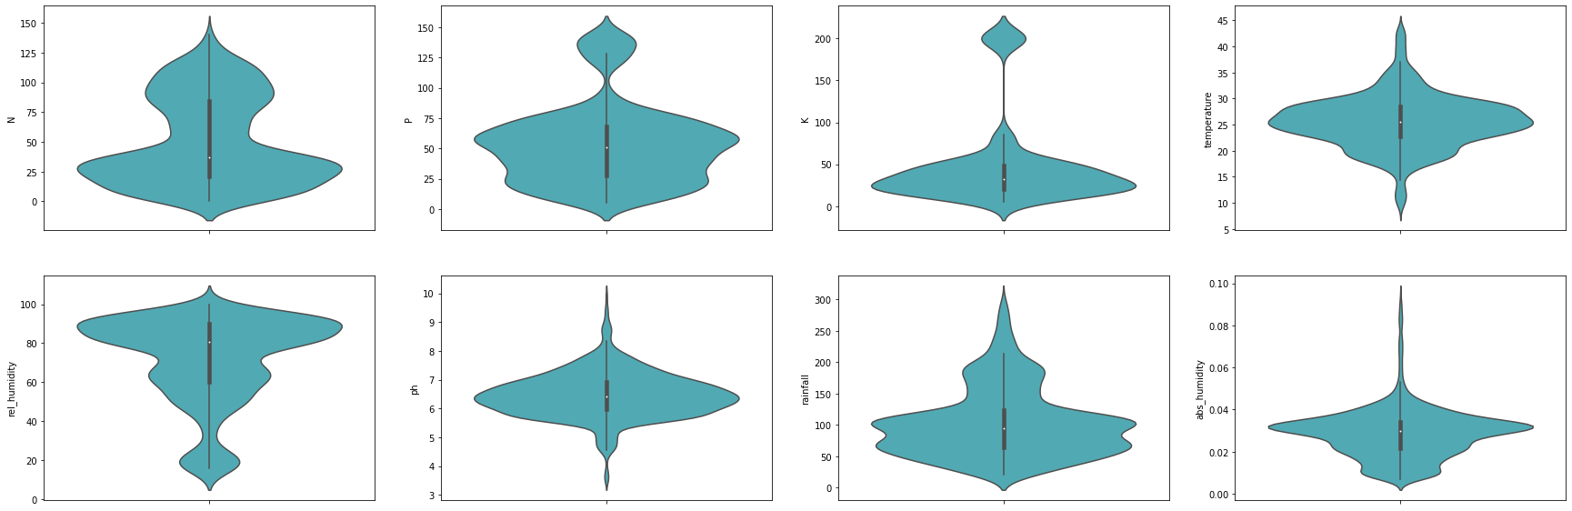
Distributions of Features

Slide 8
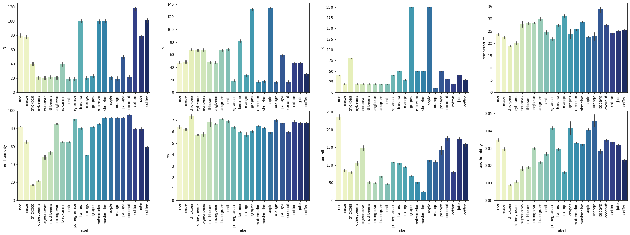
Crops vs Features View

Slide 9
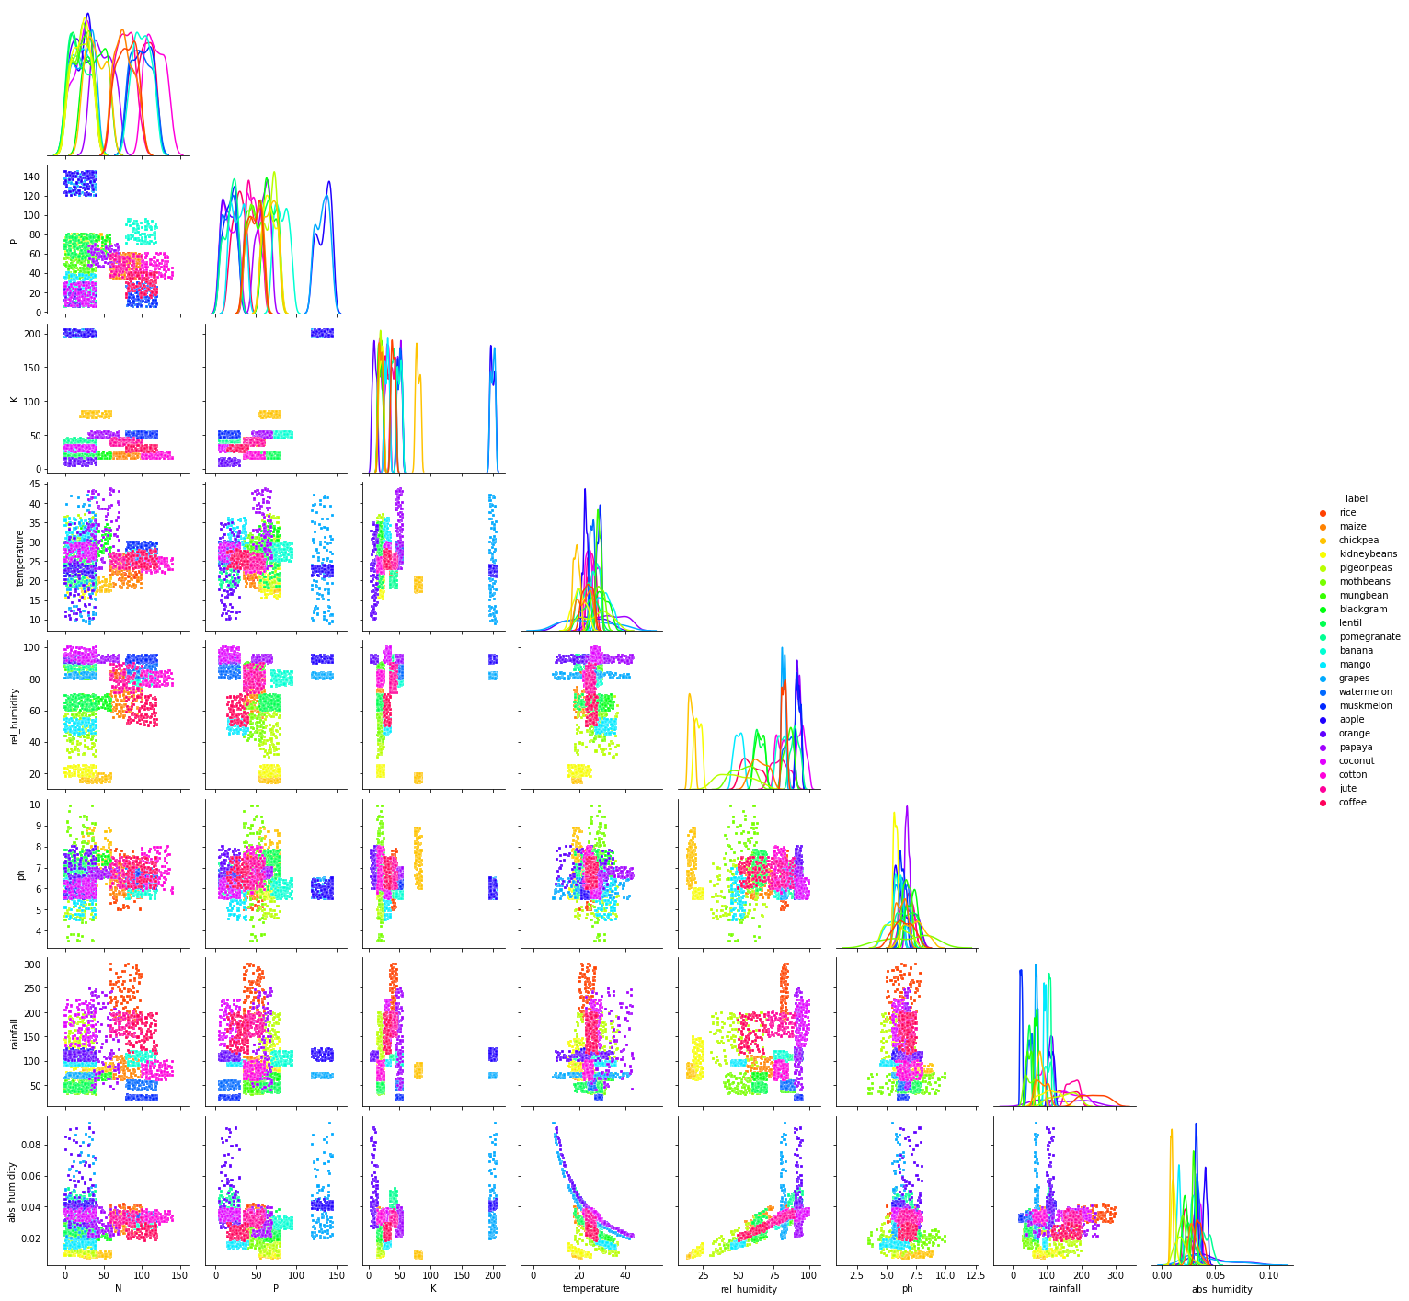
Pair Plots
Pair plots show how grouped / disperse the dataset is

Slide 11

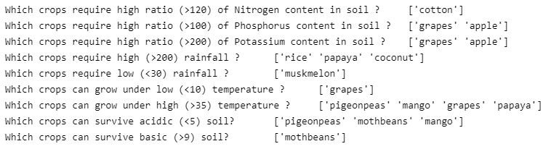
Exploratory Data Analysis

Slide 12
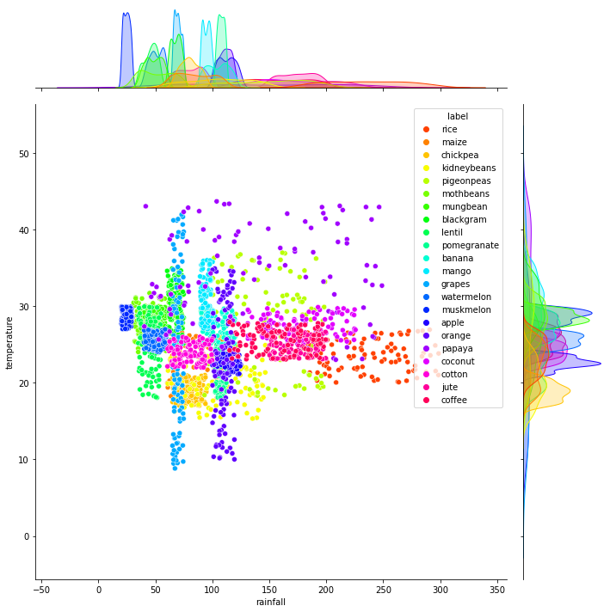

Slide 13
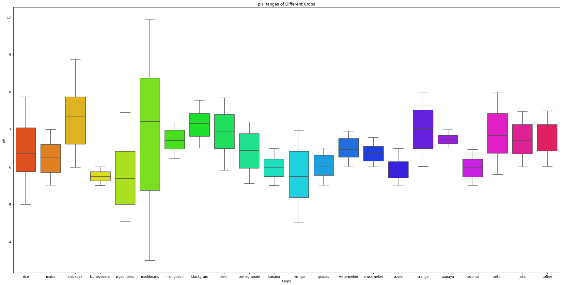

Slide 14

Models
Dataset split as 80% (n=1760) train and 20% (n=440) test
Stratification according to the labels
Normalization done using sklearn.StandardScaler()
Scaling done using sklearn.MinMaxScaler()

Slide 15
Decision Tree
Base model
4 models created
Criterions = gini and entropy
Dataset = regular and normalized

Slide 16
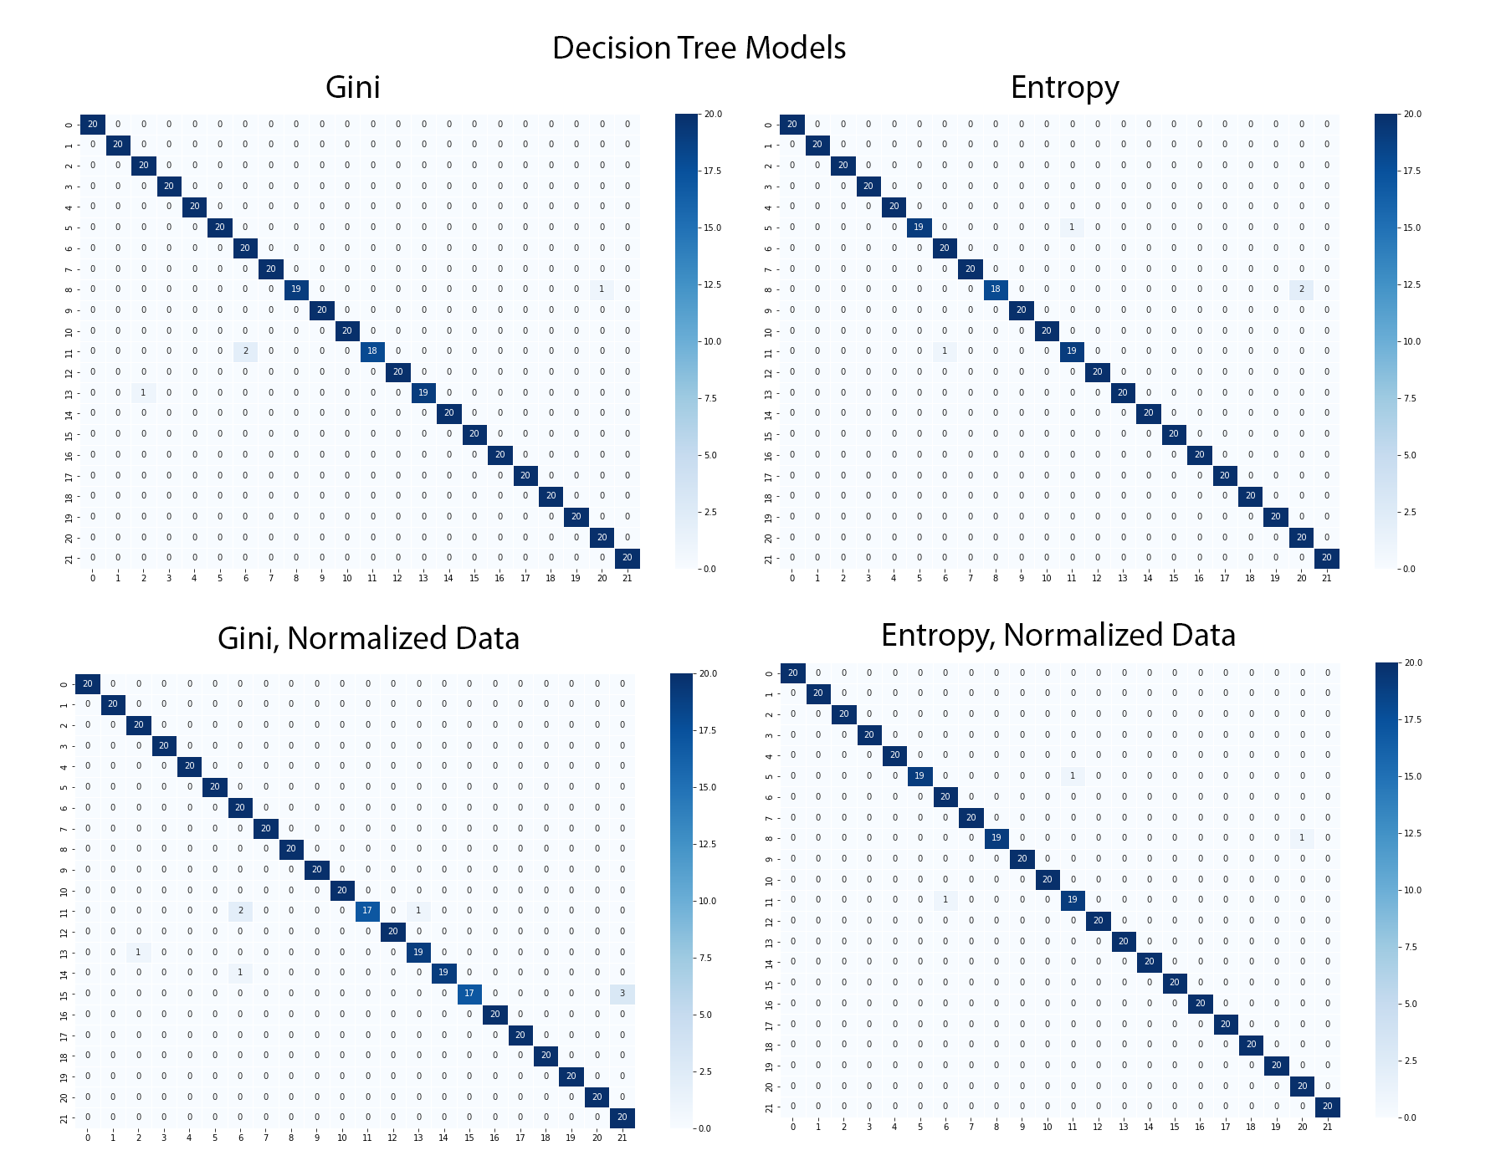

Slide 17
Other Models
Naïve Bayes, 2 models
Regular and normalized data
SVM, 2 models
Regular and normalized data
SVM polynomial kernel, 2 models
n = 3 and n = 4, both normalized data
Random Forest, 3 models
n = 12, n = 25 and n = 50, regular data
KNN, 2 models
k = 5 and k= 10, regular data

Slide 18

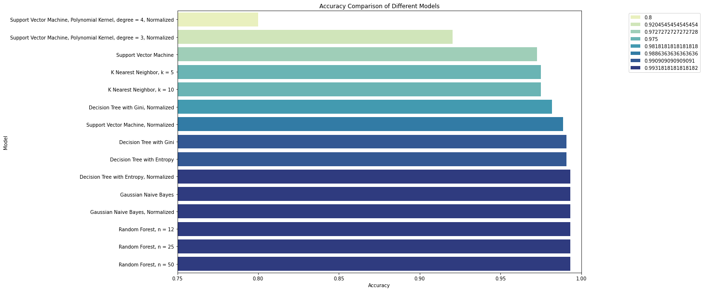
Model Comparison

Slide 19
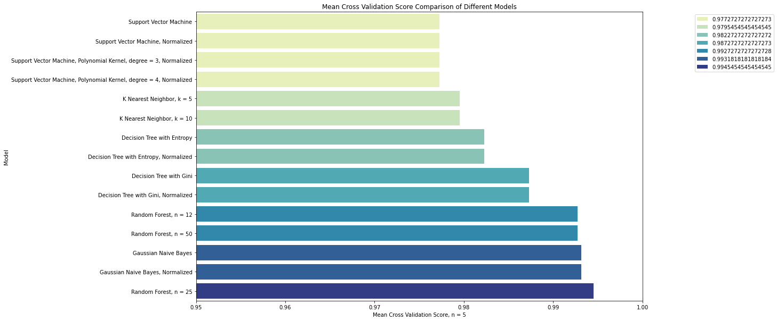
Model Comparison

Slide 20
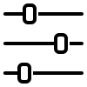
Hyperparameter Tuning
Best performing model selected
Random forest, n = 25
Accuracy = 0.9931
Due to its performance in CV
900 cycles of tuning
Done using sklearn.RandomizedSearchCV()
n = 410, min_split = 8 and min_leaf = 1
Accuracy = 0.9977

Slide 21
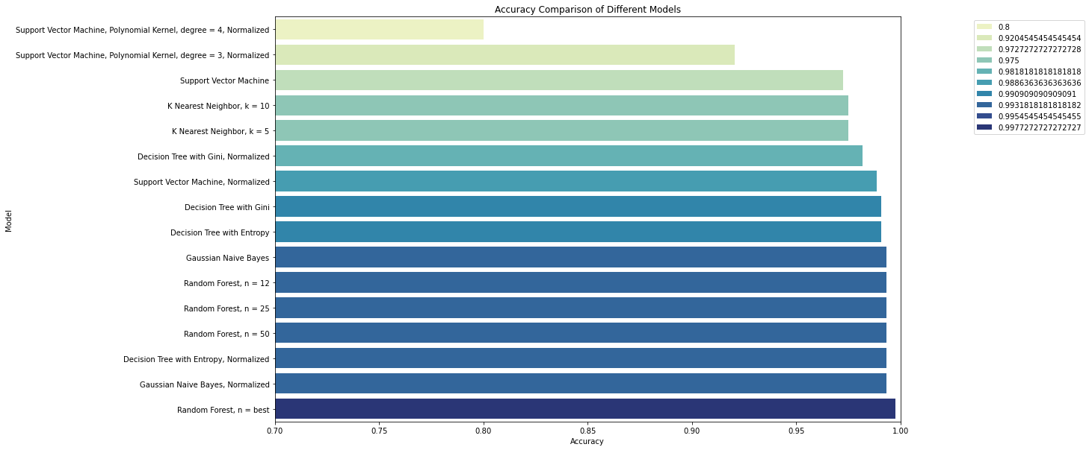
Final Accuracy Comparison

Slide 22
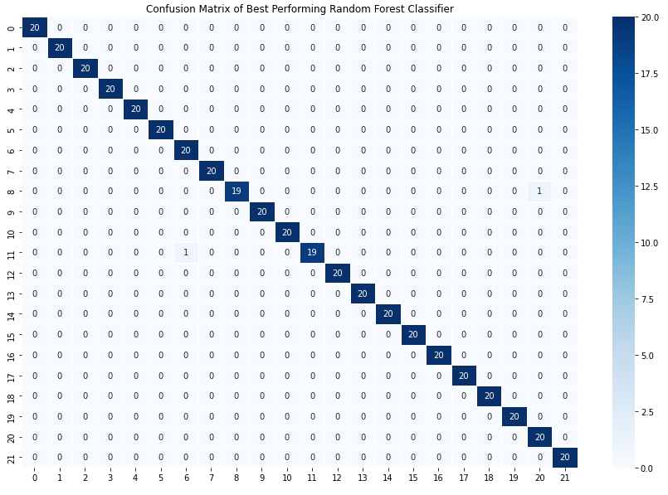
Metrics
Overfit control
Train accuracy = 1.0
Test accuracy = 0.9954

Slide 23

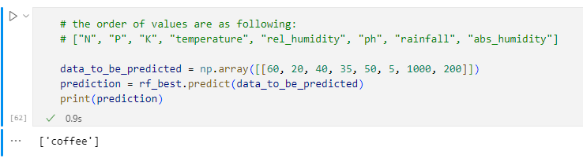
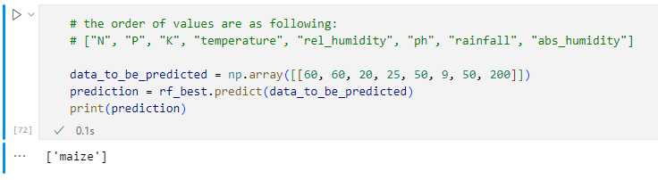
Prediction

Slide 24

Limitations

Slide 25

Future Work

Slide 26

References & Future Reading
Our github repository
https://tinyurl.com/agricommend
Secretary-General's remarks to the Global Food Security Call to Action Ministerial
https://www.un.org/sg/en/content/sg/speeches/2022-05-18/secretary-generals-remarks-the-global-food-security-call-action-ministerial%C2%A0
Food Security Update, The World Bank
https://www.worldbank.org/en/topic/agriculture/brief/food-security-update
Global Report on Food Crises 2022, Global Network Against Food Crises (GNAFC)
https://reliefweb.int/report/world/global-report-food-crises-2022
The World's Food Supply is Made Insecure by Climate Change
https://www.un.org/en/academic-impact/worlds-food-supply-made-insecure-climate-change
India Defends Wheat Export Ban
https://www.voanews.com/a/india-defends-wheat-export-ban-/6590477.html
Food Prices Approach Record Highs, Threatening the World’s Poorest
https://www.nytimes.com/2022/02/03/business/economy/food-prices-inflation-world.html
Yeni Tarım Düzeni, Ali Ekber Yıldırım, Sia Kitap, Şubat 2022

