Slide 1
Number Plate Recognition system

Slide 2
INTRODUCTION
Number plate recognition is an image processing technology which is used to identify vehicles by their number plates using optical character recognition
This technology is used to various security and traffic application search as across-control system

Slide 3
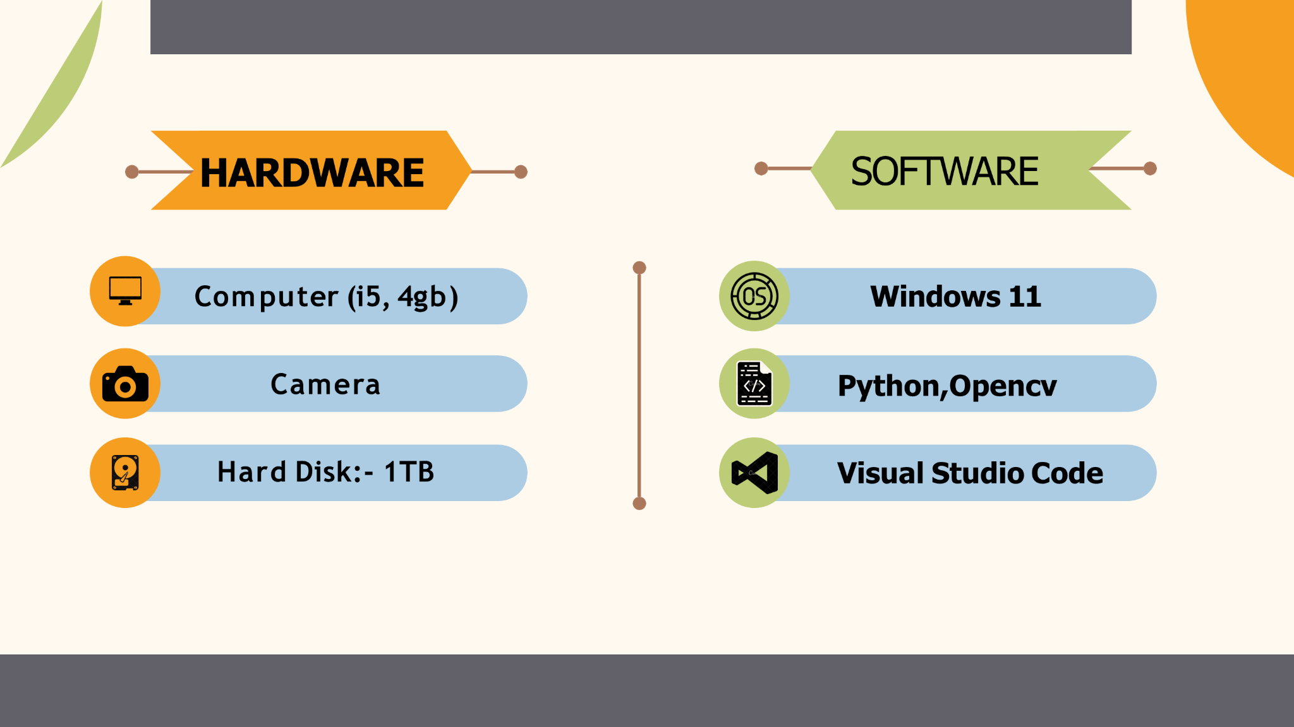
Requirements

Slide 4
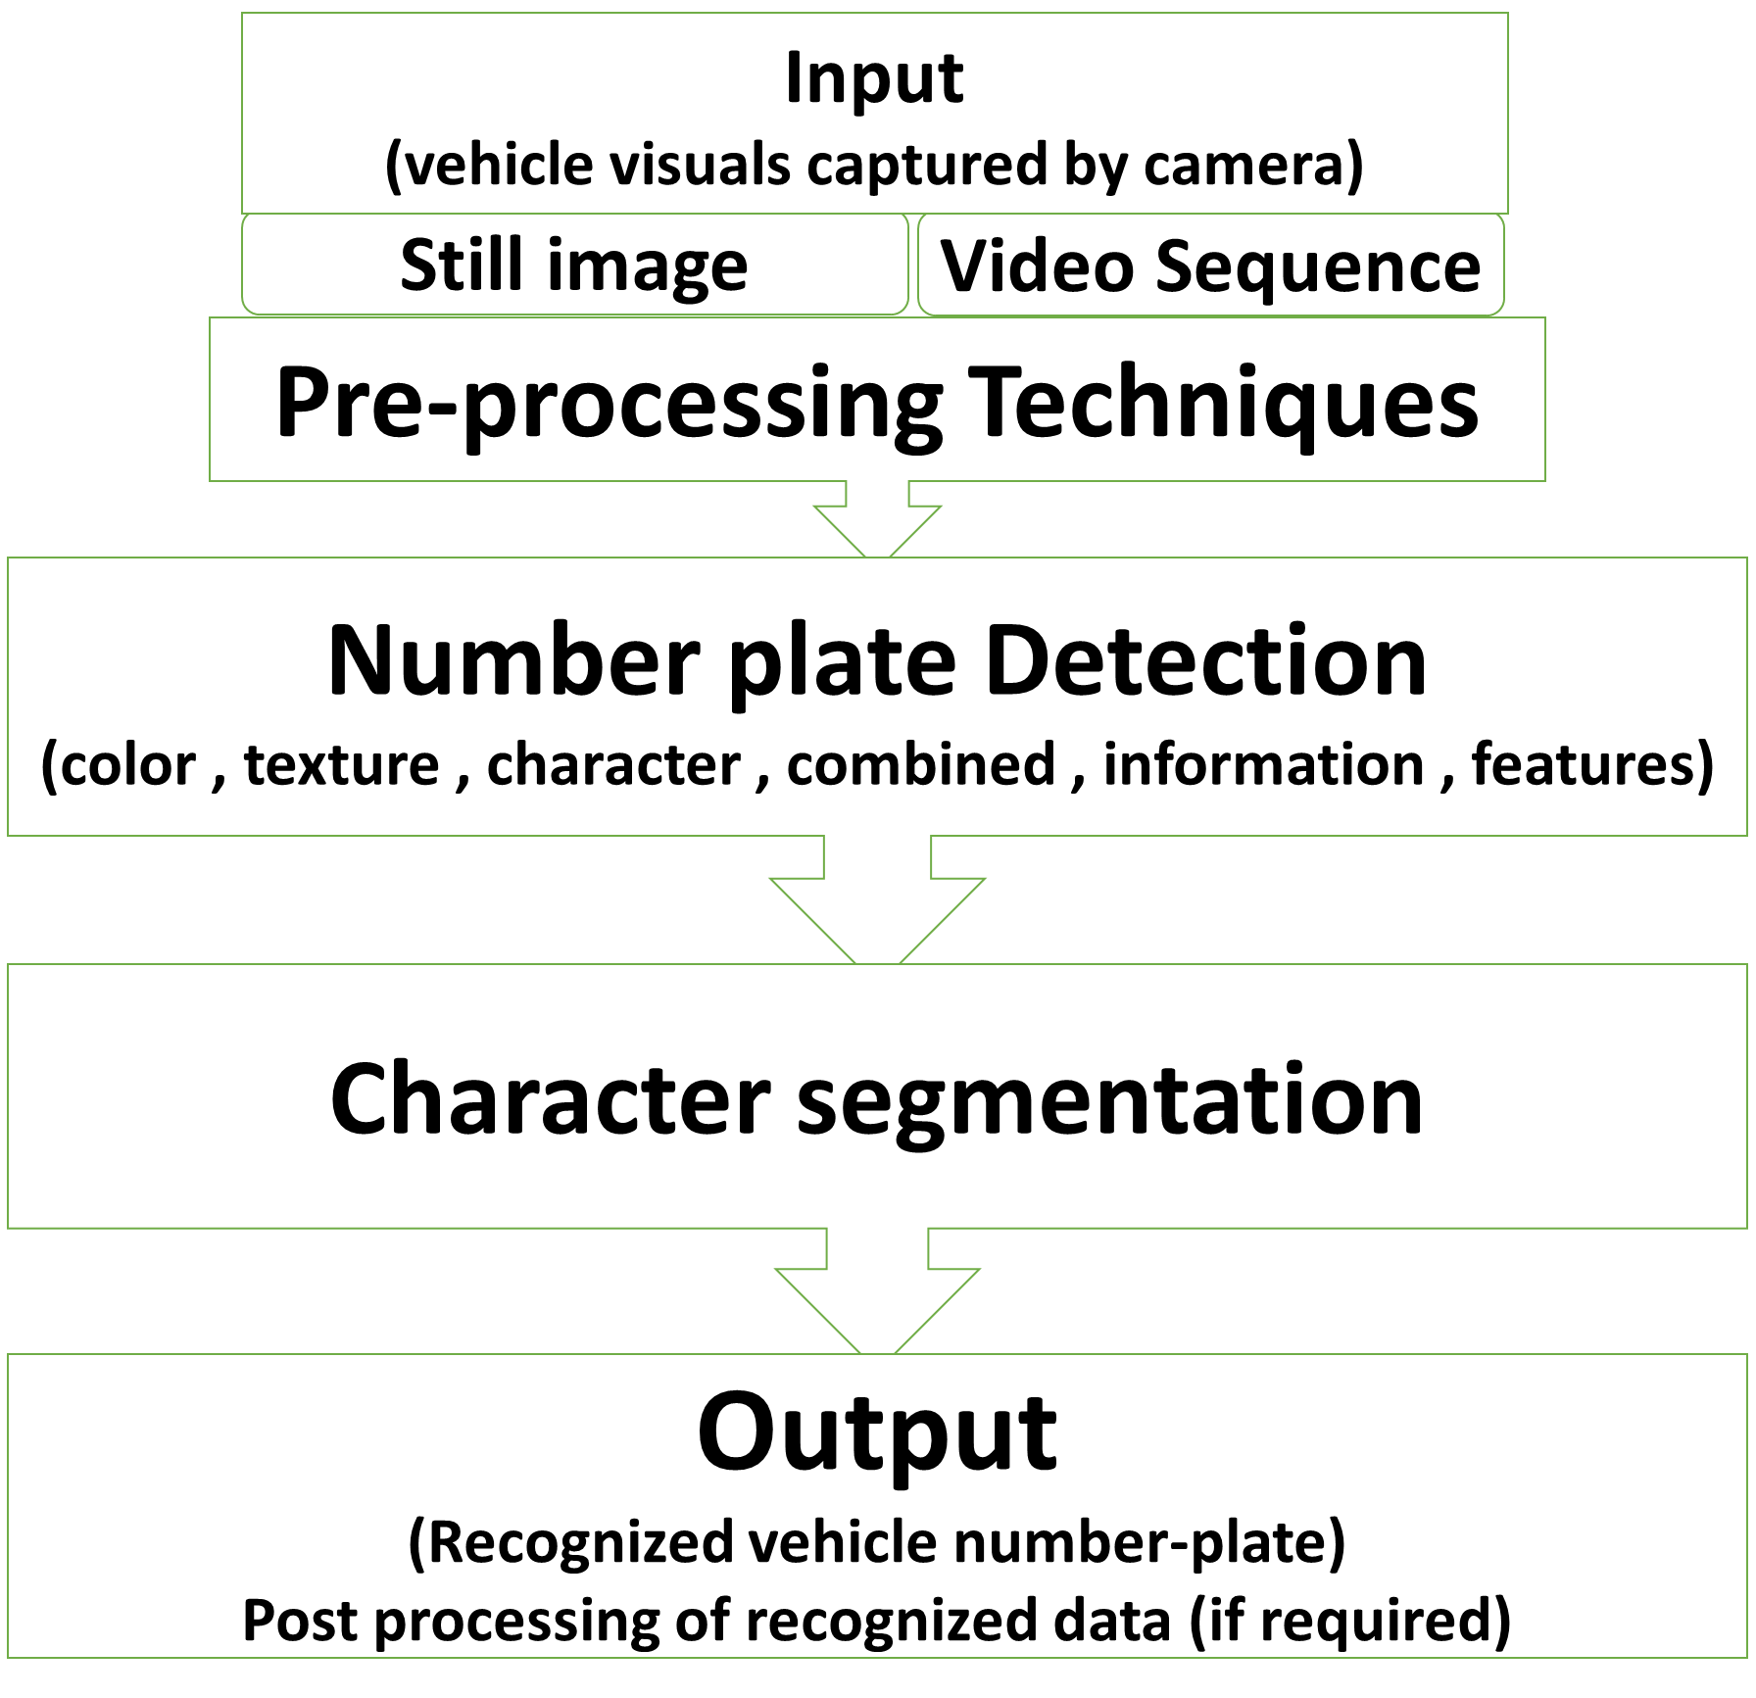

Slide 5
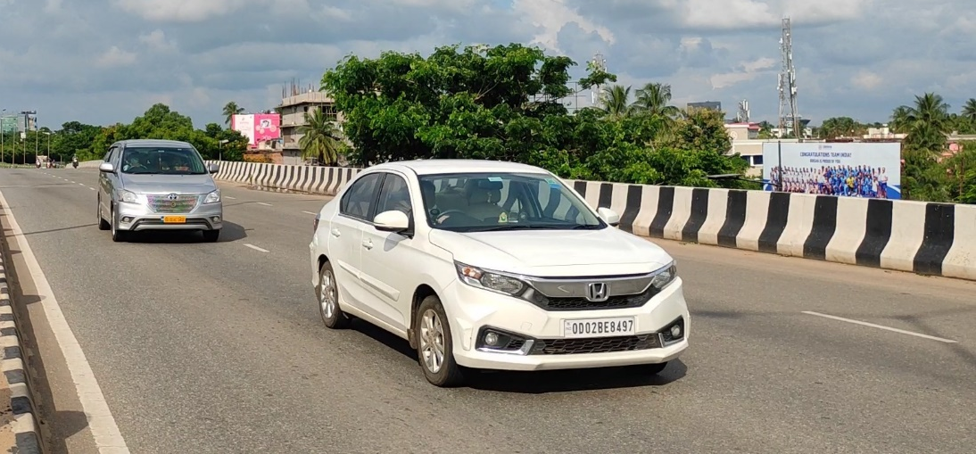

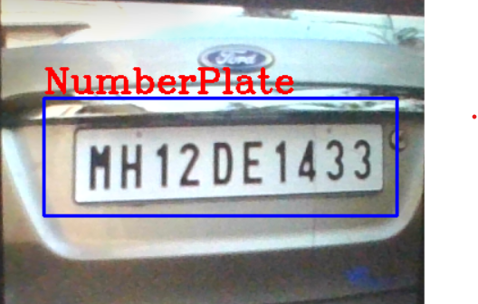
Output :
in video :
scan
detected

Slide 6
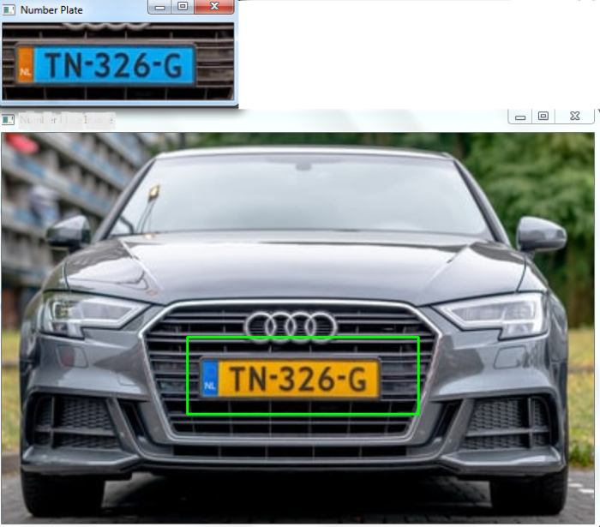
Output :
in image:

Slide 7
ADVANTAGES
Improving road safety
Reduce crime
Gives officers better information to work with
Determining tourism
Giving a greater police presence
Increasing the percentage of stop/searches that lead an arrest.

Slide 8
CONCLUSION
There is an immediate need of such kind of automatic number plate recognition system in the world as there are problem of traffic , stealing cars etc.
Government should take some interest in developing the system as the system is very economical and eco-friendly, if applied effectively.
This change will help in the progress of the nation.

Slide 9


