Slide 1
Project name
Finding district and cities information of Bangladesh.

Slide 2
Clear Idea :
The Project is to find the information of every district and cities easily.
Finding district and cities information of Bangladesh.
Aim of Project:
The aim of this project is
so that we can easily find the districts and cities information of a country.

Slide 3
Abstract of project work :
In Bangladesh, cities are conventionally classified based on population size and revenue collection.
This conventional city classification system neglects the spatial characteristics inherit and history of cities.
This project classifies these cities into 7 Divisions and its districts, By this classification we know more about our division and its history.

Slide 4
Introduction :
Cities are the engines of growth. The journey towards growth accelerates urbanization.
Bangladesh is unique for its combination of large population, high density, and low levels of development.
City classification is important for understanding functionality, resource allocation, employment, and development.

Slide 5
The concept and practice of city classification based on spatial development level are new in Bangladesh.
Since proper city classification is useful for resource allocation, decentralization, and balanced development.
this study aims to classify 331 cities in Bangladesh with cluster analysis according to spatial characteristics of cities

Slide 6
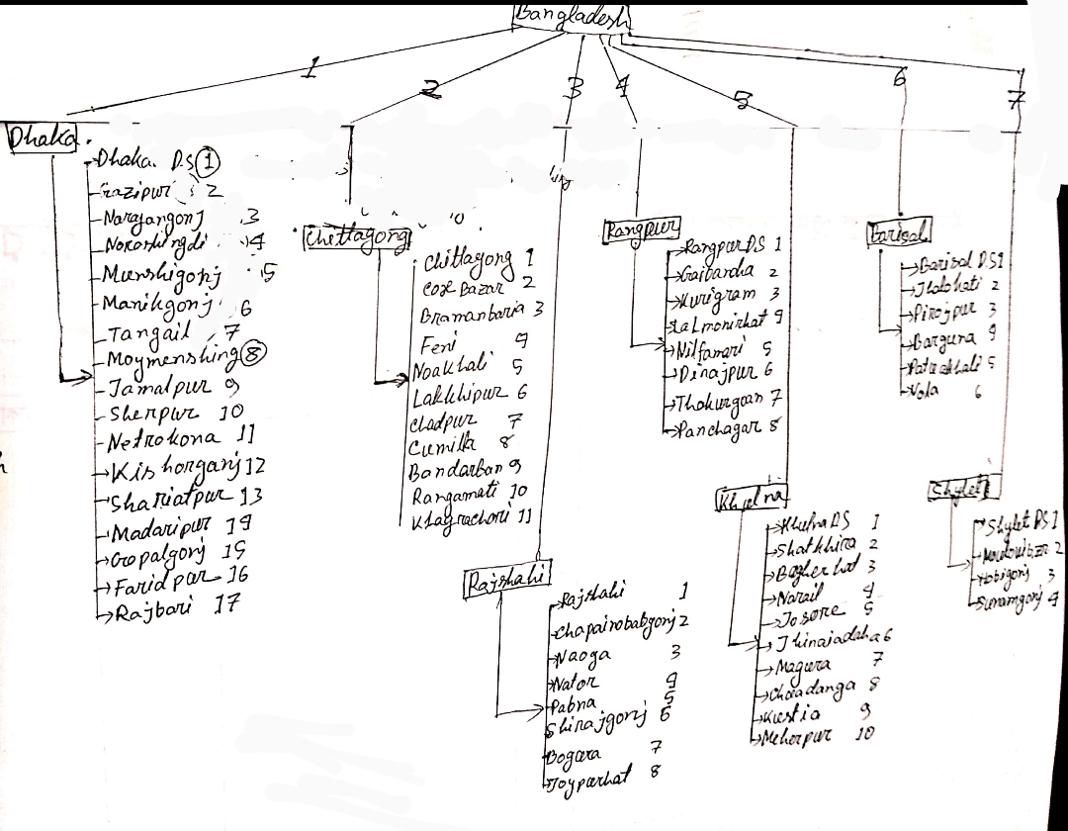
Diagram :

Slide 7
Advantages :
Classification method is very simple.
This classification can guide policymakers to focus on the development of the cities in different clusters.
Disadvantage :
It’s not proper city classification based on spatial characteristics of cities is essential for optimum resource allocation and balanced development.
It also may not be efficient nor equitable, as the system does not capture the spatial development patterns of the area.

Slide 8
Clear algorithm of the project
Start
input Division number
show Division information
input District number
show District information
end

Slide 9









Requirements
HARDWARE
SOFTWARE
Computer (i, 8gb)
Windows 7
C
Hard Disk:- 1TB
CodeBlocks

Slide 10

Requirements
HARDWARE
SOFTWARE
Computer (i3, 2gb)
Windows 7
C
Hard Disk: 120GB
Codeblocks

Slide 11
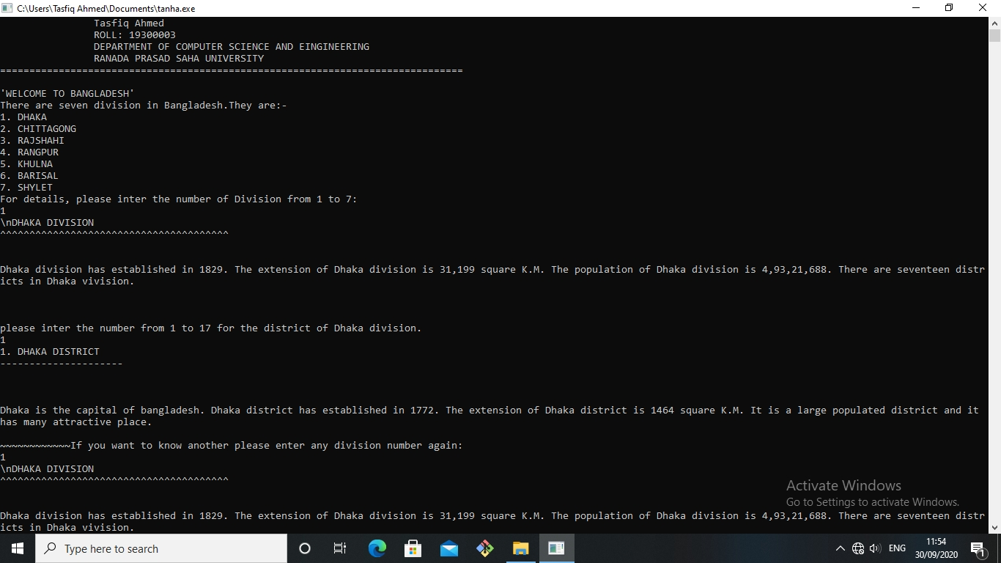
Output :

Slide 12
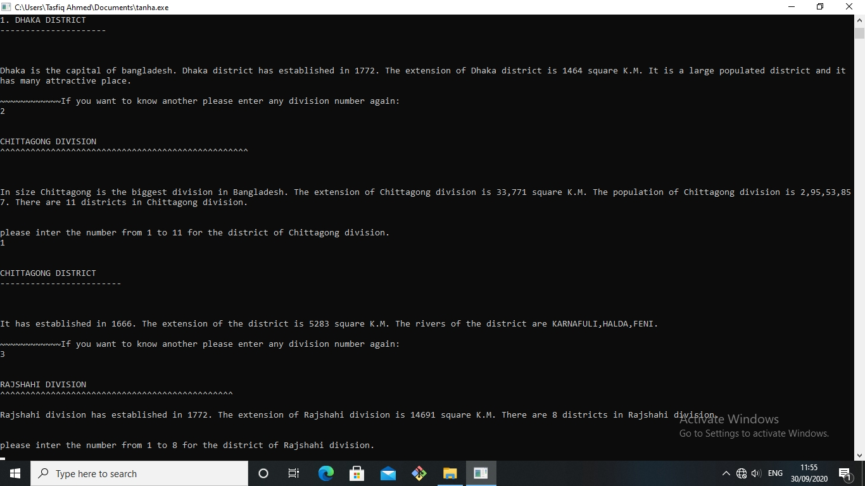

Slide 13
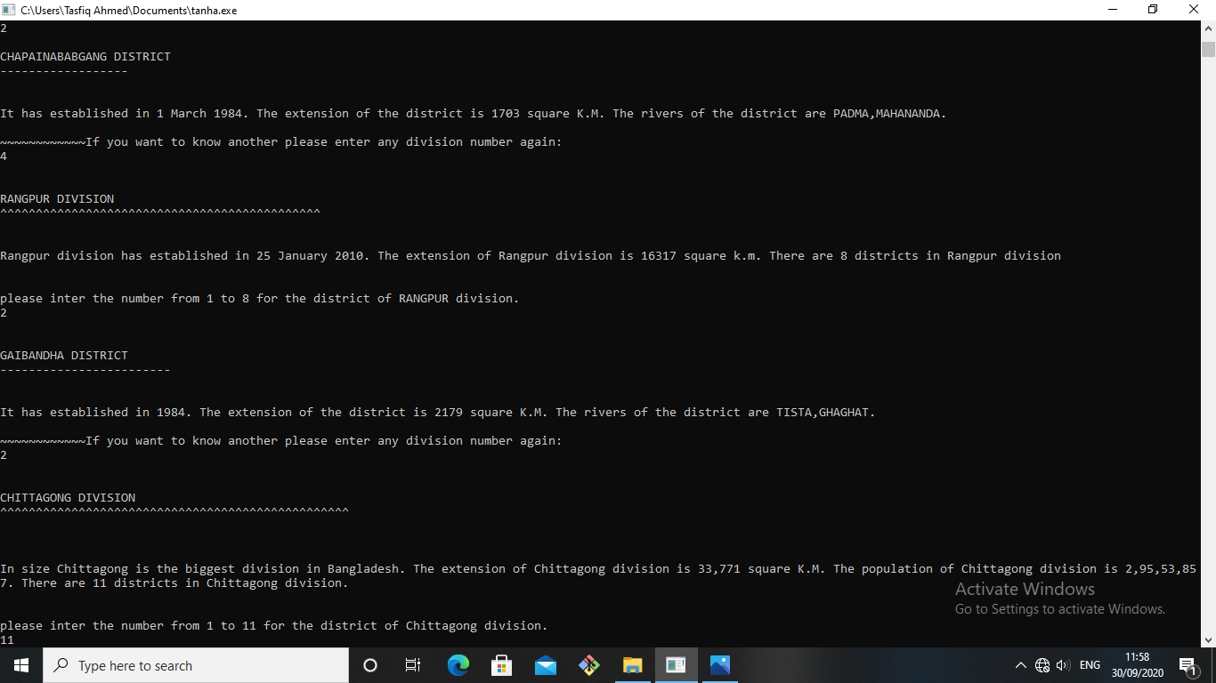

Slide 14


Slide 15


Slide 16
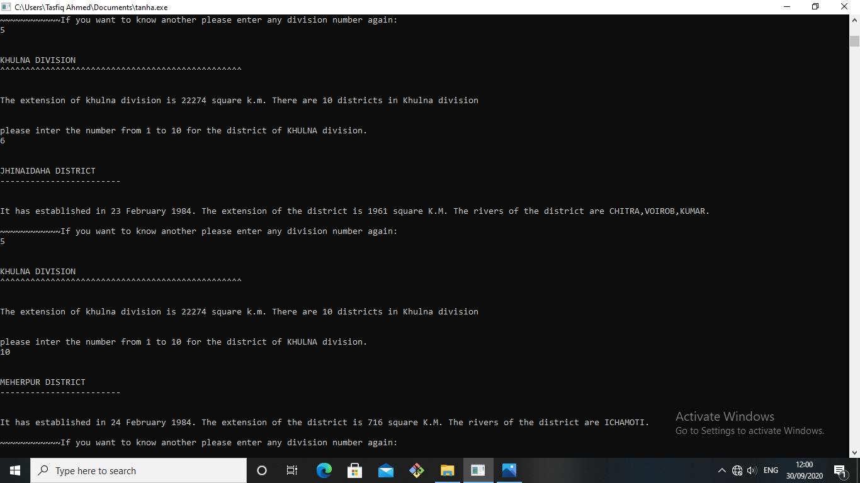

Slide 17


Slide 18


Slide 19
Conclusion
Cities in Bangladesh have different sizes and rates of urban growth. Based on conventional city classification system, development budget allocation and infrastructure development often rely on the city’s existing status.
Therefore, proper city classification based on spatial characteristics of cities is essential for optimum resource allocation and balanced development.
This study classifies 331 cities in Bangladesh based on five parameters:
city size,
urban growth,
the built-up area ratio,
urban form (AWMPFD), and
night light intensity.

