Slide 1
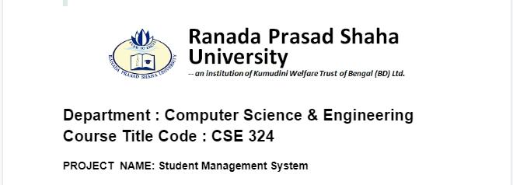
Tasfiq Ahmed
19300003
CSE

Slide 2
Introduction
Student Management System is software which is helpful for college as well as the school authorities. In the current system all the activities are done manually. It is very time consuming and costly. Our Student Management System deals with the various activities related to managing student records. This Objective is computerizing the process of student records management.

Slide 3
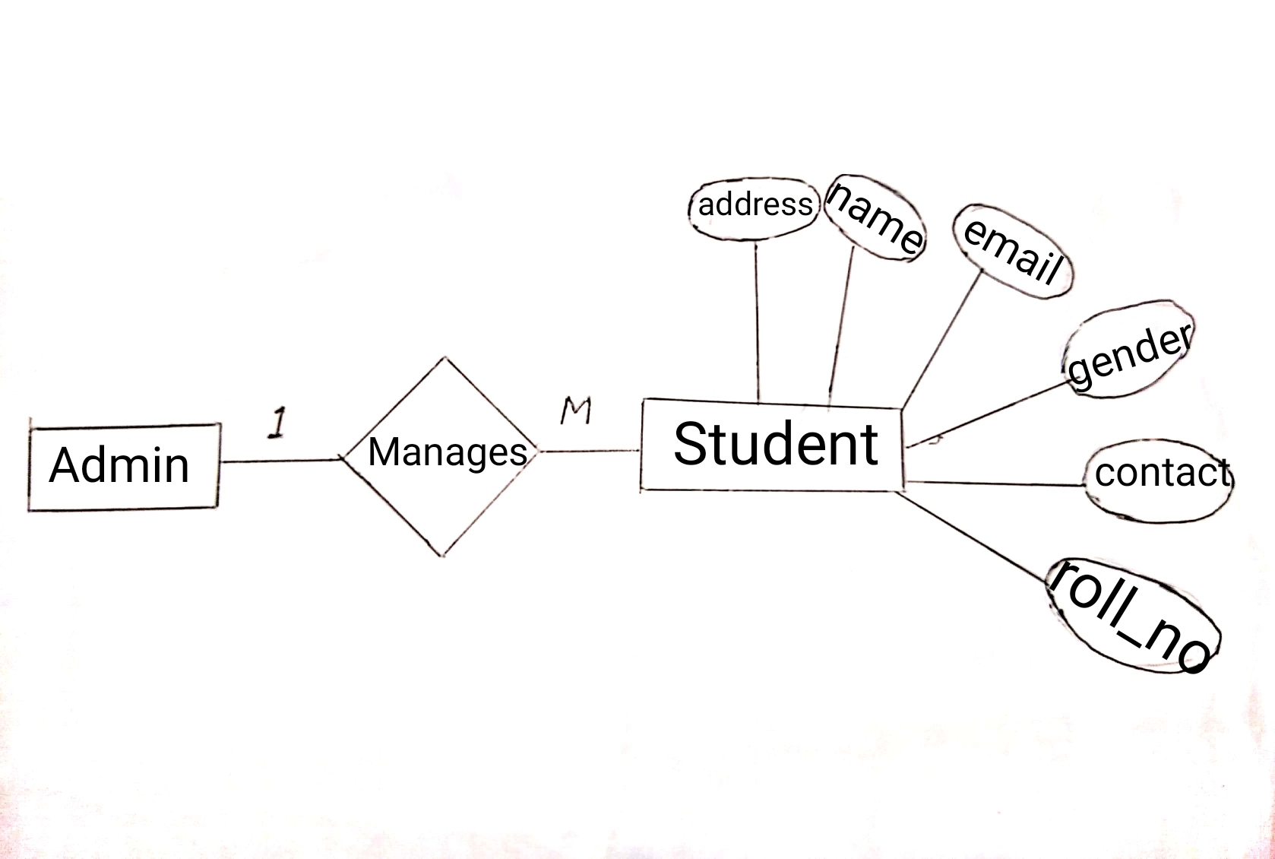
ER DIAGRAM

Slide 4
Features of Student Management System
The basic task to be performed on this Project are:
Add all the details
Update any parts from the details
Search the details of any student
Clear the details from the board
Delete the details of any student record from the database

Slide 5
Project has using
Tkinter | To create the GUI.
MySQL | To connect the program to the database and store information in it.
Logging.root | To get the user to enter database.
PyMySQL | To contain a pure python MySQL client library for showing information in the program instance so that it can be set in.
Tkinter.messagebox | To show a display box, displaying some information or an error.
Tkinter.ttk | To create the tree where all the information will be displayed.

Slide 6










Requirements
HARDWARE
SOFTWARE
Computer (i3, 2gb)
Windows 7
Python,MySQL
Xampp
Hard Disk:- 1TB
Visual Studio Code

Slide 7
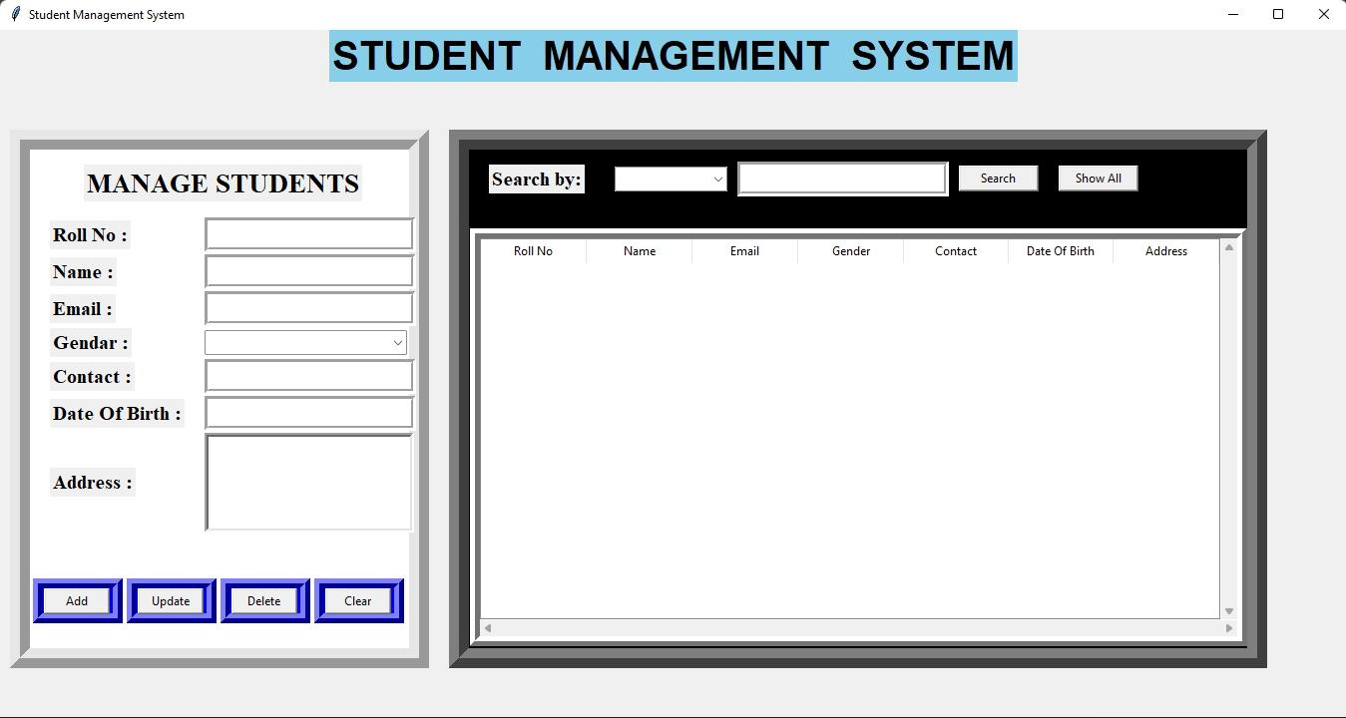
Output :

Slide 8
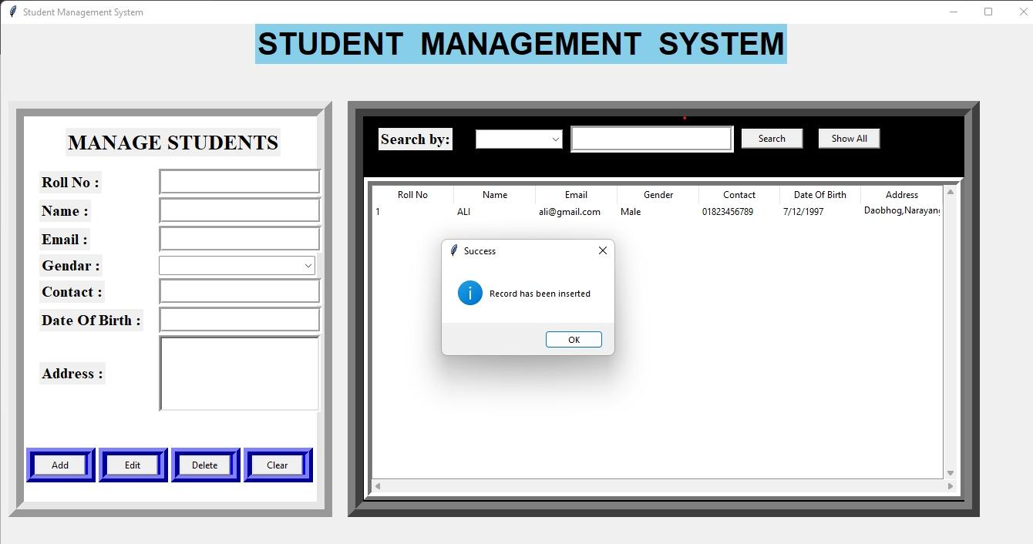

Slide 9
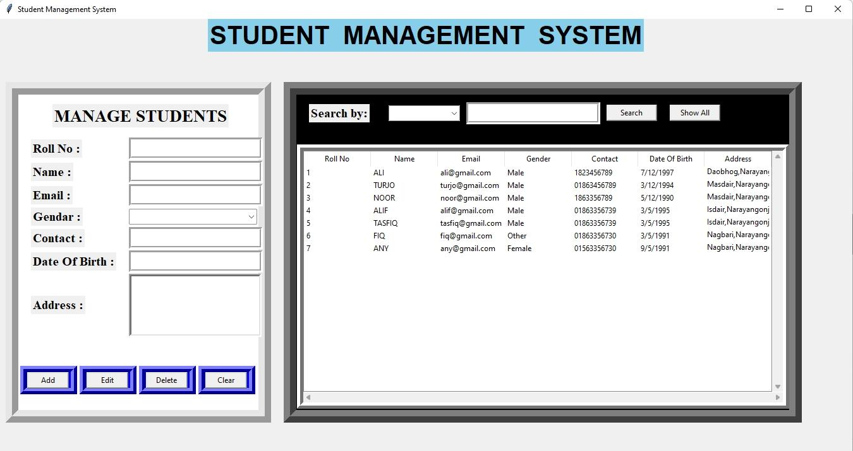

Slide 10
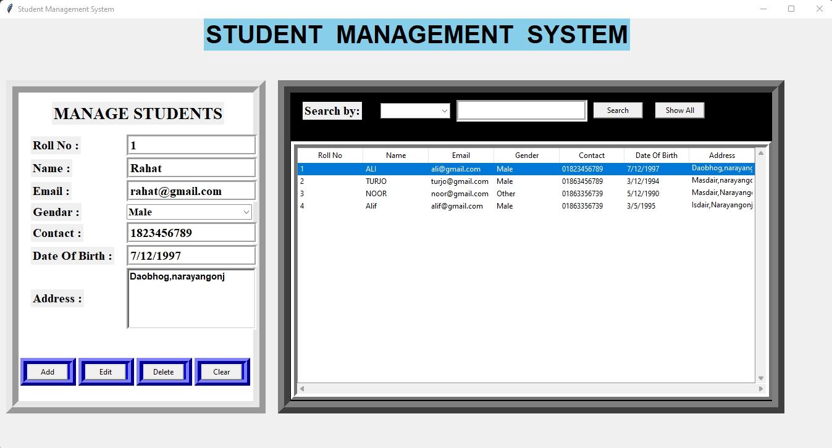

Slide 11
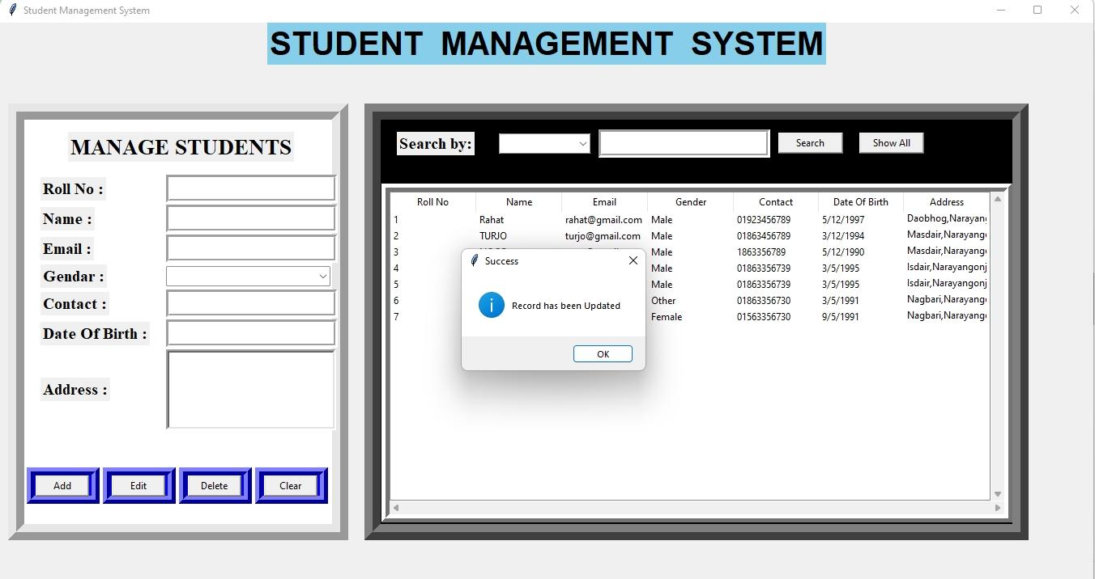

Slide 12
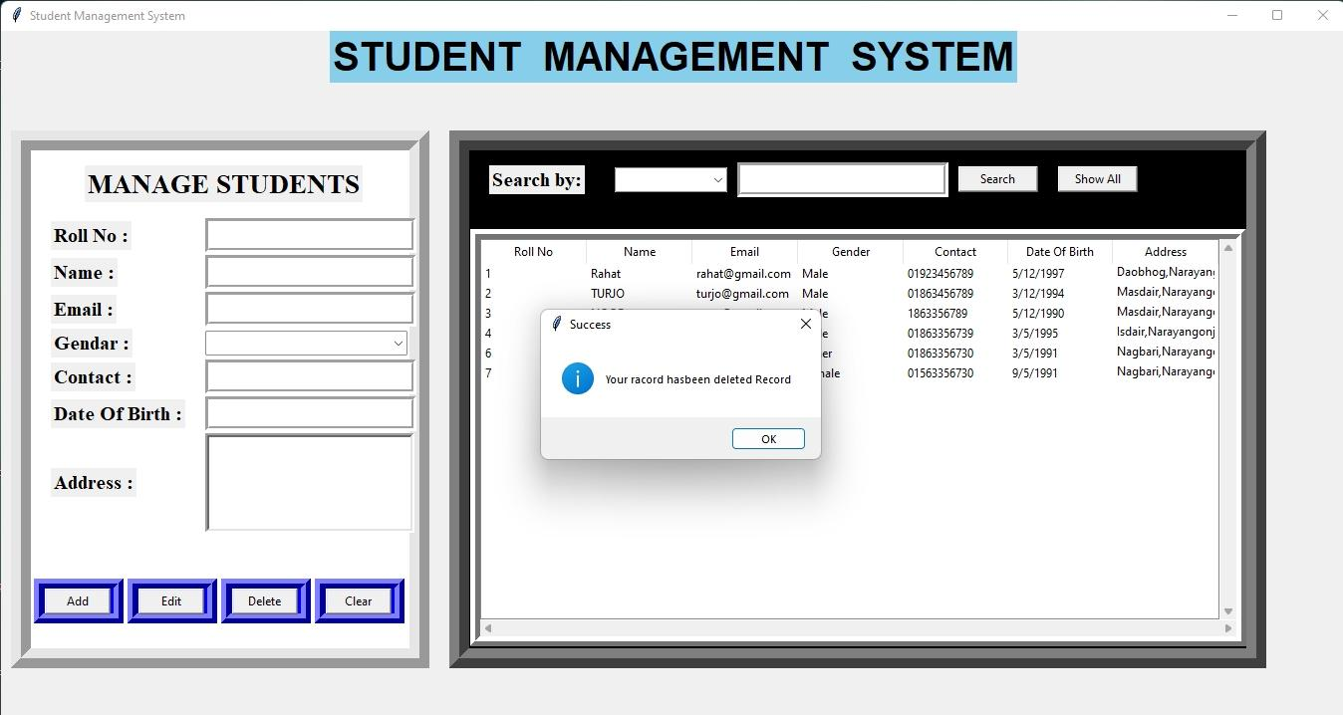
For adding any information

Slide 13
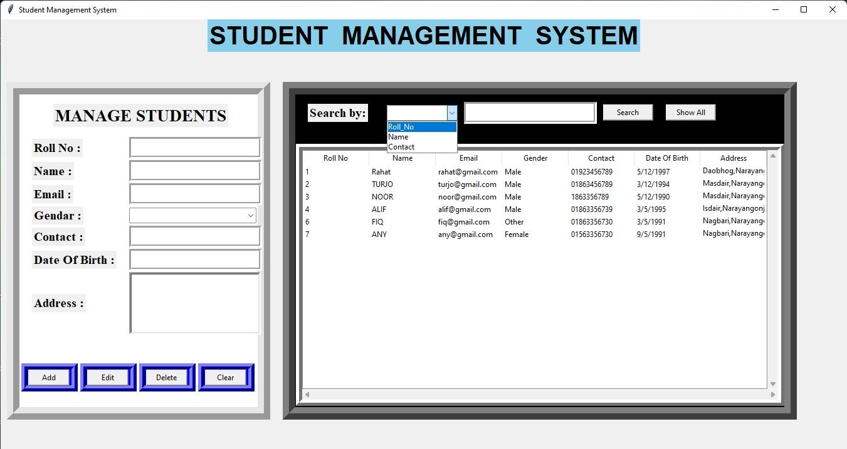

Slide 14
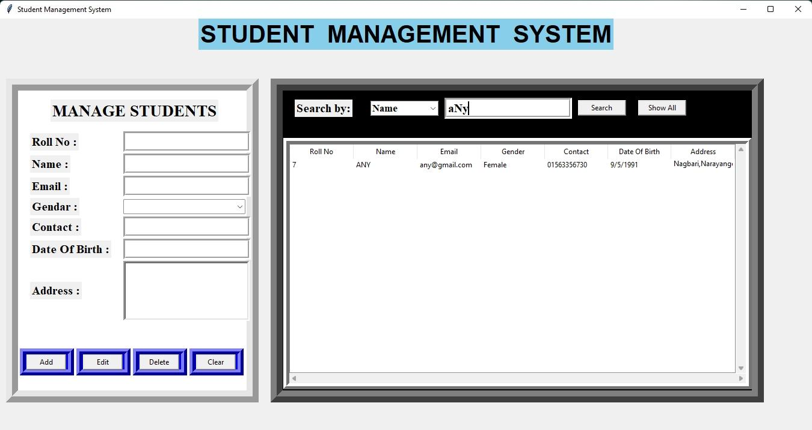

Slide 15
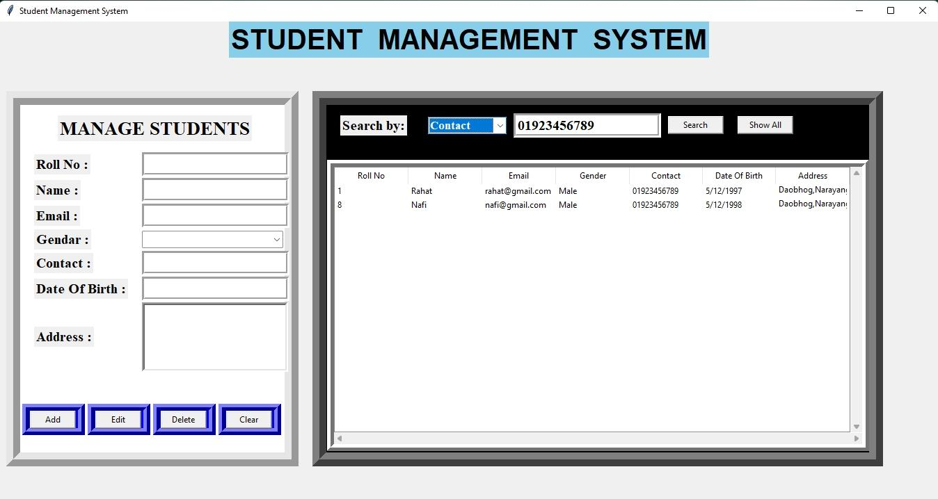

Slide 16
Advantages :
Helpful to perform paperless work and manage all data.
Provides easy, accurate, unambiguous and faster data access.
User friendly interface ,Fast access to database
Less error
More Storage Capacity
Search facility
Look and Feel Environment
Quick transaction

Slide 17
Conclusion :
Student Management System is software which is helpful for school authorities.
In the current system all the activities are done manually.
It is very time consuming and costly.
This Student Management System deals with the various activities related to the students.

