Slide 1


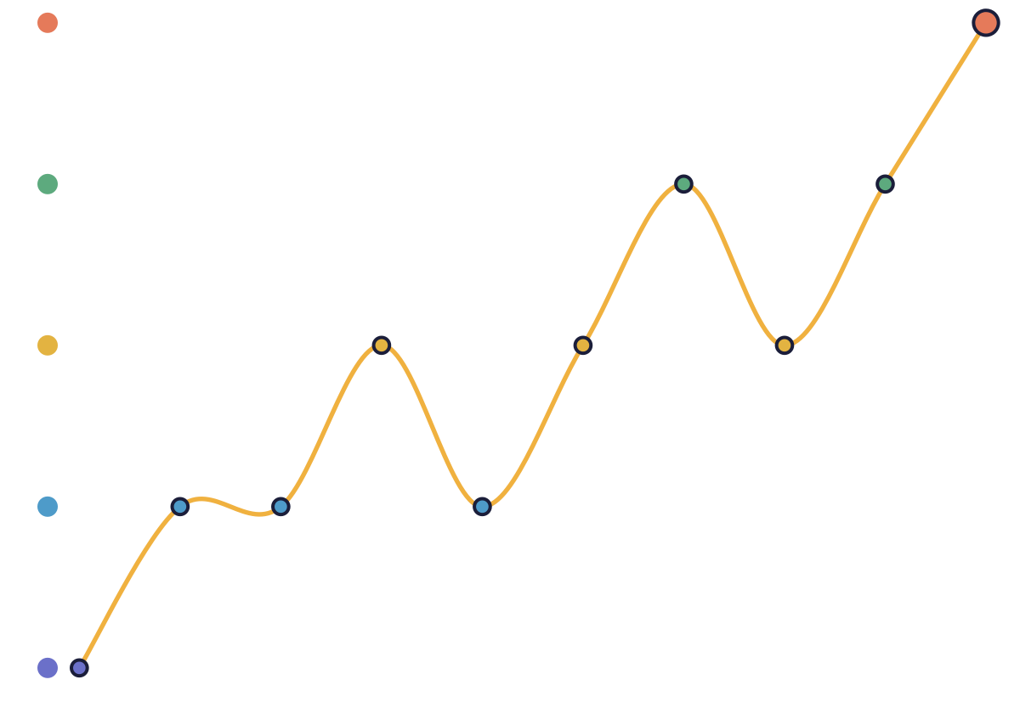





COLLEGE MINI PROJECT
MindTrack
A Privacy-First Mood Journaling &
Self-Reflection Web App
Your thoughts deserve a place to land.
TEAM
[Member 1 Name – Roll No.]
[Member 2 Name – Roll No.]
[Member 3 Name – Roll No.]
[Member 4 Name – Roll No.]
Illustrative two-week mood trend, very low → great
Guided by [Guide Name, Designation]
[Department], [College Name] · [Month Year]
Notes:
Introduce MindTrack, the team and the guide. The line on the right is the core idea: small daily check-ins that add up to a picture over time.

Slide 2







Problem Statement & Objectives
02 / 09 WHY MINDTRACK
The problem
What we set out to do
Students and young adults rarely track how they feel or why.
Make daily mood check-ins quick and comforting.
Turn a user's own entries into understandable, non-diagnostic patterns.
Most apps do only one thing: mood logs, journaling, or a chatbot.
Encourage reflection with gentle CBT-inspired prompts.
Generic insights feel like black boxes, or worse, like diagnoses.
Protect journal text with encryption.
Private thoughts deserve real privacy protection.
Let users export a counselor-friendly PDF, on their terms.

Slide 3









Key Features
03 / 09 WHAT IT DOES
STEP 1
STEP 2
STEP 3
STEP 4
STEP 5
Check in
Journal
Insights
Reflect
Report
Daily mood check-in (5 moods) + optional note and context tags
Private journal: create, edit, delete, history
Mood chart, top contexts, Mood × Context, evidence-based observations
Reflection prompts with private answers
PDF reflection report (journal text only if the user opts in)
Mindy — a friendly companion chatbot that supports the whole journey

Slide 4




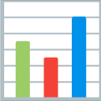


Technology Stack
04 / 09 HOW IT'S BUILT
LAYER | TECHNOLOGIES
Backend | Python, Flask (Jinja2 templates), Flask-SQLAlchemy
Database | SQLite (local); PostgreSQL ready for production
Security | Werkzeug password hashing, Flask-WTF CSRF, Fernet encryption (cryptography)
Analysis | TextBlob sentiment, keyword-based theme detection
Visuals & reports | Chart.js, ReportLab (PDF)
Frontend | HTML, CSS, vanilla JavaScript
Testing & deployment | pytest, Docker, Gunicorn, Cloud Run + Firebase Hosting (prepared)

Slide 5




System Architecture
05 / 09 HOW IT FITS TOGETHER
Browser
Flask routes (blueprints)
Service layer
SQLAlchemy models
Database
CLIENT
BLUEPRINTS
SERVICES
DATA ACCESS
STORAGE
HTML, CSS, vanilla JS
Jinja2-rendered pages
Chart.js charts
auth
dashboard
journal
insights
reports
mindy
encryption
sentiment
themes
insights
reflection
reports
Mindy
Flask-SQLAlchemy ORM
Queries scoped to the logged-in user
Encrypted text fields
SQLite (local)
PostgreSQL ready for production

Slide 6





Privacy & Security
06 / 09 TRUST BY DESIGN
WHAT THE USER WRITES
WHAT THE DATABASE STORES
“Felt anxious before the exam, but the evening walk helped.”
gAAAAABn3Kx9vQ2mTz8pW1hRk…Lr8Tq0wZbE=
Fernet
Passwords stored only as secure hashes
Journal text, reflections and chats encrypted with Fernet
Every query scoped to the logged-in user; no cross-user access
CSRF protection on every form; secure, HTTP-only session cookies
Secret keys kept outside the code (.env / Secret Manager)

Slide 7

Insights & Mindy
07 / 09 GENTLE, PERSONAL SUPPORT
Insights from the user's own data
Mindy
Rule-based companion (no external AI)
Understands 30+ everyday topics
Listens, gives practical tips when asked
Tells jokes, plays games
7/30-day/all-time views, mood trends, context breakdown
Cautious wording: “just something to notice, not a diagnosis”
Safety: crisis messages get support resources immediately

Slide 8




Testing, Limitations & Future Scope
08 / 09 WHERE WE ARE
TESTED
Limitations
Future scope
240
Mindy is rule-based
Search covers titles only (text is encrypted)
Not yet deployed
Account deletion & data export
Password reset
Cloud deployment
Optional AI-powered Mindy
automated tests (pytest)
All passing

Slide 9






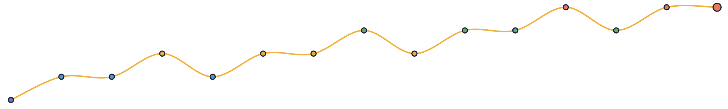
Thank You
Questions?
Small steps make big changes.
[Member 1] · [Member 2] · [Member 3] · [Member 4]

