Slide 1
Livestock Health Monitoring Mobile App
INSY8211 Final project
KALIZA NATASHA PEACE
ID: 24810
5TH August 2025

Slide 2
Problem and Goal
Monitoring livestock health is critical for food security.
Trade volumes can indicate potential outbreaks or supply issues.
Goal: Build a dashboard that shows trends in slaughter data
Supports mobile health monitoring decisions

Slide 3
Dataset
Source: USDA Livestock Slaughter Reports
Historical monthly and quarterly slaughter data
Downloaded as .xls , cleaned to .csv using Python

Slide 4
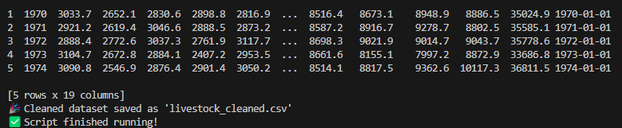
Data cleaning
Removed header/footer text rows
Dropped empty rows and columns
Filled missing numeric values with 0
Added a proper Date column
Tools used: Python (pandas)

Slide 5
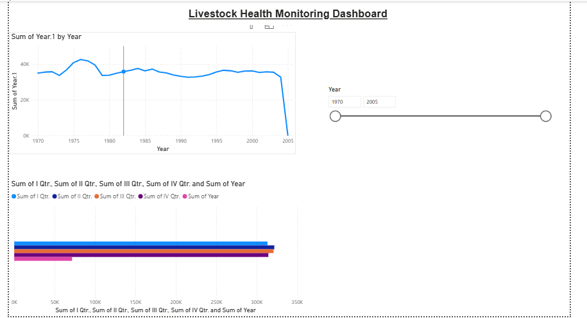
Power BI Dashboard
Loaded cleaned CSV into Power BI
Created:
Line chart: Annual slaughter totals
Bar chart: Quarterly slaughter comparison
Slicer: Filter by year
Designed to support mobile monitoring

Slide 6
Key findings
Seasonal trends are visible (quarterly peaks/dips).
Overall volume shows growth/decline trends.
Helps detect unusual drops that may signal outbreaks

Slide 7
Conclusion
Dashboard supports easy monitoring of livestock trends.
Can be integrated with a mobile app for on-the-go checks.g

