Slide 1
CS 211: Data Structures
By: Tashenea M. Burns-Young

Slide 2
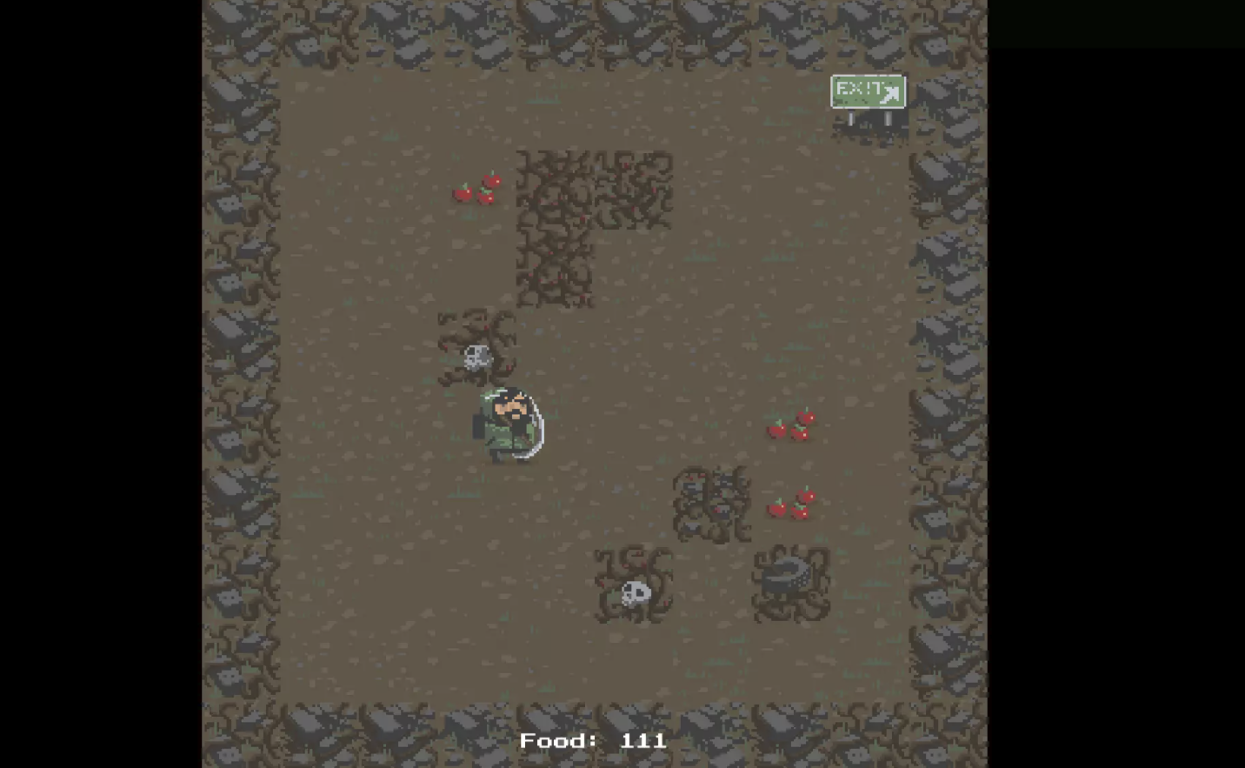
Coolest Program
Roguelike Tutorial
I really liked this the project because:
Overall using unity
Implementing Audio
Using Turn based Movement

Slide 3
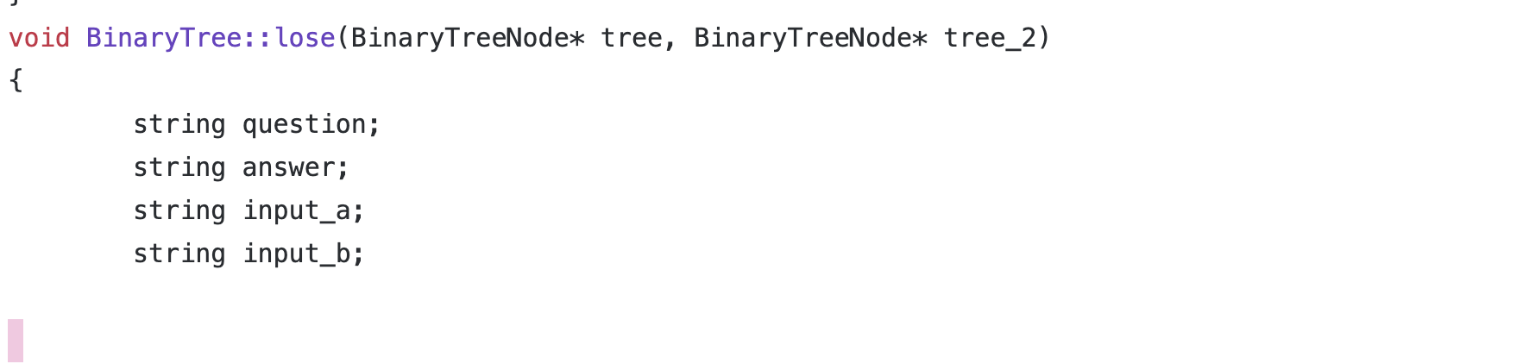
Proudest Code

Slide 4
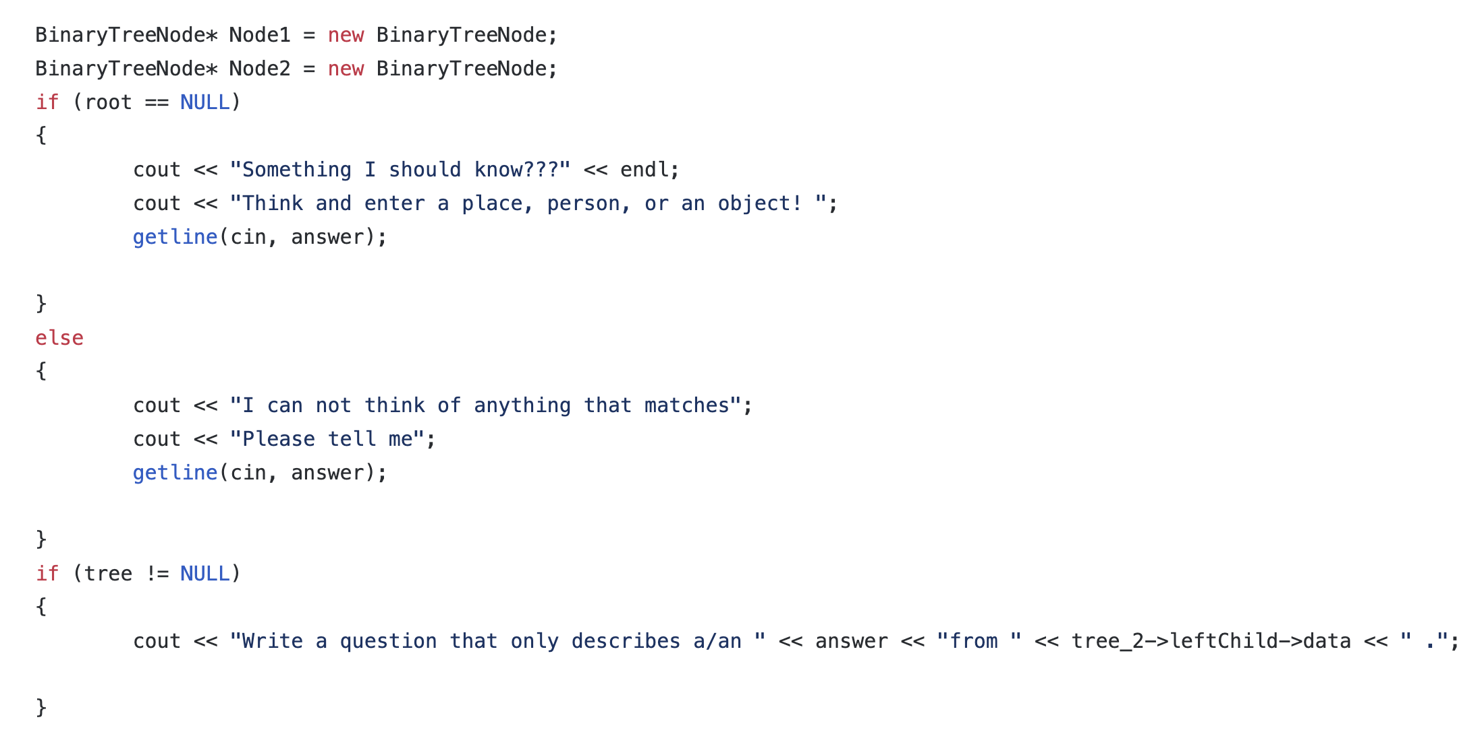
Proudest Code

Slide 5
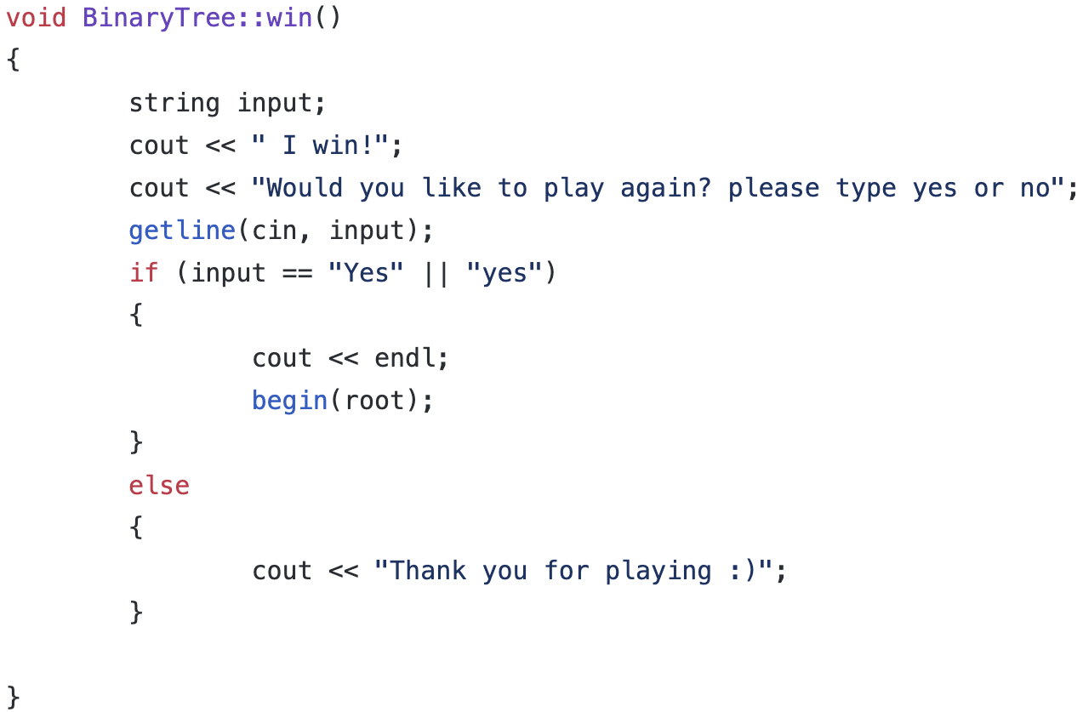
If I could do it over again

Slide 6
What I learned the most
Using Unity and C# is fun if you know how to use them
Do use the unity given tutorials
YouTube is a friend for a templating
Ask a friend for help
Go to tutoring

Slide 7
Thank you!

