Slide 1
Breast Cancer Prediction
Model Presentation
Group-7
Group Member
Sarah Noor 1821119642
Tashfiha Faruk 1911584642
Shazia Mahazaben 1912916642

Slide 2
Models Applied
Logistic Regression
Random Forest Classifier
SVM
Ada Boost Classifier
Bagging Classifier
Gradient Boosting Classifier
Decision Tree Classifier
Extra Tree Classifier
K-Neighbors Classifier

Slide 3
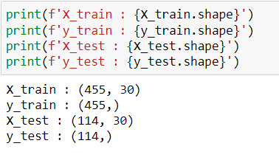
Splitting test and train data:

Slide 4
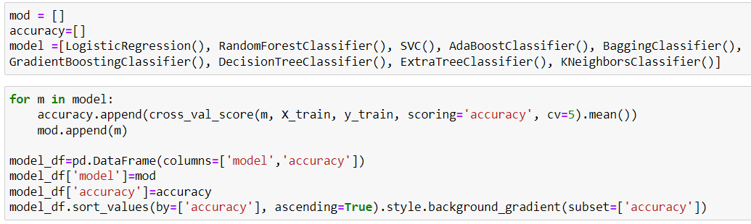
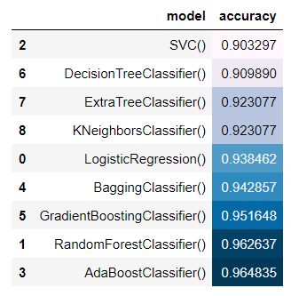
Predicting and comparing the accuracies of the models using cross validation
According to these results, we get the highest accuracy with the Ada Boosting Classifier.

Slide 5
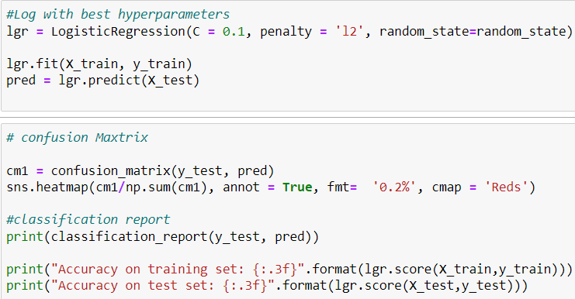
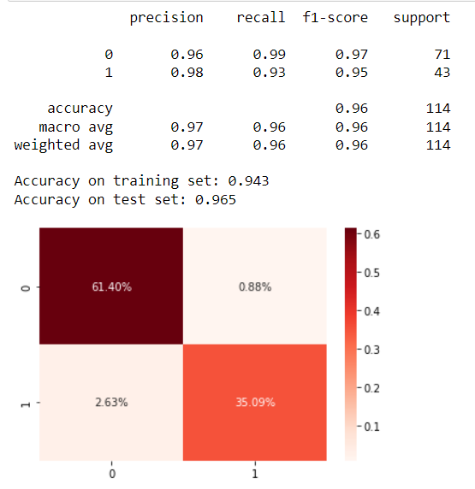
Logistic Regression

Slide 6
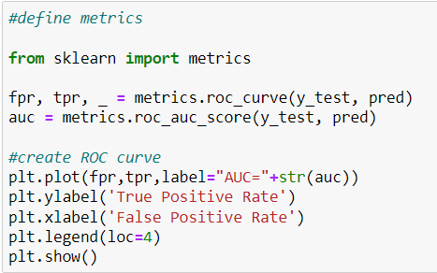
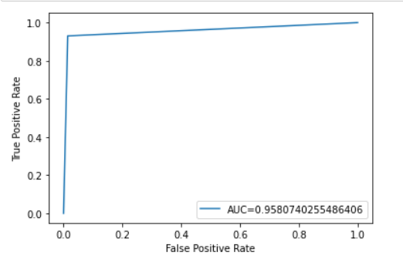
Logistic Regression
ROC & AUC

Slide 7
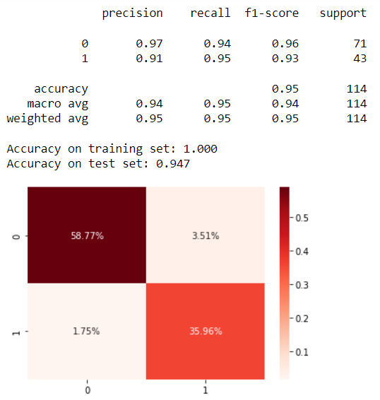
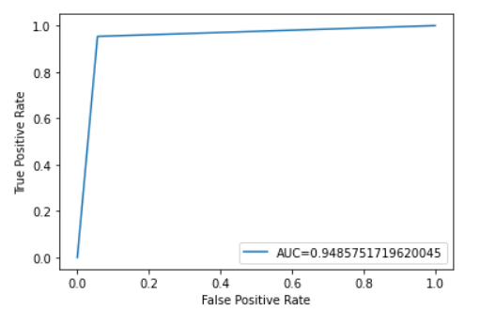
Extra Tree Classifier
ROC & AUC

Slide 8
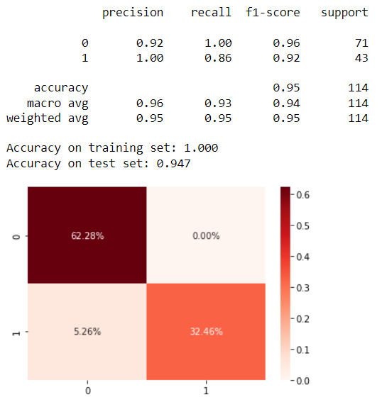
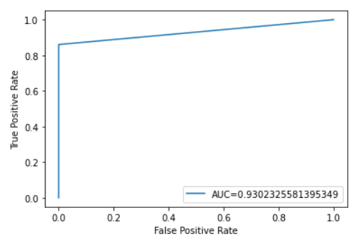
K-nearest Neighbors
ROC & AUC

Slide 9

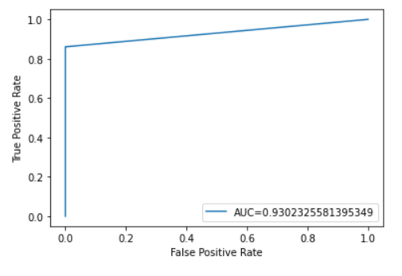
SVM
ROC & AUC

Slide 10

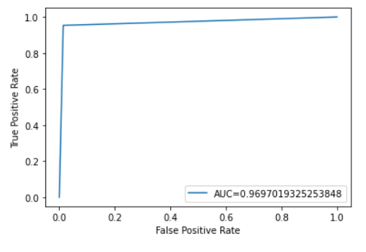
Ada Boost Classifier
ROC & AUC

Slide 11
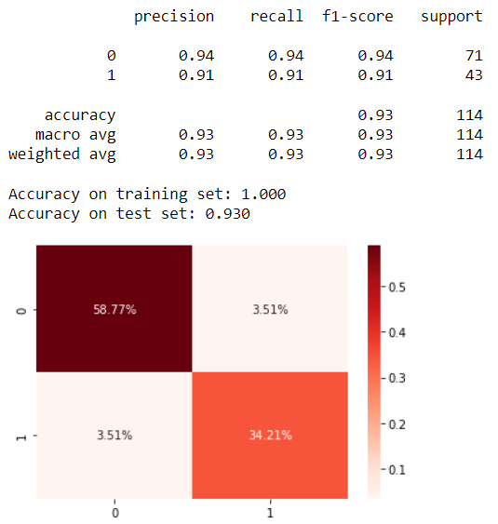
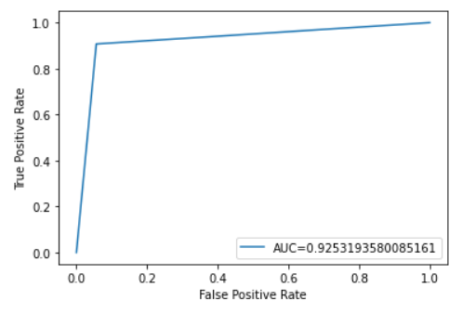
Decision Tree Classifier
ROC & AUC

Slide 12
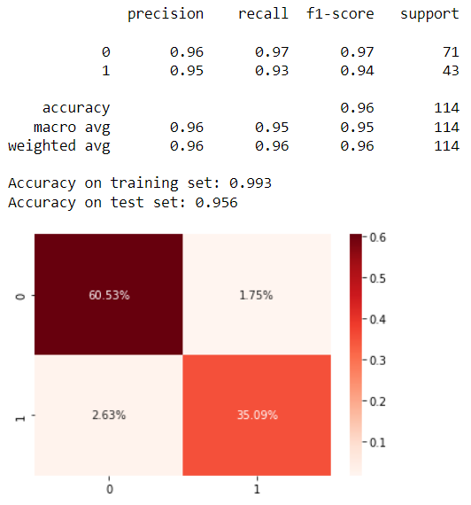
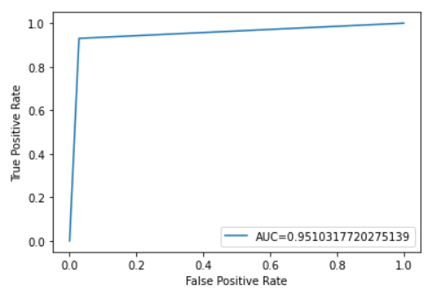
Bagging Classifier
ROC & AUC

Slide 13

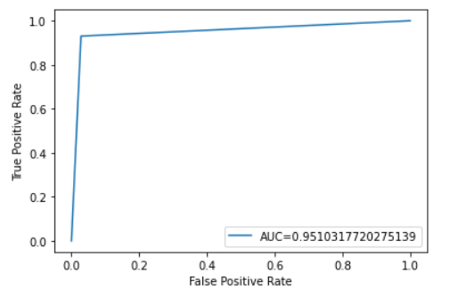
Gradient Boosting Classifier
ROC & AUC

Slide 14

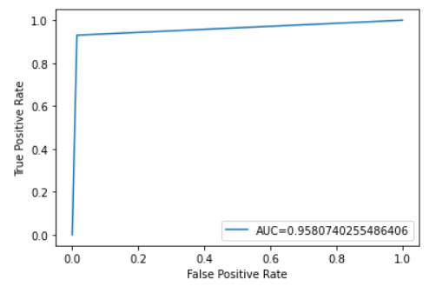
Random Forest Classifier
ROC & AUC

Slide 15
Thank You

